Slide 1
Economic outlook for 2018
Geoff Tily

Slide 2
Economic growth down but not out
“The recovery has been driven by both the manufacturing and the service sectors, supported by the weaker pound and a buoyant global economy, while construction output continues to lag.” (NIESR)

Slide 3
Economic growth down but not out

Slide 4
Economic growth down but not out

Slide 5
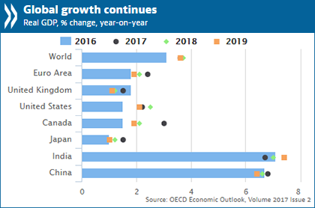
Economic growth greatly down but not out

Slide 6
Factors likely to affect outcomes
 | DEMAND | SUPPLY
POSITIVE | World trade Lower inflation, ?higher real incomes | Weaker sterling
NEGATIVE | Interest rate rises (global) QE withdrawn Ongoing austerity Brexit uncertainty Property Debt | Lack of capacity

Slide 7
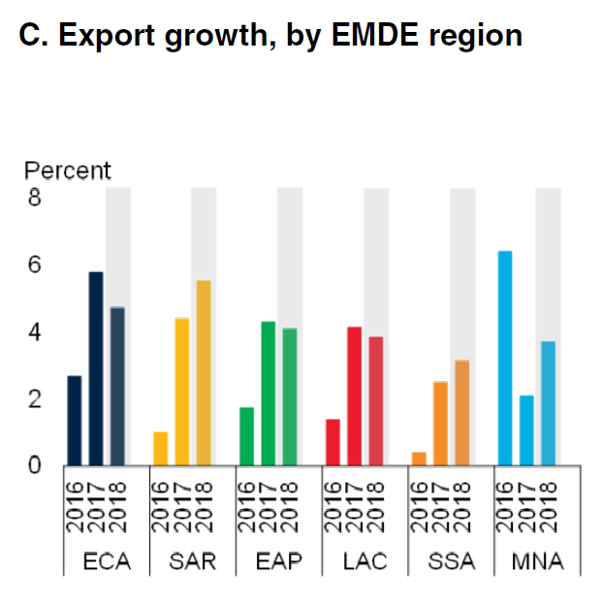
World trade: “Broad- based upturn, but for how long?”
World Bank, Economic Prospects Report, January 2018
Source: World Bank

Slide 8
World Trade: Impact on UK industries

Slide 9
World trade: weaker consumption, stronger trade

Slide 10
Lower inflation, ? higher incomes

Slide 11
Lower inflation, higher incomes (NB RPI)
Source: OBR

Slide 12
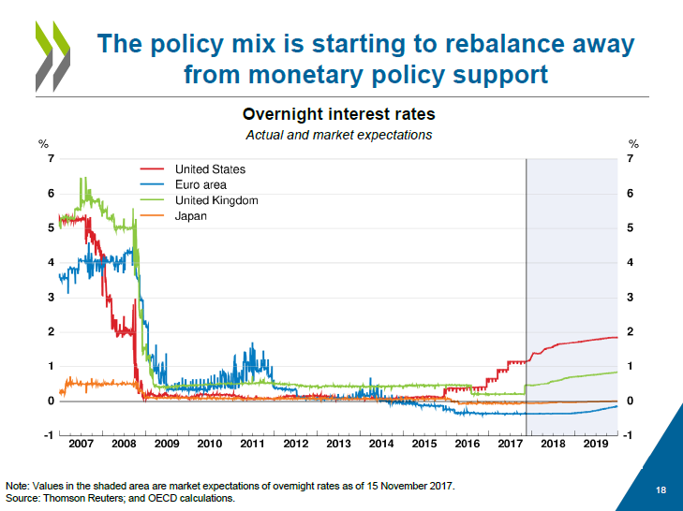
Interest rate rises / capacity
2018 is on track to be the first year since the financial crisis that the global economy will be operating at or near full capacity. World Bank
By 2019, GDP growth is projected to ease mildly in the majority of major economies as capacity constraints begin to emerge, OECD
Our models … tell a
broadly consistent story of an economy operating close to potential. OBR, Nov. EFO p. 43
Unemployment has continued to fall and the extent of spare capacity in the economy now seems limited. BoE, Nov. 2017

Slide 13
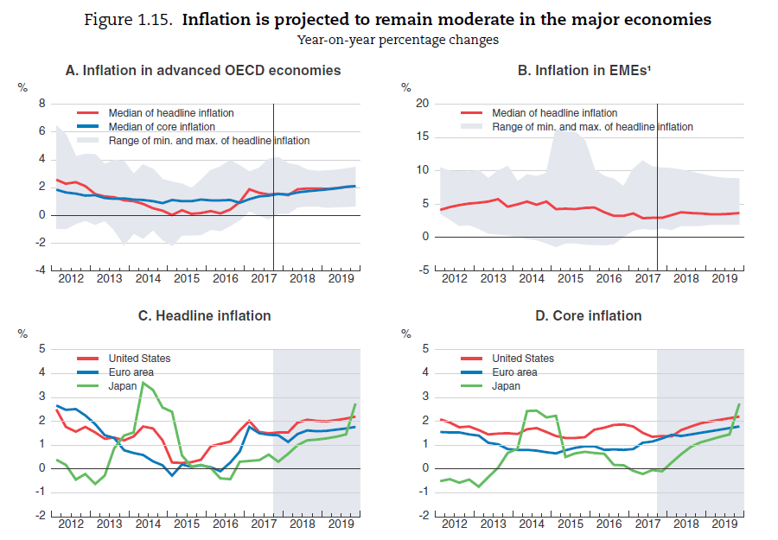
Interest rate rises: but questions over inflation

Slide 15
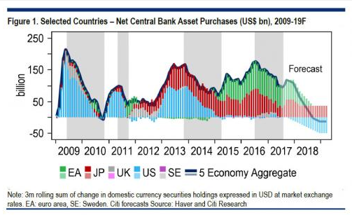
(Global) QE withdrawn

Slide 16
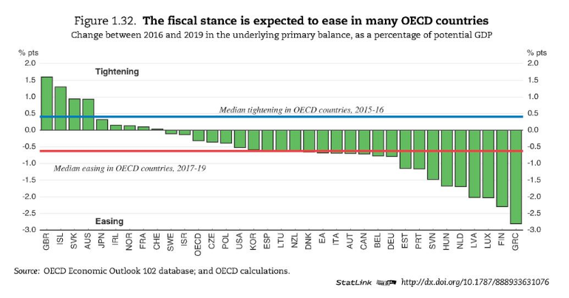
Ongoing austerity

Slide 17
Factors likely to affect outcomes
 | DEMAND | SUPPLY
POSITIVE | World trade Lower inflation, ?higher real incomes | Weaker sterling
NEGATIVE | Interest rate rises (global) QE withdrawn Ongoing austerity Brexit uncertainty Property Debt | Lack of capacity
TOTAL | MORE OF THE SAME: ONGOING HARDSHIP, FRAGILITY

