Slide 1
Outsourcing: looting the foundational economy
Julie Froud, Sukhdev Johal and Karel Williams
Manchester Business School
cresc.ac.uk

Slide 2
Outline
Outsourcing, the foundational economy and government blame shifting
Problem: Profit taking on public service contracts, without investment or market risk
Problem: Fast growing conglomerates are unstable because they cannot control their portfolios of contracts
State and corporates are co-dependent: state’s role is to attract bidders for contracts, not plan and co-ordinate services; locks out the citizen.

Slide 3
(1) Outsourcing and the foundational economy

Slide 4
Foundational economy + state retreat
Foundational economy = mundane goods and services (a) necessary to everyday life/consumed by all citizens (b) distributed through branches and networks (d) sheltered and politically franchised
30-50% of employment and output in pipe and cable utilities + transport + much retail + food production/processing + health, education + welfare
UK state retreated from foundational provision in two steps:
1980s/90s privatisation of utilities with consumer revenue streams: BT to BR
post 2000 outsourcing of public services so private contractors get contracts to provide services funded from tax revenue

Slide 5
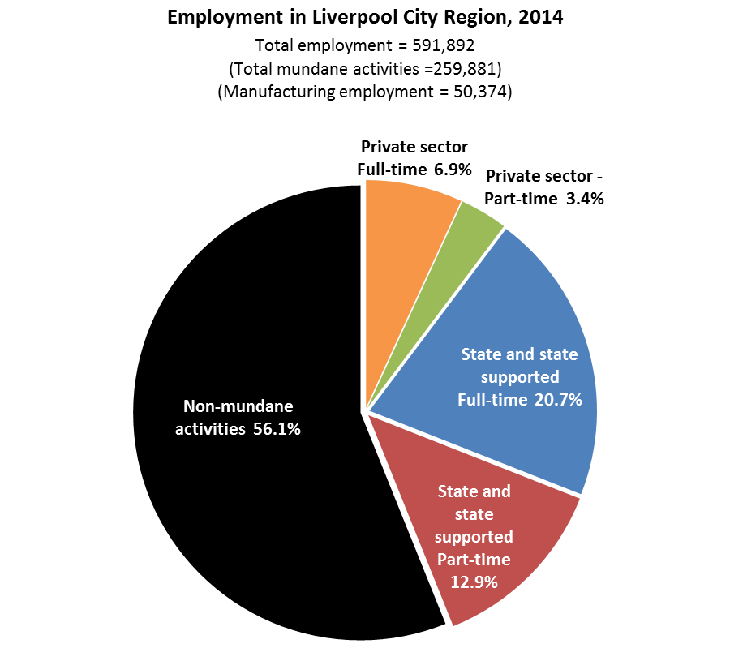
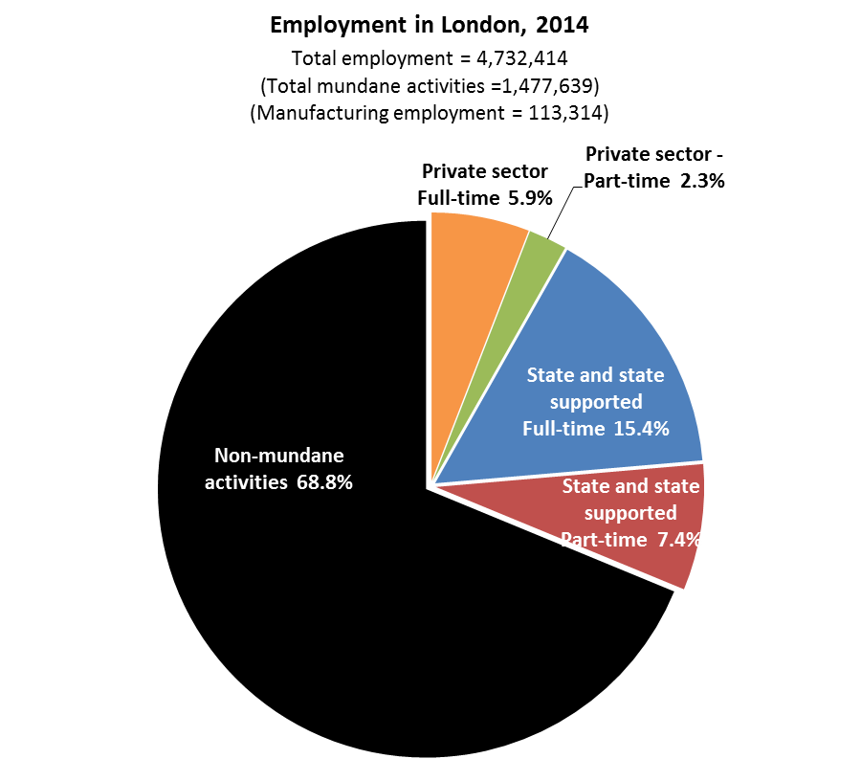

Slide 6
Huge scale of public service outsourcing (UK data)
£1 in every £3 spent by government on public services -> independent providers; industry of approx £100bn (Gash et al. 2013, p.4)
Increasingly bundled contracts: £14bn of local government bundled contracts signed 2000-2013; like eg Service Birmingham
Core state functions eg incarceration: 2010-12: > £1.5bn of incarceration and justice services outsourced (Centre for Crime and Justice Studies 2013); 2014 outsourcing of probation services for medium and low risk offenders on 10 year contracts which were nationally worth £450m a year

Slide 7
Sustains new corporate giants
Outsourcing sustains growth of multinational companies across the terrain of the foundational economy (conglomerates Serco, G4S, Atos + specialists like Sodexo and Veolia); top 40 suppliers account for 25% of central gov contracts
Franchises as sale of the monopolies (sheltered activity): test of competition for the contract standing in for/ next best to compet. markets); but contracts have to be made attractive eg allowing walk away in rail + other areas
New giants core competence in bidding and winning contracts (most critical activity) but questions about operation and ability of the conglomerates to manage a portfolio of contracts; squeezing out the little guys + not for profits

Slide 8
Convenient for government
No clear citizen interest: outsourcing is sold as being pro-consumer (against the producer interest) but in most areas choice of provider is not relevant
Cost savings uncertain: new contracts announced with (ex ante) headline figures about ‘savings’; can’t be checked because of cloak of commercial confidentiality; no standard metrics of efficiency (a leap of faith);
Much cost saving is levered on labour + wage reduction eg Labour Force Survey on private prisons £4 less per hour + adult care £2 less per hour; o discussion of wider costs eg lower wages require state subvention
Convenient for government: avoids direct responsibility for service provision, especially important in “ toxic” policy areas like deportation or invalidity benefit: options on blame-shifting when things go wrong eg G4S fails to supply security guards for Olympics; immunisation with fiascos
Government is not the well meaning ref but a lazy, self interested player

Slide 9
(2) Profits without investment or risk?

Slide 10
Horrors of the LA bundled contract
Capitalist profit is justified if the firm invests capital or takes market risks on revenue; the problem with outsourcing is that many contractors do neither.
The worst = LA bundled contracts: eg Service Birmingham under jv contract with Capita for multi-year, multi-service contract. Covers IT systems, local tax billing, back office and call centre….
Annual cost of >£100m (10% of controllable budget), cumulative cost reached £1 bn by 2013; signed in 2005 and later extended, but not disclosed until 2014.
Nowhere is there a clear, total figure for what we are paying and should be paying. The biggest issue is transparency, We have little idea of what is going on. (Councillor Clancy, 2013).

Slide 11
Modest clip on sales, high return on capital
Outsourced services = typically capital light so a modest clip on sales turns into a very generous ROCE: 3-5% on sales and 20% or more ROCE; if its capital intensive, contractors build a high ROCE into the “fair price” as in 12% ROCE in adult care
Service Birmingham financial results (2006-2012): 6.7% profit margin; return on capital 120%
Unjustified profit-taking:
No capital investment
Little revenue risk
Unclear service improvement or innovation
A new kind of capitalist business? same pattern of profit without risk in many other bundled contracts.

Slide 12
Why LAs always lose
Asymmetry of contracting expertise: Birmingham contracts once or twice, Capita can build and transfer contract expertise; bundled contracts are very complex so returns to expertise are very high
Lock-in: one administration commits several successive ones to earmarked payments and little scope for flexibility (a problem in Birmingham for the new council + leader)
Public administration is downgraded: LA competences in planning, co-ordination, integration etc become secondary); government redefines its role as writing contracts (Northampton Council sacking everybody)

Slide 13
(3) Unstable conglomerates

Slide 14
The return of the conglomerate
Outsourcing creates disaster-prone conglomerates (as well as giant specialists) eg Serco, G4S
Shareholder value requires growth as well as profit margins (more contracts plus acquisitions). Company becomes heavily capitalised through acquisitions.
Result is conglomerates playing portfolio roulette: 100s of contracts, moving into new activities the company does not understand; acquisitions; onerous contracts which incur large losses
Ties local foundational services into corporate fortunes; creates links between unconnected contracts via the conglomerate ie a private sector version of risk sharing (inverting socialised welfare)

Slide 15
Serco’s profits collapse
Growth, hubris, disaster
2014 has been an extremely difficult year for Serco, and the magnitude of the provisions, impairments and other charges reflects the scale of the challenges we have had to face.
4 profit warnings in 2014
loss of £1.3bn, wiped out accumulated profits of £941m; required £555m of new equity
Goodwill write downs; provisions on loss making contracts
Share price down 32% in one day
Contract fraud eg offender tagging + general incompetence in bidding and monitoring (what are they good at?)

Slide 16
Serco 2014 results: £1.3 bn loss
Total write-downs, Serco 2014 results | £1.6bn
Comprising
‘Onerous contract provisions’ (an ‘onerous contract’ is one that is expected to be loss- making; the provisions recognise those expected future losses) | £456.7m (including £115m for COMPASS; £66m for Royal Naval Fleet Support)
Asset impairments and other provisions | £288.6m
Goodwill impairment | £466m
Other exceptional costs | £195.5m

Slide 17
(4) What is to be done

Slide 18
Technical fixes and principles
Set limits on outsourcing: ban bundled contracts, especially in LAs; prohibit outsourcing of toxic policies like welfare cuts; prohibit complete oout sourcing of any activity
Make outsourcing safe:
Offer fee for service contracts: stop calling it profit + make it a fixed management fee so Branson, Serco and the rest wouldn’t be interested
Use prop co/ op co for a social purpose; the state can borrow more cheaply at 5% so the state should finance and hold the assets which contractor’s rent

Slide 19
A new politics
The basic problem = distraction from welfare through foundational provision; co-dependent state and corporates have other priorities.
The result = welfare critical public services become a sheltered reservation for corporate interests: little benefit for public service users+ locking out the citizen
No going back: large national command and control organisations = not the solution eg in prisons; LA direct provision is irrelevant to much adult care cf state needs to plan + invest
Citizens must struggle for a voice + buy into social innovation: new political alliances including producers + new forms of service provision; starting from a commitment to welfare through foundational services

