Slide 1

The Living Wage Campaign
Sarah Vero, Partnerships Manager, Living Wage Foundation
Northern Living Wage Summit
Thursday 7th November 2013
South Tyneside Council, Town Hall, South Shields

Slide 2
What is a Living Wage?
The minimum wage is a negotiated settlement.
The Living Wage is an hourly figure according to the real cost of living in the UK.
A basket of essential goods and services and the Joseph Rowntree MIS research.

Slide 3
What is a Living Wage?
The current UK Living Wage is £7.65, calculated by the Centre for Research in Social Policy.
In London the current rate is £8.80 per hour, calculated by the Greater London Authority.

Slide 4
History
Launched in 2001 by Citizens UK, families in East London.
Early success with Hospitals, Canary Wharf & the City.
March 2005 GLA publishes first Living Wage figure £5.80 per hour.
Living Wage Campaigns spring up around UK. Support from Trade Unions and business grows.

Slide 5
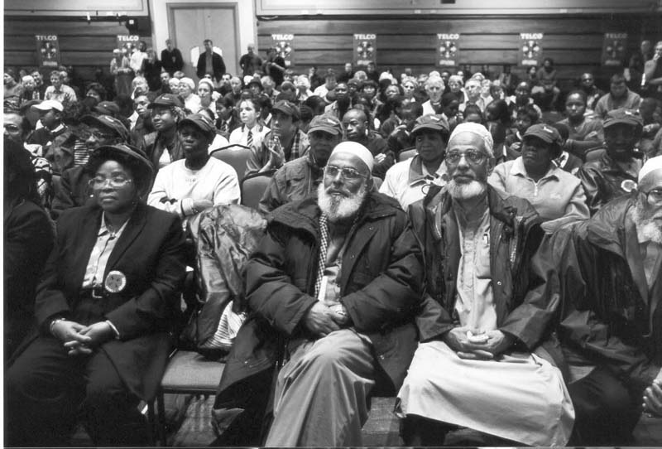

Slide 6
History
KPMG report 2009 risks and opportunities around the Living Wage
Citizens UK continues to campaign and build relationships with a broad coalition of supporters behind UK & London LW.
Momentum builds and in 2011 Living Wage Foundation launched to accredit employers across the UK.

Slide 7

What is a minimum income standard?
The income people need to have a minimum acceptable standard of living.
Based on social consensus.
Calculated from a “basket” of goods and services.
“Needs”, not “wants”: not an “aspirational” living standard.

Slide 8

What is in the basket of goods and services?
In
Computer
Mobile phone
1 week UK holiday
Occasional takeaway, modest meal out
Birthday presents
Washing machine
Out
Smart phones
Foreign holidays
Satellite/cable TV
Dishwasher
Designer trainers

Slide 9
From income requirements to a living wage
Different households need to earn different amounts
  E.g. you need to earn more to feed a larger family.
  We use average requirement for households working full time.
Some costs vary across the country and sectors
  Supermarkets have national pricing but e.g. housing & childcare vary greatly.
  For variable-cost items, we take av. cost outside London.
  Use council rents as “baseline” for families with children. Low private sector rent for those without children.

Slide 10
What the Living Wage represents
A baseline below which households outside London cannot generally afford an acceptable living standard, even if they work full time.
A standard for social participation, not just survival: “Food and shelter keep you alive, but that’s not living”.
A benchmark that reflects social values today, which will change over time reflecting changes in society.

Slide 11
The changing context
What is happening to earnings?
What is happening to support for households?
What is happening to social values and norms?

Slide 12







Slide 13
Business Benefits
80% of employers believe that the Living Wage had enhanced the quality of the work of their staff, reporting improved loyalty and customer service.
Absenteeism down by 25%.
Improved retention rates and reduced HR costs. PwC found turnover of contractors fell from 4% to 1%. When turnover of contractor staff halved KPMG saved £75,000 on one contract alone.
70% of employers feel that the Living Wage has increased consumer awareness of their organisation’s commitment to be an ethical employer.
Over 6 years cost of KPMG’s facilities operation has reduced.

Slide 14
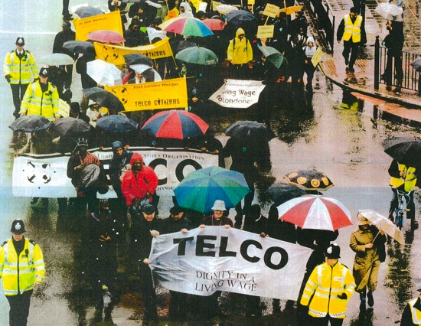

Slide 15
Living Wage Foundation
The Living Wage Foundation recognises and celebrates the leadership shown by Living Wage Employers across the UK.
Accreditation - Award Living Wage Employer Mark
Intelligence - Advice & Support for employers
Influence - Forum for organisations to back LW

Slide 16


Slide 17
The Accreditation Process
Why is accreditation important?
The accreditation process provides a framework to implement the Living Wage
Phased implementation allows large organisations to implement the Living Wage over time
We work with employers to share best practice
Building the coalition; building the brand

Slide 18


Slide 19
Living Wage Week
A National celebration of Living Wage Employers.
November 3rd – 9th 2013
Events around the UK in Nottingham, York, Cardiff, Glasgow, Edinburgh, Preston, Norwich, Durham & London
New Living Wage rates announced annually in November. 6 months to implement rise.

Slide 20
Living Wage Progress
After Living Wage Week 2012
  Step change in level of engagement
Private, Public and Third Sector Employers
  430 accredited employers and c200 in the pipeline
Financial Services Sector
  Audit & Consultancy Firms
  Lawyers
  Investor community

Slide 21

Living Wage Challenge
Research in October 2013 found:
1 in 5 employees are paid less than the Living Wage
Number up to 5.24m from 4.82m a year ago
8% rise on last year
Women, young people & ethnic minorities.
Where is the greatest challenge?

Slide 22
Living Wage - sectorally
By proportion* | By number*
Bar staff – 85% | Sales and retail assistants – 810,000
Waiters and waitresses – 85% | Cleaners and domestics – 450,000
Kitchen and catering assistants – 80% | Kitchen and catering assistants – 370,000
Vehicle valeters and cleaners – 75% | Care workers and home carers – 270,000
Launderers and dry cleaners – 70% | Storage/warehouse occupations – 170,000

Slide 23
Living Wage regionally

Slide 24
Living Wage in the North East

Slide 25


Please contact
Sarah Vero
Partnerships Manager
Living Wage Foundation
020 7043 9882
07414 639 227
sarah.vero@livingwage.org.uk
@LivingWageUK

