Slide 1



Pecyn Cymorth Sgiliau Hanfodol Cymru / Wales Essential Skills Toolkit
‘WEST’

Slide 2
Over the past twelve months Tribal has worked in partnership with the Welsh Government, and an expert user group, comprising experienced stakeholders from across the Welsh education sector to develop the Wales Essential Skills Toolkit – WEST
This bespoke online platform is aimed at post-16 learners in FE colleges, WBL, ACL, schools and prisons across Wales. WEST is fully bilingual and supports a consistent, reliable and engaging approach to the assessment and learning of Essential Skills
A pilot of the online initial assessment was undertaken by a cross section of providers throughout April 2014; feedback from which shaped the next phase of development

Slide 3
WEST went live from 1st October 2014 with the following functionality available for this launch;
A practice assessment
Initial assessment, diagnostic and ILP for literacy
Initial assessment diagnostic and ILP for math
The first tranche of learning content which will be automatically generated to target gaps in a learner’s essential skills.
Throughout November and December 2014 further releases will see diagnostic ILP and additional learning content in Welsh. The final stages of development; which will include a screener for Dyslexia, are scheduled to be complete in the first quarter of 2015.

Slide 4
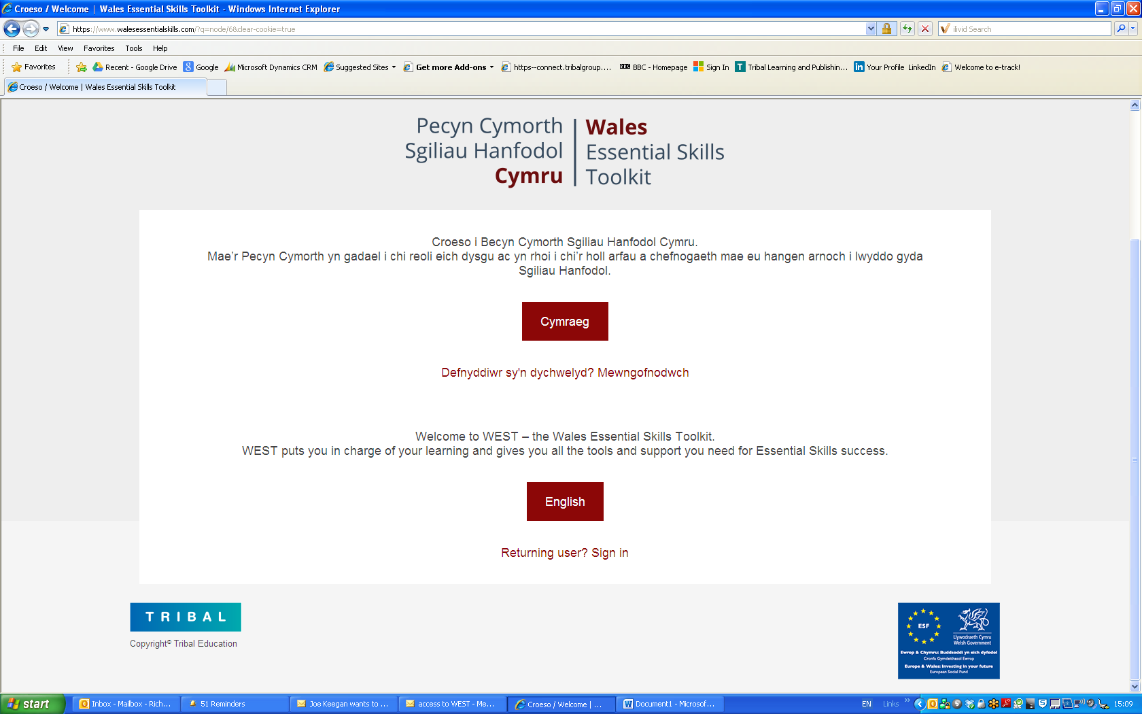
Welsh or English versions of the toolkit can be selected from the home page

Slide 5
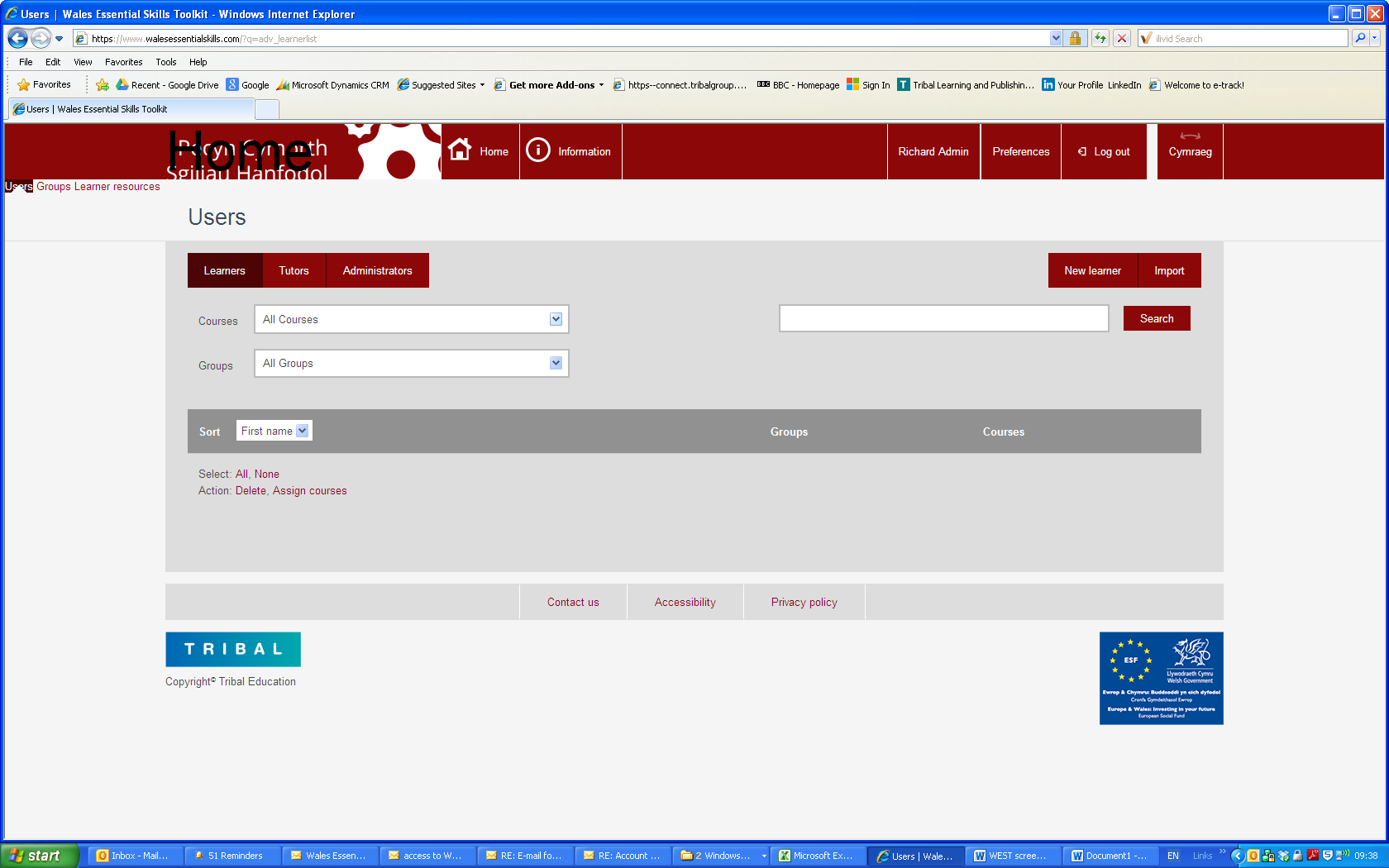
Easily navigable functions provide a clean back office administration

Slide 6
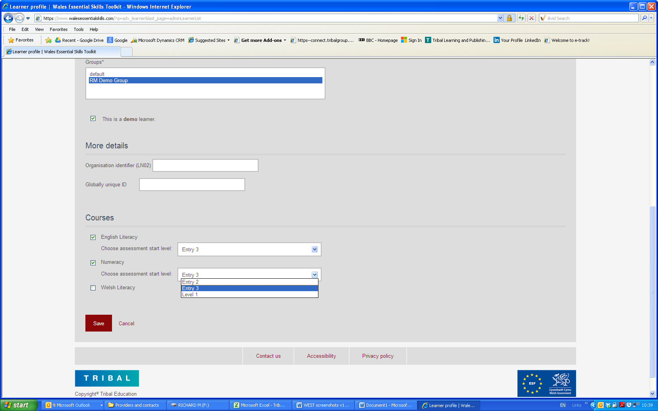
The tutor can set the appropriate starting point for a learner

Slide 7
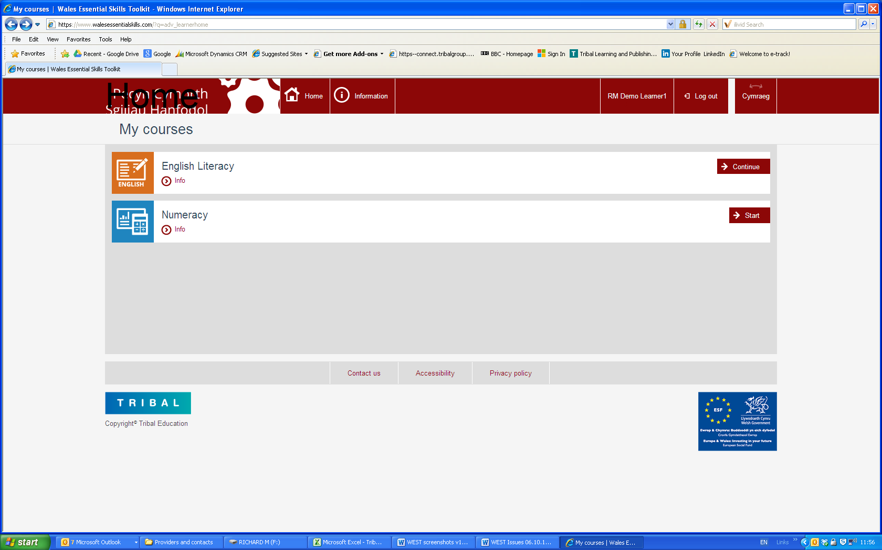
From their log in screen learners can select the assessment or continue with their learning journey

Slide 8
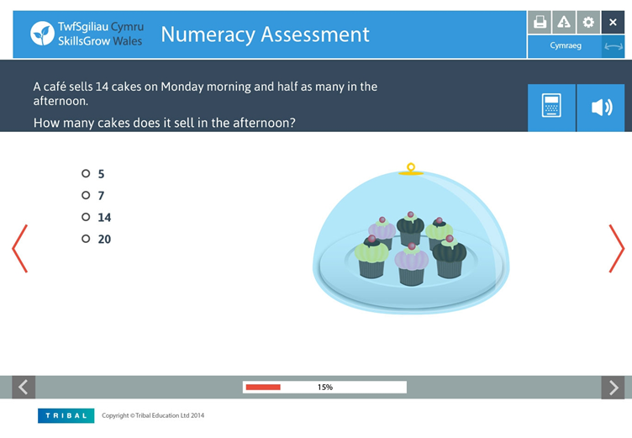
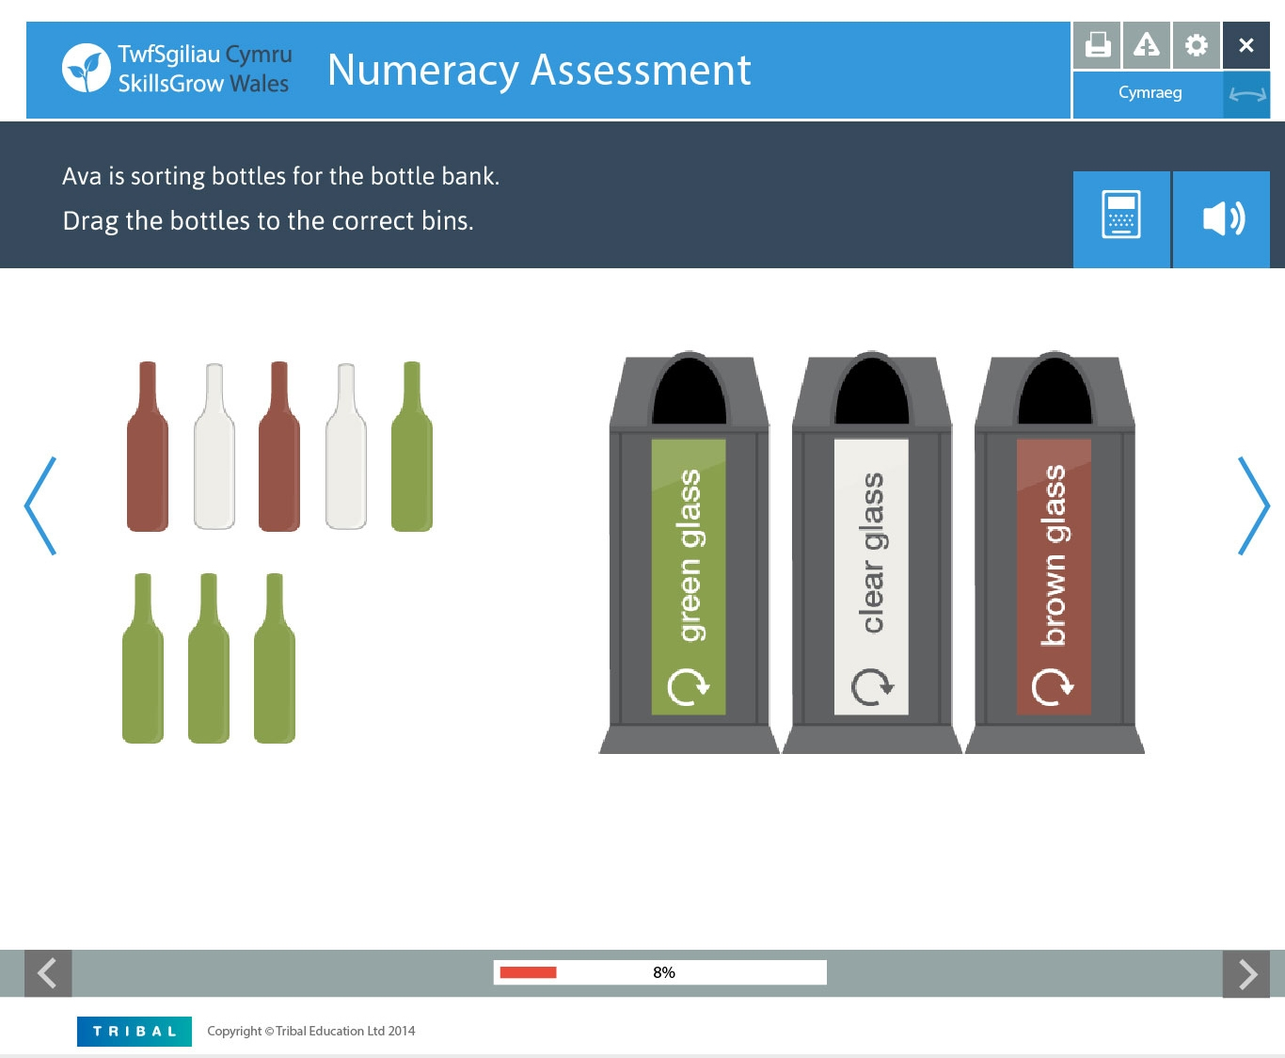
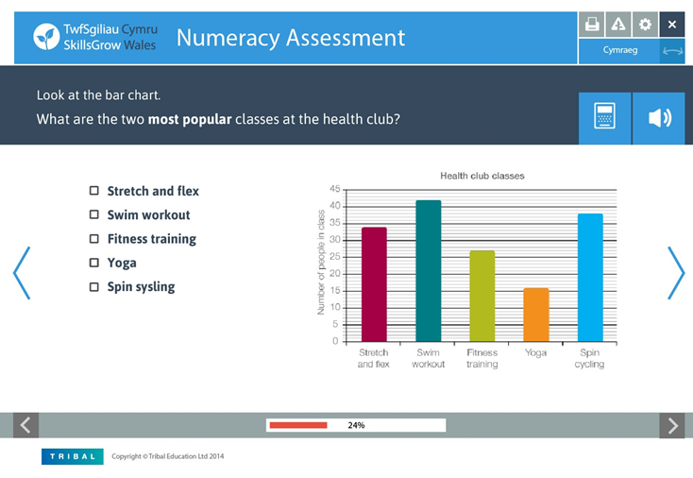
Numeracy initial assessment assessing skills from E1 – L3 with algorithm to adjust the degree of difficulty based on a learner’s answers. Changes in answering techniques and audio descriptions provides differing styles to maintain engagement

Slide 9
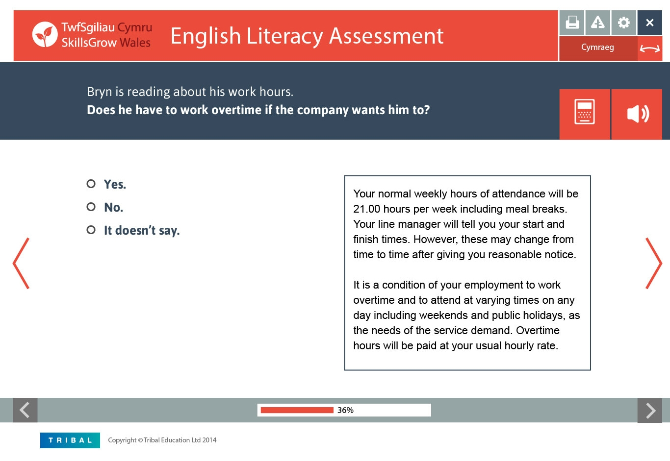
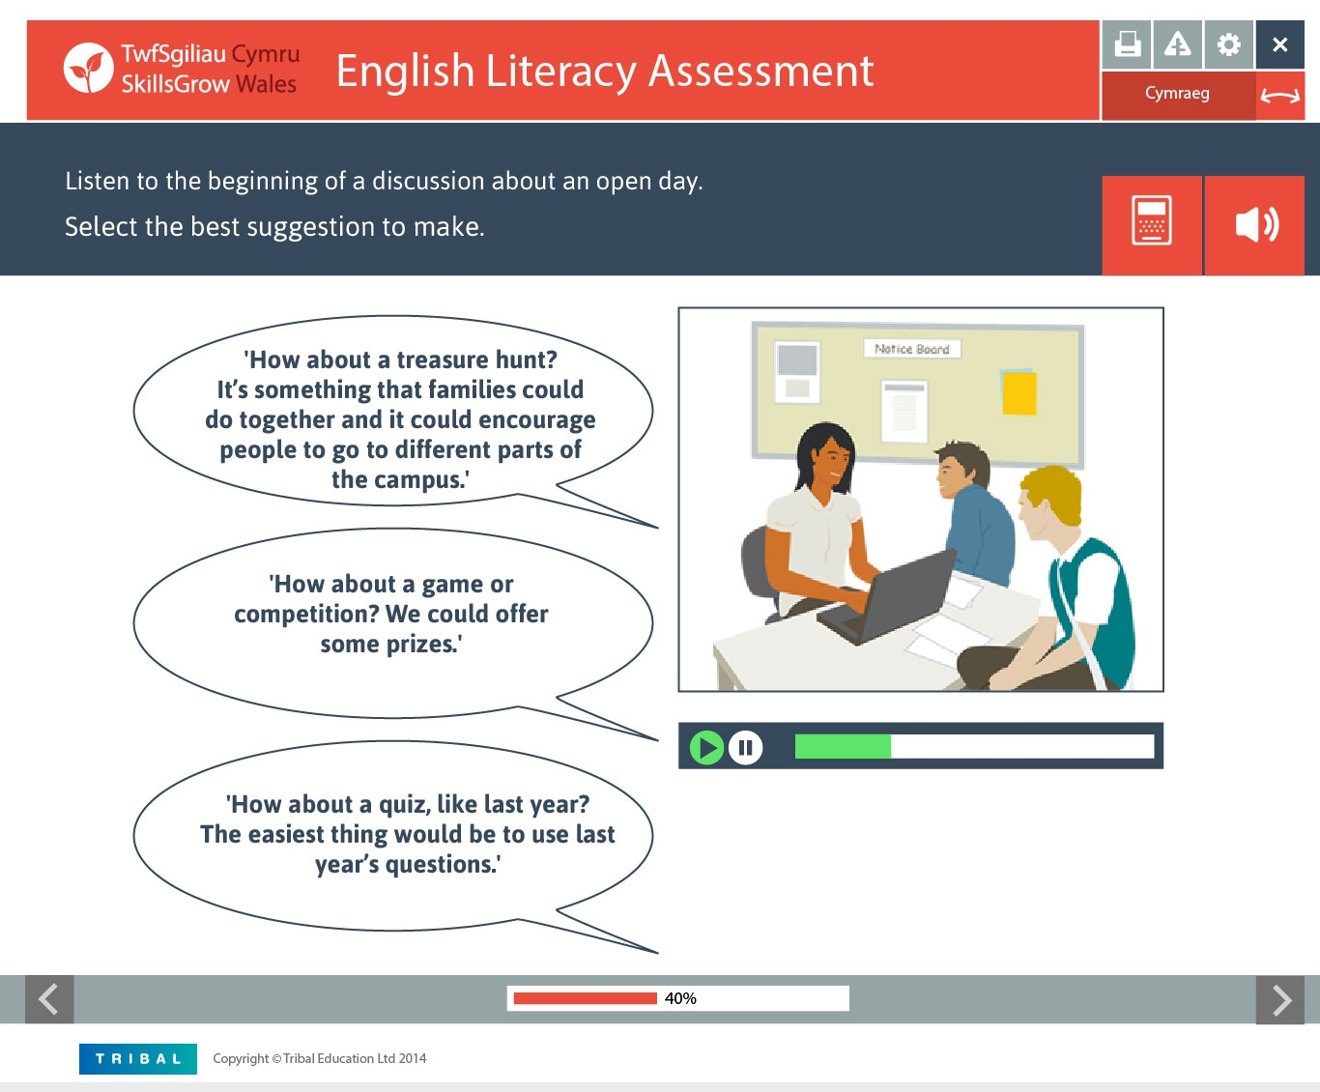
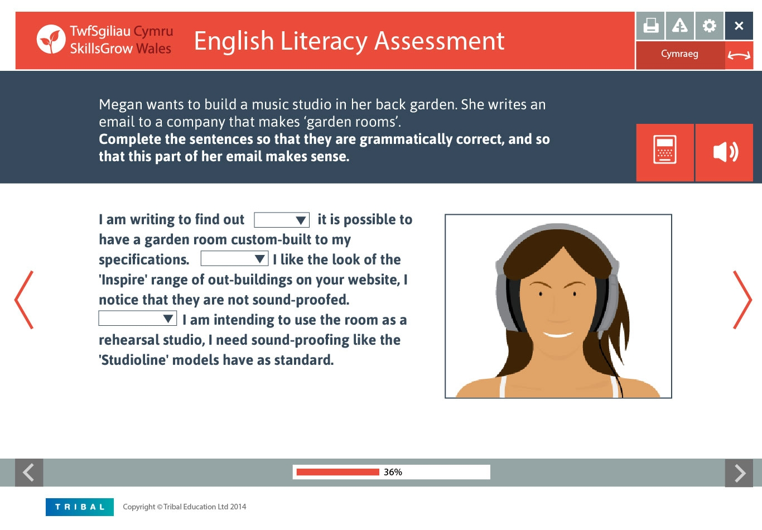
Literacy initial assessment assessing skills from E1 – L3 with algorithm to adjust the degree of difficulty based on a learner’s answers. More complex scenarios are presented at L2/L3 where the pace of the audio is automatically adjusted to reflect the level of the assessment

Slide 10
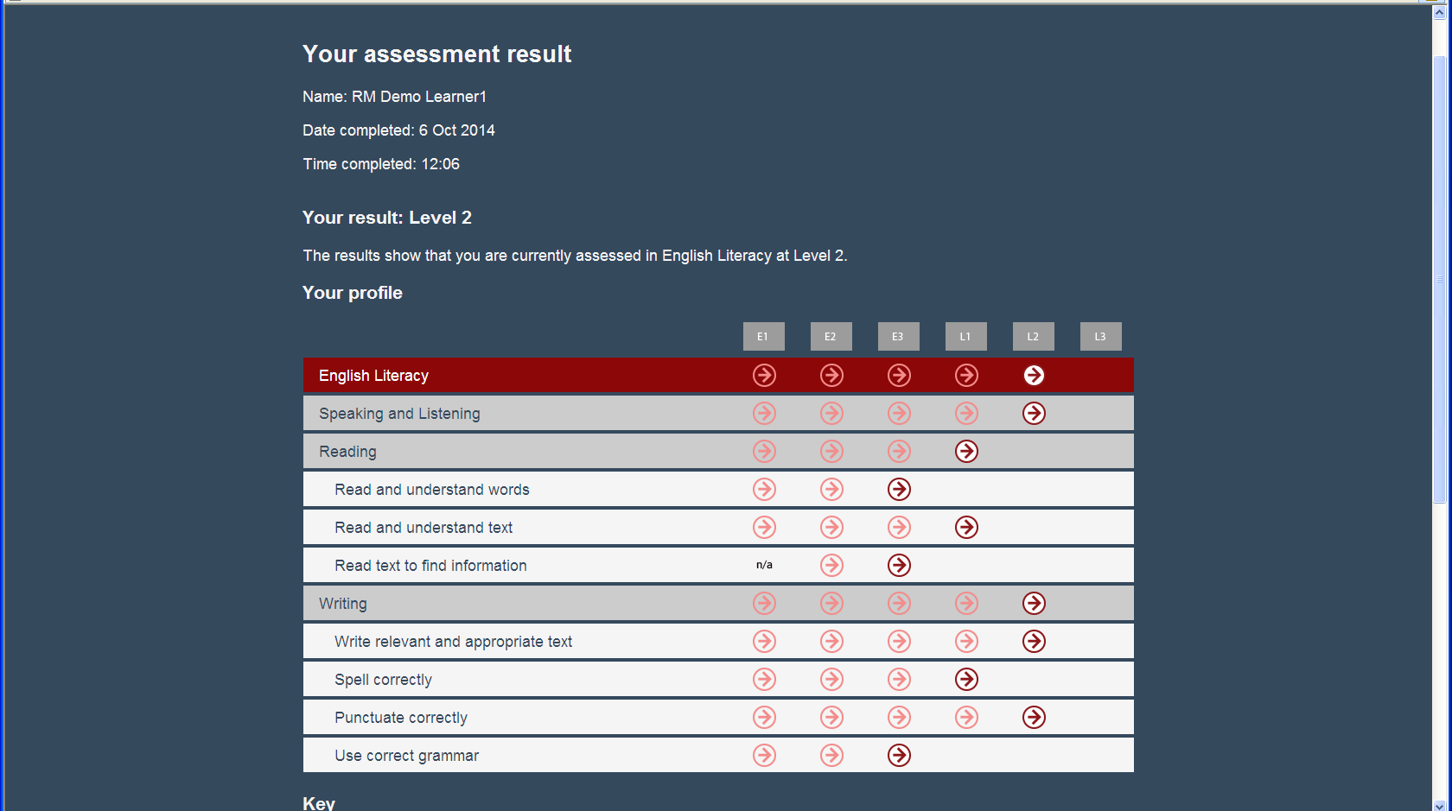
Initial assessments results create a spiky profile identifying areas of competency from which an ILP is generated highlighting development needs. Progress is shown on the learner’s dashboard. New activities or overdue tasks are viewed from the Alerts window

Slide 11
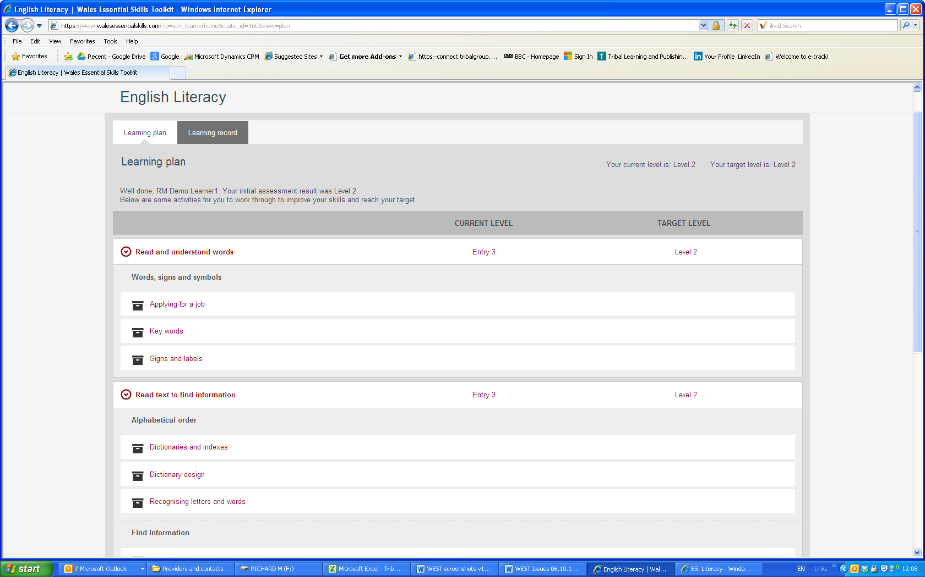
Tasks are automatically generated into a learning plan and updated as the learner completes

Slide 12
Benefits
For learners:
24/7 access to their learning, all in one place.
Resources that focus on individual needs.
Shared ownership of targets and progress.
For teachers and trainers:
Accurate identification of learners’ skills.
The flexibility to efficiently plan and effectively deliver high-quality learning for a range of cohorts.
Reliable and robust information on learning and progress, available in real time.

Slide 13
Benefits
For managers:
An easily scalable solution for assessment and learning.
Consistent and reliable learning and assessment information.
Access to real-time data to monitor outcomes and performance.
For administrators:
A centralised system to monitor impact, performance and quality.
Real-time data with a range of drill-down options.
Cost-effective solution.

Slide 14
It is expected that by September 2015 all providers delivering WG funded Essential Skills provision will be using WEST which will replace any current delivery process. This single approach will ensure that a learner’s assessment and learning of essential skills is visibly tracked and where necessary transportable.
Full training on the use of the toolkit will be delivered on site or via a webinar to suit the organisation prior to commencement with regular reviews and technical helpline support where required.
Procurement of the Wales Essential Skills Toolkit is available on a 1, 2 or 3 year renewable contract with costs based on the number of learners agreed at the start of the contract. Providers can contract as individual institutions or via an established and recognised consortium

Slide 15
The Project Board have agreed that a phased procurement of WEST takes account of the scheduled release of the toolkit, acknowledging existing delivery timetables and current arrangements with other resource suppliers.
Therefore where providers would like to commence using WEST with funded learners from 1st October 2014, organisations will be able to take advantage of a 50% reduction in the total contract value until the toolkit is fully operational at which point the remaining 50% of the contract will be charged. This gives providers the opportunity to phase out existing delivery and resources.
Where providers are not in the position to purchase WEST during the remainder of 2014 but would like to pilot WEST as a way of training staff, the toolkit will be available to pilot for free. Should a provider then wish to use WEST to assess or support funded learners then the charges outlined will be expected as agreed by the Project Board.

Slide 16
For further information, please contact:
Richard Meredith
Regional Manager, Tribal
T: 01904 550110
M: 07793605925
E: richard.meredith@tribalgroup.com

