Slide 1

ULR Conference 2014
Notes:
Intro

Slide 2

Who gets the Quality Award?
The Wales TUC Cymru Quality Award will be awarded to providers who demonstrate a core commitment to working with unions and can evidence that union learners are considered in the design, development and delivery of learning.
Notes:
Intro

Slide 3



Current holders of the
Quality Award
Coleg Gwent
Trade Union Education
ADT Ltd
Essential Skills at Dŵr Cymru
Cardiff & Vale College
Essential Skills
JanRo Ltd
Essential Skills
Notes:
Intro

Slide 4
What do providers have to do?
Awarded to a programme and/or course
Show continuous improvement
Meet the 16 good practice criteria
Awarded for 3 years
Annual reviews
“The Quality Award will help direct ULRs and other TU Reps to providers that are working successfully and flexibly with trade unions.”
Notes:
Intro Good practice criteria includes

Slide 5
Where does the evidence come from?
Evidence is gathered from,
the provider, tutors and TU learners
TU reps, officers and Wulf project managers
Evidence from Estyn, professional bodies and other quality standards

Slide 6



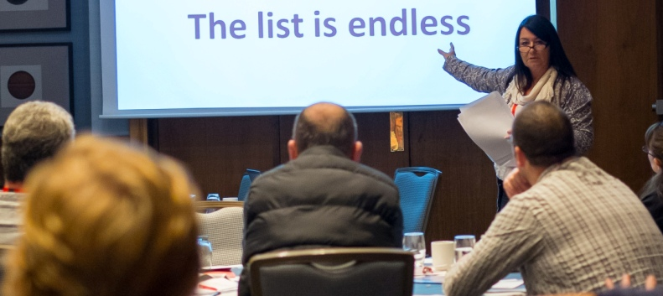


Tra
Trade Union Education Programme

Slide 7

“PDC develop leadership programmes that are innovative, practical, engaging and stretching.”
Leading Change Programme
Words from recent delegates:
Inspiring!
Reflective
Creative
Brilliant!
Notes:
Bern

Slide 8


Workplace Learning
Nurses from around Wales came
together for an intensive weekend of
Welsh and culture enjoyed it so much
they didn’t want to go home!
Valerie Bailey RCN Wales, explained, “RCN Wales worked in collaboration with WEA Cymru
to provide a bespoke Welsh Cultural
weekend for nurses and
health care staff.”
Notes:
Jo

Slide 9


Who are the assessors?
Bernice Waugh
Linsey Imms
Anne Jenkins
Jo Rees
Notes:
Bern

Slide 10

wtuceducation@tuc.org.uk
T: 02920 347010
Contact Wales TUC Cymru for details of how to apply for the Quality Award
Notes:
Bern

