Slide 1
THE BUILT ENVIRONMENT
Tailoring your workplace adjustment
Thursday 24th June

Slide 2





Tailoring your Workplace Adjustment Strategy. Focusing on progress.
BUILT ENVIRONMENT
Environment
Signage
Lighting
Flooring
Glass
Doors
Cost reduction
Optimising overall supply chain and reduce resource usage
100% trackable & traceable
Software
Digital sign-in
Data
32+ public sector clients
Working with an experienced solution provider
Tailoring your Workplace Adjustment Strategy. Focusing on progress.

Slide 3




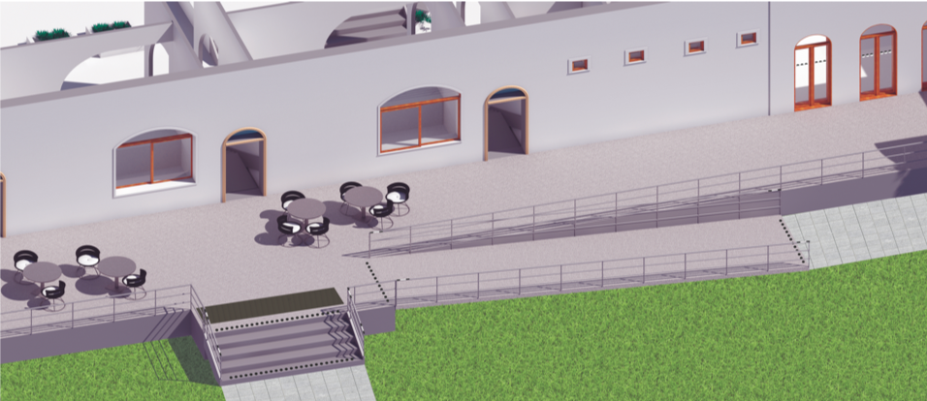
Analysis, planning, improvements and products
BUILT ENVIRONMENT
Audits & analysis of built environment
Provide suggestions and solutions
Cost, quantity, volumes
Tailored roadmap & action plans
Project planning
Insight subject of topic
Organisational tailored priorities and lead time
Analysis
Planning
Project implementation
Remove physical barriers
Enhance physical accessibility
Referral
Product delivery
Product cost & estimation
Project management
Improve
Products

Slide 4



Signage and wayfinding
BUILT ENVIRONMENT
Signage and wayfinding

Slide 5
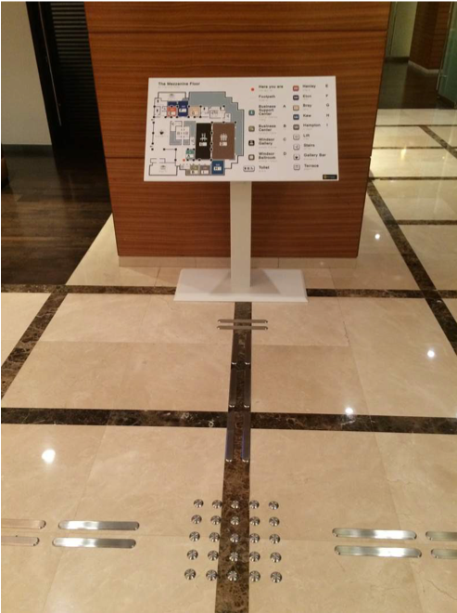
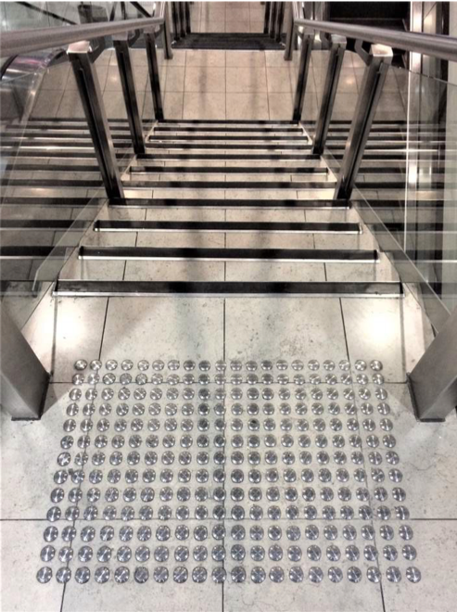
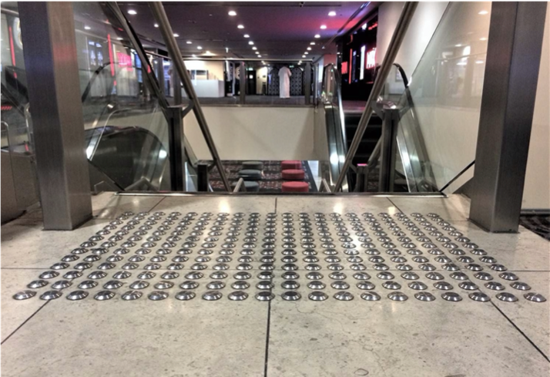
Tactile Trail & Studs
BUILT ENVIRONMENT

Slide 6
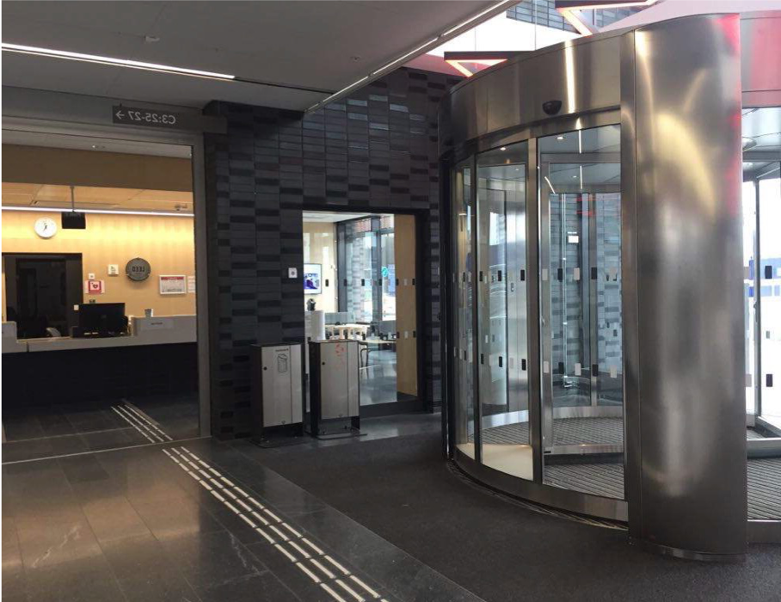
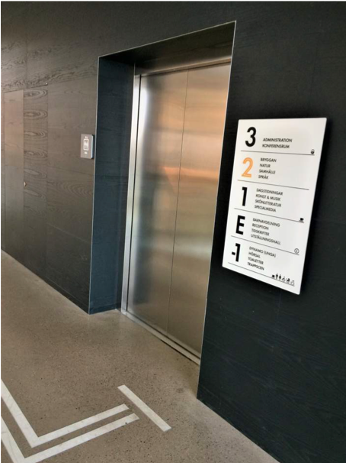
Tactile Trail & High Contrast floor markings
BUILT ENVIRONMENT

Slide 7
THANK YOU
Presented by
Rehan Hussain, Head of Physical Accessibility
Microlink PC (UK) Ltd
Microlink house, Brickfield Lane, Chandler’s Ford, Hampshire
SO53 4DP
T: +44 (0)23 80240300
E: wpa@microlinkpc.com
www.microlinkpc.com
Company registered in England No. 03325643

