Slide 1
The role of employers in tackling poverty
Child Poverty & Low Pay
Northern Living Wage Summit
Presented by Stephen Crossley
7th November 2013

Slide 3
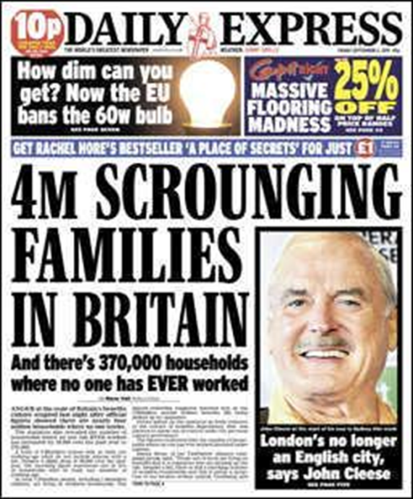
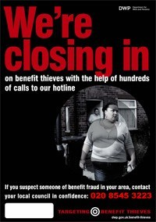
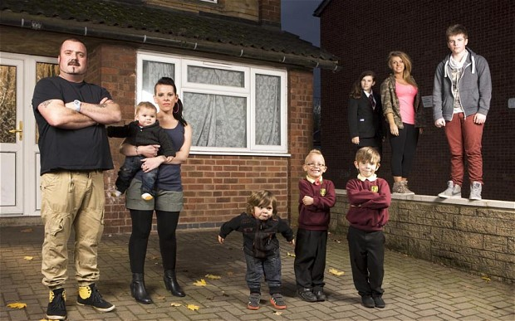
Representations of poverty
Notes:
Representations of people living in poverty
Individual behaviours v institutional behaviours

Slide 4
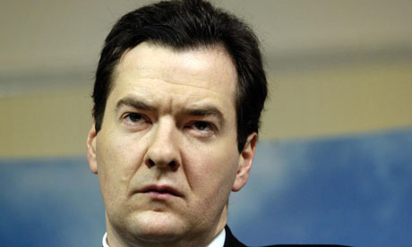
"No something for nothing anymore. People are going to have to do things to get their dole and that is going to help them into work. This is all activity that is actually going to help them get ready for the world of work.“
(Osborne 2013)
Notes:
http://www.independent.co.uk/news/uk/politics/george-osbornes-welfare-war-work-for-your-benefits--or-attend-jobcentre-daily-8847851.html

Slide 5
Child Poverty statistics
North East – 23.7% children living in poverty – equivalent to 128,405 children
Middlesbrough– 33.2%
South Tyneside 26.5%
Northumberland 17.4%
Notes:
M’boro – equivalent to 11055 children
S. Tyneside – 8110 children
N’land - 10940
Thorntree – 56%, North Ormesby & Bramble Farm – 53%

Slide 6
The consequences of poverty
The poorest infants have an almost 10 times higher chance of dying suddenly in infancy than those in the highest income group.
Children who live in poverty are twice as likely to live in bad housing. Overcrowding and spells living in temporary accommodation are also factors that affect children growing up in poverty.
Poorer families often have to pay a ‘poverty premium’ of around £1,280 per year for good and services.

Slide 7
The consequences of poverty
“The worst blow of all is the contempt of your fellow citizens. I and many families live in that contempt.”
“The worst thing about living in poverty is the way it gives others permission to treat you – as if you don’t matter”
“We hear how the media, and some politicians, speak about us and it hurts”

Slide 8
Government strategy
“This Government believes that when an individual finds and takes work the system should reward them”
“work, not welfare, is the best route out of poverty for those who are able to work.”
“First, we must ensure that families can work themselves out of poverty … we will make sure the system makes work pay.”
Notes:
All taken from the foreword to the government child poverty strategy – written by Iain Duncan Smith

Slide 9
In-work poverty
66% children growing up in poverty in the UK live in working households
Notes:
A ‘relentless rise’ – up from 43% in 1996- 97
An issue which we have the opportunity to do something about – the North East has low wages in comparison with other parts of the country
Govt strategy – in work poverty 2 mentions, worklessness 10 mentions, dependency 5 mentions, culture (in relation to parenting, dependency etc 8 mentions)
79 pages
No local authority child poverty strategies in the North East dealt with the issue of in-work poverty in any substantial way

Slide 10
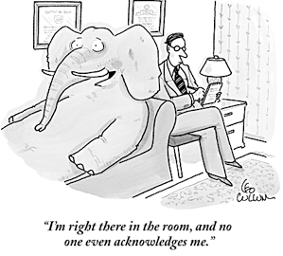
In-work poverty

Slide 11
Inter-generational worklessness?
Despite strenuous efforts, researchers have been unable to locate any families where 3 generations had never worked.
Families experiencing long-term worklessness remained committed to the value of work
No evidence of 'a culture of worklessness' – values, attitudes and behaviours discouraging employment and encouraging welfare dependency – in the families.
Notes:
http://www.jrf.org.uk/publications/cultures-of-worklessness
Similar work on the issue of ‘low aspirations’ as well

Slide 12
A Living Wage
A ‘Living Wage’ is one which is linked to a minimum acceptable standard of living, as defined by members of the public.
It is not an increased minimum wage as decided by politicians and/or officers.
The UK Living Wage is currently £7.56 per hour
Notes:
Consensual methodology – robust, internationally recognised, rarely challenged
Free from political and/or market/employer interference
Little difference recorded across the UK, London excluded
No other region in the UK is considering local Living Wages – risks bringing in regional pay through the back door.
The UK Living Wage assumes full take up of benefits
Rise of ‘payday loan’ companies
Take up of in-work benefits
Between £7.52 billion and £12.31 billion benefits not claimed each year
Between £90 – 220 million unclaimed tax credits alone in the North East

Slide 13
‘The ‘depth’ of poverty
Children living furthest below the poverty line, with a median poverty gap of around 25 per cent, include those with self-employed parents (29 per cent), workless couple parents (22 per cent), couple parents where one or more work part time (22 per cent) and couple parents who both work with at least one full time (22 per cent).
(DWP 2011)
Notes:
DWP Working Paper 103 ‘Exploring Poverty Gaps’
https://www.gov.uk/government/uploads/system/uploads/attachment_data/file/214400/WP103.pdf

Slide 14
‘In-work’ benefits
…the large poverty gap experienced by children in couple families where both work, with at least one full-time (22 per cent), is more difficult to explain…
low-income couple families are less likely to have contact with the benefits system;
perhaps they are not well-informed and have failed to claim benefits for which they are eligible or;
do not wish to engage with the benefits system.
(DWP 2011)
Notes:
There are a range of possible explanations, including data issues similar to those found with the self employed, but also issues around benefit take-up and income distributions.
Take up rates (2008/09) demonstrate that estimated take up rates among couple families is 73 per cent, compared with 95 per cent among lone parent families
While the benefits system does not guarantee to provide an income above the poverty line, it does act as a safety net which protects against very low incomes.
Although these full-time working families on very low incomes would be highly likely to be eligible for Working Tax Credit if they meet residency requirements,
(thereby slipping through the safety net)15,

Slide 15
‘Churning’ in and out of work
Around 4 in 10 people eligible for JSA do not claim (2012)
Around 50 people in the NE have been on JSA for over 10 years. (2011)
Less than 10% claim JSA for longer than 1 year.
Can people really ‘work themselves out of poverty’?
Notes:
https://www.gov.uk/government/uploads/system/uploads/attachment_data/file/222915/tkup_full_report_0910.pdf
http://statistics.dwp.gov.uk/asd/asd1/adhoc_analysis/2011/oow_ben_duration.xls
http://www.turn2us.org.uk/pdf/Mythbusting.pdf
http://www.turn2us.org.uk/pdf/Mythbusting.pdf
Employers have little difficulty in finding people to do low paid, low skilled work

Slide 16
Take-up of benefits
‘Non-take up of benefits has risen concurrently with stigma’
Notes:
http://www.turn2us.org.uk/about_us/media_centre/news_archive/benefits_stigma.aspx
Quantitative and qualitative evidence suggests that stigma is playing a role in explaining non-take-up of benefits and tax credits, with around one in four respondents to the MORI survey giving at least one stigma-related reason for delaying or not claiming
Focus group participants report a clear negative impact of stigma on feelings of self worth.

Slide 17
Alternative views
the people I meet want decent jobs. They want the opportunity to get up in the morning and go to work for a decent wage. They would accept the minimum wage even though, at this point in time, it is not high enough. Where I live, 25 people are after every single job in the jobcentre. That means that 24 are not getting employment for every single opportunity. People want to work for the best intentions and the right reasons. They want self-esteem and finances. People where I live want to work—I am sure that extends throughout the country
Ian Lavery, Wansbeck MP, (2013)
Notes:
http://www.publications.parliament.uk/pa/cm201213/cmhansrd/cm130319/debtext/130319-0002.htm#13031966000002

Slide 18
Alternative views
I did not come into Parliament to penalise and punish the vulnerable and the poor for the mistakes of the Government.
We talk about “workshy”, but what about wage-shy employers who exploit the unemployed?
Grahame Morris, Easington MP (2013)
Notes:
http://www.publications.parliament.uk/pa/cm201213/cmhansrd/cm130319/debtext/130319-0002.htm#13031966000002
“employers were content to keep jobs low skill and found little difficulty in filling vacancies. Given their current product and production strategies there was limited demand for a more skilled workforce … even if the prospects of some workers are improved, it will be at the expense of others, as long as the structure of jobs and of their design remains unaltered.”

Slide 19
Summary
Work is no longer a secure route out of poverty for many people.
A lack of good quality work is the major cause of UK poverty
The focus in tackling poverty should shift from the perceived and un-evidenced behavioural short-comings of job-seekers to the behaviours of employers and commissioners offering low-paid, insecure, poor quality work.
Notes:
Regulatory short-comings

Slide 20
Summary
“The real challenge is to look at, and change as necessary, the whole of local authority activity, in direct relation to the needs of the community it is there to serve.”
Wheeler (1995)
Notes:
Review of Local Government Anti Poverty Strategies

Slide 21
Contact details
Stephen Crossley
s.j.crossley@durham.ac.uk
Tel: (0191) 334 9107
Mob: 07983 408 966
www.ilg.org.uk/child_poverty

