Slide 1
The economic case for a living wage
Neil Foster
Policy and Campaigns Officer
Northern TUC
nfoster@tuc.org.uk

Slide 2
What Henry Ford knew
Introduced a $5 a day wage was to reduce staff turnover costs, raise morale, ‘improve character’
To create a mass market his workers needed to be able to afford his automobiles
This ‘shot like a blinding rocket through the dark clouds of the present industrial depression’
Notes:
2

Slide 3
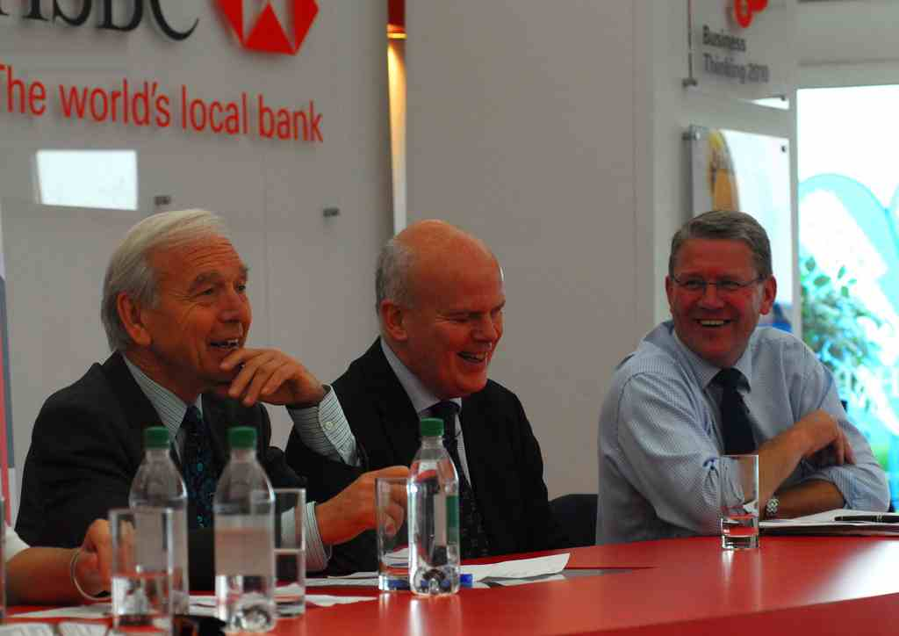
Wage-led recovery today
“The biggest thing we need to do is get earnings rising above inflation and get ordinary people spending their money again.”
Mark Berrisford-Smith,
Chief Economist HSBC,
Sept 2013
Notes:
3

Slide 4
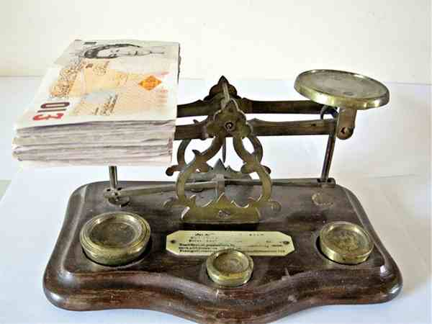
Economic benefits of a living wage
Landman Economics report concluded a living wage
Would boost demand, economic growth & create jobs
Reduce earnings inequality
Increase the share of wages in national income, & reduce extent tax credit system has to prop up low wages
Notes:
4

Slide 5
North East wage squeeze
We currently have the lowest average full-time wages in the UK
£455 per week in the North East
£506 per week across the UK
213,000 workers in the North East paid less than the living wage (22% of the region’s workforce)
Since 2007 the average full time worker in the North East is now £18 per week worse off
This equates to £1.2bn less spending power in the regional economy
Notes:
5

Slide 6
North East councils: ‘economic shepherds’
Often some of the largest employers in their local economy
Set the bar of quality employment
Key role within Local Enterprise Partnerships
Proposed LA7 Combined Authority
Public sector contracts important role in the region & multiplier effect
£3.5bn of contracts per year in the North East alone
Notes:
6

Slide 7
Re-spending our local wealth
Northumberland County Council 2005:
Local suppliers re-spent 76% of their income from contracts with local people & businesses
Suppliers from outside Northumberland spent only 36 per cent in the area
£1 spent with a local supplier is worth £1.76 to the local economy and only 36p if it is spent out of the area – spending locally worth almost 400% more
Notes:
7

Slide 8
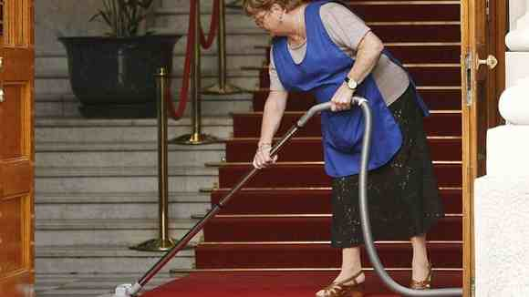
Spending locally
84% of the lowest paid local public sector workers outside of London live in the same area that employs them
Research for Unison 2011
Notes:
8

Slide 9
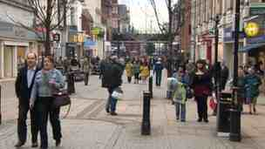
Workers are customers
74% of people in employment say they would be more likely to buy products or services from a Living Wage employer
Survation opinion poll for Unions 21, 2013
Notes:
9

Slide 10
Wider economic development
“The imperative for the North East is create more and better jobs”​
- Lord Adonis, North East independent economic review
Economic agencies should be mindful of wages for wider economic benefit:
Average manufacturing wage £31K
Minimum wage £13k
Living wage £16k
Notes:
10

Slide 11
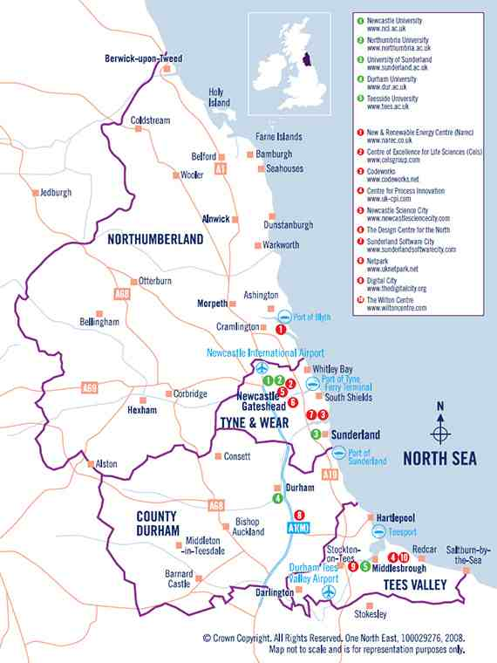
Living wage policies are an economic investment in the North East
Boost spending power
Spent locally
Reduce costly personal debt
Should improve chances of region’s firms winning contracts
Increase consumer loyalty
Quicken the region’s economic development
Notes:
11

Slide 12
Regenerate people’s incomes and we’ll regenerate place
Notes:
12

