Slide 1

Valued Partners
Hannah Pudner
and Kevin Pascoe

Slide 2


Shared Values –
committed to social justice through education in Wales, the UK and globally

Slide 3

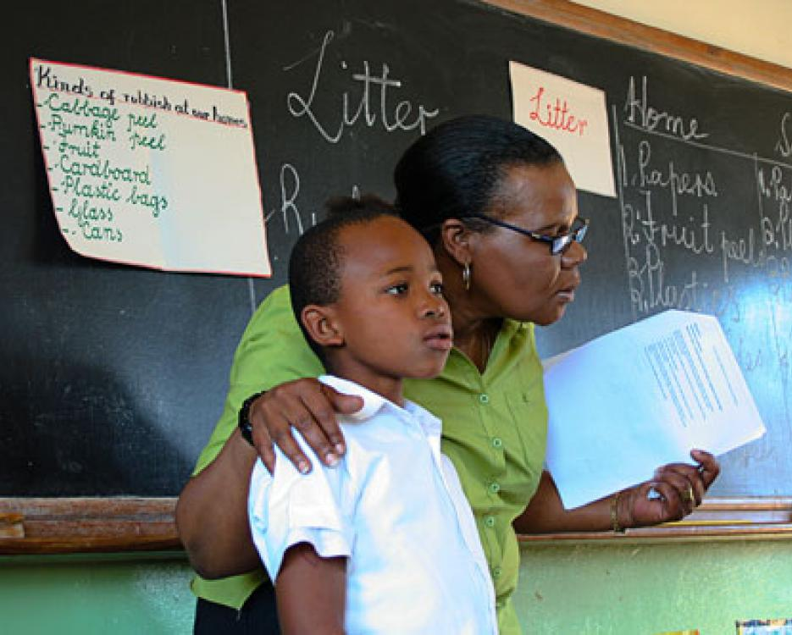
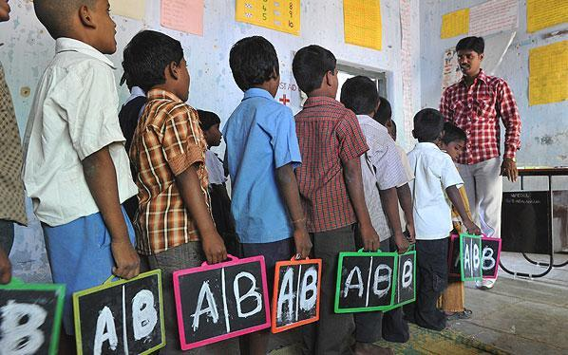
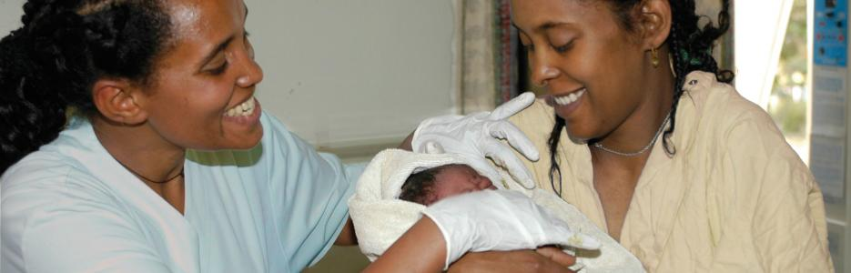

Slide 4


…. plus free ibooks on eBooks, apps and educational BBC – OU productions

Slide 5
2014 - an amazing year–
- OUiW number 1 for student satisfaction for the 10th year in a row
- Students numbers up by over 10%
- New part-time Access courses launch
- OpenLearn Cymru launched

Slide 6
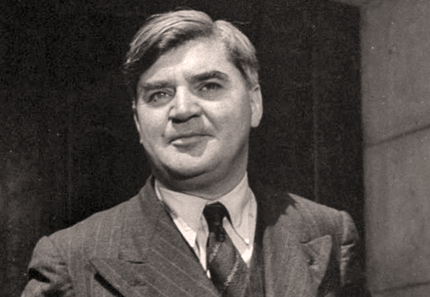
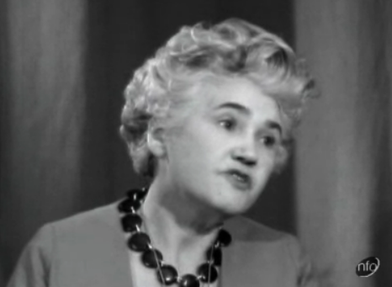

Slide 7












Union partners increase

Slide 8



Preparing for OU study –
Access Modules

Slide 9

A whole new way of learning – and its free!

Slide 10



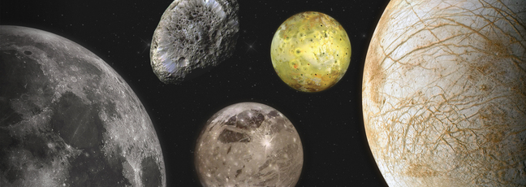
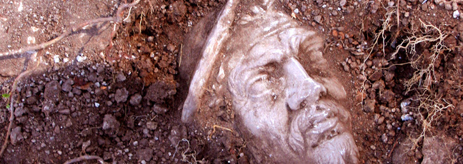

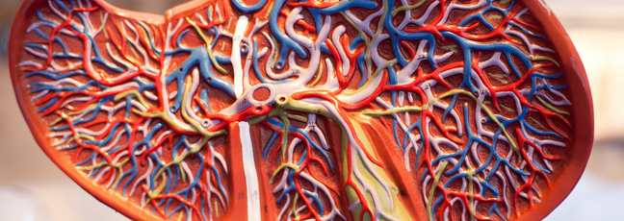
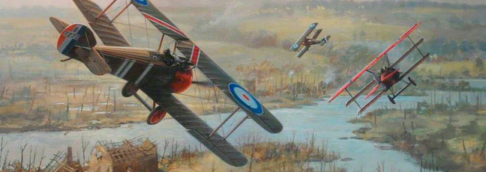

Introduction to Cyber Security
Managing my Money
Start Writing Fiction
Archaeology of Portus: Exploring the Lost Harbour of Ancient Rome
Moons
Our changing climate: past, present and future
Liver Disease: Looking After Your Liver
World War 1: Aviation Comes of Age

Slide 11

A whole new way of learning – and its free!

Slide 12


Slide 13

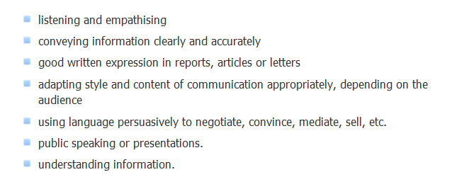

Slide 14
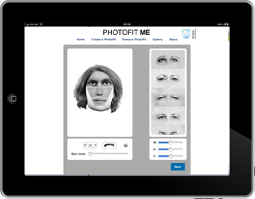

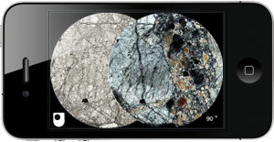
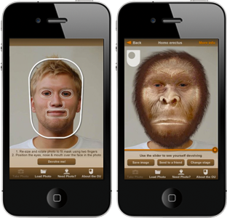


Free Apps … and more
Go to the App Store, or Google Play, search for ‘Open University’

Slide 15

Free iBooks … and eBooks
Living with diabetes
Maths everywhere
Social marketing
Children's rights
Rheumatoid arthritis
DNA – an introduction
Go to the App Store and download itunesU, or go to Google Play, search for ‘Open University’

Slide 16
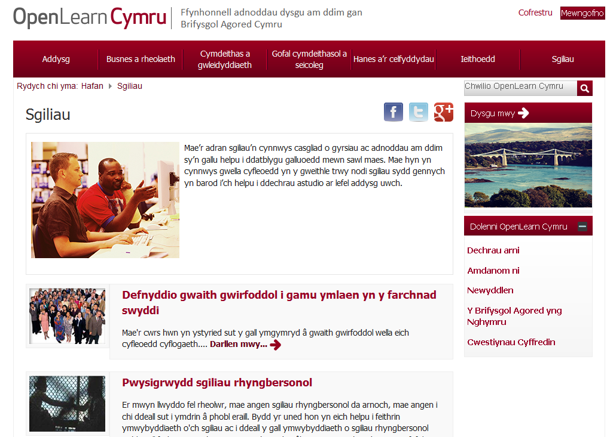

Slide 17

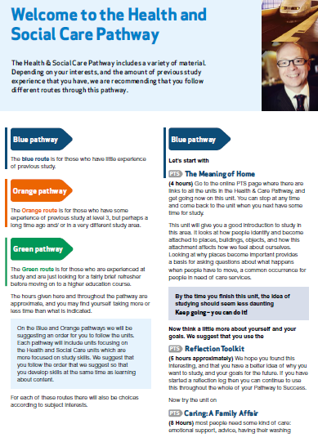
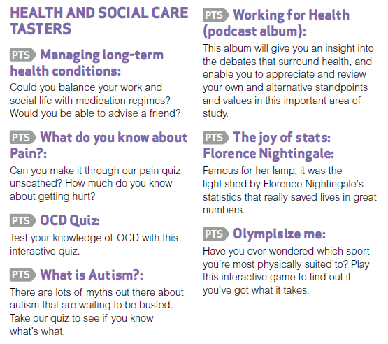
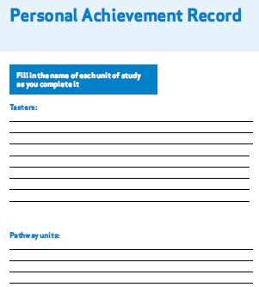

FREE preparation for OU studies
Tasters
Workbook
Guided Pathways
Participation statements

Slide 18


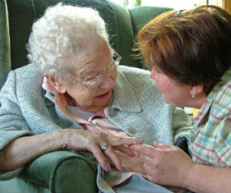

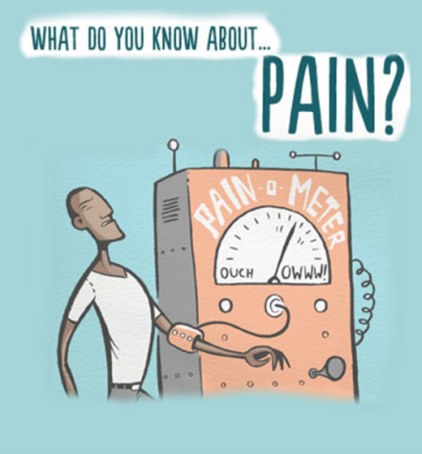

FREE resources for independent care sector
Ageing Well: Falls
Why falls are so important
Ways of assessing and reducing the risk
Recognise when to seek help
Explore how to prevent falls and injury
Dementia awareness: Can we reduce the risk?
Introductory
20 minutes
Living with Death and Dying
Introductory level
4 Hours

Slide 19

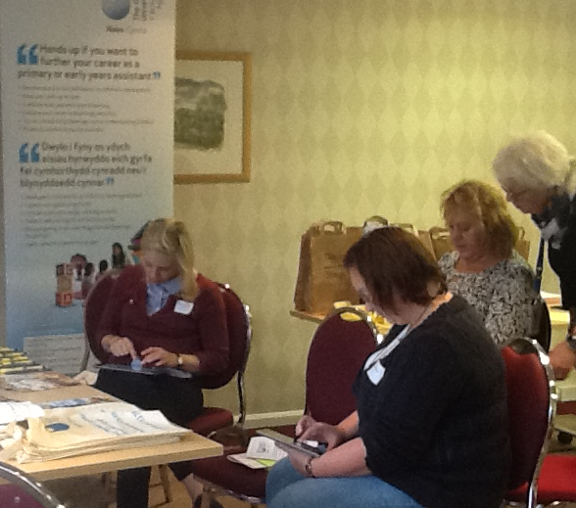

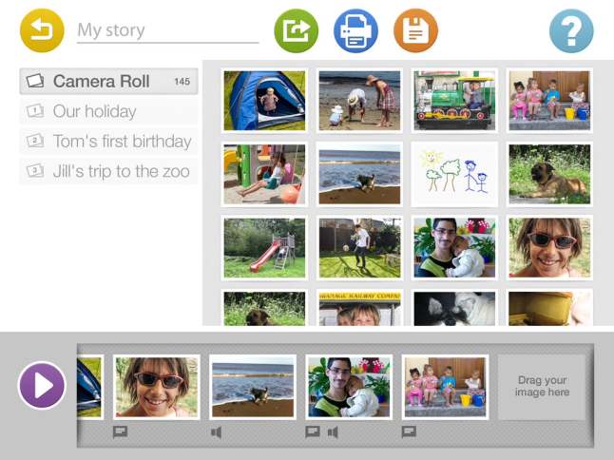

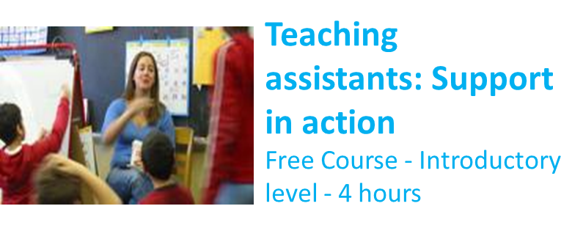
FREE resources for teaching assistants
Introduction to Child Psychology
Free Course - Introductory level - 8 hours

Slide 20
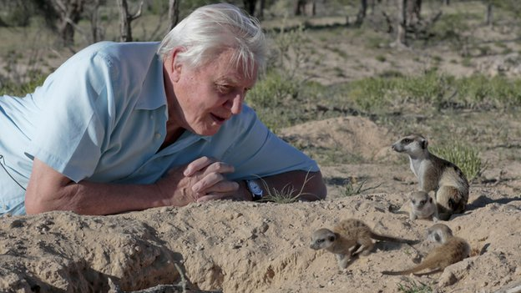
On BBC1 over the last few weeks

Slide 21

Paxman presented this in early 2014
B_ _ _ _ _ _ ‘_ G_ _ _ _ W_ _

Slide 22
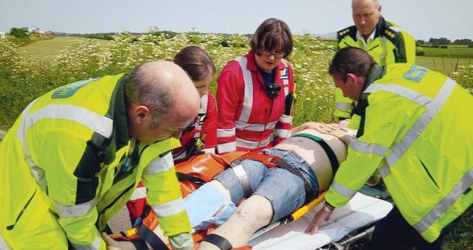
Lifesavers get there just in time?
An H _ _ _ _ to S_ _ _ Y_ _ _ L_ _ _

Slide 23
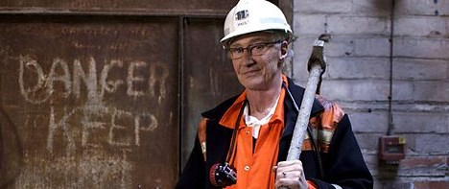
A Class Act?
P _ _ _ O’_ _ _ _ _’_
W_ _ _ _ _ _ B_ _ _ _ _ _

Slide 24

The W _ _ _ _ _ of D_ _ _

Slide 25
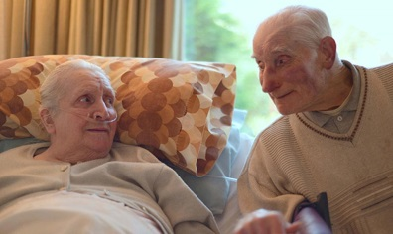
P _ _ _ _ _ _ _ _ _ O _ _ P _ _ _ _ _ _

Slide 26


@KevinPascoe
@FutureLearn
@OUFreeLearning
@OUCymru
www.open.ac.uk/study

