Slide 1


The Prospects for Earnings Under the New Government
Pay Bargaining 2016 by IDR and the TUC
London, 25 February 2016

Slide 2
Welcome and introduction
Gail Cartmail
Assistant General Secretary, Unite the Union

Slide 3
Opening address
Paul Nowak
Assistant General Secretary, TUC

Slide 4
Pay Prospects for 2016
Louisa Withers
Director, IDR

Slide 5

Pay trends and prospects for 2016
Incomes Data Research
Louisa Withers

Slide 6

Pay awards last year

Slide 7
Our latest analysis
- The IDR median settlement level has returned to 2%, having risen temporarily at the end of 2015 under the influence of the minimum wage rise and a few higher-end motor industry deals
 | IDR pay settlement data – three months to end of January 2016
 | Whole economy | Private sector | Manufacturing & production | Private services | Not-for-profit
Median | 2.0% | 2.0% | 2.0% | 2.3% | 1.4%
Average | 2.1% | 2.2% | 2.3% | 2.0% | 1.2%
Interquartile range | 1.7 to 2.5% | 1.9 to 2.5% | 2.0 to 2.5% | 1.8 to 2.5% | 0.8 to 1.8%

Slide 8
Pay awards this year

Slide 9
Median pay awards versus inflation

Slide 10
Real-terms pay rises

Slide 11
New pay deals
Organisation | % | Details | Date | Employees
Tesco | 0.0 | pay freeze | 1 Jul 15 | 310,000 employees
Nissan (NMUK) | 3.0 | plus 1% merit budget for staff 'in band'. 2nd year of 2-year deal | 1 Jan 16 | 6,700 employees
Jaguar Land Rover | 3.0 | 2nd year of 2-year deal | 1 Nov 15 | 16,900 employees
Sainsbury’s | 4.0 | minimum rate now £7.36 | 30 Aug 15 | 140,000 hourly-paid staff
Morrisons | 2.0 | Lump sum to cover Oct to Mar, then 4% to take min rate to £8.20 | 5 Oct 15 | 100,500 employees
Waitrose | 4.0 | Minimum to take min rate to £7.30 | 1 Apr 16 | 54,180 partners
ITV | 3.0 | 2nd year of 2-year deal. 2.2% had been agreed previously | 1 Jan 16 | 4,400 employees
Siemens | 2.5 | average general + merit rise | 1 Jan 16 | 14,500 employees

Slide 12
Findings from IDR research (1)
Engineering
- Pressures remain around skill shortages, with recruitment key problem
Median increase 2%, very few 3%+ and most (43%) paid a lower award in 2014/15 than in the previous year’s review
Graduates
Graduate intake rose by 11% in 2015 and is projected to rise by further 17% in 2016 – driven by the private sector
Although applications rising faster than vacancies, which means less pressure on pay
Analysis of pay leads for grads recruited 3 and 5 years ago provides evidence of a lowering effect

Slide 13
Findings from IDR research (2)
Call centres
47% reported growth in workforce last year, 32% expect further growth this year
Retention a bigger issue for employers than recruitment
- Entry-level pay close to forthcoming NLW level – LQ £14,475, Median £15,257, UQ £16,173
Retail
Very few retailers have implemented NLW early, although we have indications as to what the impacts will be
Median increase 2.5%, up from 2% last year
Number of retailers using NMW as the ‘floor’ has ticked up

Slide 14
Employers’ intentions for 2016

Slide 15
Influences on pay in 2016?
Upward pressure? | Downward pressure?
Continued economic growth | Risks to UK recovery from instability in EU, Middle and Far East?
A tightening labour market, on the main measures at least | Some softness in certain parts of the labour market?
The new National Living Wage, £7.20ph for workers aged 25 or over | Inflation to remain subdued

Slide 16
Inflation forecasts

Slide 17
Issues for 2016
- ‘National Living Wage’
- Divergence in pension schemes offered
- Premiums and unsocial hours working
- Which inflation measure to use?
- London pay and pressures on living costs in the Capital
Equal pay
Achieving pay growth in a low-inflation environment

Slide 18
Thank you
Louisa Withers
louisawithers@incomesdataresearch.co.uk

Slide 19
Economic prospects and labour market developments
Geoff Tily
Senior Economist, TUC

Slide 20
Outline
Slower growth
Financial fragilities
Disinflationary forces
Imbalances and pressures on demand and income
Employment v earnings

Slide 21
GDP growth slows

Slide 22
GDP growth slows
 | Q1-2015 | Q2-2015 | Q3-2015 | Q4-2015
Japan | 1.1 | -0.1 | 0.3 | -0.4
United Kingdom | 0.4 | 0.5 | 0.4 | 0.5
United States | 0.1 | 1.0 | 0.5 | 0.2
Euro area | 0.5 | 0.4 | 0.3 | 0.3
France | 0.7 | 0.0 | 0.3 | 0.2
Germany | 0.4 | 0.4 | 0.3 | 0.3
Italy | 0.4 | 0.3 | 0.2 | 0.1

Slide 23
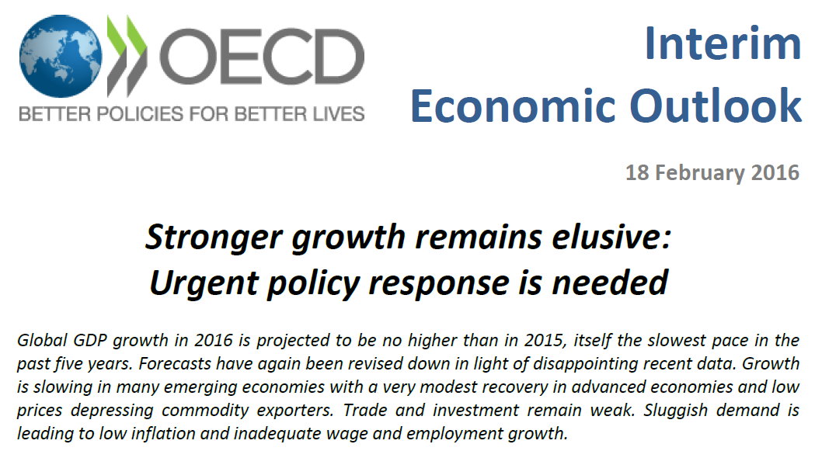

Slide 24
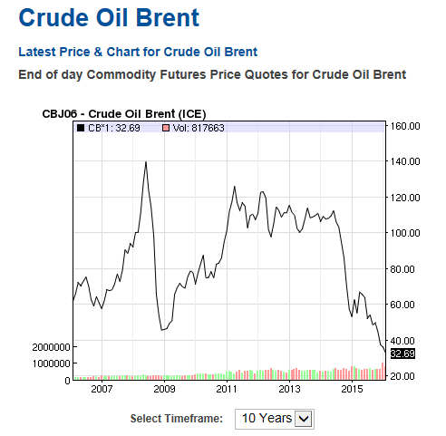
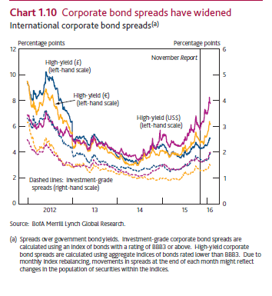
Intensified financial fragilities

Slide 25
‘Disinflationary’ pressures across economy

Slide 26
The usual industry imbalances

Slide 27
Subdued demand and pressures on income
GDP (expenditure), four quarter growth
GDP (income), four quarter growth

Slide 28
Strong employment headlines

Slide 29
But at the expense of earnings
Real average earnings, 2014 prices
AWE (regular pay), growth

Slide 30
Earnings hit govt. revenues, and hence public finances wholly unresolved
Government revenues, annual growth
Public sector debt (Maastricht), % GDP

Slide 31
And CPI inflation at its lowest since the great depression
Precarious position
Spending cuts have bigger impact than anticipated
Major underutilisation of resources
Unresolved imbalances and public and private debt
Risk of outright deflation without positive action
@geofftily @TUCeconomics
www.touchstoneblog.org.uk

Slide 32

The new 'National Living Wage'
Tim Butcher
Chief Economist, Low Pay Commission

Slide 33

The new National Living Wage
TUC and IDR Pay Bargaining Event
25 February 2016
Tim Butcher (Deputy Secretary and Chief Economist)

Slide 34
Overview
1. Low Pay Commission and National Minimum Wage | The LPC: What is it? What does it do? The NMW: What is it? How is it set?
2. Impact of the NMW | Impact on bite and coverage Impact on employment
3. The New Remit in the Summer Budget 2015 | The National Living Wage What it says? What it means for the LPC?
4. Estimated Impact of the NLW | Bite Coverage
5. Conclusion | Summary

Slide 35
The Low Pay Commission and the National Minimum Wage

Slide 36


Low Pay Commission
Set up in 1997 to define the National Minimum Wage and recommend its introductory level.
Independent advisory Non-Departmental Public Body (National Minimum Wage Act in 1998).
No specific aim/objective under the NMW Act 1998, but given specific remit by Government each year.
Independent of Government
Social Partnership
  9 Commissioners
  Balance - 3 independents, 3 with employer experience and 3 with union experience
  Appointed as individuals (NOT MANDATED) through advertised public appointments process
  All Commissioners have equal vote
  To date, always unanimously agreed recommendations
Small secretariat (Analysis, Policy and Admin)

Slide 37
What is the National Minimum Wage?
It is a WAGE FLOOR NOT A ‘LIVING WAGE’
It is NATIONAL (the same across England, Scotland, Wales and Northern Ireland)
No differences by industry, occupation or firm size
It is HOURLY (with special arrangements for piece rates)
It is CASH (benefits-in-kind except accommodation offset do not count)
It is SIMPLE (just four rates)
It does vary by AGE (and apprenticeship)
It is COMPREHENSIVE – it covers nearly all workers and types of contract, with few exemptions

Slide 38
Recommending the Rate

Slide 39
The National Minimum Wage (NMW) was intended to raise pay and tackle exploitation
No formal aim in the NMW Act but:
intended both to raise pay and to prevent exploitation.
Take the NMW out of politics and build consensus
The level is determined by affordability, not need.
To help as many low paid workers as possible…
…without any significant adverse impact on employment

Slide 40

Finding the right level
Two major concerns on NMW introduction:
  Job loss
  Wage inflation (which would fuel price inflation)
“…coming up with a minimum wage that will not seriously harm the economy, and destroy jobs, will require the wisdom of Solomon – or extraordinary luck.”
The Economist (5 June 1997)
The NMW should:
  support a competitive economy
  be set at a prudent level
  Be simple and straightforward
  Make a difference
  Low Pay Commission First Report (1998)
40

Slide 41
Evidence-based
Evidence-based judgement not a formula
  The impact so far
  State of the economy
  Prospects for the economy
  Stakeholder views
  Impact of other Government legislation
Evidence gathering
  In-house analysis
  Commissioned and independent research
  Formal consultation (Written and Oral evidence)
  Visits around the UK
  Secretariat meetings with stakeholders
  International developments

Slide 42
Phases of the NMW
The NMW has been characterised by a flexible approach
  “We have taken a prudent approach in choosing the initial rate, to find the balance between improving low pay and avoiding damage to efficient businesses and employment opportunities” George Bain, the Chair of the LPC (1998)
Initial caution, 1999-2000
Above average earnings growth increases, 2001-6
  “…we believe that there is a case for increasing the effective rate of the minimum wage, implying a series of increases for a number of years above average earnings…” Fourth Report (2003)
Caution again in uncertain times, 2007-13
  “we have no presumption that further increases above average earnings are required” LPC 2006 Report
  again little evidence of employment effects up to 2013 but awaiting further evidence of the impact of recession
A new phase? 2014 - 16
  “a move towards restoring the real value of the NMW” LPC 2014 Report

Slide 43
Between 1999 and 2015, the adult NMW has grown faster than average earnings and price inflation
Source: LPC estimates based on ONS data, AEI including bonuses (LNMQ), 1999, AWE total pay (KAB9), 2000-2015, RPI (CHAW), 1999-2015, and CPI (D7BT), 1999-2015, monthly; and GDP (YBHA), 1999-2015, quarterly, seasonally adjusted (AWE, AEI and GDP only), UK (GB for AWE and AEI).

Slide 44
Thus, the bite at 54.5% is its highest ever
Source: LPC estimates based on ASHE without supplementary information, April 1999-2004; ASHE with supplementary information, April 2004-2006; ASHE 2007 methodology, April 2006-2011; and ASHE 2010 methodology, April 2011-2015, standard weights, UK.
Note: 21 year olds became entitled to the adult rate in October 2010.

Slide 45
The NMW has clearly affected the earnings distribution

Slide 46
Indeed, the low paid have fared much better than in previous recessions and recoveries
1970s Incomes policy
NMW
Source: LPC estimates based on NES and ASHE, UK, 1975-2014.

Slide 47
Little impact on employment to date
In general, the lowest paid (on the minimum wage) have had higher wage increases than those at the median
The minimum wage has covered about 1 million workers (4-5%) every year
The bite, its value relative to the median is about 54%
Little evidence of any adverse impact on employment of individuals or on employment levels in the lowest-paid areas, although there is some weak evidence of slower growth rates in those areas
Evidence suggests that some of the additional wage costs may have been absorbed with a small reduction in hours worked, a small increase in prices to consumers and a squeeze on profits, however, this has not led to an increase in business failure.
Non-wage costs may also have been cut and pay structures adjusted.

Slide 48
Even The Economist appeared comfortable with minimum wages
“Evidence is mounting that moderate minimum wages can do more good than harm.”
“Bastions of orthodoxy, such as the OECD, a rich-country think tank, and the International Monetary Fund now assert that a moderate minimum wage does not do much harm and may do some good. Their definition of moderate is 30-40% of the median wage. Britain's experience suggests it might even be a bit higher. The success of the Low Pay Commission points to the importance of technocrats rather than politicians setting wage floors.”
The Economist (24 November 2012)

Slide 49
The National Living Wage

Slide 50
Summer Budget 2015
The Government introduced a National Living Wage (NLW), a higher minimum wage, for workers aged 25 and over.
The Government set the NLW at 50p above the NMW, effective from April 2016, making the NLW £7.20 an hour for those aged 25 and over
From April 2017, in addition to setting the main NMW, the LPC was tasked with recommending a yearly profile that takes the hourly NLW applying to those aged 25 and over to 60 per cent of the median hourly earnings of that group by April 2020.
The NMW of £6.70 an hour will continue to apply to 21-24 year olds
The main NMW will be set for those aged 21 -24

Slide 51
A Different Role for the LPC
To calculate rate of NLW & advise on path “subject to sustained economic growth” – some job loss allowed
To recommend youth, adult and apprentice NMW rates – subject to no significant job loss
Four main sorts of evidence:
Analysis of pay, labour market, competitiveness Evidence from stakeholders and experts; Visits programme across UK; Academic research on the impact of past NMW increases.

Slide 52
Future structure
From April 2016
National Living Wage (25+) | £7.20 – 55% ‘bite’ (2020 target of 60% bite = >£9?)
Adult rate of the NMW (21-24 year olds) | £6.70
Youth Development Rate (18-20 year olds) | £5.30
16-17 Year Old Rate | £3.87
Apprentice Rate | £3.30
A bite (not cash) target, and tolerance of employment risk
60,000 job losses (20,000-110,000) versus 1.1 million created by 2020 (OBR).
In effect a structured approach, calculated by LPC, and ‘subject to sustained economic growth’.
So what will it mean?

Slide 53
Impact of the National Living Wage

Slide 54
National Living Wage
Set initially at £7.20 in 2016
This is an increase of 7.5% on the NMW but it is an increase of 10.8% on September 2015
Chancellor has tasked the LPC to make recommendations on the path to a target of 60% of median earnings by 2020. When announced in July, that implied a NLW of £9.35 (a further increase of nearly 30% over 4 years – a period when average wages were expected to rise by only 21%)

Slide 55
New forecasts and new ASHE affect path to 2020
Source: ASHE 2014 Final and 2015 Provisional. OBR Supplementary Economic Tables, July 2015 and November 2015.

Slide 56
NLW in 2020 revised down by 2%
Using old ASHE and forecasts gave a target of £9.35
Revised wage growth reduces target to £9.28
Revised ASHE with old wage forecasts reduces target to £9.32
Revised ASHE and wage growth data reduces target to £9.16
Source: ASHE 2014 Final and 2015 Provisional. OBR Supplementary Economic Tables, July 2015 and November 2015.

Slide 57

Bite and Coverage of the NLW

Slide 58
The bite is now higher in 2015 and 2016
Source: ASHE 2014 Final and 2015 Provisional. OBR Supplementary Economic Tables, July 2015 and November 2015.

Slide 59
Still a significant increase in bite
Bite increases from 52.5% in 2015 to 55.1% in 2016 and 60.0% in 2020
By 2020, bite expected to be much higher in:
  For those aged 25-30 and 60 and over (around 65%)
  Small and micro firms (up to 76%)
  Low-paying sectors (reaching 100% in cleaning, hospitality and retail)
  Some regions (over 67 per cent in N. Ireland, Wales, Yorkshire & Humberside, and Eat Midlands)

Slide 60
Only London and the South East will have a bite lower than 60 per cent by 2020
Source: LPC estimates based on 2015 ASHE and OBR average hourly wage index

Slide 61
And significant increase in coverage
Coverage increases from 1 million in 2015 to 1.8 million in 2016 and 3.7 million in 2020
That is an increase from around 5% to around 14% of all UK employees aged 25 and over
By 2020, coverage for those aged 25 and over expected to be much higher in:
  Small and micro firms (up to around 25%)
  Private sector (up from 7% to 18%)
  Public sector (up from <1% to 5%)

Slide 62
Large increase in coverage of minimum wage from 2016 due to workers aged 25 and over
Source: LPC estimates based on 2015 ASHE and OBR average hourly wage index; 5p band
Note: Mid-year NMW/NLW coverage estimates and assuming an even bite path

Slide 63
NMW coverage increases from 1.4m in 2015 to 3.7m in 2020
Numbers (000s) | April 2015 | 2016 (October for NLW; April for NMW) | 2020 (October for NLW; April for NMW)
Rate | £6.50 | £7.20 | £9.16
16-20 | 159 | 159 | 159
21-24 | 248 | 248 | 248
25+ | 996 | 1,785 | 3,278
Total | 1,404 | 2,192 | 3,685
Source: LPC estimates based on 2015 ASHE and OBR average hourly wage index; 5p band
Note: Other NMW rates uprated in line with average earnings, thus implying constant coverage
Notes:
Maybe say on slide ‘uprated by average earnings’ for other rates. It’s implicit but worth making obvious.

Slide 64
Coverage for some NLW ages will be greater than for youths
Source: LPC estimates based on 2015 ASHE and OBR average hourly wage index; 5p band
Notes:
\\op2mdrv01\BIS-UniDrv\LPC\Private\SHARE\ANALYTICAL TEAM\Data and analyses\2016 Report\ASHE\ASHE TABLES\25+ for Report\coverage\coverage by age stack bar chart.xlsx

Slide 65
Overall: the LPC and NMW a success story?
In general, the lowest paid (on the minimum wage) have had higher wage increases than those at the median
The minimum wage has covered about 1 million workers every year (4-5% of all workers)
The bite, its value relative to the median is now about 53%
Since its introduction, the adult rate of the NMW has increased faster than average earnings growth or price inflation
Little evidence of any adverse impact on employment of individuals or on employment levels in the lowest-paid areas
Evidence suggests that some of the additional wage costs may have been absorbed with a small reduction in hours worked, a small increase in prices to consumers and a squeeze on profits, however, this has not led to an increase in business failure.
Non-wage costs may also have been cut and pay structures adjusted.
Weathered recession and change of government
But now has to cope with National Living Wage

Slide 66
Conclusion
The NLW is, in effect, another minimum wage (for those aged 25 and over)
The NLW target is currently £9.16 in 2020, implying an increase of 27% from April 2016 to April 2020
The bite will increase from 52.5% in 2015 to 55.1% in 2016 to 60% in 2020 but will be higher in small firms, low-paying sectors and certain areas
  It will be over 76% in micro firms
  It will be over 100% in cleaning and hospitality
  It will be less than 60% in the South East and London
Coverage will increase from 1 million (4.2%) in 2015 to 1.8 million (7.6%) in 2016 and 3.3 million (13.9%) in 2020
  Over a quarter of employees in micro firms
  Around 18% of private sector employees (and 4.5% of public sector workers)

Slide 67
Next Steps
The LPC will deliver its Spring 2016 report to the Government on Monday 29 February
  Recommendations for under 25 year olds and apprentices
  Outline proposed method for deciding upon path to 2020
  Initial estimates of the impact of the NLW
The Government will publish our report before or at the time of the Budget (16 March)
LPC will launch consultation on the NLW in the spring
LPC will report to the Government – the Autumn 2016 Report – by the end of October
  Recommendations for the 2017 NLW and indicative 2018 NLW
LPC awaits results of the Government Review of alignment of the NMW with the NLW.

Slide 68

The experience of work in low-paid sectors
Fiona Wilson
Head of Research, USDAW

Slide 70
The Experience of
Work in Low-Paid Sectors
FIONA WILSON
Head of Research and Economics
Union of Shop, Distributive & Allied Workers

Slide 71
Introduction
About Usdaw
Our Sectors
Collective Bargaining Overview

Slide 72
Collective Bargaining in 2016
Pay settlements and trends in the retail sector
What has influenced pay deals?
Non-pay issues – flexibility and work-life balance

Slide 73
Impact of the
‘National Living Wage’
Extent of coverage in Retail
Young workers
Hours of work
Premium payments and other benefits
Cuts to in-work support
Cost of living for low-paid workers
Pay differentials – rewarding skills and responsibility

Slide 74
A New Landscape for Collective Bargaining?
Working towards a real Living Wage
Bargaining for Young Workers
Measuring pay increases -the overall employment deal
The true cost of living
Analysing company performance
Productivity and ‘good work’
Focus on organising

Slide 76

What the official earnings figures show
Alastair Hatchett
Visiting Fellow, Greenwich University

Slide 77
What do the official earnings figures show?
Alastair Hatchett
Visiting Fellow, University of Greenwich, and associate of Incomes Data Research
25 February 2016

Slide 78
Introduction
Official earnings data frequently mis-interpreted: monthly AWE regularly misquoted as showing pay rises
AWE 2010-15 can be difficult to interpret
However, official data can illuminate arguments eg on regional pay, public sector pay or progression pay
Why official data is poor on highest paid

Slide 79
AWE 2010 to 2015

Slide 80
Different measures, different methods
Average Weekly Earnings(monthly): a crude but useful economic indicator. A survey of companies and workforce size
Annual Survey of Hours and Earnings (ASHE) (annual) a very large survey of employees’ earnings. Poor on bonuses not paid in April
Labour Force Survey: a smaller survey of individuals. Large proportion of proxy answers
IDS/IDR measure of pay settlements

Slide 81
ONS Average Weekly Earnings
It is a measure of the average of weekly earnings: it is calculated from data from 8,000 companies and organisations providing their monthly paybill. This is divided by the number of employees
If the overall workforce becomes less well paid and there is more part-time working then the average is reduced
Between 2008-13 a 20% fall in jobs in finance pushed down the average

Slide 82
Annual Survey of Hours and Earnings
Strengths: large sample (180,000 employees) based on HMRC PAYE records each April: data on earnings & hours obtained from employers
Very good data for standard jobs (electrician)
Weak data for small samples (paramedics)
Good data for regular earnings but poor on bonuses as it is an April survey
Does not include self-employed so very weak on the pay of the highest earners

Slide 83
Different measures, different results
ONS Average Weekly Earnings (AWE) shows: pay growth of 2.4% in year to Oct 2015, and
pay growth of 2.1% in year to Dec 2014
ONS ASHE shows median annual earnings growth for full-time employees
+ 1.8% in year to April 2015
+ 0.2% in year to April 2014
IDS/IDR median for settlements 2 to 2.5%

Slide 84
Factors contributing to lower earnings
Fewer hours worked: full-time and part-time
Underemployment: since recession many would prefer more paid work
Reduction in variable bonus pay
Government pay freeze and attempts to abolish progression pay
Wider use of zero-hours contracts/unpaid working time/cuts in pay for unsocial hours

Slide 85
The changing labour market
The recession led to widespread redundancies
Many workers found new jobs but at lower skill and pay levels and mostly part-time
Jobs lost in finance and manufacturing
Many new jobs in lower paying sectors and P/T, but also jobs growth in IT (better paid)
Large growth in self-employed who are not necessarily in the statistics (people made redundant who go freelance)

Slide 86
AWE by sector (October 2015)
Amount Rise Weight in index
Whole economy £493 2.4% 100%
Private sector £493 2.7% 82%
Public sector £494 1.6% 18%
Finance +business £630 1.8% 21%
Manufacturing £575 1.5% 9%
Construction £596 6.1% 4%
Retail, hotels etc £332 3.3% 24%
(annual growth rates: Published December 2015)

Slide 87
AWE by sector

Slide 88
AWE data on public and private sectors
Since 2010 a large number of lower-paid jobs have been cut/outsourced from the public sector
The effect of this is to raise average pay in the public sector and lower the average in the private
Pay growth in public sector is 1.6%. It would be closer to zero but for job cuts and outsourcing
Much of the jobs growth in the private sector has been in low paid jobs, but also in high tech jobs.

Slide 89
ASHE results for April 2015
Weekly earnings up 1.8%: adjusted for CPI = 1.9%, ‘first real increase since 2008’ (ONS)
Median gross weekly earnings £528 (F/T)
Median gross annual earnings £27,600 (F/T)
Top decile £1,035 a week
Lowest decile £297 a week
Gender gap, median earnings 9.4% (F/T)

Slide 90
ASHE 2015: higher pay growth for those in continuous employment
For full-time employees +4.3% compared to April 2014
Approx 80% of full-time workforce in same job between April 2014 and April 2015
‘Can experience pay increases from progression, higher min wage and pay settlements’ (ONS)
NB Not necessarily typical of majority of those in continuous employment

Slide 91
Key arguments where earnings data can shed light
Public versus private sector pay
Regional pay: fact or fiction
Pay for progression
ASHE provides data showing age is a key factor affecting earnings (age as a proxy for experience and the acquisition of new skills)

Slide 92
Pay for experience/progression exists in the private sector
Contrary to Government thinking pay for progression/experience/build up of new skills exists in the private sector
IDS/IDR research on progression for the OME
Government seeks to end progression pay in teaching, NHS and junior doctors
ASHE data shows that the hourly pay of all employees rises sharply between the ages of 17 and 42, as job-related skills and experience is rewarded

Slide 93
Mean hourly earnings for all employees by age and sector

Slide 94
Mean hourly earnings for all employees by age and sector

Slide 95
Conclusions
Changing labour markets and occupational changes have had a big impact on earnings
We need to be aware of what is being measured and what is not
Government assault on public sector followed erroneous research by hostile think tanks
Challenge on pay progression and new skills
We need a return to evidence-based pay research

Slide 96

Public sector pay policy
Professor Stephen Bach
Employment Relations, King’s College London

Slide 97
Stephen Bach
Public Sector Pay Policy
Professor of Employment Relations King’s College London
IDR/TUC Pay Bargaining in 2016
TUC, 25th February 2016
Stephen.bach@kcl.ac.uk

Slide 98
Outline
Context for public sector pay policy:
- austerity
- the smarter state
The UK in comparative perspective: EU experience
Public sector pay policy
Key themes and issues

Slide 99
Public Expenditure reductions
Austerity measures 2010-2020:
- austerity time-period extended
- aim budget surplus by 2019
Public expenditure as share of GDP:
- 41.7% 2013/14
- 36.1% 2019/20
Public service expenditure lowest level since 1948 (if exclude health)
Variability by department
- limited protections

Slide 100

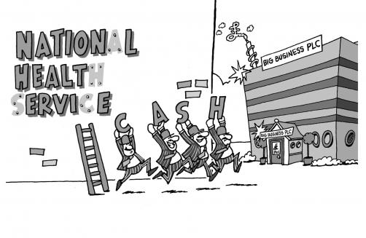
I want one of the great achievements of this government to be the complete modernisation of our public services
(January 2011)
Five principles of Open Government (2011)
Choice
Decentralisation
Open to a range of providers
Fair access
Accountability to users and taxpayers
private sector (criminal justice)
voluntary sector expansion

Slide 101
Workforce responses (2010-2015)
Recent impact of the crisis:
- private sector also making adjustments
- Labour government legacy
- public sector portrayed as privileged
Mitigation of pay restraint:
- lower paid workers
- some partial reversals of government policy e.g. NHS
Workforce insecurity/reluctance to mobilise
2015-2020 – similar responses?

Slide 102
2015- A smarter state – principles
Deficit reduction: scope to respond to volatility
- tight budgets force innovation
- doing less but doing it better
Reform:
- insurgents - new providers; payment by results
Devolution:
- place based strategies facilitate integration
- smart spending linked to local preferences
Efficiency:
- emphasis on digital transformation
- headcount reduction

Slide 103
The Smarter State – Prospects
Deficit reduction: role of wage restraint
- uncertain prospects for sustained austerity
- targeting of pay increases/local flexibility
Reform: Redefine relationship between state & citizen:
The Big Society is a vision of a more engaged nation, one in which we take more responsibility for ourselves and our neighbours; communities working together, not depending on remote and impersonal bureaucracies (Conservative Party Manifesto, 2015: 43)
- state withdrawal v. empowering communities
- increased role for voluntary sector and volunteering
Devolution: or decentralisation or delegation
Efficiency: restructuring; employment reductions

Slide 104
EU: Economic crisis and the public sector – a shock effect
Contagion: from a banking crisis to a sovereign debt crisis
Austerity in Eurozone – internal devaluation:
- cuts in wages, employment, pensions
Challenges to the public sector as…
- sheltered from international market pressures
- relatively closed: state and social partners dominant
Increased role external actors:
- EU reach and interventionism (EU/ECB/IMF)
- constrained government responses to the crisis

Slide 105
EU: New economic governance 2010-
(Bach and Bordogna, 2013,2016)
Surveillance of members’ macroeconomic policy:
- strict controls on public finances and sanctions regime
- annual semester process/economic indicators
‘Memorandum of understandings’ (ECB, EU, IMF):
- direct effects on wages, jobs, employment protection
Degree of financial vulnerability:
Sum of: GDP growth (GDP at market prices) Change on previous period - (1): Low over 2.5% - (2) Medium: 0.1 – 2.5% - (3) High ( 0 and below) | Public deficit (% GDP) - (3) High: above 6% - (2) Medium: 3 - 6% - (1) Low: below 3% | Public debt (% GDP) - (3) High: over 90% - (2) Medium: 60 to 90% - (1) Low: Below 60%

Slide 106
Degree of Financial Vulnerability (= GDP growth + public deficit + public debt) (Bach and Bordogna 2016)
 | 2007 | 2008 | 2009 | 2010 | 2011 | 2012 | 2013 | 2014 | 2015
HIGH (8/9) |  | EL | EU27; EL; IE; FR; IT; PT; UK | EL; ES; PT | EL; ES; PT | IE; EL; ES; IT; PT | CY; EL; ES; PT; | CY
MEDIUM/ HIGH (7) | EL | IE; IT; UK | DE; ES; HU; SK | EU27 FR; IE; IT; UK | IE; IT; UK | EU28; CY; NL; UK | IE; IT | IT; PT | EL; FR; IT; PT
MEDIUM (6) | IT; HU; PT | FR; HU; PT | CY; CZ; NL; | HU | EU28; CY; HU; NL; | CZ; DK; HU; | EU28; FR; NL; UK | IE; EL; ES; FR | CY; ES; UK
MEDIUM/ LOW (5) | FR | EU27 DK; DE; ES; SE | DK; SE | CY; CZ; DE; NL; SK | FR; | DE; FR; SE; SK | CZ; DK; DE; HU | EU28; DE; NL; UK | EU28; DE; IE; NL;
LOW (3/4) | EU27 CY; CZ; DK; DE; ES; IE; NL; SE; SK; UK | CY; CZ; NL; SK |  | DK; SE | CZ; DK; DE; SE; SK |  | SE; SK | CZ; DK; HU; LT; SE; SK | CZ; DK; HU; SE; SK

Slide 107
EU Change in Employment levels 2007-14
Public Administration v Economy
Public Administration: Decrease in 16/27 EU countries
Growth in other sub-sectors: Education, Health
 | PUBLIC ADMIN., DEFENCE, SOCIAL SECURITY
 | Increase | Decrease
Increase ALL ACTIVITIES | LU, HU, MT, AT, PL, SK, SE, NO | BE, CZ, DE, FR, UK
Decrease | ES, EE, LT, SI | DK, EL, IT, NL, B, IR, CY, LV, PT, RO, FI
Source: Eurostat (NACE data)

Slide 108
EU Experience
Implications for the UK
Variable outcomes:
- legacy previous reforms (e.g. Sweden)
- no relationship size public sector and cuts
- role of financial vulnerability but
- UK role of internal factors
Implications:
- tendency towards recentralisation
- austerity strengthens position of government in relation
to trade unions
- unilateral imposition of change – limited dialogue…

Slide 109
Consequences: UK Strikes (2000-15)

Slide 110
Public sector pay policy: 2010-
Two year pay freeze
Pay awards restricted to 1% average until 2019/2020
Restrictive remits for pay review bodies (PRBs)
Phasing out ‘time served’ pay progression
Increased emphasis on performance related pay
Interest in link to local labour market conditions (regional pay)
Scaling back current reward package (e.g. unsocial hours)
Increases to the national minimum wage
Restrictions on collectivism (facilities time) and strike action

Slide 111
Pay Review Bodies - Evolution
Often established in response to IR problems
Aim to avoid strike action
Affordability part of PRB remits
Government influence on PRBs long-standing
Arm’s length form of negotiations
Generally favourable outcomes for their remit groups
Examined and publicised key issues Employer concerns:
- responsibility without control
Trade unions:
- not collective bargaining
- PRBs distant from members

Slide 112
Pay Review Bodies –Prospects
Restrictive remits:
- Interventionist role of the Treasury
PRBs less central to many key reforms
Concerns about Independence from government:
- recommendations amended
- still publicise key concerns based on evidence received
Scope to deliver UK wide recommendations
Reinforces national pay determination
Future role in an evolving public sector?

Slide 113
Progression: performance related pay
Schools
Government policy:
- local flexibility in response to budget constraints
- more individualised approach
- enhance managerial control
- schools control progression rate/amount awarded
Process
Drivers of reward decision:
- performance? affordability? shortages?
- differential effects (older teachers)
Adoption by other sectors (NHS)

Slide 114
OECD 2015
Building on Basics
Problematic results of New Public Management:
‘Separation of execution and policy development has led to policies that are impossible to execute’
Reducing PRP (bonuses) for government personnel:
- fairness – requires openness and transparency
- payments have larger negative effect on non recipients
that outweigh positive effects on recipients
But additional secondary effects

Slide 115
Prospects for local pay determination
(Bach and Winchester, 1994)
Opting out of national systems of pay determination
Government shapes labour supply/aggregate demand
Political sensitivity of local pay
- staff opposition
Public sector pay controls
Institutional constraints
– role of pay review bodies
Local capacity and priorities

Slide 116
Arguments still hold?
State as an employer remains distinctive:
- political sensitivity/Treasury control
Alternative sources of labour supply:
- international recruitment
Altered provider landscape:
- pressure from private providers on terms/conditions
Challenges to a national pay framework:
- regional devolution = regional pay
- sectoral differences
- local solutions in a period of pay constraint
- employer priorities (e.g. sick pay, unsocial hours)

Slide 117
Conclusions
Deficit reduction continues
Difficulties of delivering quality public services:
- recruitment and retention problems
- workloads, pay, central direction: morale & engagement
- further planned measures e.g. exit payment caps
Sustainability of public sector pay policy:
- difficulties of portraying public sector as ‘privileged’
A shifting public sector landscape:
- more diversified provision: integration v. fragmentation

Slide 118
References
Bach, S. and Bordogna, L. (2013) ‘Reframing public service employment relations: The impact of economic crisis and the new EU governance’, European Journal of Industrial Relations, 19(4): 279-294
Bach, S. and Bordogna, L . (eds) (2016) Public Service Management and Employment Relations in Europe: Emerging from the Crisis
Bach, S. and Winchester, D. (1994) ‘Opting out of pay Devolution: The Prospects for Local Pay Bargaining’ British Journal of Industrial Relations, 32(2) 263-282.
Cameron, D. (2015) My Vision for a Smarter State
https://www.gov.uk/government/speeches/prime-minister-my-vision-for-a-smarter-state
OECD (2015) Building on Basics. Paris: OECD

Slide 119

Seven-day working in the NHS
Jon Skewes
Director of Policy & Employment Relations, RCM

Slide 120
Seven Day Working in the NHS
Jon Skewes, Director for Policy, Employment Relations and Communications

Slide 121
Seven Day Working in the NHS
Policy Definition and Motivation
Productivity and Context
Impact on NHS Staff
Union Response

Slide 122
Seven Day Working in the NHS
Policy Definition and Motivation
“Too often talk about healthcare can get bogged down in statistics and technocratic terms. But there’s actually a big vision at the heart of this plan. A vision of a modern NHS working for you seven days of the week – when you need it, where you need it.
It’s a shocking fact, but mortality rates for patients admitted to hospital on a Sunday can be 16% higher than on a Wednesday, while the biggest numbers of seriously ill patients arrive at the weekend when hospitals are least well equipped to handle them.
So seven-day care isn’t just about a better service – it’s about saving lives.
And let’s be absolutely clear. This isn’t about NHS staff working seven days a week. It’s about different shift patterns, so that our doctors and nurses are able to give that incredible care whenever it is needed. It’s about key decision makers being around at the weekend; junior doctors being properly supported and resources like scanners up and running wherever they are needed.”
David Cameron, 18th May 2015
Notes:
David Cameron made his first speech after winning the general election in May 2015 about plans for NHS including the vision of ‘seven day services’. This follows the commitment in the Conservative Party Manifesto that said they would: ‘make the NHS more convenient for you by ensuring that you can see a GP and receive the hospital care you need, seven days a week, by 2020, with a guarantee that everyone over 75 will get a same day appointment if they need one’.

Slide 123
Seven Day Working in the NHS
Policy Definition and Motivation
The Government has argued to extend services to seven days because of evidence that shows an increase in deaths in hospitals at the weekend.
A paper in the British Medical Journal by Professor Sir Bruce Keogh found the reasons for the ‘weekend effect’ are:
Patients admitted at the weekend are sicker and at greater risk of dying;
Fewer consultants practice over the weekend; and
Support services such as diagnostics are reduced over the weekend.
But, the report warned that:
“It was not possible to ascertain the extent to which the excess deaths may be preventable; to assume that they are avoidable would be rash and misleading.”

Slide 124
Seven Day Working in the NHS
Policy Definition and Motivation
A draft report by the Department of Health leaked to the Guardian says that:
“the Department cannot evidence the mechanism by which increased consultant presence and diagnostic tests at weekends will translate into lower mortality and reduced length of stay.”
The leaked report said that:
Community and social services could not cope with more discharges at the weekend;
More than 11,000 new staff are needed in hospitals in England to increase services; and
The seven day plan is likely to have an additional cost of £900 million each year.

Slide 125
Seven Day Working in the NHS
Policy Definition and Motivation
Despite this, the Government are still moving forward with their plan to extend services to seven days.
Ten clinical standards:
Patient experience
Time to first consultant review
Multi-disciplinary team review
Shift handovers
Access to diagnostics
Access to consultant directed interventions
Mental health
Ongoing review
Transfer to community, primary and social care
Quality improvement
NHS Services Seven Days a Week Forum Summary of Initial Findings, December 2013
Following discussions with the Academy of Medical Royal Colleges four of the ten standards (in bold) were identified as having the most impact on reducing weekend mortality.
Notes:
The NHS Services Seven Days a Week Forum published their initial findings in December 2013. They identified ten clinical standards that describe the minimum level of service that hospital patients admitted through urgent and emergency routes should expect to receive on everyday of the week. The ten standards are:
Patient experience
Time to first consultant review
Multi-disciplinary team review
Shift handovers
Access to diagnostics
Access to consultant directed interventions
Mental health
Ongoing review
Transfer to community, primary and social care
Quality improvement
Following discussions with the Academy of Medical Royal Colleges four of the ten standards were identified as having the most impact on reducing weekend mortality:
Time to first consultant review – all emergency admissions must be seen and have a thorough clinical assessment by a suitable consultant as soon as possible but at the latest within 14 hours of arrival at hospital.
Access to diagnostics – hospital inpatients must have scheduled seven day access to diagnostic services such as x-ray, ultrasound, CT, MRI etc. Consultant directed diagnostic tests and their reporting will be available seven days a week within one hour for critical patients; within 12 hours for urgent patients; and within 24 hours for non-urgent patients.
Access to consultant directed interventions – hospital inpatients must have timely 24 hour access, seven days a week, to consultant directed interventions that meet the relevant speciality guidelines, either onsite or through formally agreed networked arrangements with clear protocols such as: critical care; interventional radiology; interventional endoscopy; and emergency general surgery.
Ongoing review – all patients on the AMU, SAU, ICU and other high dependency areas must be seen and reviewed by a consultant twice daily, including all acutely ill patients directly transferred, or others who deteriorate. To maximise continuity of care consultants should be working in multiple day blocks. Once transferred from the acute area of the hospital to a general ward patients should be reviewed during a consultant delivered ward round at least once every 24 hours, seven days a week, unless it has been determined that this would not affect patients care pathway.

Slide 126
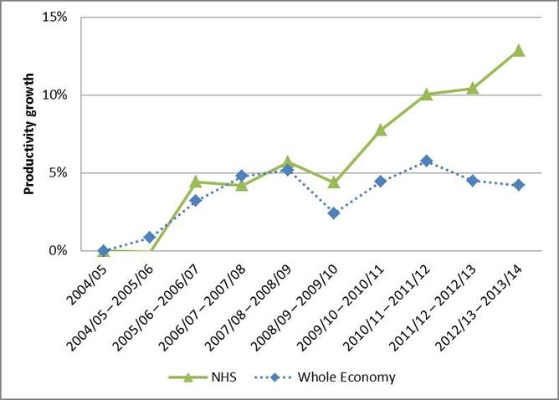
Seven Day Working in the NHS
Productivity and Context
Centre for Health Economics, January 2016
Notes:
The Centre for Health Economics published their report about productivity in the English NHS in January 2016. They found that NHS productivity is bucking trends apparent across the rest of the economy. They found:
Compared with 2004/5 in 2013/14 hospitals are treating 4 million (32%) more patients; outpatients attendances has increased by 17%; GPs consultations have increased by 25% and community care activity has increased by 14%.
Although waiting times are shorter than they were in 2004/5 they have been getting longer since 2007/8.
Taking account of the amount and quality of care overall NHS output has increased by 47% between 2004/5 and 2013/14.
Increased NHS output has come about in response to increased NHS expenditure. This has funded higher wages which rose by 24% between 2004/5 and 2012/13 (although pay has been falling since 2009). It has also paid for a 10% increase in the number of NHS staff and increased use of agency staff.
The use of non-staff resources, such as equipment and supplies, has increased by about 11% each year.
Overall, NHS inputs have increased by 31% between 2004/5 and 2013/14.
So, comparing output growth with input growth NHS productivity has increased by almost 13%.
The graph on the slide shows that compared to the wider economy NHS productivity growth has outpaced the economy over the entire period.

Slide 127
Seven Day Working in the NHS
Productivity and Context
RCM Report ‘Spending on Agency Midwives in England’ November 2015
Notes:
In January 2015 the Royal College of Midwives (RCM) sent a Freedom of Information (FOI) request to the 136 NHS trusts in England about their spending on agency midwives for 2012,2013 and 2014. The FOI had a response rate of 95.6% (130 trusts responded). In July 2015 the RCM conducted a survey of RCM members who work agency shifts. We had 138 responses to the survey.
Key Findings:
43 trusts (33.1%) have used agency staff at some point in the last three years.
There were 17 trusts using agency midwives in January 2012, this doubled to 34 trusts using agency midwives in December 2014.
The spending on agency increased from £10,159,099 in 2012 to £17,849,767 in 2014; an increase of 75.7%.
Trusts in England spent £17,849,767 on agency staff in 2014; this would pay the salaries of 511 experienced full time midwives.
Overwhelmingly, the trusts that use agency staff are in the London region, with 73.7% of trusts in London using agency midwives.
There were eleven trusts that spent over £1 million on agency midwives in the three year period with one trust spending £4,482,432 on agency midwives between 2012-2014.
According to our survey of midwives, on average, respondents said they were paid £22.84 an hour. This is a striking difference to the Freedom of Information request as the trusts reported that the spend per hour was £49.01 in 2014. This would indicate that over half of the spend per hour for midwives goes on agency fees and other on-costs.
The normal rate of pay for a Band 6 midwife with ten years experience is £17.84 an hour and when a midwife works overtime (any hours worked over 37.5 per week) they get paid time and a half which would be £26.76 an hour. The spend per hour of £49.01 is more than 2.7 times the amount for a permanently employed midwife and more than 1.8 times the amount of paying overtime.
Most midwives who work agency shifts do so in addition to a permanent post; the most common reason for midwives to only work for an agency was the need to work flexible shifts and the most common reason for midwives to work agency shifts in addition to their permanent post was the need to supplement their income.
RCM Recommendations:
The RCM believes there are two safe, sustainable and effective ways to reduce agency spending in maternity units:
Eliminate the shortage of midwives - The shortage of midwives needs to be eliminated by training and employing more midwives but also by retaining existing midwives by fair pay policies and granting flexible working requests.
Incentivise existing staff to work bank or overtime - At present the cost of overtime is being controlled but agency spend, which is much more expensive, is less controlled. This needs to be corrected as current practice in the NHS is wasteful. Managers need to be authorised to pay overtime rather than calling in more expensive agency staff.

Slide 128
Seven Day Working in the NHS
Productivity and Context
Erosion of irregular hours?
Night tube
Police
Consultation on Sunday trading
This is not happening everywhere…
MPs can claim up to £80 for a taxi home if the House of Commons sits beyond 11pm.
Notes:
Increasingly, there is a move across public services and the wider economy to extend services to include more night and weekend working and erode the idea of unsocial hours. For example:
According to the Transport for London the night tube will create 1,965 jobs (265 through direct operation of the service). For every £1 spent on delivering the night tube the benefits will be £2.70. Adding in wider economic impacts this increases the benefit by £1.20 for every £1 spent. TfL state that ‘all stations will continue to be staffed just as we do in the day’. This led to disputes on the underground between ASLEF, RMT, Unite and TSSA and TfL over the pay for underground staff and their working hours and rotas.
Following the Winsor Report into police pay, terms and conditions the way that police officers were paid for working unsocial hours changed in 2012.
The Government has recently consulted on devolving the rules on Sunday trading to local areas which could potentially allow local areas to lift the restrictions on Sunday trading.
However this is not happening everywhere – IPSA allows MPs to claim up to £80 for a tax home if the House of Commons sits beyond 11pm (although they have removed their meal allowance for late sittings).

Slide 129
Seven Day Working in the NHS
Impact on Staff
In 2015 the Department of Health asked the NHS Pay Review Body (NHSPRB) and the Doctors’ and Dentists’ Pay Review Body (DDPRB) to make observations on the ‘enablers and barriers’ within the pay systems in the NHS for delivering healthcare seven days a week.
The Department of Health wanted the NHSPRB and the DDPRB to make observations on ‘affordable out of hours working arrangements’. They defined affordable as ‘no increase to the pay bill per full time equivalent member of staff’.

Slide 130
Seven Day Working in the NHS
Impact on Staff
Currently, Agenda for Change staff in the NHS are paid unsocial hours payments for maintaining around the clock services.
Where a continuous night shift or evening shift on a weekday (other than a public holiday) includes hours outside the period of 8 pm to 6 am, the enhancements in should be applied to the whole shift if more than half of the time falls between 8 pm and 6 am.
Unsocial hours payments
Pay Band | All time on Saturday (midnight to midnight) and any week day after 8pm and before 6am | All time on Sundays and Public Holidays (midnight to midnight)
1 | Time plus 50% | Double time
2 | Time plus 44% | Time plus 88%
3 | Time plus 37% | Time plus 74%
4-9 | Time plus 30% | Time plus 60%

Slide 131
Seven Day Working in the NHS
Impact on Staff
The RCM responded to the NHSPRB arguing that we strongly object to any reforms of unsocial hours payments that will disadvantage a substantial section of the NHS workforce.
Maternity services are already seven day services. For example, labour and delivery suites operate around the clock, as do postnatal wards, to provide high quality care for women and their babies when they need it. Midwives and maternity support workers have always worked shifts and provided care on that basis and will continue to do so.
This means that midwives and maternity support workers are required to work hours at nights and weekends and expect fair compensation for doing so.

Slide 132
Seven Day Working in the NHS
Impact on Staff
The NHSPRB concluded that:
“The national Agenda for Change pay system presents no contractual barrier to the delivery of seven day services; seven day working is already well established for a number of core staff groups; and has been used at seven-day case study and early adopter sites across the UK.”
“As well as providing efficiencies, the move to seven day services is likely to require more resources, namely more staff, and there are affordability aspects to consider for all countries.”
“We have not found enough evidence to support wholesale changes to unsocial hours definitions and premia in isolation from the wider Agenda for Change pay system.”

Slide 133
Seven Day Working in the NHS
Impact on Staff
The Doctors and Dentists Review Body concluded that:
“In terms of financial sustainability, we note that the parties agreed a cost-neutral precondition at the start of their negotiations. We acknowledge that a fixed pay envelope
provides a useful starting point for pay modelling, as pay elements can be moved around
to explore what needs to be rewarded/incentivised and how. However, we note that this
fixed pay envelope applies to the existing workforce only. Therefore, any additional staff
needed to run or expand seven-day services would need to be funded separately. Also,
there will be a ‘cost of change’ that can be estimated once agreement has been reached
on a new system of pay. We have seen no evidence to suggest that this could be funded,
even in part, from within the fixed pay envelope.”
Notes:
The Doctors and Dentists Review Body were more critical of elements of the Junior Doctors contract and the Consultant contract and the ability to deliver seven day services. The DDPRB said:
a) The case for seven day services is compelling
“We find the case for expanded seven-day services in the NHS, in order to address the ‘weekend effect’ on patient outcomes, where studies show that mortality rates, the patient experience, length of patient stay and re-admission rates are all poorer for those patients admitted at weekends, to be compelling. We note that this is the area of common ground between the parties and our response to the proposals has been influenced by this broad agreement, although we realise that this is not the only driver for change to junior doctors’ and consultants’ contracts.”
b) Contracts should be UK wide
“We encourage all four countries of the UK to work together in order to make progress on both contracts. We support UK-wide contracts for junior doctors and consultants as we feel that they best serve the needs of patients.”
c) There needs to be trust and confidence that the arrangement can balance seven days services and safeguards around working hours
“Both sets of proposed contractual arrangements require trust and confidence-building. Junior doctors and consultants need to believe the new arrangements can and will be operated fairly, given that each set of changes leads to a degree of reduction in their control over working patterns. The working hours of junior doctors will still matter and consultants will need a reasonable work-life balance. We feel that contractual safeguards are necessary given that management practice appears to be highly variable.”
d) There will be costs of implementing the new system, particularly the costs of extra staff
“In terms of financial sustainability, we note that the parties agreed a cost-neutral precondition at the start of their negotiations. We acknowledge that a fixed pay envelope provides a useful starting point for pay modelling, as pay elements can be moved around to explore what needs to be rewarded/incentivised and how. However, we note that this fixed pay envelope applies to the existing workforce only. Therefore, any additional staff needed to run or expand seven-day services would need to be funded separately. Also, there will be a ‘cost of change’ that can be estimated once agreement has been reached on a new system of pay. We have seen no evidence to suggest that this could be funded, even in part, from within the fixed pay envelope.”
e) There is no standard for pay for unsocial hours and most health services are not providing a full seven day service
“In responding to our remit, we commissioned research on pay arrangements for other workforces that are asked to deliver seven-day services. We found that 24/7 services have become more prevalent since the late 1990s. However we found that there was no agreed norm; employers decide the services that they need to provide and then establish pay systems that support them, taking account of the labour markets in which they operate. We also investigated the position in healthcare systems elsewhere in the world and it is our understanding that outside of accident and emergency services most international public healthcare systems are not providing a comprehensive twenty four hour, seven-day service. We therefore conclude that the proposed new NHS arrangements would be trailblazing within healthcare systems.”

Slide 134
Seven Day Working in the NHS
Union Responses
In September 2015, after over two years of negotiations about the junior doctors contract, the BMA voted to ballot junior doctors for industrial action. In a turnout of over 76% junior doctors voted overwhelmingly for action.
The BMA have tried to negotiate a solution with Government and employers and so far have taken two periods of industrial action.
On the 11th February Jeremy Hunt announced that the Government would impose the new contract on junior doctors rather than negotiating an acceptable agreement. This is the first time that a contract has been imposed in the NHS.
The BMA has announced that it will now consider further dates of industrial action.
The Government is in negotiations with the BMA about the consultant’s contract and has made clear that they want to change unsocial hours payments for Agenda for Change staff.

Slide 135
Seven Day Working in the NHS
Union Responses
The Agenda for Change terms and conditions cover the vast majority of NHS staff including midwives, nurses and support staff.
The Agenda for Change structure was introduced in 2004 fundamentally based on the principle of equal pay for work of equal value. Underpinning the structure is the job evaluation scheme.
The Agenda for Change terms and conditions are negotiated in partnership through the NHS Staff Council. The independent NHS Pay Review Body determines annual uplifts to pay.

Slide 136
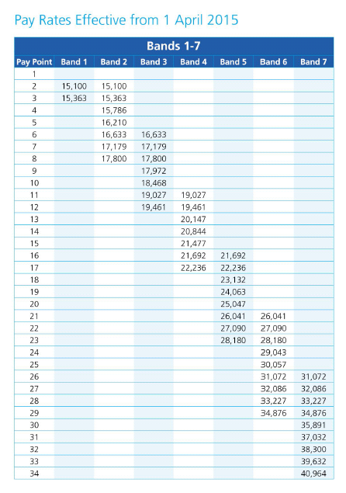
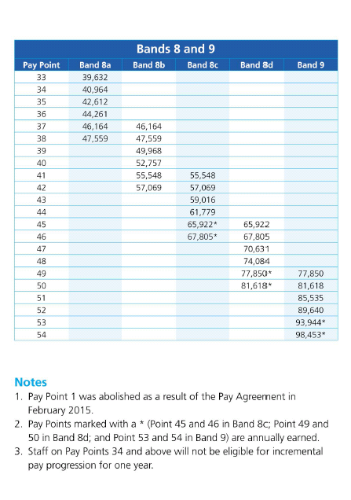
Seven Day Working in the NHS
Union Responses
The Agenda for Change structure has 9 pay bands with 54 pay points:

Slide 137
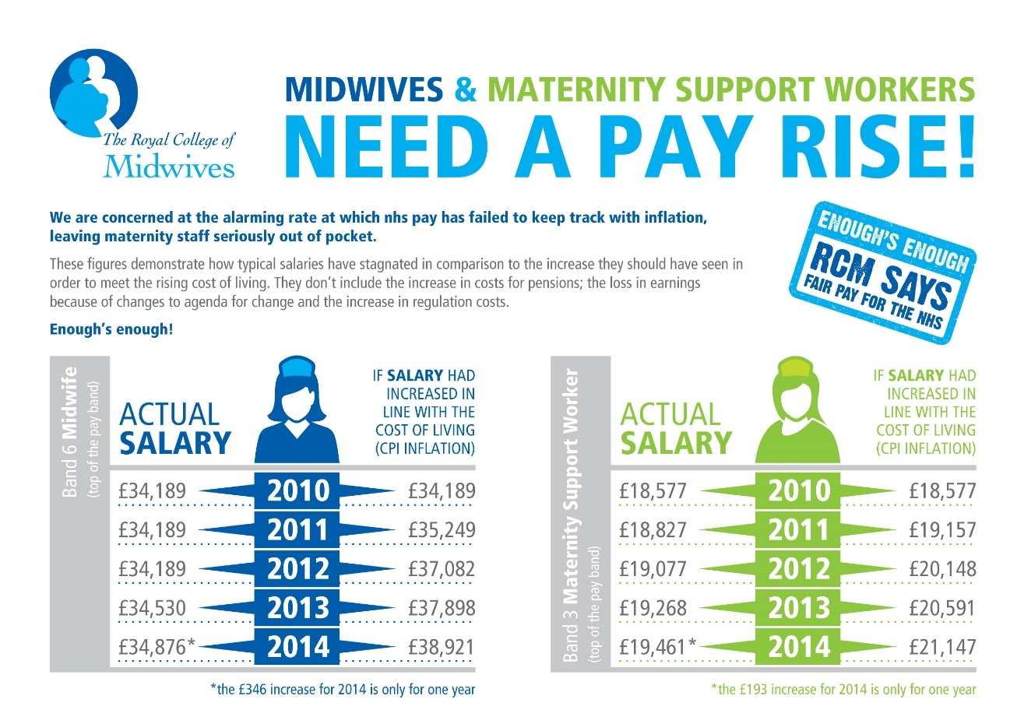
Seven Day Working in the NHS
Union Responses
Agenda for Change staff have faced pay restraint since 2010 which has had a long term impact on their pay.

Slide 138
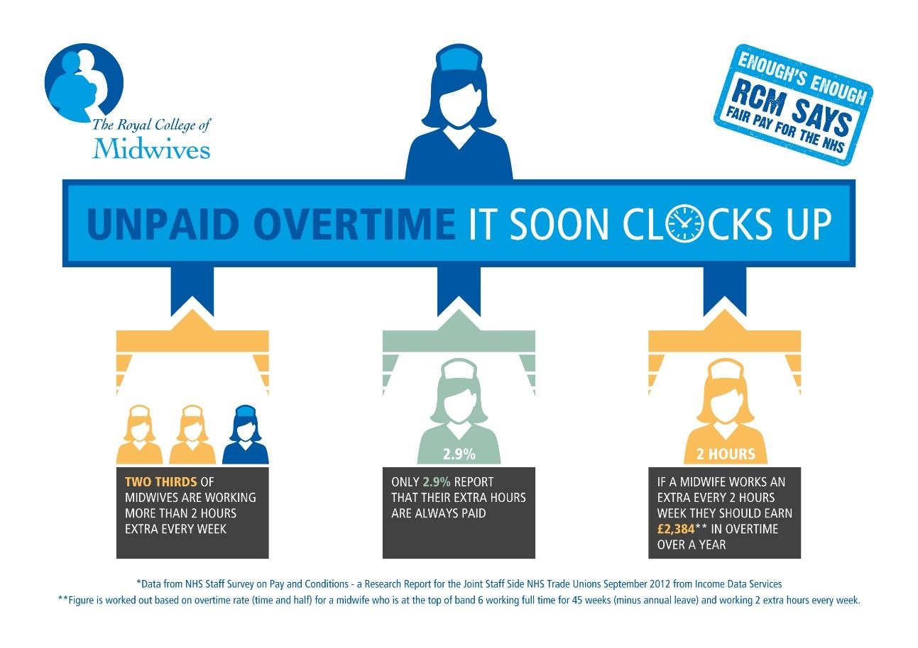
Seven Day Working in the NHS
Union Responses
There are also vast amounts of goodwill in the NHS:

Slide 139



Seven Day Working in the NHS
Union Responses
Agenda for Change is a UK wide system but, following the pay dispute in 2014 there are now differing pay rates for England, Wales and Scotland.

Slide 140
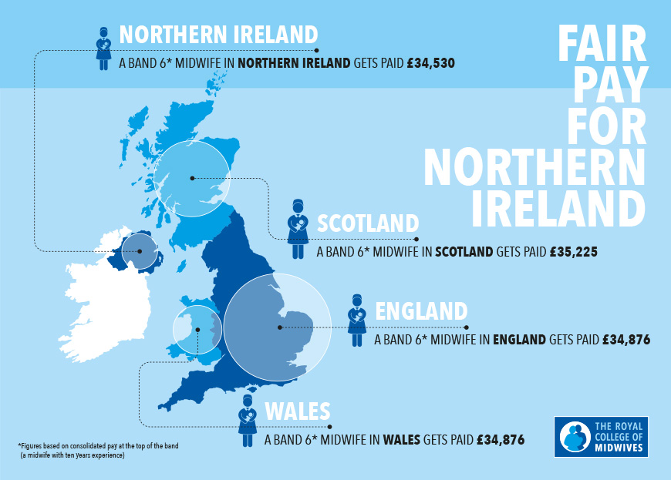
Seven Day Working in the NHS
Union Responses
But still no agreement for Northern Ireland…

Slide 141



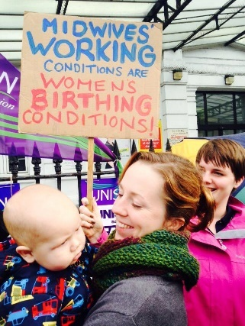


Seven Day Working in the NHS
Union Responses
In 2014/15 Jeremy Hunt rejected the recommendation of the NHS Pay Review Body and refused to pay a 1% pay increase to Agenda for Change staff. This resulted in the RCM taking industrial action for the first time in our 134 year history.

Slide 142
Seven Day Working in the NHS
Union Responses
The NHS trade unions won the dispute and vast majority of Agenda for Change staff were paid the 1% pay uplift.
A condition of the settlement of the dispute was that the NHS trade unions would agree to discuss changes to the pay structure.
There have been discussions in the NHS Staff Council executive on a non-prejudicial basis. However there are different objectives from the different parties:
The trade union focus is to concentrate on the architecture of the pay system rather than looking at individual elements of the contract;
The employers are less focused and want to look at different individual elements of the contract; and
The Government focus is to change the structure to include more performance related pay and to address unsocial hours.

Slide 143
Seven Day Working in the NHS
Union Responses
The trade union focus of the architecture is to:
shorten the length of the pay bands (currently there are 54 pay points across 9 pay bands); and
to determine that everything hangs from the top point of the band.
85% of Pay – Starting Salary
95% of Pay
100% of Pay – True Rate for Job
105% of Pay – Discretionary Point
90% of Pay

Slide 144
Seven Day Working in the NHS
Union Responses
Challenges:
Different focus from the trade unions, employers and Government;
The threat of unsocial hours;
The new structure will need investment; and
The Government has shown it is willing to reject the recommendation of the NHS Pay Review Body and that it is willing to impose change.

Slide 145


For further information
Website: www.rcm.org.uk
Telephone: 0300 303 0444
Email: info@rcm.org.uk
www.facebook.com/midwivesRCM
@MidwivesRCM

Slide 146
Tax credits and the interaction between pay & welfare
Nicola Smith
Head of Economic & Social Affairs, TUC

Slide 147
The Prospects for Earnings Under the New Government
Pay Bargaining 2016 by IDR and the TUC
London, 25 February 2016

