Slide 1
The ‘Dying to Work’ campaign
Employment protection for terminally ill workers.
www.dyingtowork.co.uk

Slide 3
Why do terminally ill employees require additional employment protection?
Terminally ill employees often don’t have the time to reskill or adapt to the “reasonable adjustments” that could be put in place by an employer.
A terminally ill employee can be forced to undergo stressful HR procedures and risks losing the positive stimulation and distraction of work.
By losing their job, they not only lose their income but also the dignity of dying in work.
Furthermore, termination of their employment will also mean the loss of death in service payments that the employee has planned for and earned through a life-time of work.

Slide 4
A growing issue?
As retirement ages are increasing and Cancer Research UK are projecting that 1 in 3 people will be diagnosed by cancer, more people will be receiving terminal diagnosis’ during their working life.
Currently 1 in 10 new cancer cases are found in people aged under 50 (Over 33k cases each year)
An internal McMillan Survey showed that 37% of cancer patients “experienced discrimination” on their return to work.

Slide 5
The campaign - What do we want to achieve?
The “Dying to Work” campaign is calling for terminal conditions to be made a ‘protected characteristic’. This would mean that all employees battling terminal conditions would enter a protected period within which they could not be dismissed as a result of their condition.
This would ensure that the employee was able to take an appropriate amount of time for rest and the care they require without the fear of stressful HR procedures, loss of financial security, stimulation and dignity from work.
Furthermore, it would ensure that they would be secure in the knowledge that their family would be provided for after their death.

Slide 6
Public support
The GMB commissioned a poll from IPSOS Mori to determine public understanding of the issue and support for a change to the legislation.
The poll produced some striking results. Firstly, over half of all people interviewed believe the protection already exists in law to prevent an employee being dismissed after receiving a terminal diagnosis. Secondly, just shy of 65% of people would support a law which would mean that workers with a terminal illness could not have their contacts terminated after diagnosis with under 16% of people opposing such a measure.

Slide 7
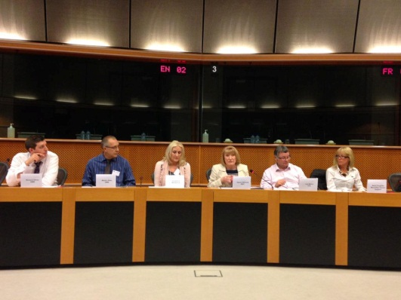
What’s next?
Media & public launch
European Parliament
UK Parliament
Employer charter & support from business
Third sector support

Slide 8
Questions?

