Slide 1
TUC Trustee Conference
- De-risking

Slide 2

DB pension risk is asymmetric
Downside potential
Members’ benefits are reduced
Employers face unsupportable costs
Trustees have to balance member and employer interests
Upside potential
Members looking for enhanced benefits?
Employers looking for a return of surplus?
Trustees not looking for either of these
Trading some upside potential to protect downside risk
Notes:
Not all schemes want to de-risk but many do.
Session is all about de-risking unrewarded risks and
Limiting downside, not maximising the upside
Link to Xmas
Why is there a picture of Christmas presents?
Lets take the obligation of buying xmas presents for your loved ones and whether to leave this to the last minute or plan ahead and make sure that you get a good present for everyone.
You could risk leaving buying presents to the last minute, going out on Xmas eve to see if you can snap up a bargain…… However, the down side risk here is that you could miss out on getting a present for a loved one, the consequences of which could be disastrous
OR, you could plan ahead give yourself sufficient time to ensure you have a great present for everyone. You may pay slightly more and not be able to pick up a potential bargain but you have limited the downside risk of a very awkward Christmas meal!

Slide 3
Lots of threads to draw together
Asset allocation vs liabilities
Inflation risk
Annuity prices
Longevity risk
Size of deficit
Speed of execution
Uncertain member data
Operational model
Changing market conditions
Notes:
In a pension scheme context, there are lots of different risks to consider.
This is just a sample!
How do you pull all these risks together in a risk management plan,
in a way that can actually be implemented.

Slide 4
OK there are lots of risks….so why do pension schemes stay exposed?
Planned or tactical risks
Lower the expected cost of funding benefits
Cost of removing the risk is deemed too high
Diversification with other risks
Risks to reduce (in control)
External risks (out of control)
Scheme administration
Regulatory
Implementation/operational risks
Notes:
Talk through these risks.
Like the concept of buying out a pension scheme with an insurance company, removing your lifetime obligation of buying xmas presents for your loved one would be very expensive (just like pensions the present this year has to be slightly bigger and better than the present last year!)
Even if you could afford to buy all future Xmas presents you would probably prefer to spread the cost across? Having a plan to buy your presents gradually as the pay cheques come in is likely to be less painful on the bank balance.

Slide 5
What do you need to manage pension risk?
1. What you are trying to achieve
What risks are you trying to remove?
2. Where do you want to get to?
What is your target?
3. What is the plan is to get there?
How long do you expect to take?
What will you do if things go better or worse than expected?
Notes:
Are you trying to remove all risks? If so then you may want to target the buyout liabilities. Unless your scheme is very well funded the target with this is usually a long time in the future.
Are you trying to reduce investment risk? If so then a lower risk target might be appropriate over possibly a shorter time frame
But how are you going to reach these targets? Are you going to request additional contributions from the company or sponsor or are you going to try and capture positive movements in the investment markets?

Slide 6
Key risks we will focus on
Asset allocation vs liabilities
Asset risk
“How should I manage asset risk?”
Inflation risk
Annuity prices
Longevity risk
2. Liability risk
“I have dealt with the assets, what about the liabilities?”
Size of deficit
Speed of execution
Uncertain member data
3. Operational risk
“What about the operational aspects of
de-risking”
Operational model
Changing market conditions
Notes:
Agenda today we are going to focus on the three key sources of risk in a pension scheme.
Asset risk – the risk of your assets not delivering the returns that are required
Liability risk – The risk that the liabilities continue to increase overtime (for example your actuary telling you that life expectancy has increased again!)
Operation risks – covering both the operation of the scheme as a whole and the implementation of de-risking exercises
Although we show the risks as separate in reality many of these risks are intermingled.

Slide 7

1
How should I manage asset risk?

Slide 8
Where do you want to get to?
assets
liabilities
operations
Buyout premium
Buyout premium
Approx.
buyout
target
(e.g. Gilts –
0.5% p.a.)
Expected
returns
Low risk or ‘Self-sufficiency’
target
(e.g. Gilts +
0.0-0.5% p.a.)
Conts
“Reliance on Growth”
target
(e.g. Gilts +
1-2% p.a.)
Assets
Typical “ongoing”
target
Notes:
Historically the only target that most pension schemes had was their ongoing funding target. Usually that would be calculated based on expected returns on the growth assets that were being held, and it’s shown in the first coloured bars on the left hand side. Assets are less than liabilities, but even when contributions are added and the scheme is fully funded, it is still a long way from buyout.
A substantial part of the difference is made up of expected returns on the assets over the remaining lifetime of the scheme. But even then the scheme would be short of buyout.
At the other end is a full buyout target, which is the orange bar. That represents a target where the scheme genuinely has enough money to buy out the benefits with an insurer, and that might be equivalent to assuming investment returns of less than gilts.
What we’re seeing as a popular target nowadays is the bar in the middle, which is often called “self-sufficiency”. Typically it will be along the lines of “enough money that the pension scheme no longer needs to invest in growth assets but can invest wholly in matching assets and expect to be able to run the scheme without additional contribution”. It’s still not full buyout funding, but it’s close. And that means two things:
That it is within “cheque-writing distance” – ie it’s close enough that the Company could probably afford to bridge the gap and extinguish the liability from your books
b) It’s close enough that from time to time when annuity pricing is competitive you may be able to buy out for very little additional funding
The charts here show clearly that different targets involve different amounts of money. But they also feel very different when you get there.

Slide 9
How are you going to get there?
assets
liabilities
operations
Notes:
Your path to full funding needs to balance various parameters – the key ones are shown here:
Contributions
Investment strategy
Timescale
And of course the target
Your plan will be unique to you, but what will have in common with all other plans are two things:
That there will be compromises in what you want to do, need to do and are able to do
That it has to balance – in the end the combination you chose has to have a reasonable chance of working
Both of those can be difficult, and there are times that it genuinely feels as though there is no combination that works. In the end, though, there has to be. If there isn’t then your scheme is destined for the PPF.

Slide 10
Sample flight plan – managing asset risk
assets
liabilities
operations
Current position
60% growth, 40% matching
Recovery Plan for Gilts 1.5% p.a. target
Contributions of £1m p.a.
Long term target
20% growth, 80% matching
Gilts + 0.5% p.a.
70% chance of reaching by 2030

Slide 11
De-risking triggers – what are others doing?
assets
liabilities
operations
Our tool for monitoring funding levels daily is used to track progress against triggers
Trigger to sell 10% of equities to lower risk assets breached
Triggers are now mainstream, and increasing in use
Notes:
Message 4 : Triggers are common now, with 30% doing them and more on the way

Slide 12
Taking the opportunities to de-risk over the long term
assets
liabilities
operations
Flight plans: A long term business plan for the pension scheme
Notes:
Flight plans are typically used as the framework to manage de-risking.
If experience is good then derisking (for example reducing investment risk) is not the only option you could:
Look to reduce the deficit contributions (unlikely)
Strengthen your target (i.e. aim to remove even more risk eventually)
Reduce the time period for you to reach your target
Increase the certainty of you getting to your target

Slide 13

You are in competition for opportunities with every other DB pension scheme in the UK
(and some other parties as well)
… whether you like it or not.
Notes:
Whether you like it or not, you are in competition for opportunities with every other DB pension scheme in the UK – and some other people as well
What do I mean by that?
Look at gilt yields. What do you think will happen when yields rise? Pension schemes around the country will start to buy gilts, demand will increase, prices will rise and yields will fall. The schemes who are slow to act may miss the opportunity.
Look at annuities. We’re already seeing providers exit the market on the basis that the capital providers are not finding the returns attractive. There is a distinct possibility that pent-up demand will outstrip supply for many year
Look at incentive exercises. One of the biggest obstacles at the moment is lack of IFAs to provide advice. A scheme at the back of the queue could be waiting a long time to get advice to its members.
Even look at something as simple as cash. If the Company has strong cashflow then you’re not in competition with other schemes – unless you have more than one scheme in your business in which case you are – but you’re in competition with the banks (who will want loans repaid), shareholders (who will want dividends) and the management (who will want to use it for new projects).
What all of that means is that your reaction to these opportunities is important – they may not stay opportunities for long.

Slide 14
Summary
assets
liabilities
operations
✓
A Flight Plan is a long term business plan for the pension scheme
✓
Strong desire for lower risk position, but not always a robust plan to get there
✓
A robust plan will commonly include some form of trigger
✓
Triggers are now mainstream, and increasing in use
✓
Inefficient execution can result in some of your gains being lost

Slide 15
I already have a plan to de-risk my assets. What about the liabilities?
2

Slide 16
Survey findings
assets
liabilities
operations
Status of liability management
Source : Aon Hewitt Global Risk Survey 2013
Additional member options becoming more mainstream
Notes:
… As well as de-risking assets, many schemes and sponsors are interested in what other levers can be pulled, to smooth or accelerate the journey
In this session, I’ll provide some further detail on how two of these options– liability management and pensioner buy-ins – can be worked into a flight plan, and will then talk in more general terms about weaving in wider opportunities
Let’s start though by looking at how popular these other actions are
{explain table}

Slide 17
Pension Increase Exchange at retirement
assets
liabilities
operations
What is PIE at retirement?
Member option to reshape benefits (a bit like exchanging pension for a cash lump sum at retirement)
Inflationary pension increases are exchanged for a higher non-increasing pension
Why do it?
Allows members to reshape their benefits
Reduces inflation risk
Reduces longevity risk
Conversion terms often structured to create a ‘saving’
Post conversion liabilities can usually be better matched
This option is becoming more mainstream
Notes:
PIE at retirement might not be for all but companies are looking at this very seriously as a way to reduce risk (and particularly inflation risk) in scheme
Example:
Current Option - Retirement pension of £10,000 p.a. increasing with inflation increases each year
PIE Option - Retirement pension of £15,000 p.a. which does not increase in payment.
The member receives a higher pension in the first few years but then a lower pension

Slide 18
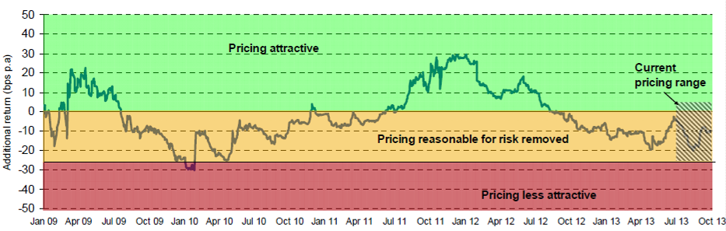
Annuity purchase - when is the right time?
assets
liabilities
operations
Notes:
Can trigger an annuity purchase using BAMM – just look for when the index is at the right level.
Orange is cost of annuity and purple are your technical provisions. So good value if orange close to or below purple. Also Although the nominal amount has gone up if your are invested in gilts these will also have risen in value.
It’s topical because terms look reasonably priced right now.
Need to act fast when trigger hit because:
The market price can move 10% in a short period
There is limited capacity and lots of demand chasing it, so a big first mover advantage
The theory is easy, in practice it needs a lot of planning. It all about the ‘How’
{explain table}
Strong project management is required.
In fact, the list of who’s involved is simplified…
The reality is that there are 20-30 stakeholders that need to be included in the project plan in order to successfully implement a deal.
Certainly not impossible, but it needs careful planning and good lines of communication.
As products standardise it gets easier and more standard and less people involved up front. E.g. PRAG writing guidance for those preparing accounts

Slide 19
You are in competition for opportunities with every other DB pension scheme in the UK
(and some other parties as well)
… whether you like it or not.
Notes:
Whether you like it or not, you are in competition for opportunities with every other DB pension scheme in the UK – and some other people as well
What do I mean by that?
Look at gilt yields. What do you think will happen when yields rise? Pension schemes around the country will start to buy gilts, demand will increase, prices will rise and yields will fall. The schemes who are slow to act may miss the opportunity.
Look at annuities. We’re already seeing providers exit the market on the basis that the capital providers are not finding the returns attractive. There is a distinct possibility that pent-up demand will outstrip supply for many year
Look at incentive exercises. One of the biggest obstacles at the moment is lack of IFAs to provide advice. A scheme at the back of the queue could be waiting a long time to get advice to its members.
Even look at something as simple as cash. If the Company has strong cashflow then you’re not in competition with other schemes – unless you have more than one scheme in your business in which case you are – but you’re in competition with the banks (who will want loans repaid), shareholders (who will want dividends) and the management (who will want to use it for new projects).
What all of that means is that your reaction to these opportunities is important – they may not stay opportunities for long.

Slide 20
Summary
assets
liabilities
operations
✓
Liability management actions are integral to the flight plan
✓
These exercises are increasingly popular (especially at retirement options)
✓
Understand the impact on the flight plan
(arrival time versus risk reduction versus contribution reduction)
✓
Plan in advance for implementation

Slide 21
What about the operational
aspects of de-risking?
3

Slide 22
What can we learn from past experience?
assets
liabilities
operations
✓
Plan ahead and identify actions in advance
✓
Align operational model with the strategy
✓
Intelligent implementation
Notes:
Sum up Xmas shopping experience:
1 – You need a plan or you might forgot someone
2 – Agree with others what you are getting (to avoid duplicate presents)
3 – Actually go and buy them – or delegate the shopping to someone else
In our context:
1 – need a plan itself (ie a destination and how to get there)
2 – you can lose as much on poor execution as you can gain through de-risking actions
3 – eg the stakeholders need good lines of communication

Slide 23
What is keeping you awake at night?
assets
liabilities
operations
1
2
External costs of running the
pension scheme
3
Concentration of knowledge in a small number of individuals
4
Availability of MNT candidates
Ability of the scheme to react quickly to opportunities / threats
5
Availability of resources for ad hoc projects
RANK 1
RANK 2
RANK 3
RANK 4
RANK 5
Concerns over costs, readiness for action and resourcing
Notes:
Three themes from these concerns:
1 – are there activities that are unnecessary or could be automated?
2, 3 and 5– changes to operational model/resourcing
4 – put scheme in a state of readiness for action
So the next three subsections cover:
investment to reduce costs,
being ready for action and
the evolving operational model

Slide 24
Cost: Investment in administration to reduce costs
assets
liabilities
operations
Data Cleanse
Agree
Self-Service
Strongly agree
Disagree
Strongly Disagree
Standardisation
-60%
-40%
-20%
0%
20%
40%
60%
80%
100%
Source: Aon Hewitt Mid-Market Survey 2012
Support for reducing costs and being ready to move
Notes:
In the survey we asked whether schemes would be prepared to invest now (either time or money) to reduce ongoing costs. Overall, the answer was a resounding “yes”, with twice as many respondents saying that they would be prepared to invest to get reduce costs as would not.
Also, this actions don’t just reduce costs but also risks: ie being ready to act

Slide 25
Readiness: Clean scheme
assets
liabilities
operations
 | % done or in progress
Clean member data | 86
Confirmed benefits | 80
Member resolution | 79
Deed review | 78
Employer history | 71
Processes and procedures | 61
Equalisation | 53
Asset readiness | 46
Source: Aon Hewitt Mid-Market Survey 2012
Delaying ‘clean scheme’ can delay opportunities or increase the price
Notes:
This list represents our view of what steps are required to be ready for a de-risking project.
We asked our clients for their state of readiness.
Many schemes are now well placed, but a significant minority are not.
Staggering that only half of schemes have cracked equalisation – is this GMPs?
These issues don’t get better over time – the reverse, as knowledge gets lost.
House sale analogy

Slide 26

Resources: Reviewing the operational model
assets
liabilities
operations
✓
speed
✓
access
day to day running
✓
resources
✓
focus
COMMUNICATIONS
Simplify the operational model via delegation

Slide 27
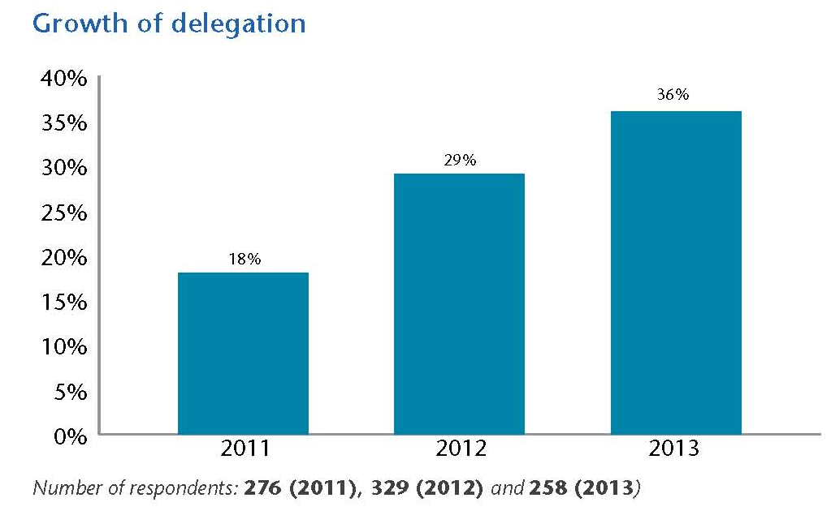
Resources: Reviewing the operational model
assets
liabilities
operations
Example: delegated investment
An increasing focus towards delegation of day to day activities

Slide 28
Where is the world heading?
assets
liabilities
operations
Path to de-risking
Assets and liabilities
Current
position
Risks systematically
reduced
Low
risk target
Operations
Insourced
management
Focused
working
Outsourced operations
Complete control retained by trustees and sponsors
Multiple hand-offs
More reliance on
sub-committees
Streamlined governance processes
‘Light touch’
management
Third parties tasked with implementation
Pre-determined actions when conditions met
Operational plan needs to adapt to changing risk profile
Notes:
Operational model – aligned with the strategy
Based on our research, this diagram represents how we see the operational model evolving over time.
Some schemes have already moved some way along this chart
Speed
Access
Resources
Focus

Slide 29
Conclusions
✓
De-risking flight plans are increasingly commonplace
✓
They are a powerful framework for asset and liability de-risking actions
✓
Poor implementation can lead to missed opportunities or worse outcomes
✓
Increased focus on delegation to help manage implementation
Notes:
1 – need a flight plan (ie a destination and how to get there under different circumstances)
2 – what actions might you take to speed up/smooth the journey?
you can lose as much on poor execution as you can gain through de-risking actions
3 – define the hand offs and ensure the stakeholders have good lines of communication

Slide 30
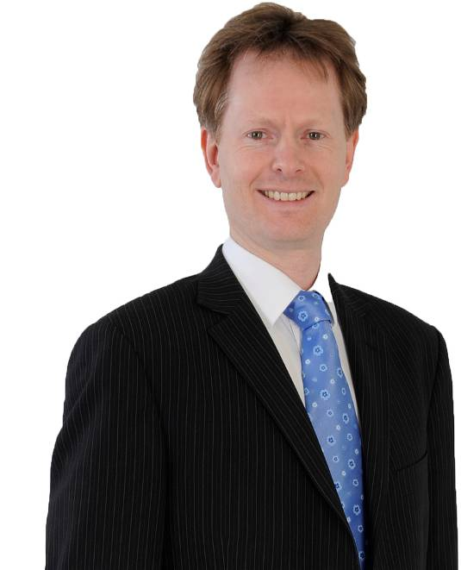
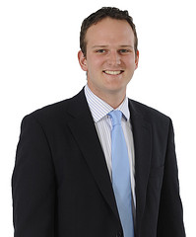
Contact Details
Matthew Arends
Partner
E: matthew.arends@aonhewitt.com
T: 020 7086 4261
John Hardern
Senior Consultant
E: john.hardern@aonhewitt.com
T: 01727 888329

Slide 31
About Aon Hewitt
Aon Hewitt is the global leader in human resource consulting and outsourcing solutions. The company partners with organisations to solve their most complex benefits, talent and related financial challenges, and improve business performance. Aon Hewitt designs, implements, communicates and administers a wide range of human capital, retirement, investment management, health care, compensation and talent management strategies.
With more than 29,000 professionals in 90 countries, Aon Hewitt makes the world a better place to work for clients and their employees.
Nothing in this document should be treated as an authoritative statement of the law on any particular aspect or in any specific case. It should not be taken as financial advice and action should not be taken as a result of this document alone. Individuals are recommended to seek independent financial advice in respect of their own personal circumstances.
© 2013 Aon Hewitt Limited
Aon Hewitt Limited is authorised and regulated by the Financial Conduct Authority. Registered in England & Wales. Registered No: 4396810.
Registered Office: 8 Devonshire Square, London EC2M 4PL.
aonhewitt.co.uk

