Slide 1
Covid-19, Health & Safety at work

Slide 2
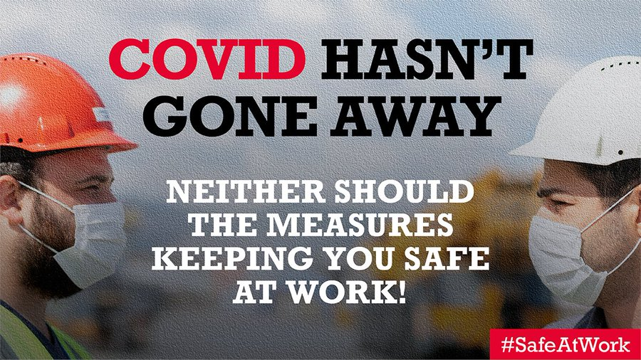
End of ‘lockdown’
New workplace guidance is rushed
End of legal requirement for social distancing and face coverings
CEV no longer told to work from home
But employer duty remains!

Slide 3
Stand firm: stay safe

Slide 4
We’ve made work safer

Slide 5
Disabled workers most at-risk

Slide 6
Covid-19 Outbreaks
Source: PHE

Slide 7
High case rates means low pay for many

Slide 8
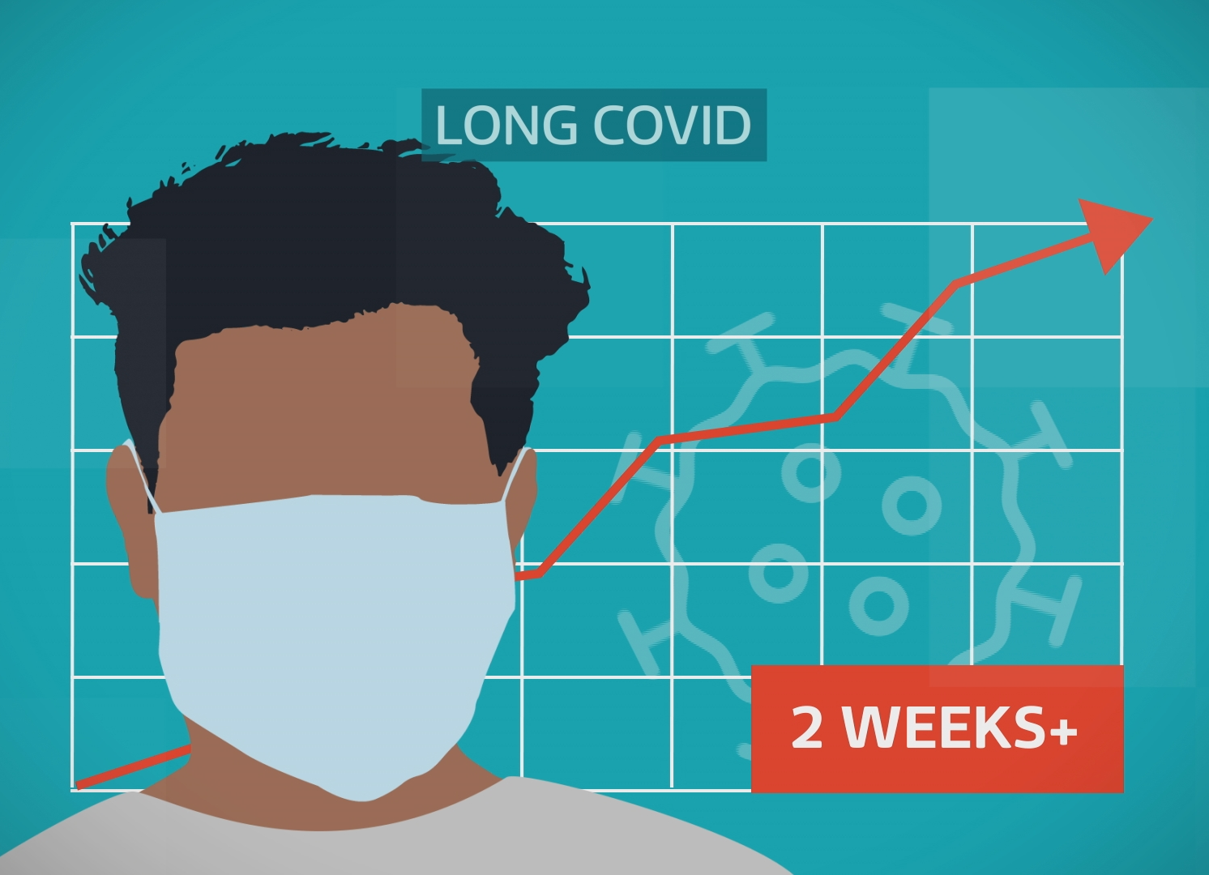
Long Covid risk
Survey of 3,000 people
One third experience symptoms more than 1 year
50%+ experienced discrimination
Calling for disability recognition
Occupational illness recognition and support
Universal access to occupational health

Slide 9
“Covid-Secure”:
Not ‘secure’ enough
Not enforced enough

Slide 10
TUC poll:
54% say no social distancing
58% no PPE
62% no risk assessment

Slide 11
Taking action works

Slide 12
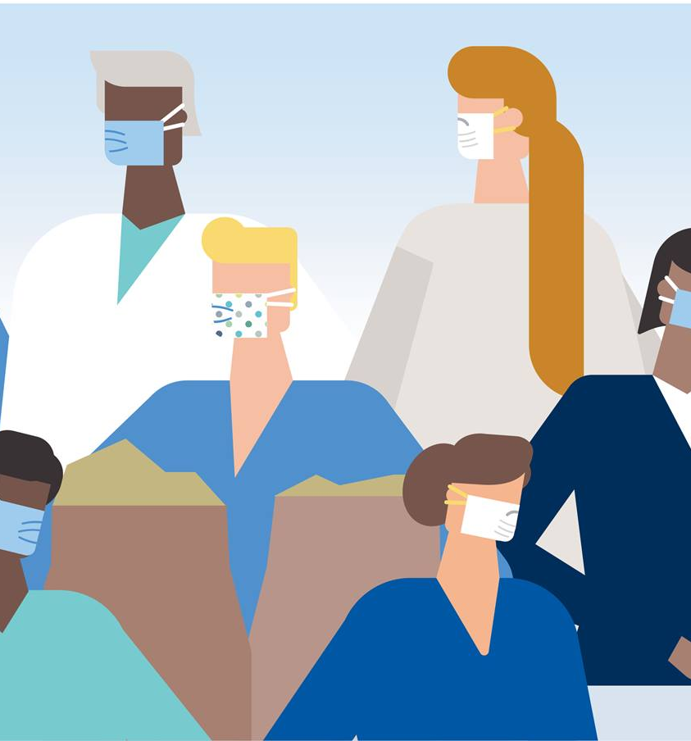
What needs to change?
Ventilation, ventilation, ventilation
PPE
Published risk assessments
Sick Pay
Vaccinations

Slide 13
Unions make work safer

