Slide 1

ASSISTIVE TECHNOLOGY SOLUTIONS

Slide 2



















COMPANY BACKGROUND
THE COMPANY
Established in 1992 working within the higher education and workplace sectors
Helped over 500,000 disabled people to succeed
Operating in the UK, USA, South Africa and Middle East

Slide 3
ASSISTIVE TECHNOLOGY
INTRODUCTION
Barry Croniken Head of Research & Development
Carl Ward Head of Training and on-site staff
Notes:
Hi everyone and thanks for joining me today. I’m Michael a assistive technology consultant I’m

Slide 4
ASSISTIVE TECHNOLOGY
INTRODUCTION
Assistive Software
Portable Aids
Ergonomic Equipment
Notes:
Hi everyone and thanks for joining me today. I’m Michael a assistive technology consultant I’m

Slide 5

LITERACY SOFTWARE CLARO READ
ASSISTIVE SOFTWARE
LITERACY SOFWTARE – CLAROREAD
ClaroRead is a highly effective, multi-sensory software solution for supporting reading and writing. Designed with maximum simplicity and flexibility for all ages and abilities, ClaroRead aids concentration and increases confidence. You can read any on-screen text out loud and improve your writing in MS Word.

Slide 6
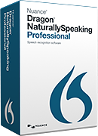
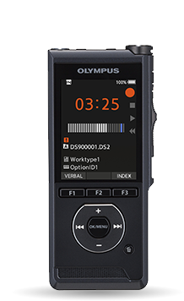
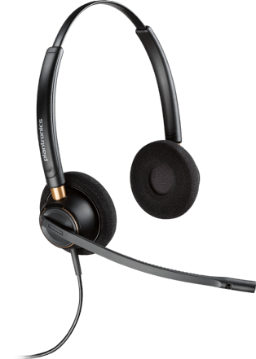
VOICE RECOGNITION – DRAGON NATURALLY SPEAKING
ASSISTIVE SOFTWARE
VOICE RECOGNITION – DRAGON NATURALLY SPEAKING
’’
Create documents, capture ideas with dictation using your voice
Compatible with Microsoft Office
Control your computer using voice commands
Navigate and dictate into web pages
Create custom commands to automate command tasks
Transcribe recordings from digital recorders

Slide 7
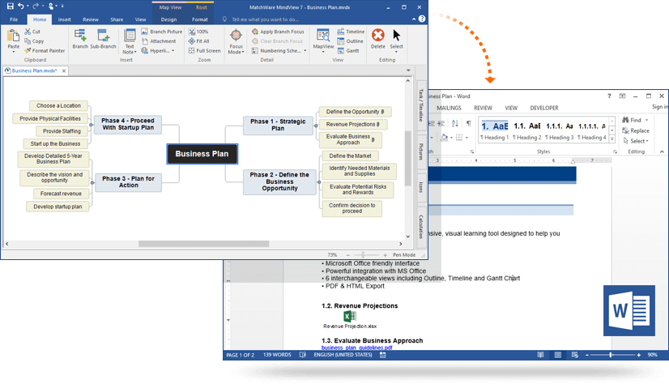
MIND MAPPING – MINDVIEW
ASSISTIVE SOFTWARE
Visualise ideas and concepts
Turn brainstorming sessions into action plans
Run meetings more effectively
Create Work Breakdown Structures, Gantt chart and timelines
Collaborate better with team member and clients
Outline reports, strategies and marketing plans etc.
Export your mind map to Word, PowerPoint, Excel, Outlook, Project
Import Word, PowerPoint, Excel, Outlook, Project and convert to a mind map

Slide 8

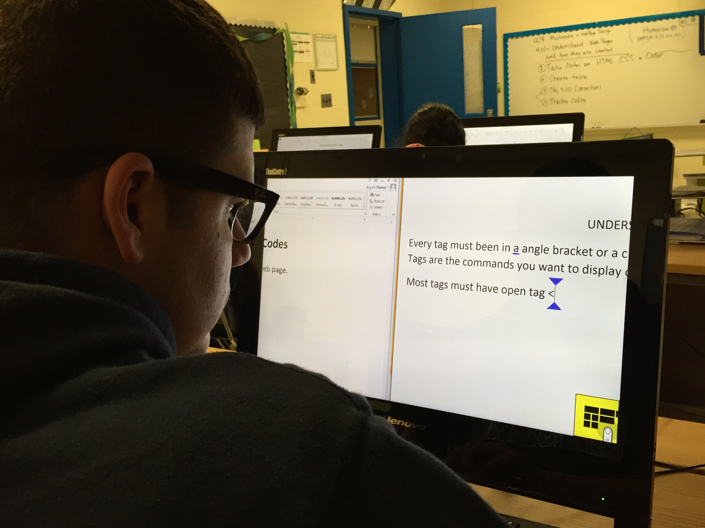
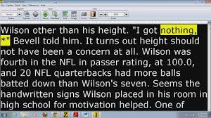
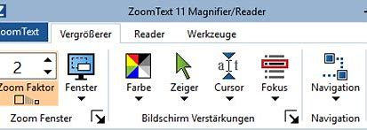
ZOOMTEXT MAGNIFIER/READER
ASSISTIVE SOFTWARE
ZoomText Magnifier/Reader software is for people with low vision. Read your documents, web pages and email, with real human sound text to speech output.
Supports dual monitors

Slide 9

JAWS SCREEN READER
ASSISTIVE SOFTWARE
Software that enables a blind or visually impaired user to read the text that is displayed on the computer screen with a speech synthesizer or braille display.
Read documents. emails, websites and apps
Easily navigate with your mouse
Scan and read all your documents, including PDF
Fill out webforms with ease
Surf the net with web browsing keystrokes

Slide 10

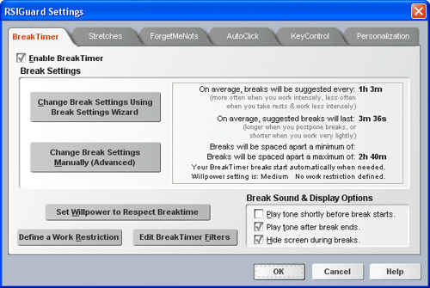
RSI GUARD
ASSISTIVE SOFTWARE
Desktop ergonomic software solution that reduces the impact of repetitive strain injuries (RSI) for office workers.
BreakTimer is a tool that reminds you to rest from the computer when the model identifies that rest would be beneficial.
AutoClick - When you move the mouse to a new location, AutoClick will automatically click for you.
ForgetMeNots is a feature designed to increase your awareness of your body during work and to remind you to take microbreaks.
KeyControl - Reduce mouse strain by allowing you to do basic mouse actions (like double click or drag and drop) with less straining hotkeys
Reduce keyboard and mouse strain by taking lengthy keyboard/mouse activities and assigning them to hotkeys.

Slide 11
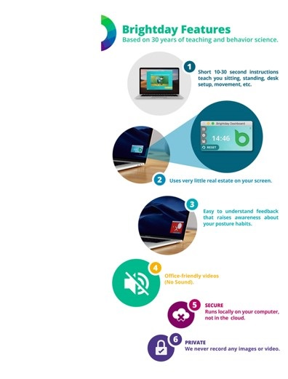
BRIGHT DAY
ASSISTIVE SOFTWARE
BRIGHTDAY
’’
For either end consumer or companies looking to improve workforce well-being Brightday is an advanced, exciting new technology that measures and corrects posture while a person is sitting at their workstation, creating less discomfort and risk of repetitive strain. Brightday use AI and augmented reality to measure and correct your sitting and standing posture to help a person look and feel better and increase confidence.

Slide 12

PORTABLE AIDS
PORTABLE AIDS

Slide 13


NOTE TAKING – LIVE SCRIBE ECHO/WIFI
PORTABLE AIDS
NOTE TAKING – LIVESCRIBE ECHO/WIFI
Record everything you hear, say, write and draw.
sync notes and audio (echo uses USB and desktop software for sync).
Stores hundreds of hours of audio and thousands of pages of notes

Slide 14
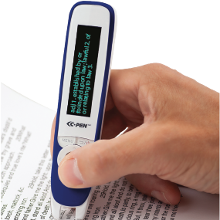
READING SUPPORT – CPEN
PORTABLE AIDS
Hear words & lines of text read aloud
Collins's 10th Edition Dictionary
Voice recorder
Secure (GDPR Compliant)

Slide 15
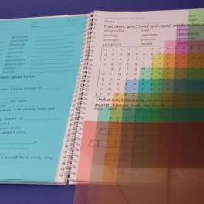

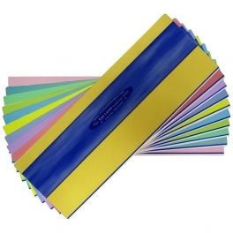
CROSSBOW OVERLAYS AND READING RULERS
PORTABLE AIDS-VISUAL
CROSSBOW OVERLAYS AND READING RULERS
Colour overlays can be ideal for people with learning difficulties and/or disabilities and individuals with visual impairments. They come in a range of colours, designed to provide users with the most comfortable reading experience.
Eye Level Reading Rulers were created for visual stress sufferers to combine page tinting with tracking support.

Slide 16
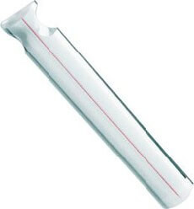
SCHWEIZER READING BAR MAGNIFIER WITH RED GUIDING LINE
PORTABLE AIDS- VISUAL
SCHWEIZER READING BAR MAGNIFIER WITH RED GUIDING LINE
The Bar Magnifier or Magnifying ruler is made of pure optical plastic and is ideal for following lines of text when reading and can be used for long periods of time.
Red guide-line to aid reading.
Easily tracked across the page
Available in different sizes

Slide 17
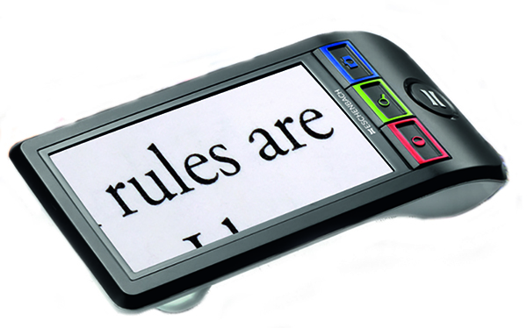
ESCHENBACH SMARTLUX DIGITAL VIDEO MAGNIFIER
PORTABLE AIDS- VISUAL
ESCHENBACH SMARTLUX DIGITAL VIDEO MAGNIFIER
The Smartlux® Digital is a portable video magnifier.
The large 5" LCD TFT display provides 5x, 7x, 9x, or 12x magnification, along with 5 different viewing modes that include full colour, black on white, white on black, black on yellow, and yellow on black.

Slide 18

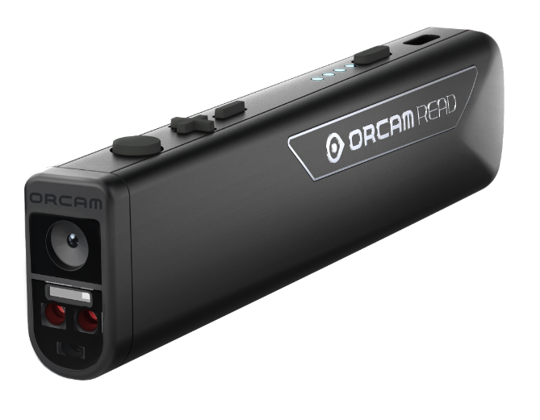
ORCAM READ
PORTABLE AIDS- VISUAL
The reading camera to support the visually impaired and reading impaired.
Reads any printed or digital text
Point and click to read aloud
Smart Reading
Optional Bluetooth speaker or headphones
No internet connection required
Notes:
Transform the Way You Read with OrCam Read for students or employees with mild to moderate visual impairments as well as those who have difficulty reading, including people with dyslexia and those who experience reading fatigue.
The OrCam Read is the first lightweight and portable device ever to integrate an smart camera capable of reading any printed or digital text that speak in a clear natural voice. Just point the portable digital reading over the surface of the book or digital screen and click to read aloud which uses the 2 precision laser guidance to capture a block of text, a whole page or you can choose where to begin reading.
Smart Reading allow you to input voice commands once the page or text has been captured by saying something like read the headlines, to hear the headlines read aloud then say read second article. Other sample are, “Start from Humming fish” at a specific point in book and “Read dates” to hear the dates from that page that was captured.
There is no 3.5mm jack to plug in a wired headphone, while the use of Bluetooth for wireless speaker and or Bluetooth earphones is optional.
Thought I’ll mention that no internet connection is required when using the digital reader making the data secured, unlike some smartphone apps when capturing a page to convert the text to read aloud that could be saved to mobile or in cloud.

Slide 19
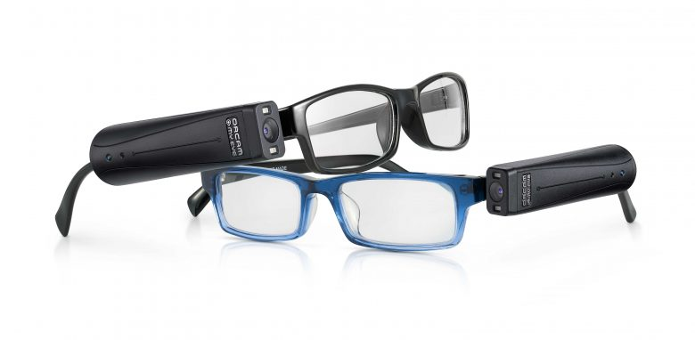
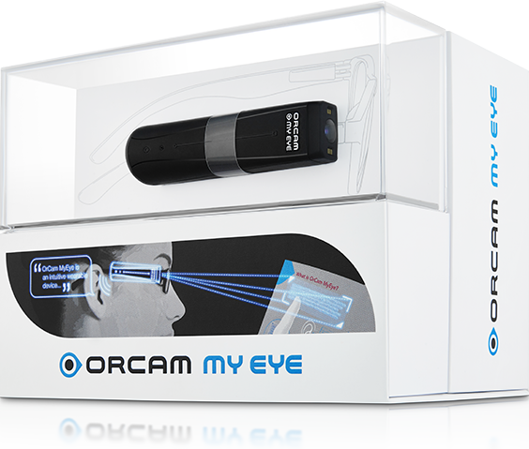
ORCAM MYEYE 2.0 PORTABLE TEXT READER
PORTABLE AIDS - VISUAL
ORCAM MYEYE 2.0 PORTABLE TEXT READER
The most advanced wearable assistive technology device for the blind and visually impaired, that reads text, recognizes faces, identifies products and more.
Read Text Including: newspapers, books, menus, signs, product labels and screens.
Real time identification of faces is seamlessly announced
Identification of products, enabling an independent shopping experience
Intuitively responds to simple hand gestures
Connect with Bluetooth enabled devices, allowing for headphone or speaker use.

Slide 20
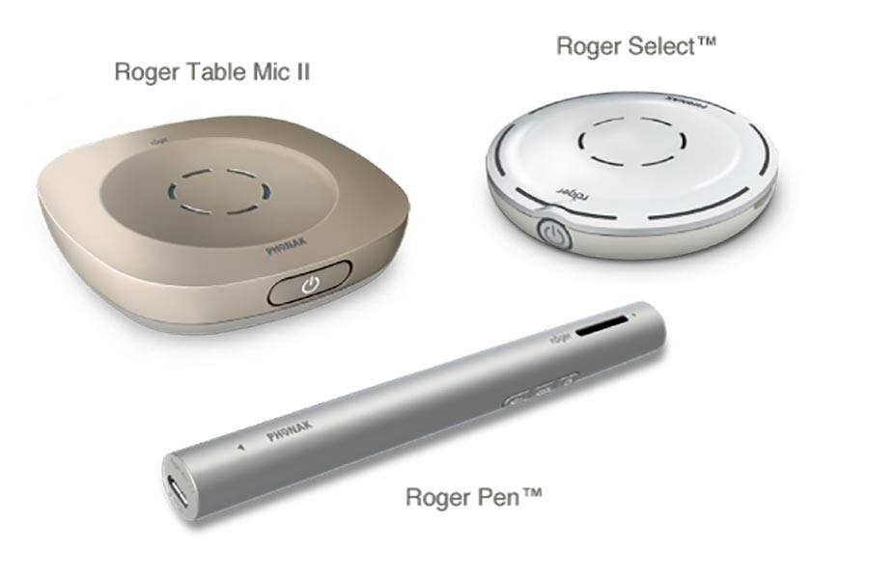
ROGER ASSITIVE TECHNOLOGY
PORTABLE AIDS - VISUAL
Assistive devices for hearing impaired individuals
Can be connected to hearing aids
Improves speech clarify especially in noisy environments
Directional sound

Slide 21
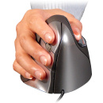
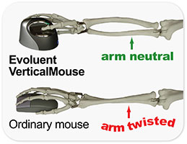
VERTICAL MOUSE
ERGONOMIC EQUIPMENT
Comfortable and easy to use. The shape is thoughtfully sculpted for uncompromised comfort and easy-to-reach programmable buttons. No finger contortions are needed to operate the buttons.
Adjustable optical sensor. Pointer speed controls on the side allow convenient adjustment without even releasing your grip from the mouse.
Available in 3 different sizes and in left and right-handed versions.

Slide 22
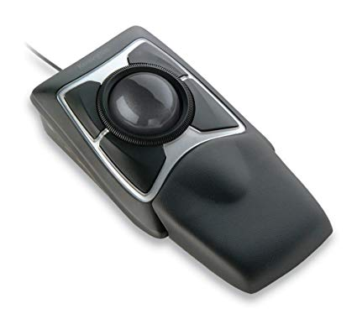
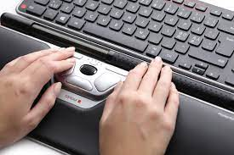
TRACKBALL AND ROLLERMOUSE
ERGONOMIC EQUIPMENT
Alleviates strain of muscles often associated with conditions such as repetitive strain injury and carpel tunnel syndrome.
Often have an ambidextrous design.
Roller Bar doesn’t require the gripping and squeezing of a handheld mouse, reducing hand, wrist, and forearm strain.

Slide 23
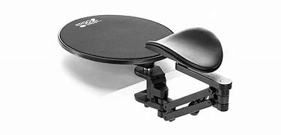
ERGOREST FOREARM SUPPORT WITH MOUSE PAD
ERGONOMIC EQUIPMENT
Ergorest Arm Support with Mousepad. Desk-clamping forearm support with 360-degree swivel and height adjust-ability. This wrist support clips easily onto the outside of the desk and provides a support for the forearm. The arm has 360 degrees of movement so that you can easily use the mouse and keyboard without and hassle. Includes a mouse mat above the position of the desk clamp.

Slide 24
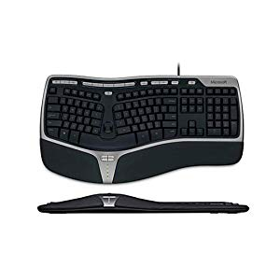
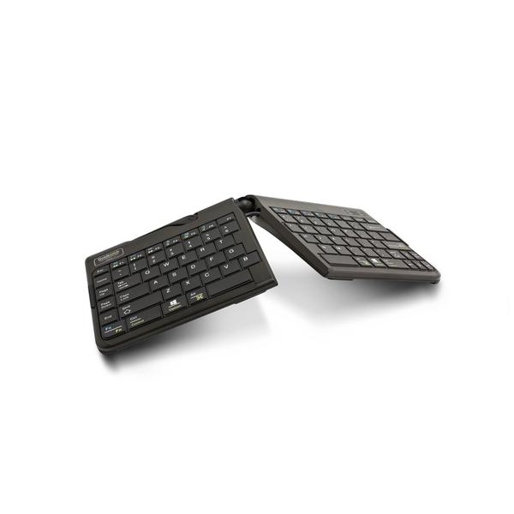
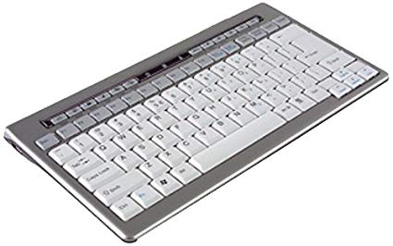
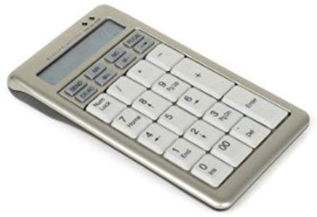
MICROSOFT NATURAL ERGONOMIC KEYBOARD 4000
ERGONOMIC EQUIPMENT
Ergonomically designed keyboard that can reduced the symptoms of carpal tunnel syndrome.
Rest your wrists against the plush palm rest in a relaxed, natural angle with this keyboard’s curved key bed, ergonomic arc, and reversed slope.
Apart from comfort and support, enjoy quick, customisable way to reach files, folders, and web pages with handy hot keys.
For close-in tasks, use the Zoom Slider, located in the middle of the keyboard, to zoom in and out with the touch of a finger.

Slide 25
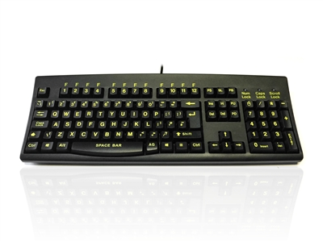
GOLDTOUCH V2 ADJUSTABLE KEYBOARD | PC AND MAC (USB)
ERGONOMIC EQUIPMENT
It has been widely recognised that people with impaired sight respond more positively to Yellow fonts on a Black background. With its Black background and enlarged Yellow font the Accuratus Hi-Vis is a cost-effective assistant.
In a full-size Windows layout with full height shaped keys on a contoured inclined base, the 260 provides hours of comfortable typing.

Slide 26
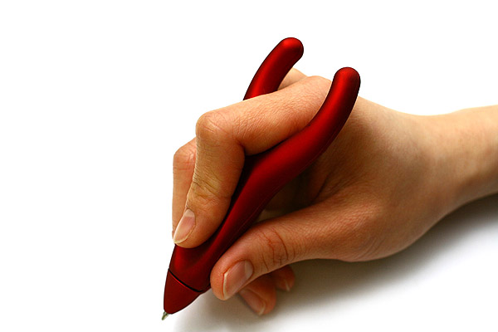
PENAGAIN ERGOSOF PEN
ERGONOMIC EQUIPMENT
The PenAgain’s “Y” formation allows your hand to relax and guide it, rather than forcefully grip it, which reduces hand fatigue, making the PenAgain ideal for those suffering from carpel tunnel syndrome, repetitive stress injuries, Arthritis, Parkinson’s, etc…

Slide 27
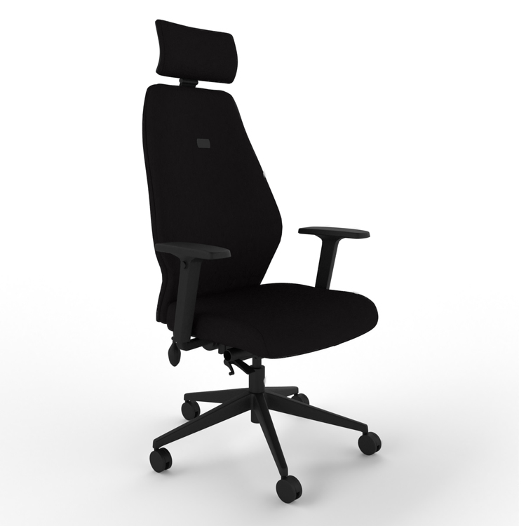
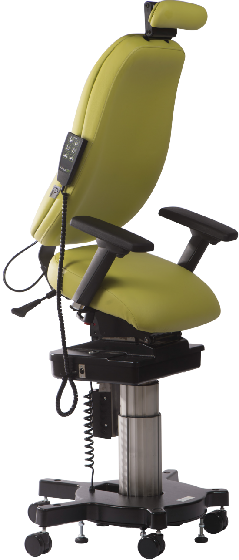
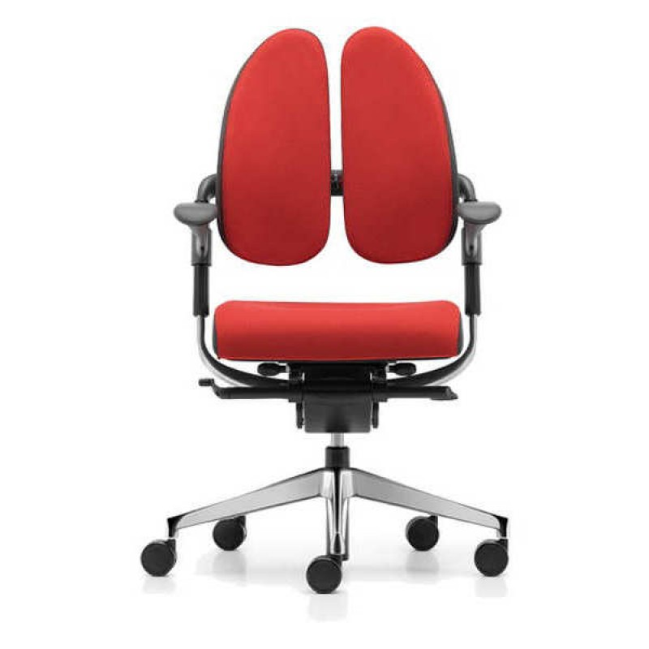
ORANGEBOX FLO ERGONOMIC CHAIR
BLACK FABRIC, HIGH BACK & ARMRESTS
ERGONOMIC EQUIPMENT
Adjustable seat height and depth
Adjustable armrest height and width
Adjustable backrest height with a lumbar pump
for lower back support
Optional height-adjustable headrest
Backrest recline tension control

Slide 28
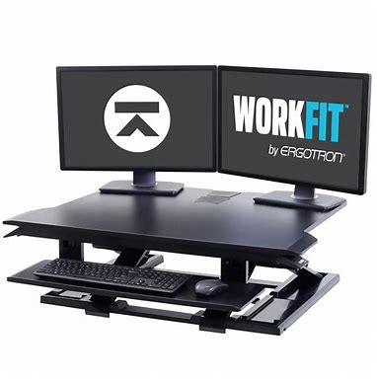
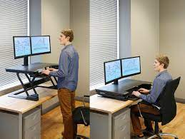
WORKFIT-TX STANDING DESK CONVERTER
ERGONOMIC EQUIPMENT
WorkFit™ adjustable standing desk
Height-adjustable, back-tilt keyboard that sits below the worksurface
Large worksurface integrates into your space and keeps office essentials nearby
Easily modifies an existing space

Slide 29
THANK YOU
Microlink pc (UK) Ltd
Microlink house
Brickfield Lane
Chandler’s Ford
Hampshire
SO53 4DP
T +44 (0)23 80240316
M+44 (0)7870 603128
E nasser@microlinkpc.com
www.microlinkpc.com
Company registered in England No. 03325643
Presented by
Dr Nasser Siabi OBE, CEO Microlink
Helen De Bretton , Director of Operations, Microlink
Mr Carl Ward, Head of Training and on-site staff, Microlink
Barry Croniken, Head of Research & Development , Microlink

