Slide 1

Violence at work
Prevention & protection
Proudly sponsored by

Slide 2
Eddie Dempsey
General Secretary, RMT Union

Slide 3
Sian Elliott
Director of Organising, TUC

Slide 4
Our survey says…
Over 5,000 responses in four weeks
90% were permanently employed
69% public facing all or most of the time / 15% some of the time
80% have experienced verbal or physical abuse in the last year

Slide 5
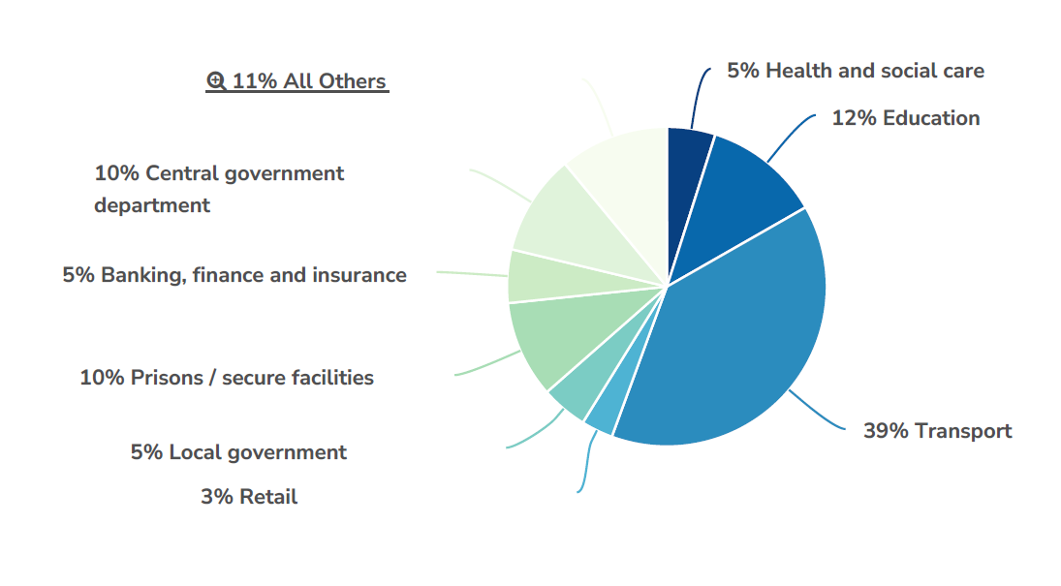
Respondents by sector

Slide 6
Frequency of Verbal Abuse (last 12 months)

Slide 7
Frequency of Physical Violence (last 12 months)

Slide 8
Impact of Most Serious Incident

Slide 9
Overall Impact of Violence or Abuse

Slide 10
Why Workers Don’t Report

Slide 11
Jo Soccard
Principal Personal Injury Lawyer
Thompsons Solicitors

Slide 12
Violence and Abuse at Work
Joanne Soccard
Associate Solicitor & Principal Lawyer

Slide 13





Who are Thompsons?
We are the UK’s largest trade union law firm​
We were established in 1921 to act for working people and for trade unions and their members​
We remain proudly part of the trade union movement today​
We have 18 offices across England and Wales, with a Belfast office servicing members based in Northern Ireland and six offices at our sister firm in Scotland​
We are the most experienced personal injury and employment rights practice in the UK ​
We are experienced in pursing claims following assaults for trade union members and understand the challenges faced by workers in different employment areas, such as teaching, healthcare, retail, transport and the prison service.

Slide 14
What constitutes an “Assault”?:
The Health and Safety Executive (HSE) defines a workplace assault as:
  ‘Any incident in which a person is abused, threatened or assaulted in circumstances relating to their work’.
This includes racial, sexist and homophobic verbal abuse.
It is not just from third parties (patients, clients, service users or customers), but can be from managers or colleagues.

Slide 15
Legal Routes to Compensation
A claim against the assailant
A claim against the employer
An application to the Criminal Injuries Compensation Authority
An award of compensation following criminal proceedings
Generally, we are looking at the middle two types of claims.
You can pursue more than one route for compensation but there is no double recovery allowed

Slide 16
Time Limits
Claims against Employers or the Assailant must be made within 3 years of the date of the incident. This includes vicarious liability claims (claims against the employer where a colleague has caused the harm).
CICA Applications must be made within 2 years of the date of the incident.

Slide 17
Employer’s Duties
Section 2(1) of the Health and Safety at Work etc. Act 1974 :
  It shall be the duty of every employer to ensure, so far as is reasonably practicable, the health, safety and welfare at work of all his employees.
Management of Health and Safety at Work Regulations 1999 compel employers to manage workplace risks effectively:
  Reg 3 - carry out "suitable and sufficient" risk assessments
  Reg 4 – plan, organise, control, monitor and review H&S arrangements
  Reg 10 – provide adequate training and comprehensive information regarding risks
Employers who fail to address or minimise the risk of violence against their workers may be liable if assaults in the workplace occur.

Slide 18
What Do We Need to Prove?
As in any personal injury claim, we need to prove:
A duty of care was owed
The duty was breached
The breach of duty caused the injury
The injury was not too remote
The burden of proof is on the Claimant.

Slide 19
Stumbling Blocks
In assault claims, proving a breach of duty and causation is often not straightforward
1. Breach of duty. Did the employer take all reasonably practicable steps to provide a safe working environment eg risk assessments, staffing levels, training, PPE, control measures etc?
2. Causation. Did the breach cause the injury? What difference would it have made? Staffing levels, training etc?
Incidents are often sudden and unprovoked meaning they could not be foreseen or prevented.
Sometimes there are no warnings from the assailant’s previous behaviour.
Often there is a breach of duty, but causation is not made out (i.e. out of date training or being a staff member short, but such breaches did not cause the incident.) “But for” test.
These can mean that the claim is likely to fail.

Slide 20
Disclosure
As each case is fact specific, the disclosure requests made to the Defendant at the start of the claim will differ for each type of claim and indeed from claim to claim.
The Defendant will argue their inability to share records where they relate to individual service users due to GDPR/Data Protection reasons (i.e. student or patient records). They will ask that a Court Order be obtained. Contrary to DPA 1998, which allows for data sharing in respect of prospective legal proceedings.
The MOJ argue where criminal proceedings are outstanding they cannot disclose any documents until they are concluded. How long do criminal proceedings take – a LONG time?

Slide 21
Witness Evidence
Crucial to corroborate the member’s evidence.
Often it will contradict the Defendant’s disclosure. In practice the workplace situation may be very different to that told in their paperwork.
Witnesses may also be aware of things that the member did not know.
Union representatives can prove to be useful as they may know of previous claims, training issues, existence/content of documents.
Witnesses will sometimes be able to send us the statement they gave to their employer, which gets us ahead of the game when it comes to exchange of statements in proceedings.
Not every witness will however come forward despite victimisation being contrary to employment law.

Slide 22
CICA
There are a number of hurdles you must get over to qualify for an award. Some of the key ones are as follows:
Application must be lodged within 2 years of the incident
Injury was caused by a crime of violence
The applicant must report the incident to the Police as soon as possible (e.g. 24 hours) and co-operate with the police and Criminal Justice System
Applicant's previous criminal record is relevant (no unspent convictions)
No award if the assailant has no capacity (i.e. psychiatric care claims)

Slide 23
Employer’s Support for the Victim
When an incident happens at work where staff are subject to violence and aggression, you would expect to see the following:
Incidents will be reported.
All colleagues to be seen as soon as possible afterwards by either their line manager (or nominated other manager) to ensure support in place.
A debrief session arranged to consider incident and safety moving forward.
Review of risk assessments.
Review of training or support needs and provision arranged if need identified.
Provision of counselling/peer support.
Amending work patterns where appropriate.
Notification of employer’s Health and Safety team.
Formal investigation.
Co-operation with the police.

Slide 24

Legislation – Effective or Not?
One NHS Trust H&S Policy reads “Our staff should not be expected to accept such behaviour as inevitable”
An employer is not however always responsible. On average 66% of claims will fail.

Slide 25
The Scale of the Problem
HSE reports 649,000 incidents of violence at work – 360,000 threats and 288,000 assaults.
75,000 of them occur in the NHS – that is approximately 11% of all assaults. Violent and aggressive incidents are the third highest cause of injuries reported under RIDDOR from the Health and Social Care sector.
UK Government reports 8,616 assaults on prison officers in England and Wales in 2023. Assaults on prison staff had increased by more than 300% in the last 5 years.
RMT 2025 survey of 6000 members reported 66% had experienced an incident of violence at work in the last 12 months.
NASUWT 2025 survey of members showed a 40% increase in abuse/violent behaviour experienced by members in the last 12 months.
USDAW surveyed 9400 shopworkers last year and 77% reported verbal abuse, 53% were threatened and 10% physically assaulted.

Slide 26
Improvements
Clearer guidance needed on agency workers and the duties of the agency vs those imposed on the employment provider.
Enforcement of sanctions to deter workplace violence – enforce a zero-tolerance approach don’t just put posters up.
Assaults on Emergency Workers (Offences) Act 2018, but what about other public facing employees? Shopworkers, railways staff, school teachers/TAs, care workers…
Better resources for the Police to improve response times.
More resources for the Courts to reduce backlogs.
Consideration of minimum levels of safety provisions for lone working – safer premises, better PPE, on-call provision.
Review of the CICA scheme – tariffs not updated since 2012 implementation and still has a £500,000 cap, with sick pay only paid after 28 weeks, and limited to SSP levels.
Legal costs – currently assault cases fall outside the fixed costs regime due to their complex nature, but defendants argue the point. If the legislation changes then they will become harder to run as the costs of doing so could be greater than the legal costs that can be recovered from the defendant.

Slide 27
Useful Resources

Slide 28


Free Online Legal Guides and Employment Law Review
Members can access a range of legal guides and resources:
Employment Law Review
Weekly newsletter – direct to your inbox.
Covering relevant case summaries for reps.
Searchable on the Thompsons website.

Slide 29
How to get in touch
For personal injuries, industrial diseases and clinical negligence: www.thompsonstradeunion.law
0800 587 7515
For conveyancing, probate, powers of attorney and wills:
0800 051 4218
For employment rights:
Contact your local union representative.
1016.391

Slide 30
John Hendy KC
Vice Chair of the APPG on Occupational Safety and Health

Slide 31
Questions
Jo Soccard
Vincent Reynolds
Lord Hendy KC

Slide 32
Comfort break
11:20 – 11:35

Slide 33
Andrea Oates
Labour Research Department

Slide 34

Violence and Abuse at Work: Prevention and Protection
Risk assessments and violence policies
Andrea Oates (Labour Research Department)
TUC conference April 2026

Slide 35

Labour Research Department
Labour Research Department (LRD) is “the information service for trade unions”
www.lrd.org.uk
Labour Research
Workplace Report
Guides
Legal Handbooks
Online Services
Help for Union Reps
Customised Research
TUC conference April 2026

Slide 36
Labour Research Department
Key pieces of health and safety law
Health and Safety at Work etc Act 1974
Management of Health and Safety at Work Regulations 1999
TUC conference April 2026

Slide 37
Labour Research Department
Health and Safety Executive (HSE) advice to employers
A five-step approach to tackling violence and abuse at work
Identify the hazards
Assess the risks
Decide how to control the risks
Put in place the right control measures
Report and learn from incidents
TUC conference April 2026

Slide 38
Labour Research Department
Managing the risk of violence and aggression at work
HSE research on employer shortcomings
Policies in place but monitoring and review lacking
Risk assessments too generic – high-risk areas not identified
Assessments and training failed to include all workers at risk
Training too generic – not based on a training needs analysis
Training identified as mandatory but in practice optional
No suitable assessment of trainers’ competency
Lack of clarity over roles and responsibilities and lack of time and resource for those with roles and responsibilities
Failure to use available data sources
Lack of clarity over what should be reported and how
TUC conference April 2026

Slide 39
Labour Research Department
Key union messages
“Even in the most challenging circumstances where those receiving care or education are known to have violent tendencies, there are always actions that can improve the situation and reduce the risk”
“Violence to workers is never the individual problem of the person involved. It is an occupational safety and health issue and should be dealt with at the organisational level”
(GMB)
TUC conference April 2026

Slide 40
Labour Research Department
Causes of violence
Every workplace is different and there is usually no single, simple solution
Unions have identified causes ranging from unmet additional needs support in schools to rising crime and organised gangs stealing to order
Common themes across sectors
Lack of money/investment
Not enough staff/lone working
Cuts to services resulting in eg longer waiting times and frustration
Lack of enforcement and accountability for perpetrators
TUC conference April 2026

Slide 41
Labour Research Department
Union advice on risk assessment and policies
Emphasis on prevention and control with PPE a last resort
Union involvement and consultation
Appropriate staffing levels (day and night)
Policies and procedures for incidents and support for workers affected
Staff trained, prepared and know what to do in the event of a violent incident, including emergency procedures
Abuse and violence can happen outside work including journey to and from work
TUC conference April 2026

Slide 42
Labour Research Department
Union advice on risk assessment and policies
Avoid lone working
Quick, simple, effective reporting systems
Consideration of design of workplaces and surroundings
Data collection to identify trends and hotspots - including protected characteristics
Procedure to deal with inappropriate behaviours including escalation process
Reporting to regulators and police
TUC conference April 2026

Slide 43
Labour Research Department
Union resources and tactics
Model and template policies
Safety rep checklists
Campaign resources (Freedom from Fear, Get Me Home Safely, Action on Assaults)
Survey resources/help with analysis
Advice on linking tackling violence with organizing
Roadmaps
Strikes
TUC conference April 2026

Slide 44
Thank you!
andrea.oates@talk21.com

Slide 45
Campaigns, organising & prevention strategies
James Ratcliffe, Health and Safety Advisor, USDAW
Alison Spencer-Scragg, Director of Equalities, Unite
Louise Church, Head of Health, Safety and Wellbeing, RCN
Jackie Marshall, National Executive, POA
Patrick Bennett, Health and Safety Policy Officer, NEU
Alan Lofthouse, Deputy Head of Health, UNISON

Slide 46


Slide 47

Safe Inside: Trade Union Organising in Prisons through Joint Unions in Prisons Alliance
Louise Church – Royal College of Nursing
JUPA Co-chair
-

Slide 48

What is the Joint Unions in Prison Alliance?
Focus: Safety of staff working in prisons
Coalition of 10 trade unions and professional organisations
Unions include those recognised and non-recognised with His Majesties Prison and Probation Service (HMPPS)
JUPA Co-chairs:
Paul Bridge, UCU - Head of Further Education
Louise Church, RCN – Head of Health, Safety & Wellbeing (job share)

Slide 49

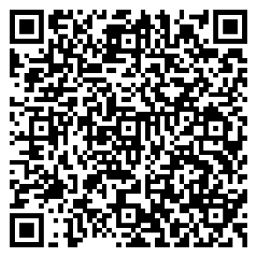
Safe Inside -Prisons Charter
Sets out clear principles for a positive H&S culture. Themes include:
Zero tolerance for violence and harassment
Cooperation and coordination with third party employers
Non-JUPA unions have endorsed/ shown support for the Charter

Slide 50

Safe Inside – Position Statement
Highlights urgent concerns on rising violence and underreporting of incidents
Calls for action:
  HSE inspections and enforcement
Calls for action on HMPPS:
  Undertake thorough risk assessment
  Employers to reinvigorate and reinforce the zero tolerance to violence, harassment and abuse of prison workers
  Make a clear commitment to prevent sexual harassment and assault of workers

Slide 51
Safe Inside – Position Statement
Calls for action:
  Broaden the definition of zero tolerance to violence, harassment and abuse to include sexual harassment and assault
  Develop and implement a national violence reduction standard
  Conduct a review of the incident management system to ensure all incident types are reportable
  Fully implement a single incident reporting system for all prison workers
  Promotion of the importance of reporting incidents
  Review the use of body worn cameras and protocols to ensure there is clear governance in place

Slide 52
Campaigns, organising & prevention strategies
James Ratcliffe, Health and Safety Advisor, USDAW
Alison Spencer-Scragg, Director of Equalities, Unite
Louise Church, Head of Health, Safety and Wellbeing, RCN
Jackie Marshall, National Executive, POA
Patrick Bennett, Health and Safety Policy Officer, NEU
Alan Lofthouse, Deputy Head of Health, UNISON

Slide 53


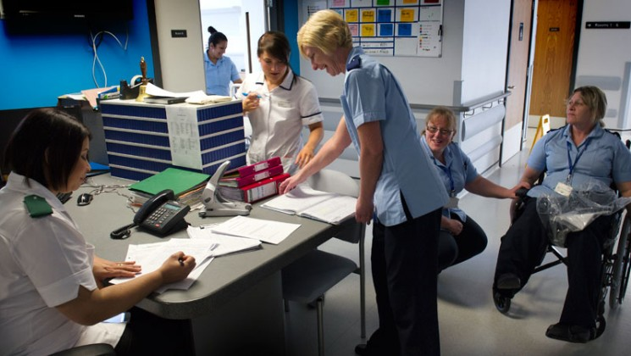
Learning from partnership working.
Alan Lofthouse, Deputy Head of Health – UNISON

Slide 54
Scale of violence in the NHS
14 – 15% of NHS Staff report physical violence every year
Over 200,000 assaults each year
Highest risk areas are learning and disability, mental health, and ambulance
High levels of under reporting

Slide 55


Violence is a priority area
Tackling violence and aggression:
“the government will ask the existing groups established in the NHS Social Partnership Forum working on violence reduction to work with the health and wellbeing group of the NHS Staff Council to identify ways to tackle and reduce violence against NHS staff.”

Slide 56

SPF report on ways to tackle and reduce violence against NHS staff
Making work and workplaces safer
Leadership
Data driven decision making and supporting a reporting culture
Risk assessment training and support
The role of partnership working
Notes:
Mandate VPR standard, ensure collaboration across governments, CQC inspections
National strategy, consistent messaging (staff and patients), plus dealing with clinically challenged behaviours. Making this about retention
New data standard and new reporting system and improvements to reporting culture (issues with the Staff Survey as a source of data).
Improve RA training, skills and guidance on supporting staff and minimising risks – particularly with clinically challenged behaviours. HSWG developing post incident support.
Doing it all in partnership!!

Slide 57
Partnership working is delivering
Assaults on Emergency Workers (Offences) Act 2018
Mandating the Violence Prevention and Reduction Standard
Changes to statutory and mandatory training
National VPR comms for staff and patients
Safe working practice guidelines
Data reporting framework
Post incident support guidance
However, more needs to be done at employer level

Slide 58
Campaigns, organising & prevention strategies
James Ratcliffe, Health and Safety Advisor, USDAW
Alison Spencer-Scragg, Director of Equalities, Unite
Louise Church, Head of Health, Safety and Wellbeing, RCN
Jackie Marshall, National Executive, POA
Patrick Bennett, Health and Safety Policy Officer, NEU
Alan Lofthouse, Deputy Head of Health, UNISON

Slide 59
Using violence surveys as an organising tool
Patrick Bennett, Policy Officer, Health, Safety & Environment, NEU
Notes:
We are aware of an increase in violent assaults on our members since the pandemic.
Some from parents/carers, but mostly from students.
Primary schools report more assaults than secondary, but the impact of assaults in secondary is often more serious.
Special schools report most assaults of all. This is because of a lack of funding, staffing, and the existence of too many children with unmet need.

Slide 60
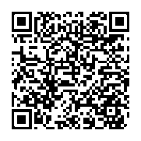
Using violence surveys as an organising tool
NEU = 2-pronged approach = RISK REDUCTION
Supporting organising through advice and guidance
  See QR code:
  This includes model policies, checklists, an adaptable individual pupil behaviour risk assessment pro forma etc.
Organising to win via the violence survey
  Reps can email healthandsafety@neu.org.uk to request a violence survey
  They are then given a link to share with members at their school/college
  Once the survey is complete, the survey will be analysed and the results sent to the rep so they and members can press management for changes to working conditions in the areas highlighted by the survey
Notes:
Violence and assaults is a complex area, and I don’t personally claim to have all the answers. However, it’s clearly desirable to organise to reduce violent assaults in the first place, and it’s that work that I’m here to talk to you about today.
The NEU seeks to do this in two main ways – firstly by supporting its members and reps with useful resources such as model violence policies, checklists for different groups such as reps, leaders, support staff etc., template individual pupil behaviour risk assessment forms and so on. These are all available on the NEU website – you can find them quickly by scanning the QR code on the slide.
The second way is the use of the violence survey. The violence survey is administered nationally, but co-ordinated locally at school level. Members in a school might have been citing problems with violence but feeling that their leadership team was not listening, or there might have been a sense that violent incidents were on the increase but there had been no co-ordinated attempt to act on them. Either way, a violence survey would be a logical step forward. The rep would be sent a link by NEU HQ which they then share with members. (And non-members, if desired). Typically, survey respondents spend 2 weeks filling in the survey. Then, on a pre-agreed date, the survey is closed and analysed whereupon the results are sent to the rep for sharing with members/negotiation with management. In their discussions with management, reps will tend to highlight areas of the survey results which are of particular concern and bring these to the fore in their negotiations to improve policies and working practices. For example, where the survey shows that a high number of staff have taken sick leave as a result of violent incidents in the recent past, this should demonstrate to school leaders that their current approach to managing workplace violence is not working and needs to be reconsidered.

Slide 61
The NEU violence survey
The NEU violence survey seeks out a range of information, including:
Type of assaults being perpetrated
Who carried out the assault?
Was it reported and how?
Was any action taken by the employer?
Was any sick leave taken by the victim, either because of physical injury or because of stress?
Does the employer have a violence policy?
Is it followed?
Are knives, weapons or noxious substances carried by pupils?
Does support from management arrive swiftly following an incident?
Are staff members noting stress symptoms as a result of violence in school?
The NEU runs a stress survey which operates on similar lines to the violence survey.
Notes:
This slide shows the sort of data collected by the violence survey. The survey itself was designed in partnership with health and safety reps from Enfield. One of the issues we find time and again is that reporting arrangements are not up to scratch in far too many workplaces. It seems some employers will essentially obfuscate the processes that should be in place regarding the accident book, and consequently a large number of members opt to record incidents on behaviour systems instead, believing they have fulfilled their obligation to record, when in fact they haven’t.
Another point worthy of note is that members who have suffered – or indeed witnessed – workplace violence often suffer mental ill-effects in addition to any physical injury they may have incurred. Stress and violence go hand-in-hand, and the NEU has a stress survey which is often used at the same time as the violence survey to pick up these issues.

Slide 62
Using violence surveys as an organising tool
Violence/stress survey email address:
healthandsafety@neu.org.uk
My email address:
Patrick.Bennett@neu.org.uk
Thank you for listening today.

Slide 63
Campaigns, organising & prevention strategies
James Ratcliffe, Health and Safety Advisor, USDAW
Alison Spencer-Scragg, Director of Equalities, Unite
Louise Church, Head of Health, Safety and Wellbeing, RCN
Jackie Marshall, National Executive, POA
Patrick Bennett, Health and Safety Policy Officer, NEU
Alan Lofthouse, Deputy Head of Health, UNISON

Slide 64
Questions and comments

Slide 65
Lunch
13:00 – 13:50

Slide 66


Get your goods!

Slide 67
Workshops
Tools for personal safety and lone working.
With Saskia Garner, Head of Policy and Campaigns, Suzy Lamplugh Trust (Room 3)
What personal injury lawyers can do for you and your members, and how reps can help ensure your members get compensation.
with Vincent Reynolds and Jo Soccard, Thompsons Solicitors
(Main room)
What is the role of regulation and enforcement?
With Dan Shears, Head of Health, Safety and Environment, GMB
(Room 4)

Slide 68
How do we support union campaigns going forward?
John Leach, Senior Assistant GS, RMT
Aadam Muuse, Lay rep, Unite
Mark Morris, National Executive, NASUWT
Carol Knowles, President, Accord
Bev Laidlaw, Deputy President, PCS

Slide 69
How can TUC support union campaigns going forwards?
Convene a joint union ministerial roundtable on Government action to protect workers from violence.
TUC coordinated campaign to secure stronger legislation for workers not covered by existing standalone offences, and improvements, where necessary, to existing legislation.
Updated TUC guidance for reps on dealing with violence – drawing on best practice from affiliates.
Targeted press and publicity around the need for greater protections for workers against assaults, including identifying an annual date in the calendar to highlight the issue.
Identifying coalition partners from civil society for joint activity around reducing violence against workers and society more widely.

Slide 70
How do we support union campaigns going forward?
John Leach, Senior Assistant GS, RMT
Aadam Muuse, Lay rep, Unite
Mark Morris, National Executive, NASUWT
Carol Knowles, President, Accord
Bev Laidlaw, Deputy President, PCS

Slide 71
Questions and comments

Slide 72
Closing remarks

Slide 73

Stay in the know

