Slide 1
Violence and Abuse at Work
Workshop
Joanne Soccard - Associate Solicitor & Principal Lawyer
Vincent Reynolds – Partner & Regional PI Manager

Slide 2
Reminder of Legal Services for Union Members
Personal injuries or accidents, in and out of work
Professional Misconduct
Industrial disease, including asbestos diseases
Criminal injuries compensation
Employment rights
Basic wills
Settlement agreements
Free legal advice
Criminal law

Slide 3
Other Legal Services for you and your family
Discounted rates – special terms
Clinical negligence
Criminal injuries compensation
Criminal injuries compensation
Non-working family members are covered for all types of personal injury (free)
Conveyancing
Non-working family members are covered for all types of personal injury (free)
Criminal injuries compensation
Non-working family members are covered for all types of personal injury (free)
Probate
Basic wills
Basic wills
Basic wills
Lasting powers of attorney
Deputyships
Sample text goes here

Slide 4
Why Injury Claims should be pursued through union legal schemes
All our services are on a no-win, no-fee basis
Members and their families receive 100% compensation for injuries that occur in the UK
This can include injuries on the road or in another public place
Members and their family members also receive better rates or significantly more of their compensation than they may get from other law firms for the following legal services:
  Clinical negligence
  Injuries outside the UK
  Conveyancing
  Probate
  Powers of attorney

Slide 5
Legal Routes to Compensation
A claim against the assailant (member’s insurance own H&C policy – unsatisfied judgments?) – 3 years
A claim against the employer – 3 years
An application to the Criminal Injuries Compensation Authority – 2 years
An award of compensation following criminal proceedings
Generally, we are looking at the middle two types of claims.
You can pursue more than one route for compensation but there is no double recovery allowed

Slide 6
Employer’s Claim - What Do We Need to Prove?
In any personal injury claim, we need to prove:
A duty of care was owed
The duty was breached
The breach of duty caused the injury
The injury was not too remote
The burden of proof is on the Claimant.
We need to show that the employer was aware of the risk of injury prior to the incident to the extent that they should have ensured they took all reasonably practicable steps to reduce the risk of the incident occurring.

Slide 7
PI Claim Process
Vulnerable Adult or Minor or over £25,000:
Initial Instructions
Letter of Claim
3 weeks to acknowledge and 3 months for liability reply
Admission – medical evidence and schedule of loss – settlement/issue proceedings
Denial – disclosure, review then (a) close or (b) proceed as per admission.
No Vulnerable Adult/Minor or under £25,000:
Initial Instructions
Portal Claim Notification Form completed
8 weeks for liability response
Admitted – medical evidence and schedule of loss then Settlement Pack submitted with an offer.
Denied – disclosure, review then (a) close or (b) proceed as per admission.

Slide 8
Assault Claims Disclosure/Documents
Documents and evidence to consider when determining this would be as follows:
Incident reports and RIDDOR report
Pre and post risk assessments
Assailant’s care plan and records (if appropriate) school records/nursing notes/NOMIS records
Previous reported complaints and incidents behaviour logs
Details of training provided and training logs
Employer's policy documents in relation to violence/health and safety
Minutes of health & safety and/or staff meetings
CCTV footage
Safe Systems of Work

Slide 9
Court Proceedings
Issue Claim Form
Serve Claim Form with Particulars of Claim, medical report and schedule of loss
Acknowledgment of Service (14 days after service)
Defence (14 days after acknowledgment)
Directions Questionnaire and Draft Directions
Directions Order
Disclosure
Witness Statements
Medical Reports finalised
Schedules of Loss finalised
Pre-Trial Review
Trial

Slide 10
Case Examples
Millward v Oxfordshire CC [2004] Court of Appeal
The Claimant was a teacher at a secure residential unit run by the Defendant. She told a pupil to shut up – he responded by assaulting her. He had arrived at the unit 10 days earlier and had a record of assaults especially against women. The Claimant had not been told about his history of violence or the risk and her claim was successful.
Rita Armah v (1) Midlands Partnership & University Hospitals of North Midlands NHS Trust (2) The University Hospitals of North Midlands NHS Trust [2022] Stoke Combined Court
The Claimant was employed by D1 as a Health Care Support Worker on a Psychiatric Ward at St George’s Hospital in Stafford. In the early hours of the morning of 11 October 2017 a patient, N, was brought by the police. N’s behaviour was strange and erratic and the police believed he may be mentally ill. There was also a suggestion he had assaulted his father. N was risk assessed at a category ‘1’ - posing no particular risk to himself or others. A doctor examining N concluded transfer was required and an ambulance was called to take N to the Royal Stoke Hospital. However, before the ambulance had left the hospital, the patient assaulted a paramedic in the ambulance causing substantial injury to her, including a fractured skull. N was re-assessed as a category 4 patient. He was taken to Stoke in another ambulance, accompanied by the police.
The Claimant was requested by her employer to attend the Royal Stoke Hospital to undertake an observation of N together with a colleague. Whilst observing N at Stoke, N became agitated. Whilst the Claimant and a nurse assisted N in using the commode he assaulted the nurse and then assaulted the Claimant.
D1 was responsible for the provision of hospital services at St. George’s Hospital.
D2 was responsible for the provision of hospital services at the Royal Stoke Hospital and at the time of the assault was responsible for the care of the patient who assaulted her.
The Judge concluded that D1 was in breach of its duty of care in sending the Claimant to observe the patient with no special precautions other than a 2:1 observation ratio. The risk posed by N after the assault on the paramedic meant that reasonable care required it to take further steps to keep her safe. The Judge concluded that whilst D1 may have believed it likely that the D2 would take appropriate steps while the Claimant was at the Royal Stoke, and, or, that it was the D2’s duty to keep her safe while she was at the Royal Stoke. The existence of a duty owed by the D2 did not affect the continuing non-delegable duty owed by D1.
The Judge also concluded that D2 had also breached their duty of care as it was reasonably foreseeable that N presented a serious risk of violence to those around him. That serious risk was such that it was reasonably necessary for D2 to take particular steps to keep the Claimant safe while she was observing N. [However the case against them failed on causation as even with the breach, she would still have been injured as there was no evidence that security being there or a doctor reviewing the patient sooner would have prevented her injuries].

Slide 11
Case Examples
P v MOJ
The Claimant (aged 54) worked as a prison officer and was asked to assist in restraining a dangerous prisoner who needed to be transferred to another prison.
Liability was denied. The judge ruled the Defendant was held accountable for breaching their duty of care by failing to inform the Claimant of the risk posed by a violent prisoner, failing to carry out a risk assessment for the transfer and the need for appropriate PPE during the prisoner’s removal.
He sustained injuries to his lower back, left shoulder, neck, ribcage, elbows, knees as well as bite injury to his left middle finger, nerve and tendon damage and C-PTSD. Unfortunately, he was retired through ill health and has not worked since 2016.
Following a liability trial win, the parties held a Joint Settlement Meeting in June 2024 in an attempt to settle. Several offers were made between the parties, and on Counsel’s advice, the Claimant accepted an offer in the sum of £655,873.05.

Slide 12
Vicarious Liability – difficult to prove
The Assailant must be an employee or in a relationship which was “akin to employment”
There must be a sufficiently close connection between their position as an employee and the wrongdoing (i.e. we need to analyse their normal “field of activities” to assess if there is a link between what they were normally authorised to do and what they did). See case of Morrisons v Various Claimants – data breach held not liable as personal vendetta).
The key criterion is (i) whether the wrongful act derives from a risk created by the Defendant in assigning activities to the wrongdoer, and (ii) assessing whether such an activity is an integral part of the business activities carried out by the Defendant.

Slide 13
Mohamud v WM Morrison Supermarkets PLC [2016] KSC 11
15 March 2008 the Claimant entered D’s petrol station. Having parked his car he entered the kiosk to ask whether he could print some documents from a USB stick. An employee of D, Mr. Khan, refused in a rude manner. Mr Khan responded in foul, racist and threatening language and ordered the Claimant to leave. The Claimant returned to his car followed by Mr. Khan. Before the Claimant could drive off Mr. Khan opened the passenger door, told the Claimant in threatening words never to return and punched him on the left temple. The Claimant got out and walked round to close the passenger door when Mr Khan subjected him to a serious attack. The Claimant had not done anything which could be considered aggressive or abusive.
The Claimant brought proceedings against D on the basis that it was vicariously liable for the actions of its employee Mr. Khan. The trial Judge dismissed the claim because he considered that there was an insufficiently close connection between what Mr. Khan was employed to do and his tortious conduct in attacking the Claimant for D to be liable. The Court of Appeal upheld the Judge’s decision. The Claimant appealed and won. In this case, it was an abuse of power whilst he was undertaking the tasks he was expected to do (serving a customer) and so Morrisons were liable.

Slide 14
A v [ ]CC
The Claimant was employed by the Defendant as a Residential Care Worker at a children’s home.
The Claimant’s colleague was sexually aggressive towards the Claimant, by saying words to the effect of ‘nice skirt, shame it’s a bit too long’ and ‘it’s a good skirt for arse licking, I could take you from behind in that skirt.’ They then came up behind the Claimant and asked her if she had fed the fish in the office fish tank. Standing behind her, they said ‘don’t turn behind too fast or you’ll get my hard cock right in your face’ and then thrust their penis towards her.
The Defendant admitted responsibility as the assailant had previous history and they had failed to provide any proper training for sexual harassment. The Claimant suffered with PTSD, but had a history of psychological issues. She agreed a settlement with the Defendant for £10,000.
A v C
The Claimant was in an appraisal with her manager when he became frustrated and was shouting. He pushed/threw a wheelie chair across the room and then threw a window blind, which caught the Claimant on the leg. The Claimant left work and has never returned to employment. As a result of her injuries, she sustained C-PTSD, a flare-up of gastric symptoms and agreed a settlement of £250,000 as the psychiatrist confirmed that she was unlikely to work again.

Slide 15
Employment Rights Act – Sexual Harassment
The Act will require employers to take all reasonable steps to prevent sexual harassment (as opposed to just reasonable steps)
A report of sexual harassment having taken place also amounts to an express prescribed disclosure for the purposes of whistleblowing.
Employers will be liable for harassment by third parties (clients, customers and service users) related to the protected characteristics of age, disability, gender reassignment, race, religion or belief, sex and sexual orientation unless the employer took all reasonable steps to prevent it.
These provisions are due to come into force in October 2026.

Slide 16
Need to Establish Causation
The claimant was a prison officer. He was involved in an altercation with a prisoner in the morning. The prisoner made threats to assault him. The claimant reported this, however, he remained working on the same landing.
Later that same day the prisoner became involved in an altercation with another prisoner. The alarm was sounded and officers, including the claimant, came to break up the fight. During the restraint the claimant was injured.
The claimant sought to bring a claim on the basis that he had reported the threats by the prisoner and so the prison service were responsible for his assault.
The claim was unsuccessful. While there may have been a breach in not moving the claimant off the landing the assault was not caused by that breach as it was not related to the threat made by the prisoner earlier in the day.

Slide 17
Quantum
General Damages – Pain, Suffering and Loss of Amenity + Special Damages (financial losses)
Financial Losses can include – loss of earnings, medical treatment, medication, care and assistance, travel, adaptions to home/cars, medical aids, pension loss and future losses
Two tools to value a claim:
JC Guidelines
Previous Case Law

Slide 18
JC Guidelines
Chapter 4 - Psychiatric and Psychological Damage
Section (B) - Post- Traumatic Stress Disorder
The symptoms may include nightmares, flashbacks, sleep disturbance, avoidance, mood disorders, suicidal ideation, and hyper- arousal. Symptoms of hyper- arousal can affect basic functions such as breathing, pulse rate, and bowel and/ or bladder control.
(a) Severe - £79,080 to £133,000
Such cases will involve permanent effects which prevent the injured person from working at all or at least from functioning at anything approaching the pre- trauma level. All aspects of the life of the injured person will be badly affected.
(d) Less Severe - £5,220 to £10,810
In these cases a virtually full recovery will have been made within one to two years and only minor symptoms will persist over any longer period.

Slide 19
JC Guidelines
Chapter 14 - Minor Injuries
(a)Injuries where there is a complete recovery within seven days.
(b)Injuries where there is a complete recovery within 28 days.
£910 to £1,810
(c)Injuries where there is a complete recovery within three months.
£1,810 to £3,240
A few hundred pounds to £910

Slide 20
CICA
There are a number of hurdles you must get over to qualify for an award. Some of the key ones are as follows:
Application must be lodged within 2 years of the incident
Injury was caused by a crime of violence
The applicant must report the incident to the Police as soon as possible (e.g. 24 hours) and co-operate with the police and Criminal Justice System
Applicant's previous criminal record is relevant (no unspent convictions)
The CICA scheme has a tariff setting out various injuries and identifying the appropriate award for a certain type of injury. Minimum of 13 weeks for a physical injury and 6 weeks for a psychological injury (but this must be a clinically diagnosed condition, such as PTSD or depression – not generalised anxiety).
No loss of earnings unless CICA satisfied that the Applicant was unable to work for more than 28 weeks – then limited to SSP

Slide 21
What action can you take in the workplace?
Ensure that you are aware of the accidents/assaults which are happening in the workplace. If you have not previously looked at the Accident Book, then you should look at this.
Ensure that your employer informs you about all accidents and sends you a copy of all accident/incident report forms. This can be achieved in a number of ways but examples would include the following:
  You are one of the points of contact in the event of an accident
  The Accident Report form has a box where the injured person agrees for a copy of the form to be sent to you
  You are, or are notified by, the first aider who would be called in the event of an accident
Ensure that all accidents are reported (even where member does not wish to make a claim) to the employer
Report all near misses to the employer
Ensure that your employer has carried out risk assessments
Report all complaints about working conditions and relating to any health and safety issue in the workplace to the employer
Attend Health and Safety Meetings and obtain and keep copies of all minutes of those meetings
In the event of an accident conduct an early and thorough investigation into the cause. This can be as part of your employer’s investigation or independently of it. The Safety Representatives & Safety Committees Regulations 1977 (reg 4) allows H&S reps the right to undertake their own investigation following an incident.
If you have health and safety concerns that have caused, or have the potential to cause, significant harm, that have not been resolved after consulting with the employer you can contact the Health and Safety Executive and their contact details are on the HSE Website
Make yourself known/introduce yourself to all members and potential new members in your workplace and tell them about your role and how you can help them.
You should refer injured members on for free legal advice.
Check Settlement Agreements carefully for any waiver clauses – the PI claim should be excluded from the agreement.

Slide 22


What to do in the event of an Accident/Assault
Carry out an early and thorough investigation into the cause of the accident and where possible assist the member in completing the accident/incident report form.

Slide 23

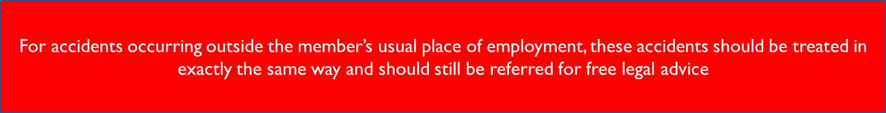
What to do in the event of an Accident/Assault
Take photographs if necessary to provide evidence of the cause of the accident, location, relevant equipment etc. The employer should not refuse permission for you to do this as this is an important part of the investigation.

Slide 24
Working together
Member awareness of the Personal Injury claims service is important. We need to remind members that their families can also access free legal services as well.
Where there is a dispute, we can work together with union reps. We may look for help on issues in specific cases, for example:
  Establishing if documents exist and obtaining them.
  Reviewing relevant assailant history.
  Details of training/PPE provision.
  Collecting details of helpful witnesses.
  Confirmation of workplace practices.
  Explanation of pay and pension provisions.
  Encourage your member to agree to publicity where their claim was successful.
Working together to identify developments such as multiple claims or new safety concerns in the workplace.

Slide 25
Useful Resources

Slide 26

Free online legal guides
Members can access a range of legal guides and resources by scanning the QR code:

Slide 27
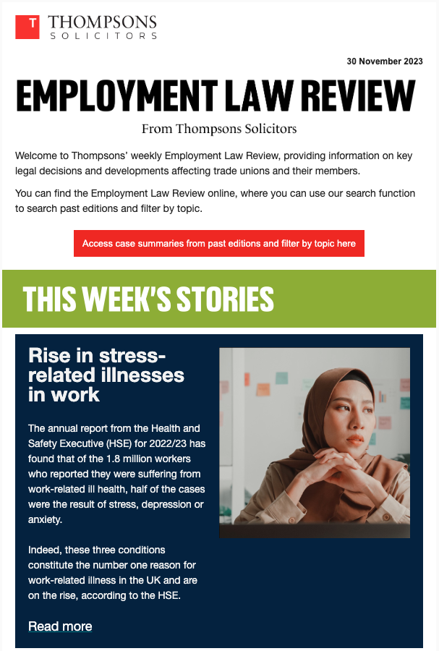

Employment Law Review
Weekly newsletter.
Covering relevant case summaries for reps.
Direct to your inbox.
Searchable on the Thompsons website.

Slide 28
How to get in touch
For personal injuries, industrial diseases and clinical negligence: www.thompsonstradeunion.law
0800 587 7515
For conveyancing, probate, powers of attorney and wills:
0800 051 4218
For employment rights:
Contact your local union representative.
1016.391

