Slide 1


PERSONAL SAFETY AND LONE WORKING
TUC CONFERENCE
SASKIA GARNER
HEAD OF POLICY AND CAMPAIGNS
The Suzy Lamplugh Trust

Slide 2

Who Was Suzy Lamplugh?
1
Estate agent
2
25 years old
3
Appointment at 12.40PM
28TH July 1986, with Mr Kipper
4
6.45pm, manager reported Suzy
missing to police
5
Disappeared - presumed murdered
Notes:
Before we begin I’d like to give you a brief over view of SLT, for those of you who are not aware of who we are and why we are here​​
​​
The Trust was set up in 1986 by Paul and Diana, the parents of Suzy Lamplugh​​
12.40pm on 28th July, Suzy had left her office Fulham Road, ​​
Taking some personal possessions but leaving her handbag behind. ​​
Ten minutes later she was seen waiting outside an empty property, which had only been on the market for one week. ​​
At 1.00pm she was joined by a man (presumably the “Mr Kipper” she had written in her diary) who was dressed “immaculately – as if he’s used to it” and minutes later they were seen walking away from the house. ​​
At 6.45pm her manager reported Suzy’s disappearance to the police.​​
​​
Suzy's parents belived that she had been stalked and this is what led to our long history of campaigning in this area.​
​

Slide 3



Our Work Includes
Support
Free safety tips​​​
National Stalking Helpline​​​
Community projects​
Education
Personal Safety training​​​
Publishing guidance​​​
Consultancy​
Campaigning
Raising awareness​​​
Influencing policy makers​​​
Working with partners​
Notes:
Suzy Lamplugh Trust is widely regarded as a field expert in lone-working and personal safety training, stalking training, as well as consultancy, campaigning, and support services.
It has a long history of working within the Violence Against Women and Girls sector, dealing particularly with stalking and harassment, given that it is believed, and indeed the evidence suggests Suzy may have been targeted by a stalker.
The National Stalking Helpline was set up by the Trust in 2010, it has helped over 65,000 victims since its inception, and is the only service of its kind globally.
The Trust campaigns heavily to raise greater awareness of personal safety and stalking issues, demand systemic change where needed, influence public policy, and promote a society in which people are safer and feel safer.
Its longest running campaign has been the licensing of the operators and drivers of minicabs and private hire vehicles, which begun in 1998.
This campaigning and policy work has been pivotal to changes in legislation and practice nationally - including in the introduction of the Protection from Harassment Act 1997, and the Protection of Freedoms Act 2012, which introduced specific offences for stalking, and the 2020 stalking protection orders.

Slide 4

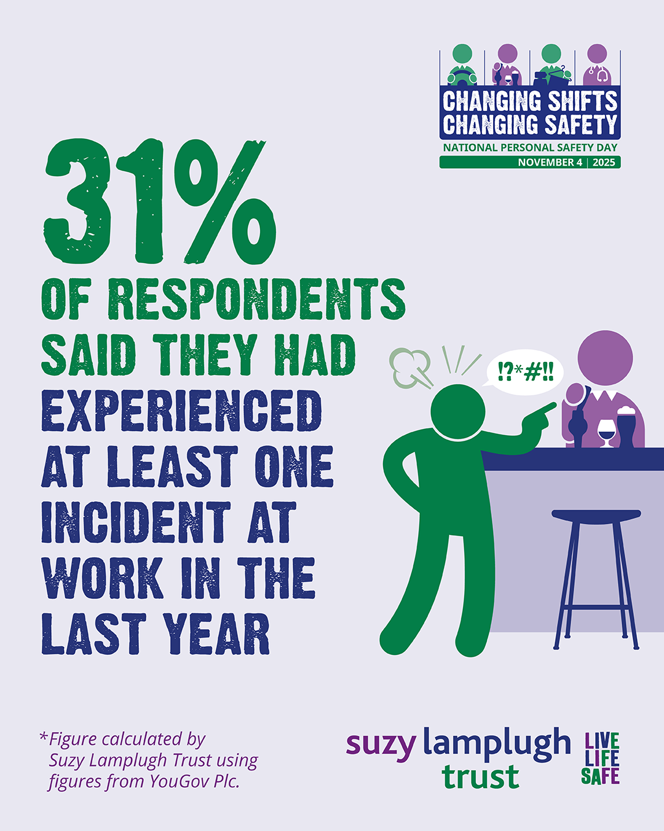
Workplace safety
The most common incidents experienced by workers across all four sectors included verbal abuse or threats and bullying or intimidation.
1 in 5 respondents stated they felt they were often or sometimes at risk of violence, aggression, abuse or harassment in the workplace
Gap between perceived risk and actual incidents experienced
Notes:
In September 2025, we commissioned a survey with YouGov looking at workers’ experiences of violence, aggression and abuse in the workplace across 4 key sectors: transport, healthcare, hospitality and retail.
The results were shocking.
31% of respondents stated that they had experienced one incident at work within the last year.
The most common incidents experienced by workers across all four sectors included verbal abuse or threats (21%) and bullying or intimidation (14%).
1 in 5 stated that they felt they were often or sometimes at risk of violence, aggression, abuse or harassment in the workplace.
The gap between perceived risk and actual incidents experienced suggests a normalisation of frontline violence for workers in these sectors. Incidents of violence, aggression, abuse or harassment do not necessarily seem to make them feel more unsafe but are rather seen as part of the job.

Slide 5

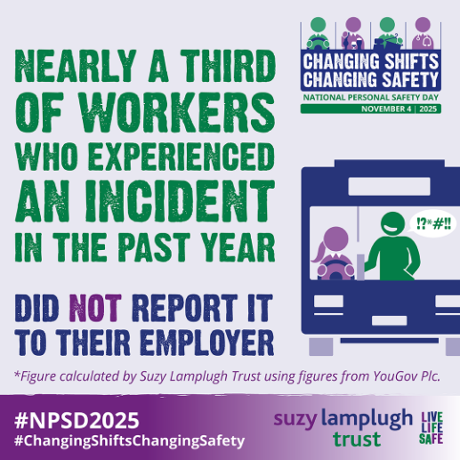
National Personal Safety Day 2025:
Changing Shifts, Changing Safety
Notes:
Last year, National Personal Safety Day focused on violence, abuse and harassment against frontline workers. Our 2025 report ‘Changing Shifts, Changing Safety: Tackling workplace violence across the retail, transport, healthcare and hospitality sectors’ found that women, disabled workers, LGBTQ+ staff, and Black and minoritised workers were found to experience disproportionately higher levels of harm.
The Suzy Lamplugh Trust's research supported by Peoplesafe showed that:
1 in 5 workers felt at risk of violence at work
Nearly a third reported experiencing an incident in the past year
Women were approximately 8 times more likely than men to experience sexual harassment and/or assault at work
30% of workers said that they had not received any training or resources from their employer on preventing or managing violence or harassment
Specialist training was seen as valuable, with 13% supporting personal safety and lone working training, 8% calling for specific training on sexual harassment, and 15% identifying bystander training as helpful. Others emphasised the importance of visible security measures: 17% said CCTV or security guards would make them feel safer, while 12% wanted access to panic alarms, apps, or other devices to call for help. A further 13% stressed the need for robust and transparent reporting mechanisms, and 13% highlighted strengthening workplace safety policies in consultation with specialist services.

Slide 6
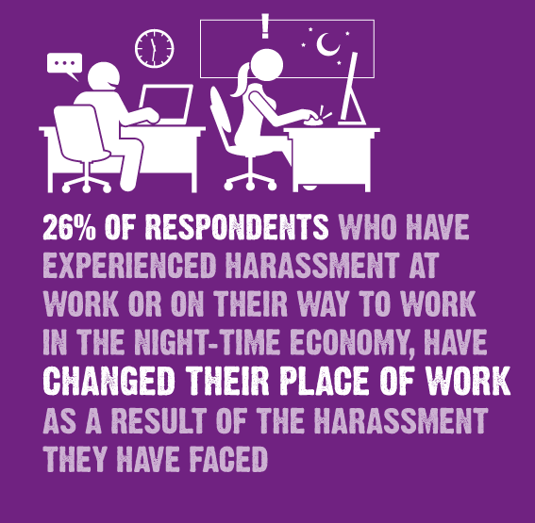
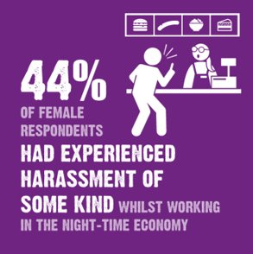
Harassment at work
Notes:
The Suzy Lamplugh Trust conducted a YouGov survey in September 2022 to gather information of the experiences of employees that work in the night-time economy, with a specific focus on harassment at work .
Of the 1,768 night-time workers surveyed, a shocking one third (34%) had experienced some form of unwanted behaviour whilst working, or on their way to work, in the night-time economy. 15% of respondents had experienced sexual harassment whilst working, or on their way to work.
Our findings show that women are more likely than men to have experienced harassment within or on their way to their workplace, with 26% of men having experienced harassment compared with 44% of women.
Essential to recognise stalking and harassment and signpost employees to specialist support

Slide 7
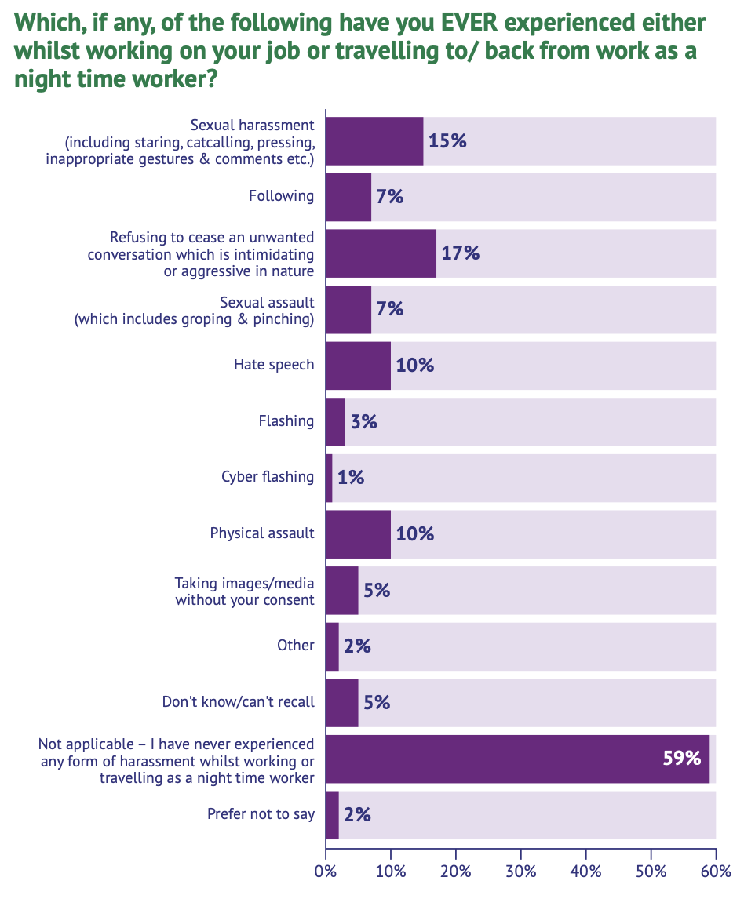
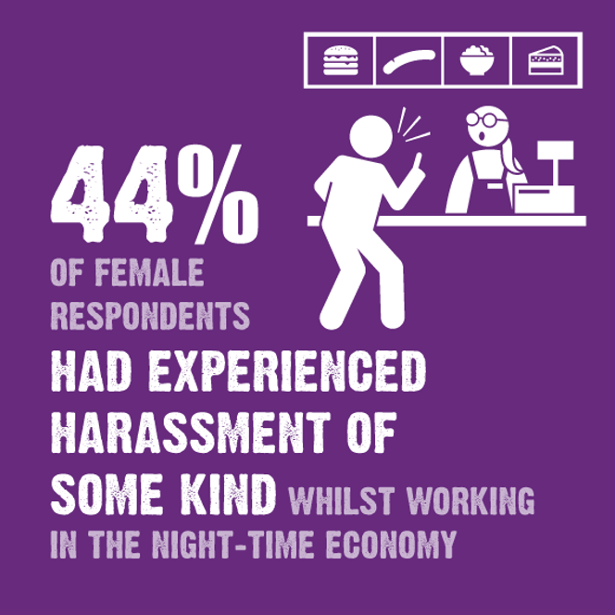
Harassment in the Night-Time Economy
Notes:
2022 same report
Of the 1768 night-time economy workers surveyed, a shocking one third (34%) had experienced some form of unwanted behaviour whilst working, or on their way to work, and 15% of respondents had experienced sexual harassment. Our findings show that women are more likely than men to have experienced harassment within or on their way to their workplace, with 44% of women having experienced harassment compared with 26% of men. In the majority of all reported cases of harassment (83%), the perpetrator was a man. These findings indicate that women are disproportionately disadvantaged within the workplace compared to their male counterparts, due to their increased experiences of harassment as indicated by our findings.

Slide 8
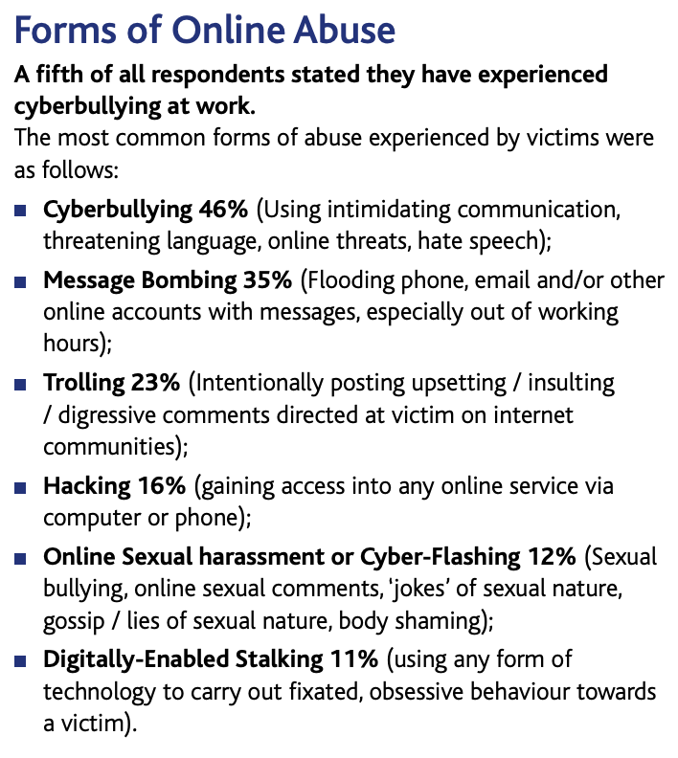
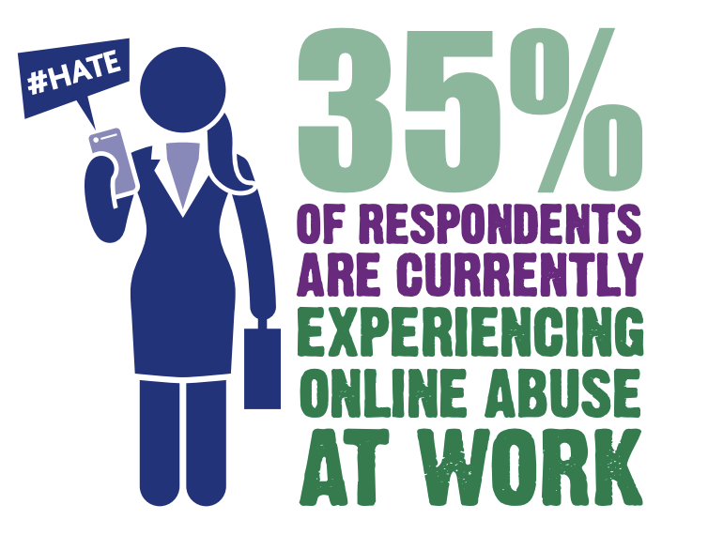
Cyber Safety at Work
Notes:
In 2020 we conducted research into the escalation of online harms and the increasingly blurred lines between work and home life as a result of the pandemic. We found that one third of participants were currently experiencing online abuse at work. Of these victims, 83% indicated that the abuse has escalated over the period of the pandemic. The study found major gaps in employers’ provision of personal safety support for lone workers while online. Employers, employees and online social media and communication platforms all share responsibility for the cyber safety of the worker. Initiatives like the Women's Night Safety Charter will ensure that workplace safety, both online and offline, are embedded into company policy.

Slide 9

Worker Protection Act
26th Oct 2024
Prevention over Redress
Anticipatory Duties
Compensatory Uplift
EHRC and Tribunal Enforcement
Notes:
In collaboration with organizations such as the TUC and other unions, we have campaigned to strengthen worker protections, particularly against workplace sexual harassment. Notably, we supported the introduction of the Worker Protection (Amendment of Equality Act 2010) Act 2023, which came into force on 26th October 2024.
The Worker Protection Act 2023 is an amendment of Equality Act 2010 is a significant piece of legislation that aims to better protect employees from workplace harassment, particularly sexual harassment. Here are the key points you need to know:
Prevention Over Redress: The Act shifts the focus from ‘redress’ to ‘prevention’. This means an employer would be liable for the sexual harassment of employees and introduces a positive duty on employers to prevent sexual harassment. The preventative duty includes a duty to take reasonable steps to prevent sexual harassment. Whilst employers are not legally responsible for preventing harassment from third parties towards their employees, the act is drafted broadly enough to cover harassment by third parties in certain cases. Employers should therefore anticipate the risk of employees being harassed by third parties as part of their risk assessment.
‘Reasonable steps’ in this context could include policies and clear protocols for steps that will be taken to remedy a complaint against a third party or prevent it from happening again.
Anticipatory Duties: Employers should not wait until a complaint of sexual harassment has been raised before they take any action. The duty requires that employers should anticipate scenarios when its workers may be subject to sexual harassment in the course of employment and take action to prevent such harassment taking place. However, if sexual harassment has taken place, the preventative duty means an employer should take action to stop sexual harassment from happening again. If an employer fails to take reasonable steps to comply with the preventative duty, there are consequences.
Compensation Uplift: Any successful tribunal claim will be subject to a compensation uplift of up to 25%. This means that if there has been a breach of the employer’s duty in sexual harassment cases, a tribunal may order the respondent to pay an amount to the complainant (a “compensation uplift”) in addition to the compensation amount.
EHRC/Tribunal: Employers are under a statutory duty to take reasonable steps to prevent sexual harassment in the workplace. If employers fail to take reasonable steps to prevent sexual harassment, then the Equality and Human Rights Commission can take enforcement steps. This new duty to prevent sexual harassment will be enforceable by an employment tribunal, where it has first upheld a claim for sexual harassment

Slide 10
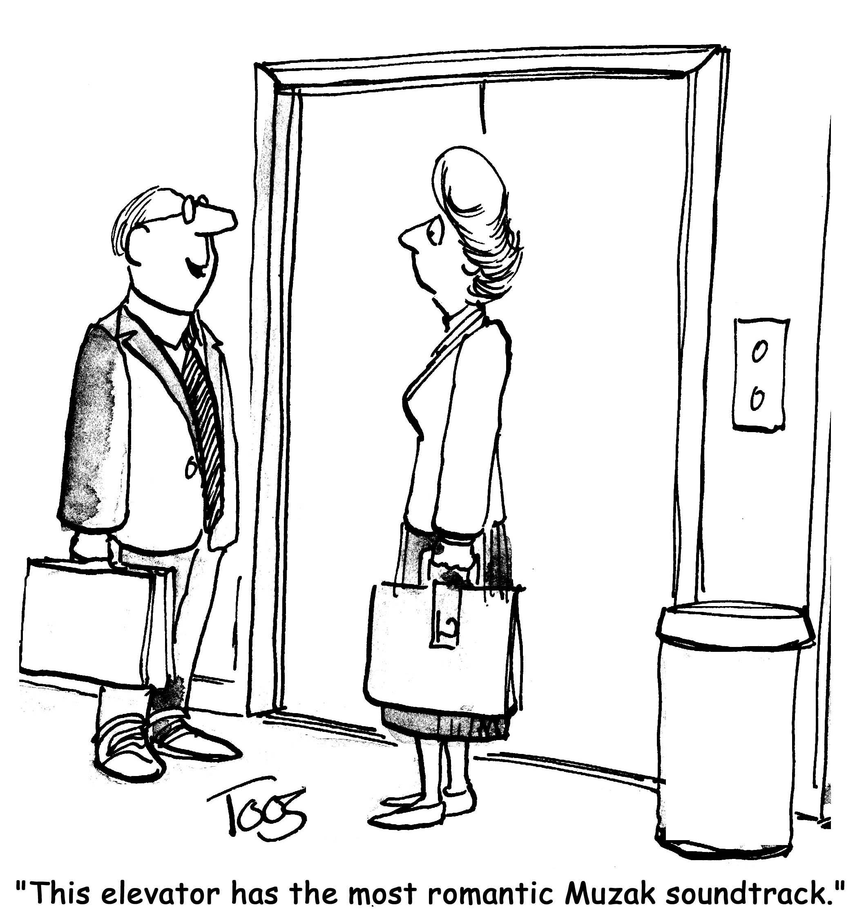
EHRC’s 8-Step Guide to Preventing
Sexual Harassment At Work
Step 1: Developing an effective anti-harassment policy.
Step 2: Engaging staff.
Step 3: Assessing and taking steps to reduce risks.
Step 4: setting up a reporting system.
Step 5: Training.
Step 6: Handling complaints.
Step 7: dealing with third party harassment.
Step 8: monitoring and evaluating actions.
Notes:
Aligned with the new Worker Protection Act 2023, the Equality and Human Rights Commission has outlined 8 steps as part of their detailed guidance on how organisations can effectively prevent and respond to sexual harassment in the workplace. While this is not a comprehensive list, implementation of these steps will nonetheless help to drive positive actions that will collectively help prevent sexual harassment at work.
Importantly, all employees, including managers and senior staff must be trained on what sexual harassment in the workplace looks like, what to do if they experience or witness it, and how to handle any complaints. Where third-party harassment from customers is more likely, employees should also be trained on how to address these behaviours. It is therefore important to consider:
What Sexual Harassment Is
Including how it overlaps with and differs from bullying and other forms of harassment.
Legal Protections and Current Legislation
A summary of laws that safeguard employees from harmful and unwanted behaviour.
The Role of Workplace Culture
How organisational norms and behaviours can enable or discourage harassment, and sexual harassment.
Impact on Individuals and Organisations
The personal and professional consequences of misconduct, including its effect on morale, wellbeing, and performance.
Shared Responsibility for Change
The roles of both employers and employees in preventing, addressing, and eliminating these behaviours — with the goal of creating lasting behavioural and cultural change across the organisation.
What to Do if You’re Experiencing Harassment:
Provide practical steps and resources for individuals facing harassment, including internal reporting procedures and external avenues for support.

Slide 11
Questions for you to consider
as an employee
Do you know what harassment is?
Can you recognise it?
Do you know if you are supported by a relevant policy?”
Does your policy set a culture of zero tolerance?
What are the consequences for perpetrators?
Do you know what to do if it occurs?
Notes:
Does everyone know how the organisation talks about harassment in their policies? Do you know where the policies live?
Have your rights been communicated to you clearly? Have the processes been communicated clearly?
Do you know how to report an incident? Who? What steps? Consequences of reporting? Consequences for perpetrator?
Are there multiple methods of reporting (including confidential, anonymous and not just via a line manager)?
Sexual Harassment needs to potentially be ‘on the agenda’ at every meeting/interaction, not just confined to training/awareness sessions. If necessary, it must be raised and addressed in:
informal one-to-ones
sickness absence or return-to-work meetings
meetings about performance
open door meetings with senior management or ‘town hall’ meetings
exit interviews
a post-employment survey
mentoring programmes and staff networks

Slide 12
What is harassment?
Harassment could be if someone:
Contacts you or attempts to contact without your permission or after having been asked not to
Monitors a person’s movements, by use of internet, email or any other form of electronic communication
Makes inappropriate comments/sexual innuendos
Make rude physical gestures or facial expressions towards a person
Makes unwanted sexual remarks
Makes requests for sexual favours
Interferes with any property in the possession of a person
Displays images or graffiti that are unwanted or offensive (either online and offline)
Notes:
Harassment could be if someone:
Contacts you or attempts to contact without your permission or after having been asked not to
Monitors a person’s movements, by use of internet, email or any other form of electronic communication
Makes inappropriate comments/sexual innuendos
Make rude physical gestures or facial expressions towards a person
Makes unwanted sexual remarks
Makes requests for sexual favours
Interferes with any property in the possession of a person
Displays images or graffiti that are unwanted or offensive (either online and offline)
There is significant overlap between stalking and harassment and it is often mis-identified by the police, however the Suzy Lamplugh Trust advocates for stalking to be actively identified and investigated in cases of repeated unwanted behaviour against an individual to ensure its not mis-identified as harassment, as outlined in the super-complaint we submitted at the end of last year. It is vital that this distinction is made so that victims of stalking receive the correct support.

Slide 13
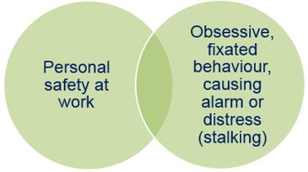
What is stalking?
“Stalking is a pattern of fixated and obsessive behaviour, which is intrusive and causes fear of violence or engenders alarm and distress in the victim.”​
Stalking behaviour is unwanted, persistent, and it is almost always carried out (or orchestrated by) one individual towards another individual​
Stalkers could be partners / ex-partners, the public, clients, suspects, witnesses, colleagues ​
1 in 5 women and 1 in 10 men in UK will be stalked in their lifetime. It is as pervasive as domestic abuse ​
80% of our callers are women
There were an estimated 1.4 million victims of stalking in England and Wales in the year ending March 2025
Of those who contact us, over 94% are stalked by someone they know
Notes:
We would like to start by outlining what stalking and harassment are, and how they can be perpetrated within the workplace.
“Stalking is a pattern of fixated and obsessive behaviour, which is intrusive and causes fear of violence or engenders alarm and distress in the victim.”​
Stalking behaviour is unwanted, persistent, and it is almost always carried out (or orchestrated by) one individual towards another individual​
Stalkers could be partners / ex-partners, the public, clients, suspects, witnesses, colleagues ​
1 in 5 women and 1 in 10 men in UK will be stalked in their lifetime. It is as pervasive as domestic abuse (CSEW 2017)​
80% of our callers are women (Suzy Lamplugh Trust 2017)​
An estimated that 1,144,602 adults in England and Wales experienced stalking that year (CSEW 2017)​
Of those who contact us, over 94% are stalked by someone they know
Gracie Spinx

Slide 14
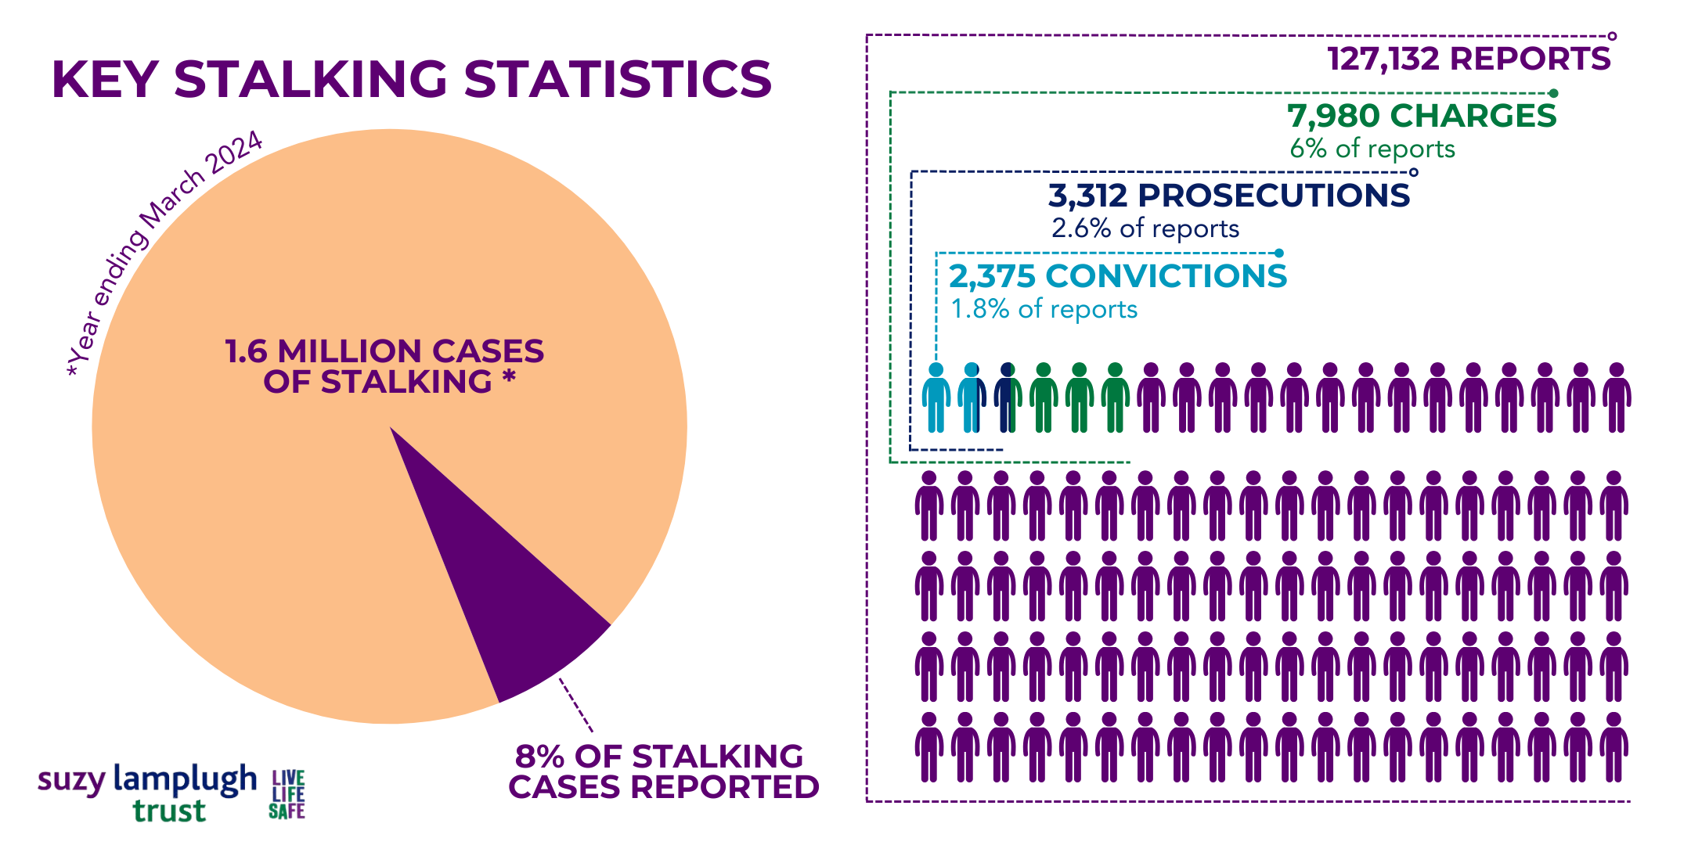
Stalking
What is stalking?
​Stalking is a pattern of fixated and obsessive behaviour, which is intrusive and causes fear of violence or engenders alarm and distress in the victim (Suzy Lamplugh Trust)
  Stalking behaviour is unwanted, persistent, and it is almost always carried out (or orchestrated by) one individual towards another individual

Slide 15
Stalking behaviours
Stalking Behaviour​​ | Percentage of clients reporting​​ | Stalking Behaviour​​ | Percentage of clients reporting​​
Social Networking sites​​ | 32.63%​​ | Harassment​​ | 8.54%​​
Text messages​​ | 29.18%​​ | Letters​​ | 8.54%​​
Phone calls​​ | 27.06%​​ | Gifts​​ | 6.05%​​
Visit house/work​​ | 24.09%​​ | Physical assault​​ | 4.36%​​
Third party contact​​ | 22.40%​​ | Criminal damage​​​ | 4.12%​​​
Emails​​ | 20.28%​​ | Death threats​​​ | 3.45%​​​
Threats​​ | 18.04%​​ | Hacking technology​​​ | 3.33%​​​
In/Through workplace​​ | 11.38%​​ | Threaten suicide​​ | 2.97%​​
Following​​ | 15.07%​​ | Spying​​ | 2.60%​​
Loitering​​ | 9.14%​​ | Break in​​ | 2.12%​​
Other​​ | 9.14%​​ | Revenge Porn​​ | 2.00%​​
Vexatious complaints​​ | 8.78%​​ | Use of tracking device​​ | 1.15%​​
Watching​​ | 8.66%​​ | Sexual assault​​ | 0.85%​​

Slide 16
THE IMPACT OF STALKING
Others Targeted
1 in 4 targeted children
1 in 3 targeted family and friends
1 in 5 targeted work colleagues
Hypersensitive/ Hyper vigilant
Loss
Jobs
Relationships
Families
Global
Physical/ Emotional Effects
Anxiety
Sleep Disorders
Anger
Distrust
Eating Disorders
Self Harm
PTSD
Contact to gain information
21
Financial and Social loss
Suffer Multiple Incidents Before Reporting
Secondary Impact
Friends
family
Notes:
The impacts of stalking are incredibly complex due to the many layers of the crime:
The prolonged victimisation individuals experience can mean their trauma is deeply embedded in their lives and hard to overcome.
50% had been stalked for longer than 18 months; The average stalking case lasts between six months and two years, but cases have lasted more than four decades.
The globalism of stalking compounds the impact - the majority of victims report that multiple forms of contact were used including phone, e-mails, spying, letters, turning up, social media, child contact and court processes; making it impossible for them to feel safe in any place or at any time.
Many victims also experience guilt as their stalker has also targeted their children, family, friends, or colleagues; an average of around 21 people connected to the victim are targeted
The social impact of stalking can cause victims to lose jobs, relationships, friends, 10% of victims move house, and the majority have financial impacts of trying to stay safe. Many isolate themselves to try to minimise the impact on others, or because they cannot trust who might be targeted or befriended by their stalker next.
There are wide-reaching physical and emotional effects –
anxiety, depression, sleep disturbances, weight loss, anger, distrust, eating disorders, self harm, post traumatic stress disorder.
Victims can be hypersensitive and hyper vigilant, with more than 70% in one study developing symptoms of PTSD
16

Slide 17
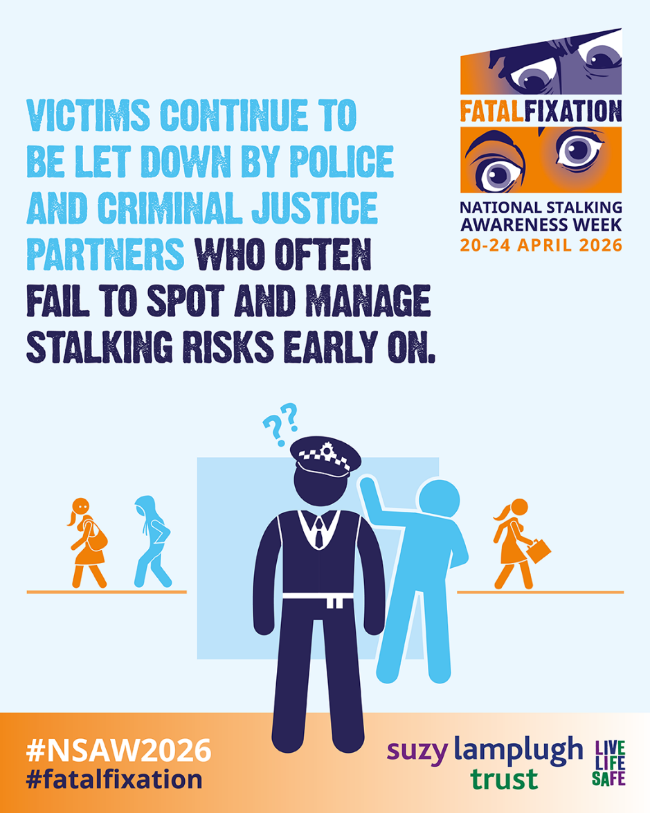
Our research shows …
Stalking is not harmless and can escalate to serious violence, suicide and homicide.
Far too often, warning signs are missed or minimised, meaning missed opportunities for early intervention.
Victims across both domestic and non-domestic contexts may be affected, with intersecting vulnerabilities increasing risk.
Greater awareness and recognition is needed.
Notes:
Stalking is a pattern of repeated, unwanted, fixated and obsessive behaviour that can escalate in risk and severity over time. These patterns can precede serious violence, suicide and homicide.
One key problem is that behaviours are treated as isolated incidents rather than part of a broader pattern. Warning signs are frequently overlooked, miscategorised (often charged as harassment or malicious communication) or not consistently acted upon across public bodies and agencies as highlighted in the super-complaint on the police response to stalking.
Even in Domestic Abuse Related Death Reviews, stalking may not be consistently recognised or documented, including inconsistencies to how things are recorded.
Evidence indicates victims stalked by ex-intimate partners, especially after separation may face heightened risk. Post -separation has been identified as a key risk factor/trigger even within other relationship types.
There is also a lack of understanding and research of stalking outside of intimate or family relationships. As a result, opportunities to intervene early are missed, allowing situations to escalate to serious harm or death.

Slide 18

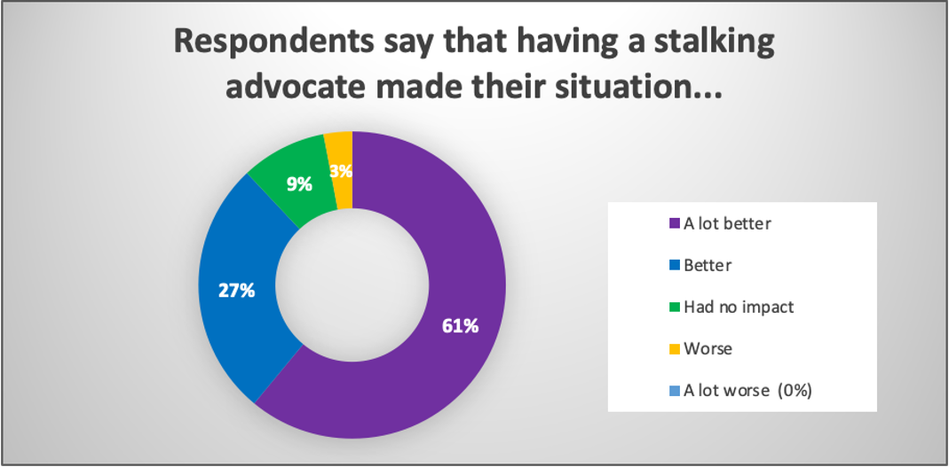
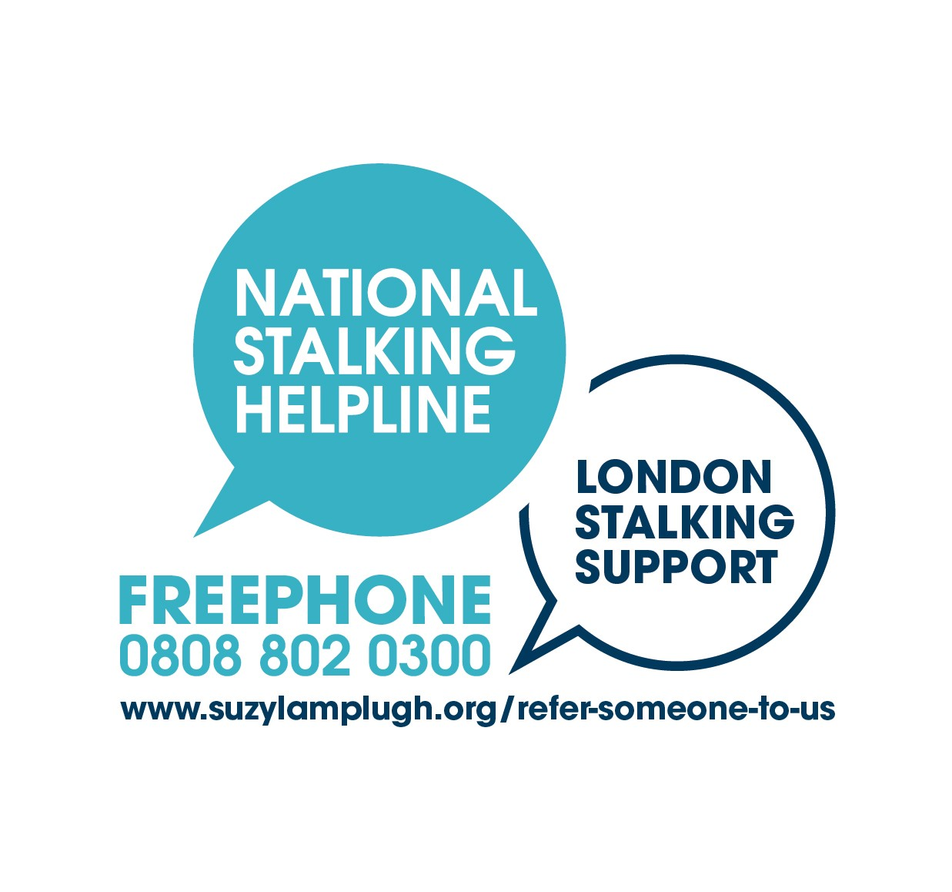
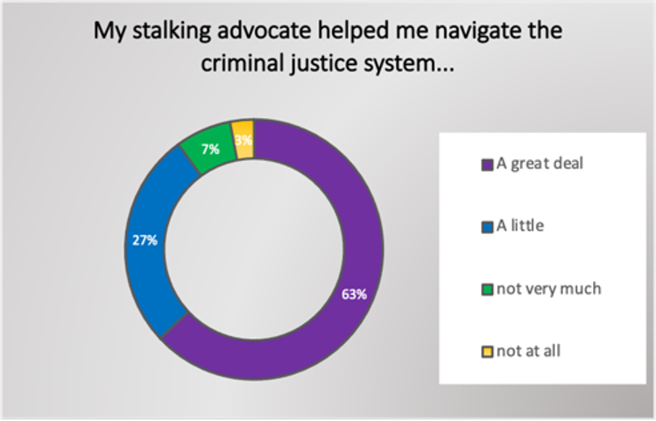
Supporting Victims:
National Stalking Helpline & Advocacy Service
Notes:
Our Independent Stalking Advocates are trained specialists who provide victims with expert advice and support during a period of crisis, often when the stalker’s behaviour is escalating and the response from the criminal justice system or other agencies fails to address it. ​
Stalking advocacy support is often ongoing and can last for many months or longer.- length of stalking case​
Stalking advocates support victims in a holistic way to help them manage and cope with their situation and to recover from the abuse they are experiencing. ​
They carry out specialist risk assessments and ensure that safety plans ​
Informing victims of their rights ​
Helping victims gain confidence and empowering them to take next steps​
Ensuring that police investigate cases of stalking, collect evidence, and apply appropriate safeguarding obligations and protection orders ​
Advising victims on how to gather evidence ​
Accompanying victims to court ​
Representing victims’ voices with whatever agencies may be involved in the case including, social services, housing, or their employer​
Connecting victims to other forms of support as needed ​
And much much more....
Approximately one in four respondents who were supported by a stalking advocate saw their stalkers convicted. This is substantially better than the published rates for England and Wales where only one in 1,000 stalkers are convicted.

Slide 19
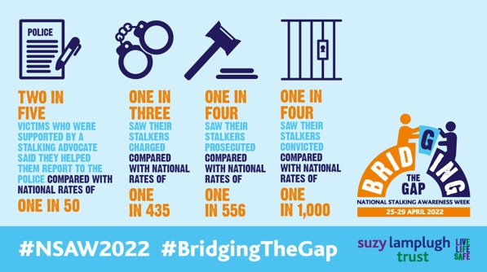
Advocacy helps the victim reach criminal justice outcomes
Notes:
Key role of ISAs
Our Independent Stalking Advocates are trained specialists who provide victims with expert advice and support during a period of crisis, often when the stalker’s behaviour is escalating and the response from the criminal justice system or other agencies fails to address it.
Stalking advocacy support is often ongoing and can last for many months or longer.- length of stalking case
Stalking advocates support victims in a holistic way to help them manage and cope with their situation and to recover from the abuse they are experiencing.
They carry out specialist risk assessments and ensure that safety plans are in place
Informing victims of their rights
Helping victims gain confidence and empowering them to take next steps
Significantly, the results of our report survey in 2022 indicate that victims who were supported by a stalking advocate had higher rates of reporting to the police and were more successful when pursuing legal action against their stalkers than the national rates.
2 in 5 respondents (38%) who were supported by a stalking advocate said their advocate helped them report to the police, a third (30%) saw their stalkers charged, a quarter (26%) saw their stalkers prosecuted, and a quarter (25%) saw their stalkers convicted.
This is compared with published rates for England and Wales where only one in 50 cases are reported, one in 435 stalkers are charged, one in 556 stalkers are prosecuted, and one in 1,000 stalkers are convicted.
Yet of the 197 respondents who told us that they reported to the police, only 15% were signposted to a stalking advocate by the police; vital and we urge this; consortium services.

Slide 20
Safety Planning
Buddy System
Getting Home Safe
Enabling a person to alert others should an incident occur, both via devices (phones and personal alarms) or in person (bystanders).
Letting a trusted person know your planned route to a destination.
Checking in about your safety during time you are out.
Carrying a spare bank card or cash separate from your bag containing your phone or wallet in case this is lost or stolen, as well as a list of essential phone numbers to call for help or alert friend or family if you need assistance.
Notes:
Whilst at the Suzy Lamplugh Trust, we do not believe the victim is responsible for keeping themselves safe from harassment, personal safety advice can give individuals options to feel and be safer in the short term.
Buddy System
Having a buddy system enables a person to alert others should an incident occur, both via devices (phones and personal alarms) or in person (bystanders). Letting a trusted person know your planned route to a destination, checking in about your safety during the time you are out, and sharing your route home to help you safely arrive. This does not in any way suggest that any action an individual takes would prevent them being harassed or attacked but it would alert a trusted contact to a need for assistance were an incident to occur.
Getting Home Safe
It can be helpful to have a second option in case your wallet is lost or stolen or your phone runs out of battery, and you are trying to get home. Carrying a spare bank card or cash separate from your bag containing your phone or wallet, as well as a list of essential phone numbers to call for help or alert friend or family if you need assistance, gives you more options to get back home safely if an unwanted incident occurs.
Personal alarm or lw device

Slide 21
Risk Assessing
FORMAL
DYNAMIC
Snapshot in time
To identify and prioritise risks
A team approach
Before a task is carried out
Analysis of data and knowledge
Line Management responsibility
Ongoing process
To identify and raise personal awareness of risks
The individual
Continuously
Using personal perception and judgement
Individual responsibility
Notes:
.
Formal Risk Assessment/Generic Risk Assessment – the Five Stages for Risk Assessment
The Health and Safety Executive (HSE) proposes five stages for risk assessment1:
1) Identify the hazards
2) Identify who is at risk
3) Evaluate the risks
4) Record the findings
5) Review and modify risk assessments annually or as and when working practices change.
Dynamic Risk Assessment – using SLT’s A.P.P model
3 step process model for on-the-spot risk assessment to take account of changing circumstances; i.e. people’s behaviour, the weather/escape routes, etc. and recognition of the inherent level of risk in a given task or situation.

Slide 22

LONE WORKER
CHECKLIST
Suggested for
questions for lone workers-
adapt to meet
your own requirements.
If the answer to any of the
questions is ‘NO’ then the
lone worker should be
expected to speak to a line
manager before continuing.
Do I need to go?
Have I checked the file for
relevant information?
Have I told someone of
my intended movements?
Have I got means of
communication?
Have I thought through
my own ‘what if plan’?
Do I feel confident to go?

Slide 23
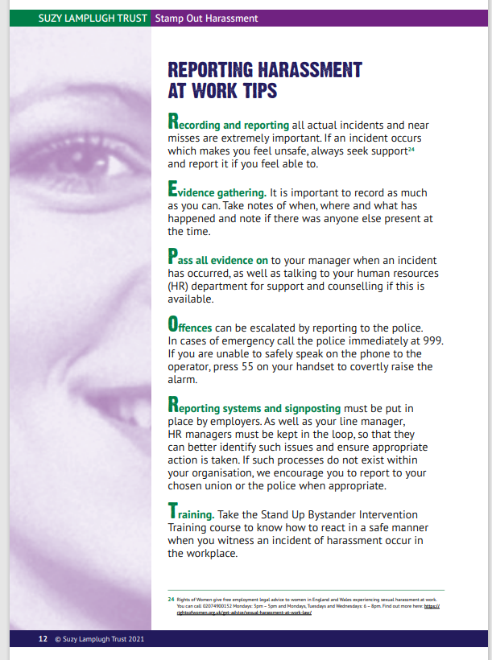
Notes:
Policies should include all the above and include advice about signposting to specialist services where someone might need support after an incident.

Slide 24
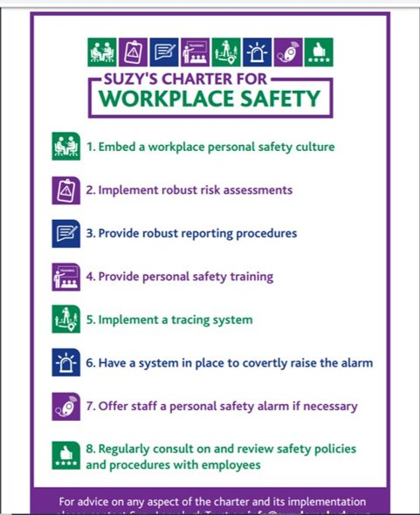
Notes:
PREVENTION
What we can we put in place to minimise risk to employees
Developed charter with steering group
Best Practice; construction; lanyards and remote signal
Multi-function offices; ID and signing in; reporting
Buddy systems and escalation; taking responsibility
POLOCY SHOULD COVER ALL THIS

Slide 25

Personal safety policies
Personal Safety and the Law
Risk Assessments
Reporting
Personal safety procedures
Conflict De-escalation
Emergency procedures
Support following an incident
Monitoring and Review
Notes:
Policy should include all of the above as well as:
Definitions in law to help identify harmful behaviours

Slide 26
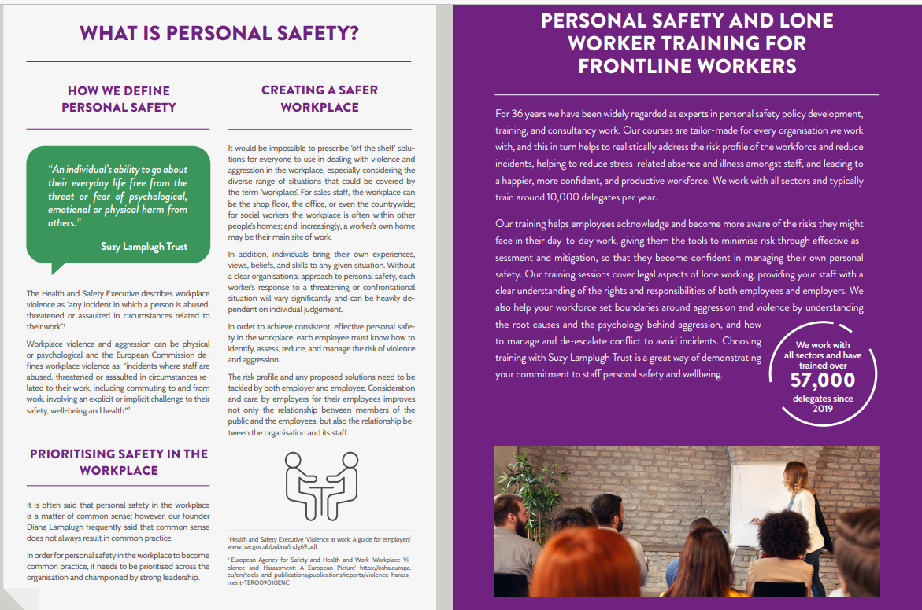
Personal Safety Training
Notes:
Best Practice; establishing a personal safety culture
With the Worker Protection Act coming into place in October 2024, the Suzy Lamplugh Trust can support with providing training to your employees.
We can provide training on mitigating and managing harassment and sexual harassment in the workplace, helping organisations to set boundaries around, and manage undesirable behaviours effectively, implementing approaches necessary for effective escalation, reporting and supporting those adversely affected.
Our awareness raising talks can drive mindfulness of these topics, upskilling and empowering employees to stand up to unwanted and harmful behaviours, whilst ensuring managers clearly know their next steps.

Slide 27
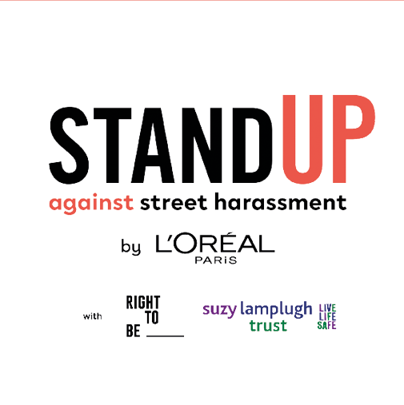
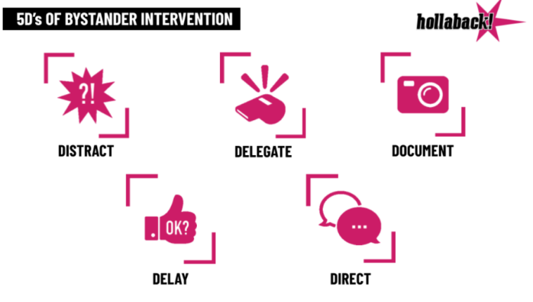
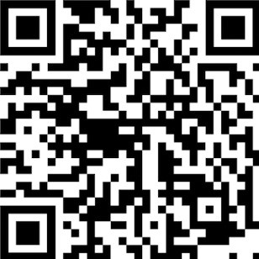
Bystander Intervention
Notes:
Harassment also shows up in ways tied to our identities—race, religion, sexuality, gender, disability, or immigration status. It might be slurs on a bus, threats shouted from across the street, unwanted touching, sexual comments, or even physical attacks. This especially affects marginalised communities: ethnic minorities, LGBTQIA+ people, disabled people, immigrants, faith communities, older people, and women—over 80% of whom have experienced sexual harassment in public at least once.
But here’s the thing: when you see harassment happening, you have the power to change what happens next.
We know it can feel scary to act—maybe you’re not sure what to do, or you’re worried about your own safety. That’s why we share the 5Ds Methodology of Bystander Intervention. Developed by the American NGO “Right To Be,” it’s about knowing your options to safely support someone being harassed, without putting yourself in harm’s way.
Let’s break down the 5Ds—remember, you don’t have to be a hero, and you don’t have to do everything. Just one action can make a real difference, but whatever you do, remember the 5Ds allow you to make a choice depending on how safe you feel, and your safety is priority number one!
Distract: Create a distraction to break the tension. Drop something (safely), ask a random question, start a funny conversation—anything to give the person being targeted a chance to breathe.
Delegate: Get help. Find someone who can help safely—maybe a staff member, security, a friend, or another bystander. You don’t have to face it alone.
Document: If it’s safe, take out your phone and record what’s happening. Stay discreet and never post anything without the permission of the person targeted. Your video is for them, not for the internet.
Delay: Even if you didn’t feel comfortable to step in during the moment, you can check in with the affected person/s afterwards. Ask, “Are you okay? Do you want help?” Knowing someone cares can ease the impact of what happened.
Direct: If you feel safe, address the harasser directly. Be calm, firm, and clear: “That’s not okay. Leave them alone.” Then, turn your attention to the person targeted and see how you can support them.
To learn more, undertake the 30-minute free, globally approved “Stand Up Against Street Harassment” by visiting the Suzy Lamplugh website under “Events” or scan the QR code on the slide.

Slide 28





FOR MORE INFORMATION …
training@suzylamplugh.org
advice@stalkinghelpline.org
www.suzylamplugh.org
www.stalkinghelpline,org
Suzylamplughtrust
stalkinghelpline
@life_life_safe
@talkingStalking
Notes:
Signpost to ROW - contact the Sexual Harassment at Work advice line on 020 7490 0152, see our opening hours at Rights of Women: Get Advice.

