Slide 1
Work-Related Violence:
What does the law say, and What Can We Do?
Dan Shears
National HS&E Director
TUC/Thompsons Violence Workshop
17th April 2026

Slide 2
What is work-related violence?
The Health and Safety Executive (HSE) defines work related violence as:
“Any incident in which a person is abused, threatened or assaulted in circumstances relating to their work. This can include verbal abuse or threats as well as physical attacks.”

Slide 3
Why do we care about violence at work?
Violence is an increasing and extremely serious hazard in many sectors:
  Security
  Hospitality
  Health Sector
  Retail
  Public Transport
  Police/Prisons/Probation etc
It may be unpredictable, but it is forseeable, and it can be prevented – so why isn’t it?

Slide 4
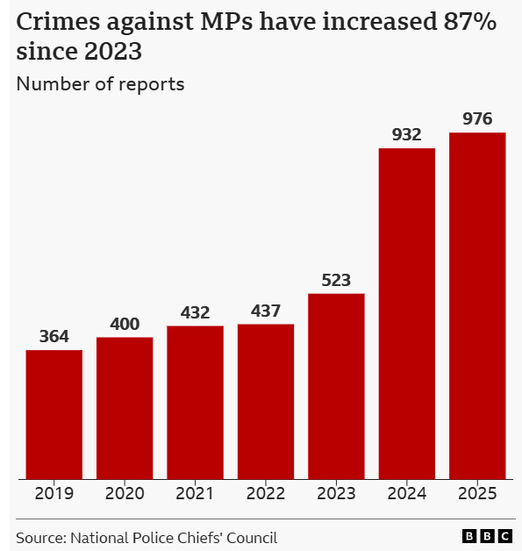
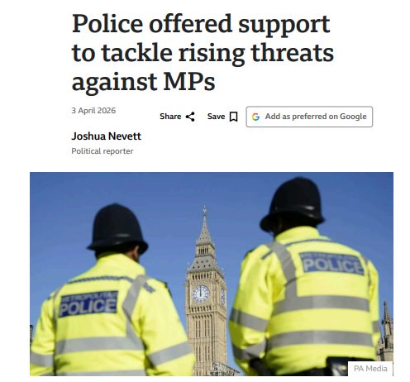
Violence towards public figures
Notes:
Stephen Timms, stabbed 2010; Jo Cox 2016; David Amess 2021

Slide 5
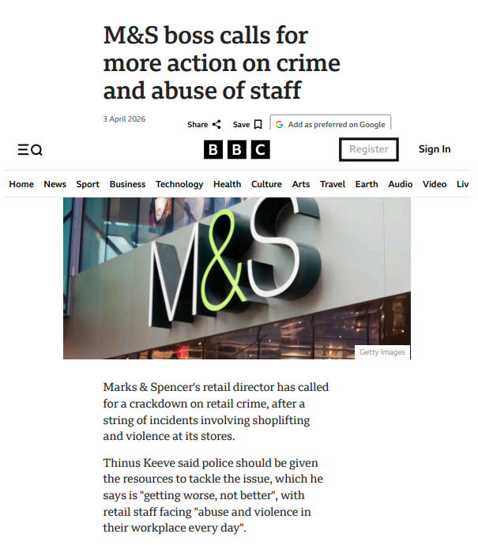
Violence in Retail

Slide 6
How much of a problem is this?
In 2024/25, there were an estimated 689,000 incidents of violence at work in the UK (specifically Great Britain), according to the Crime Survey for England and Wales (CSEW).
This figure represents an increase of approximately 47,000 incidents compared to the previous year, continuing a rising trend in workplace aggression.
Breakdown of the 2024/25 Statistics
The data, which is largely derived from the highlights the following:
Total Incidents: 689,000
  Assaults: 370,000 (Physical attacks)
  Threats: 319,000 (Threats of violence)

Slide 7
How much of a problem is this?
Victims: An estimated 329,000 adults experienced at least one incident of work-related violence during the year.
Injuries: Approximately 38% of the assaults resulted in physical injury.
Underreporting: The HSE notes that workplace violence remains severely underreported, often because staff in high-risk sectors view it as "part of the job.“
This represents roughly about 1% of working adults experiencing workplace violence in a year (consistent with prior survey trends).

Slide 8
How much of a problem is this?
Highest Risk Occupations
Frontline and public-facing roles continue to face the highest levels of risk. The top five occupational groups identified in the latest report are:
Protective Service Occupations (e.g., police, security)
Health and Social Care Associate Professionals
Sales Occupations (notably retail workers)
Health Professionals (e.g., doctors, nurses)
Managers and Proprietors (specifically in service sectors)

Slide 9
How much of a problem is this?
Key Trends
Alcohol Factor: Alcohol was estimated to be a factor in 52% of all workplace assaults.
Perpetrators: 60% of offenders were strangers to the victim, while 24% were clients or members of the public known to the victim through their work.
Retail Surge: Separate data from the British Retail Consortium (BRC) for the same period showed a sharp spike, with incidents in the retail sector reaching over 2,000 per day in 2023/24, a 340% increase since 2020.

Slide 10
What does the law say?
A big part of the problem is that there are no specific H&S regulations on violence at work.
The general duties in the Health and Safety at Work Act 1974 extend to violence and aggression (Sections 2,3 and 7);
Regulation 3 of the Management of Health and Safety at Work Regulations 1999 on risk assessment should include violence and aggression risks
The Personal Protective Equipment Regulations 1992 require PPE to be provided if it can mitigate violence risk that cannot be reduced in any other way.

Slide 11
What does the law say?
The Reporting of Injuries, Diseases and Dangerous Occurrences Regulations 2013 require violent incidents to be reported if they result in death, certain types of hospitalisation, or absence from normal working duties for more than 7 days
The Safety Representatives and Safety Committees Regulations 1977 and the Health and Safety (Consultation with Employees) Regulations 1996 require employers to consult with employees on the control of violence risks
The Serious Violence Duty within the Police, Crime, Sentencing and Courts Act, 2022 can extend sentencing where there are aggravating factors; and Assaults on Emergency Workers (Offences) Act 2018 increases sentences where Emergency Workers are assaulted – but it is unclear if these have any deterrent effect.
So the law is broad and non-specific. Violence is often therefore treated as a reactive matter for the Police, rather than a standard work hazard to be managed.

Slide 12

Specific legislation is possible…

Slide 13
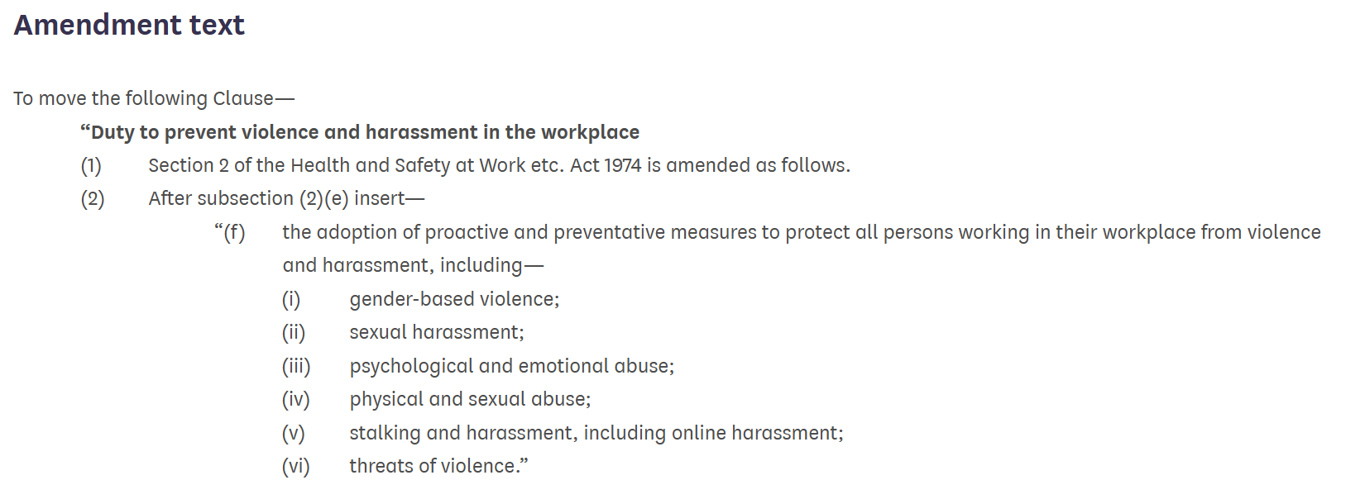
… and could have been enacted
Notes:
Liz Saville-Roberts proposed amendment to the Employment Rights Bill/Act 2025. Debated, but not called to the vote.

Slide 14
So what can we do? Reporting to HSE
How to Report a Concern
You can report a health and safety issue directly to the HSE if you believe there is a risk of serious harm.
Online Reporting: Use the HSE's official "Tell us about a health and safety issue" service. You will need to provide details about the location, the nature of the violence, and how your employer has responded so far.
By Phone: If you cannot report online, you can call their team at 0300 003 1647 during office hours (Mon–Fri).
Whistleblowing: If you are reporting as an employee, you have certain legal protections to prevent you from being treated unfairly or losing your job for raising safety concerns.

Slide 15
Check the Enforcing Authority
Before reporting, ensure the HSE is the correct body for your specific workplace.
HSE: Regulates hospitals, factories, schools, and construction sites.
Local Authorities (Environmental Health): Generally regulate offices, shops, restaurants, and care homes.
Office of Rail and Road: Regulates public transport
Office for Nuclear Regulation, Maritime and Coastguard Agency, Civil Aviation Authority in rare circumstances.
You can use the HSE's authority finder to confirm who to contact.

Slide 16
Getting Action from the Regulators
When will HSE Intervene?
The HSE generally intervenes when there is evidence of a systemic failure in how an employer manages risks – see Birmingham University Stress Case
They are more likely to take action if:
The violence has resulted in a RIDDOR report, but is not a police matter
There is a clear breach of the Health and Safety at Work Act 1974, such as a total lack of risk assessments or refusal to implement basic security measures.
All internal avenues (HR, Safety Reps, Safety committees) have been exhausted
But 99% of the time, they won’t act on an individual case/report unless it is extremely serious

Slide 17
What should employers do?
Firstly, a risk assessment, involving the workforce, needs to be performed.
This should take into account feedback from the workforce;
Consider any high-risk circumstances or work activities
Include specific risks faced by lone workers, young workers, pregnant workers, disabled workers, and vulnerable workers.
Make use of existing data – injury reports and near-misses; reports of verbal abuse; police intelligence and worker input
Identify any work activity that is high-risk and implement measures to eliminate or reduce these risks – this is the Safe System of Work for controlling violence risks

Slide 18
What does a safe system of work look like?
1. Workplace Design:
Giving space and a clear layout, for example ensuring good visibility throughout the workplace and providing good lighting to remove blind spots and ensure workers and others can be seen
Managing places where tension could grow, for example implementing a suitable queuing system
Security measures, like CCTV, trained security personnel, body-worn cameras, alarm systems, building security – they can act as a deterrent but also provide evidence for the police to convict offenders
Carefully worded signage and visual displays can remind people to respect each other and not abuse workers

Slide 19
What does a safe system of work look like?
2. Work Activity
Employers should ensure there are adequate staffing levels to manage violence and respond to incidents
They should consider how workers engage with the public and what might trigger people to act aggressively – expectations can be managed with clear information about delays or problems
They must manage lone working by making arrangements to keep in touch with people who work away from their base, for example using mobile phones and personal alarms
Good communication between management and workers should be the standard.

Slide 20
What does a safe system of work look like?
3. Training
Training can be used to prevent and manage violence. It can provide workers with appropriate skills to reduce or diffuse potential incidents.
Training should be available to everyone who may be at risk, including cleaners and maintenance workers. This also applies to temporary or agency workers.
However, the level of training provided to workers must reflect the specific needs of the work activities identified in the risk assessment.

Slide 21
What does a safe system of work look like?
3. Training
Some job roles may require additional training, such as physical intervention techniques, if there is a serious risk of physical aggression towards the workers.
Training needs should be monitored and reviewed regularly and training courses evaluated for their effectiveness. Employers should carry out refresher training periodically to ensure workers’ skills are kept up to date.

Slide 22
What does a safe system of work look like?
3. What should training cover?
Basic training in the principles of managing violence often includes:
identifying underlying and immediate causes
understanding that it should not be accepted as part of the job
recognising warning signs, such as body language
relevant interpersonal skills, such as verbal and non-verbal communication skills
details of working practices and control measures
incident reporting procedures

Slide 23
What does a safe system of work look like?
4. Protective Equipment
Panic Alarm
Body Cam – but these can result in perpetrators acting out
Body Armour
Vehicle Cams – Dash Mounted/External/360º
All of these can contribute to protective measures, deterrent effect and evidence collection, but none of these are the ‘magic bullet’ and they should not be considered as the sole solution. Reducing violence is as much about active management as it is physical measures.

Slide 24
What does a safe system of work look like?
5. Incident Reporting
There must be a clear definition of what work-related violence is. This must go beyond simply physical assaults to include threatening language and verbal abuse. Verbal abuse, as well as the harm it may do in its own right, may develop into physical abuse if it is not challenged.
To encourage reporting, there should be an agreed reporting form. This should be kept as short as possible, to encourage those affected by violence to complete the reporting process. One approach which works well is to have a single page report capturing key details, with extra sheets provided to capture detail where this is needed in more serious incidents.

Slide 25
What does a safe system of work look like?
5. Incident Reporting
The reporting form should be written in plain and straightforward language, which will direct the person completing it to provide factual evidence. The critical elements for reporting are the incident time and location; a description of assailant; and a description of any injuries suffered.
Translated forms should be available for all workers for whom English is not their primary language. If this is not possible, efforts should be made to provide interpretation to allow a report to be made. All workers should be briefed on the expectation to report violent incidents, particularly where workers may not read or write English as their primary language.

Slide 26
What does a safe system of work look like?
5. Incident Reporting
Crucially, the worker involved must be given the necessary time to complete the report form in full, as soon as possible after the incident. This will ensure that the incident details are fresh in the mind, and allows for the report to be actioned as quickly as possible after the incident has occurred. Employers should not insist on employees waiting until breaks to complete the forms.
Whilst reporting can be done electronically through smartphones, tablets or other devices, a copy must be provided to the worker upon completion. This should be a hard copy provided at the time that the report is submitted or a soft copy emailed to the employees preferred email address.
The report form should also give details on how feedback will be provided to the affected worker, along with the timescale for action. It is important that staff see action being taken as this will encourage more staff to report similar incidents in the future.

Slide 27
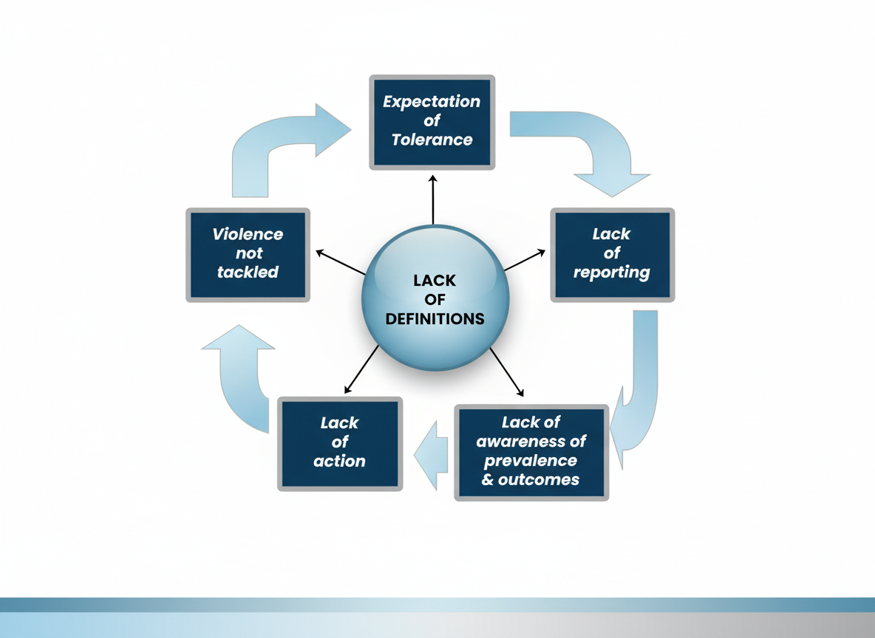
What does a safe system of work look like?
5. Incident Reporting
The Perpetual Cycle of
Unchallenged Workplace Violence
Source: HSL

Slide 28
What does a safe system of work look like?
6. Post-Incident Support
There can be a significant impact on workers who are directly involved and those who witness an incident. It can affect workers’ mental and physical health.
Victims will react in different ways − employers should consider changing a person’s job role or working conditions if they are particularly affected by the incident
Sensitive and appropriate support will reduce the victim’s suffering, for example offer them a chance to talk openly about the incident as soon as possible
Employers should provide confidential counselling or signpost victims to local counselling services, or charities such as Victim Support
All workers dealing with post-incident situations must be fully trained and competent, and know how to support their colleagues

Slide 29
What does a safe system of work look like?
7. Investigate, Review and Implement
Every significant incident will have lessons that need to be learned and applied across the organization
A serious incident is a failing of both the risk assessment and the safe system of work. Both should be formally reviewed by the employer and the workforce together.
Incidents should never be considered as a ‘one-off’ or ‘unforeseeable’. Root causes must be identified, and all aspects considered.
All learnings must be integrated into a reassessment and new SSOW.
Investigations should involve unions at all levels. In serious incidents where the Police or HSE are involved, there may be issues regarding prejudicing legal proceedings – where this is the case speak to your Full Time Officer

Slide 30

Further Information:
GMB Guide on Violence in Schools –Principles apply across all workplaces:https://www.gmb.org.uk/assets/media/downloads/2320/hs-violence-schools.pdf
INDG69 - Violence at work: a guide for employers
HSG133 – Preventing Violence to Retail Staff: First complete HSE guidance on violence
HSG229 – Work-Related Violence: Case Studies
TUC Webinar: https://www.youtube.com/watch?v=lLizx1YG4rU
HSE Website: https://www.hse.gov.uk/violence/index.htm
Case Studies: https://www.hse.gov.uk/violence/employer/examples-to-prevent.htm
Hazards Magazine: https://www.hazards.org/violence/index.htm
Reporting Form: https://www.hazards.org/violence/h132hitlist.pdf
https://www.tuc.org.uk/sites/default/files/Violence%20and%20Abuse%20Reporting%20Form%20%28pdf%29_0.pdf

Slide 31
De-escalation techniques
HSE advice on basic techniques used to calm situations down and prevent violence and aggression:
be polite and use a clear, calm voice
relax your posture and keep your hands by your side
keep a safe distance and allow personal space
face the person and maintain eye contact
show empathy and that you are listening and acknowledging their feelings
avoid raising your voice and arguing
offer alternative solutions to their problem so the person has a way out other than aggression
Trust your instincts. If the situation does not feel safe, and de-escalation is not working, then you could use a diversion tactic, such as advising that you need to check with your manager.
If none of these actions help, you could follow your emergency procedures, such as using a panic alarm.

