Slide 1
The Social Model in Practice:
Union Reps and Reasonable Adjustments

Slide 2

Participate how you feel comfortable

Slide 3

Roxanne Steel (they/she)
Parallax Perspectives Founder & Director

Slide 4


Agenda
  Setting the scene
  Models of disability
  Exploring Barriers
  Reasonable Adjustments
  Practical Tips
  Questions

Slide 5

When you hear ‘reasonable adjustments,’ what comes to mind?

Slide 6
Stats - TUC
  55% of disabled workers who requested adjustments had either only some of their request, or none, implemented.
  Among those whose requests were refused or only partly granted
        24% of employers said the adjustment was “not practical to implement
        22% said it wouldn’t “resolve the disadvantage
        19% cited financial reasons

Slide 7

Models of Disability

Slide 8

Medical
  Labelled as a problem
  Professional Opinions
  Fixed or Cured

Slide 9
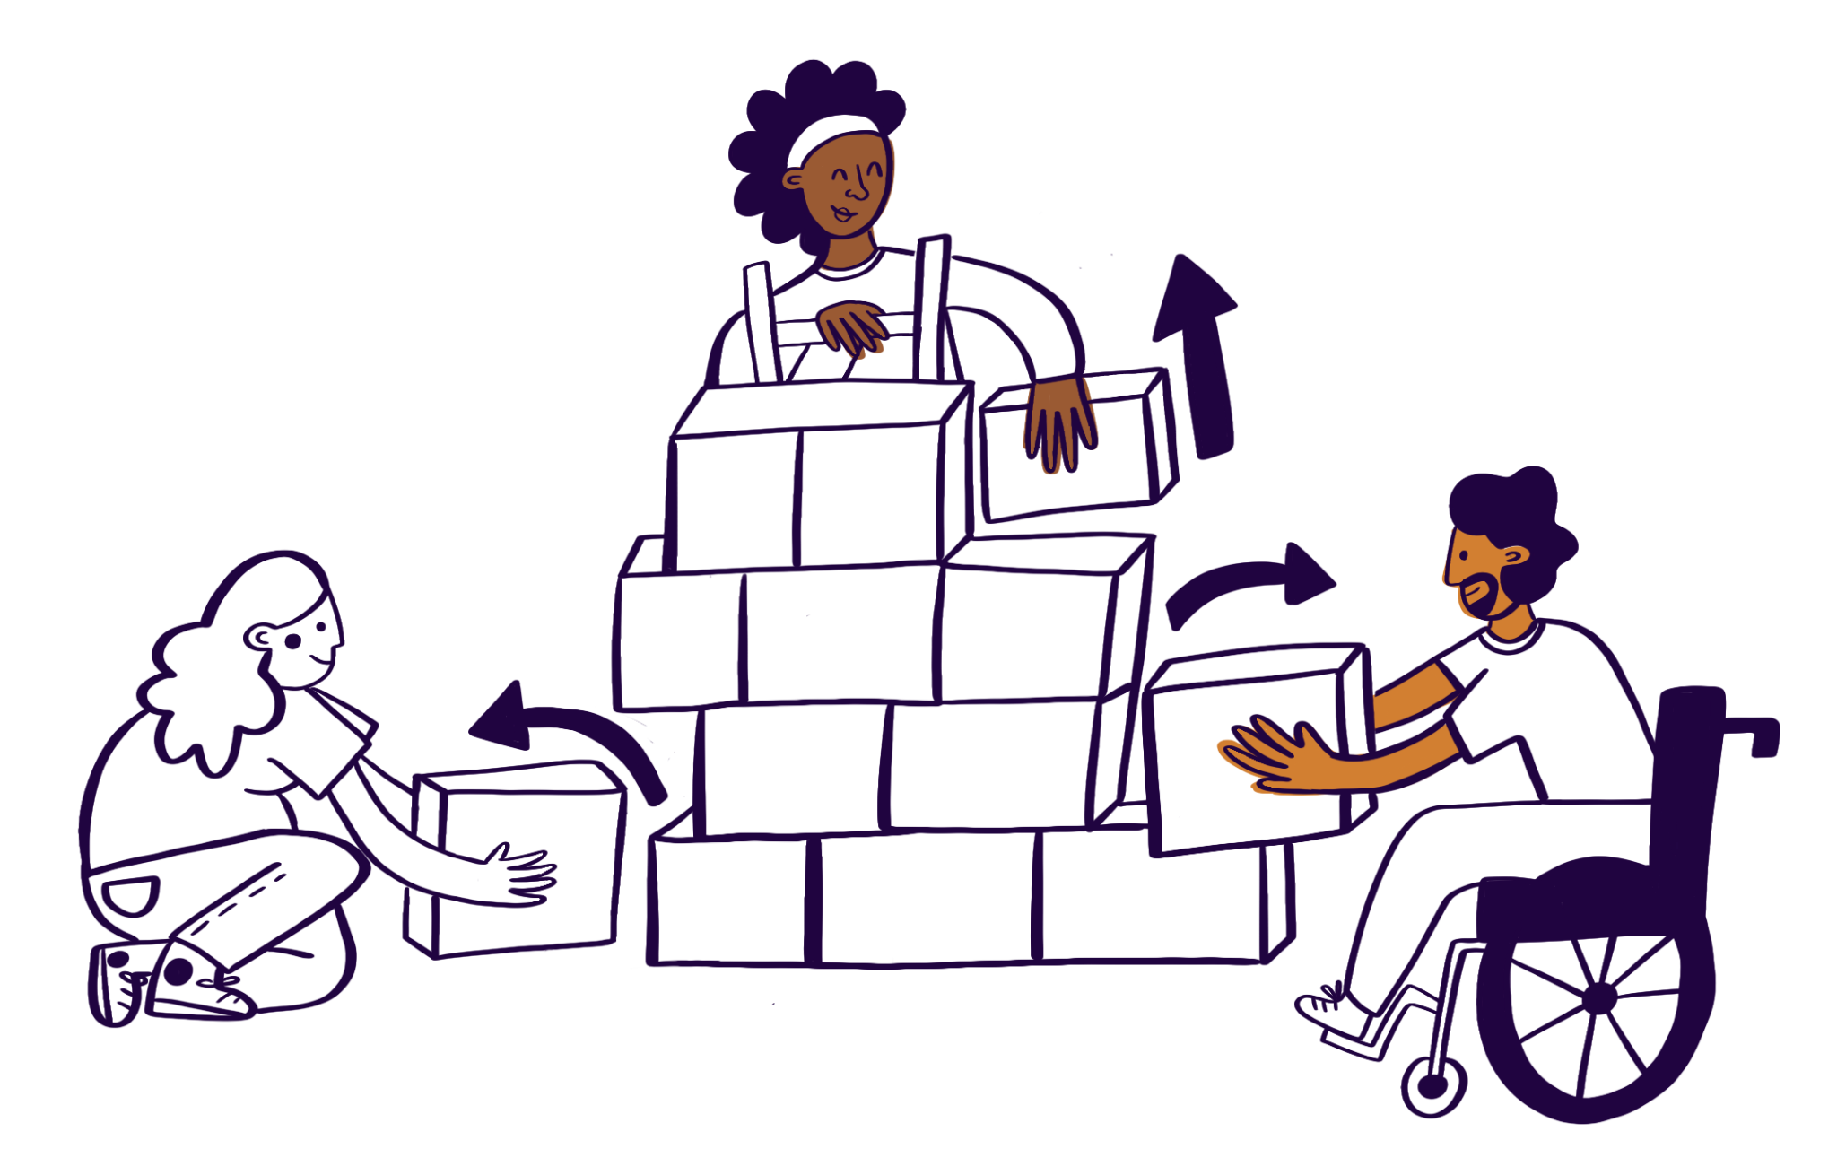
Social
  Society creates barriers
  Change enables everyone
  Culture over cure

Slide 10
Exploring Barriers

Slide 11

Barriers
Physical
Communication
Information
Attitudinal
Policy

Slide 12
Reasonable Adjustments

Slide 13

What is a reasonable adjustment?
Changes or modifications made to remove barriers that may disadvantage disabled people.
To the workplace
To the way things are done
To provide additional support

Slide 14
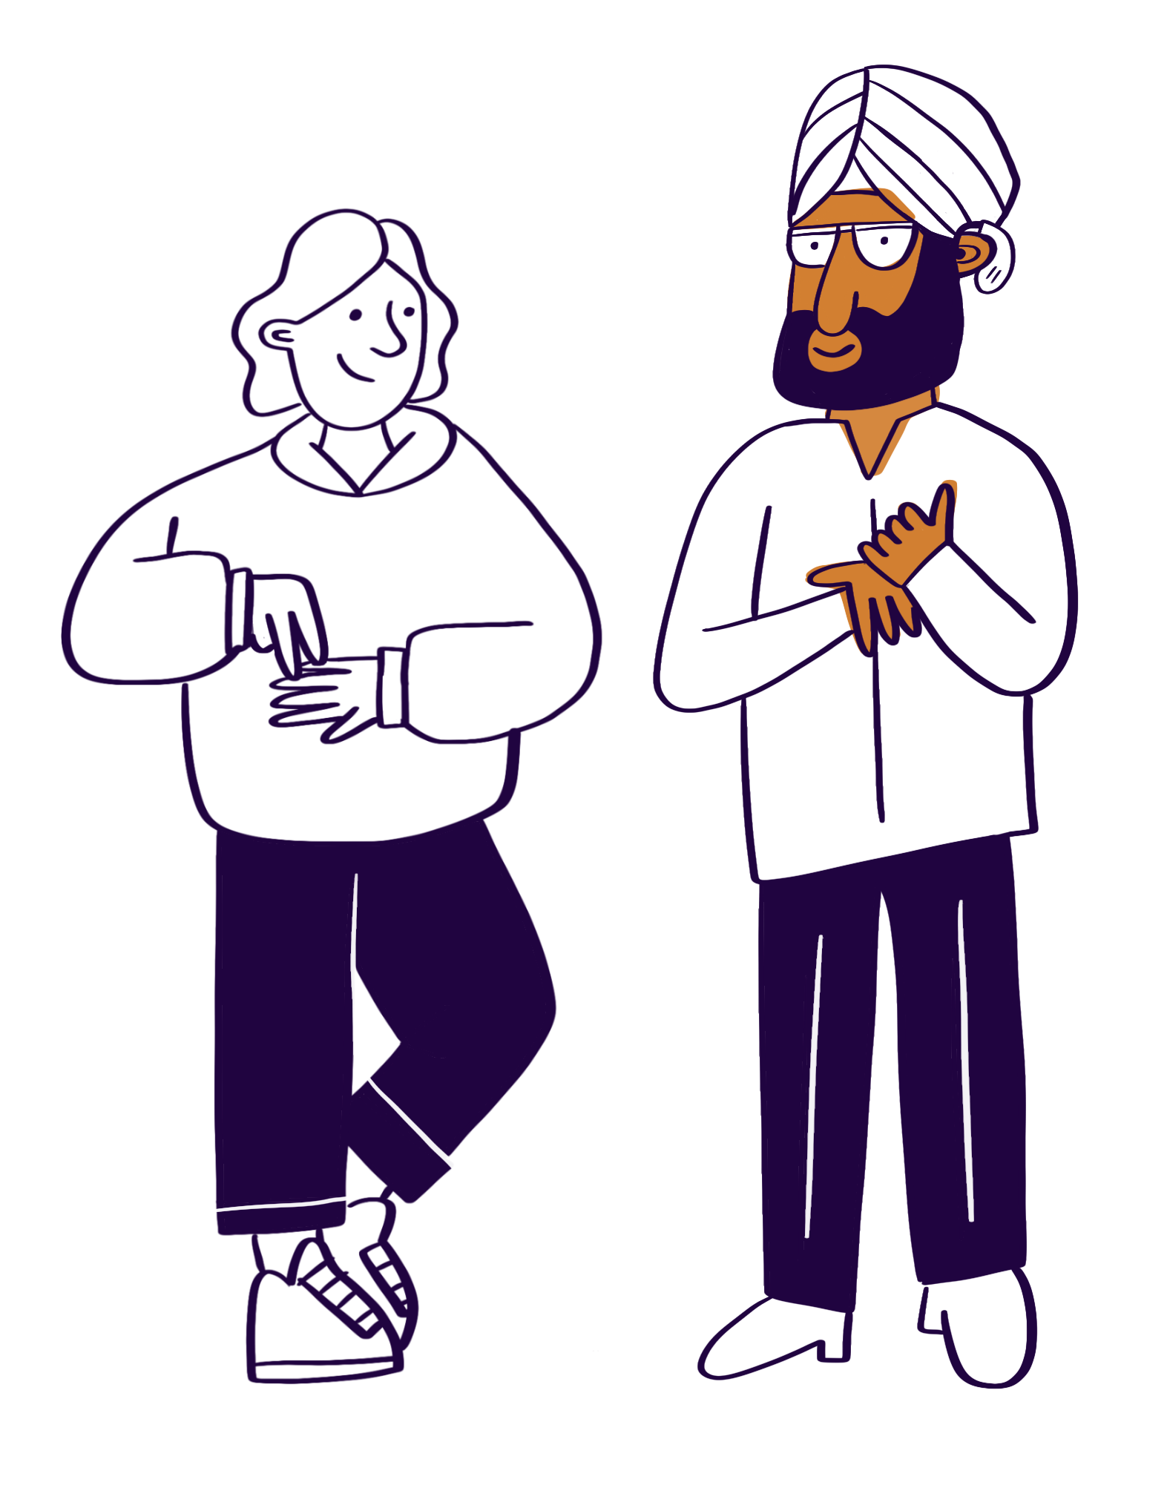
Adjustments - Examples
Physical changes
Ergonomic Equipment
Training and Development
Assessment Methods
Tools and Technology
Communications Methods
Policy Adjustments

Slide 15
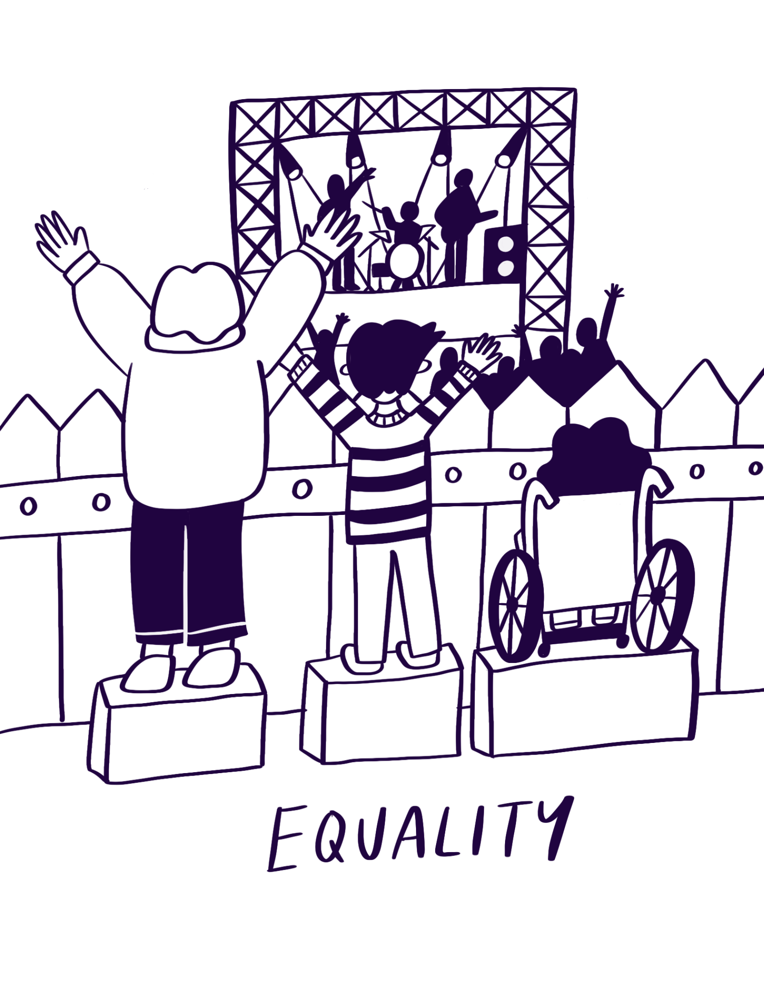
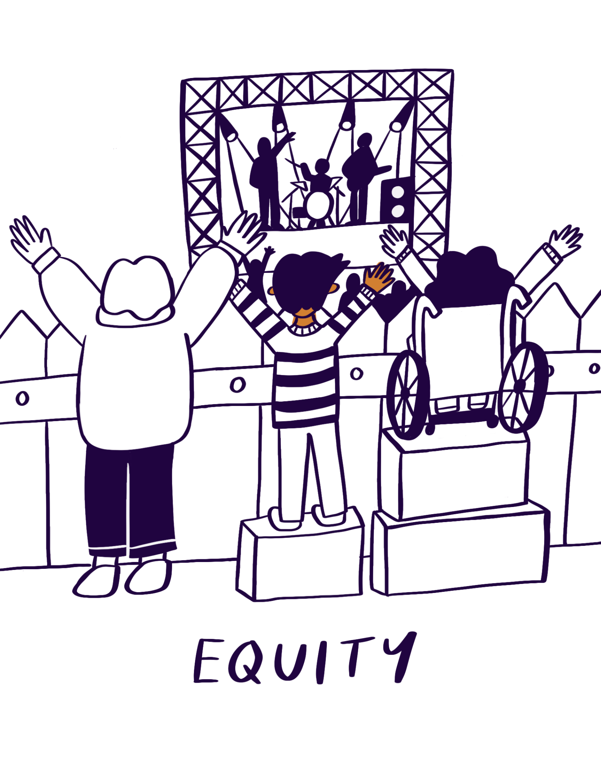
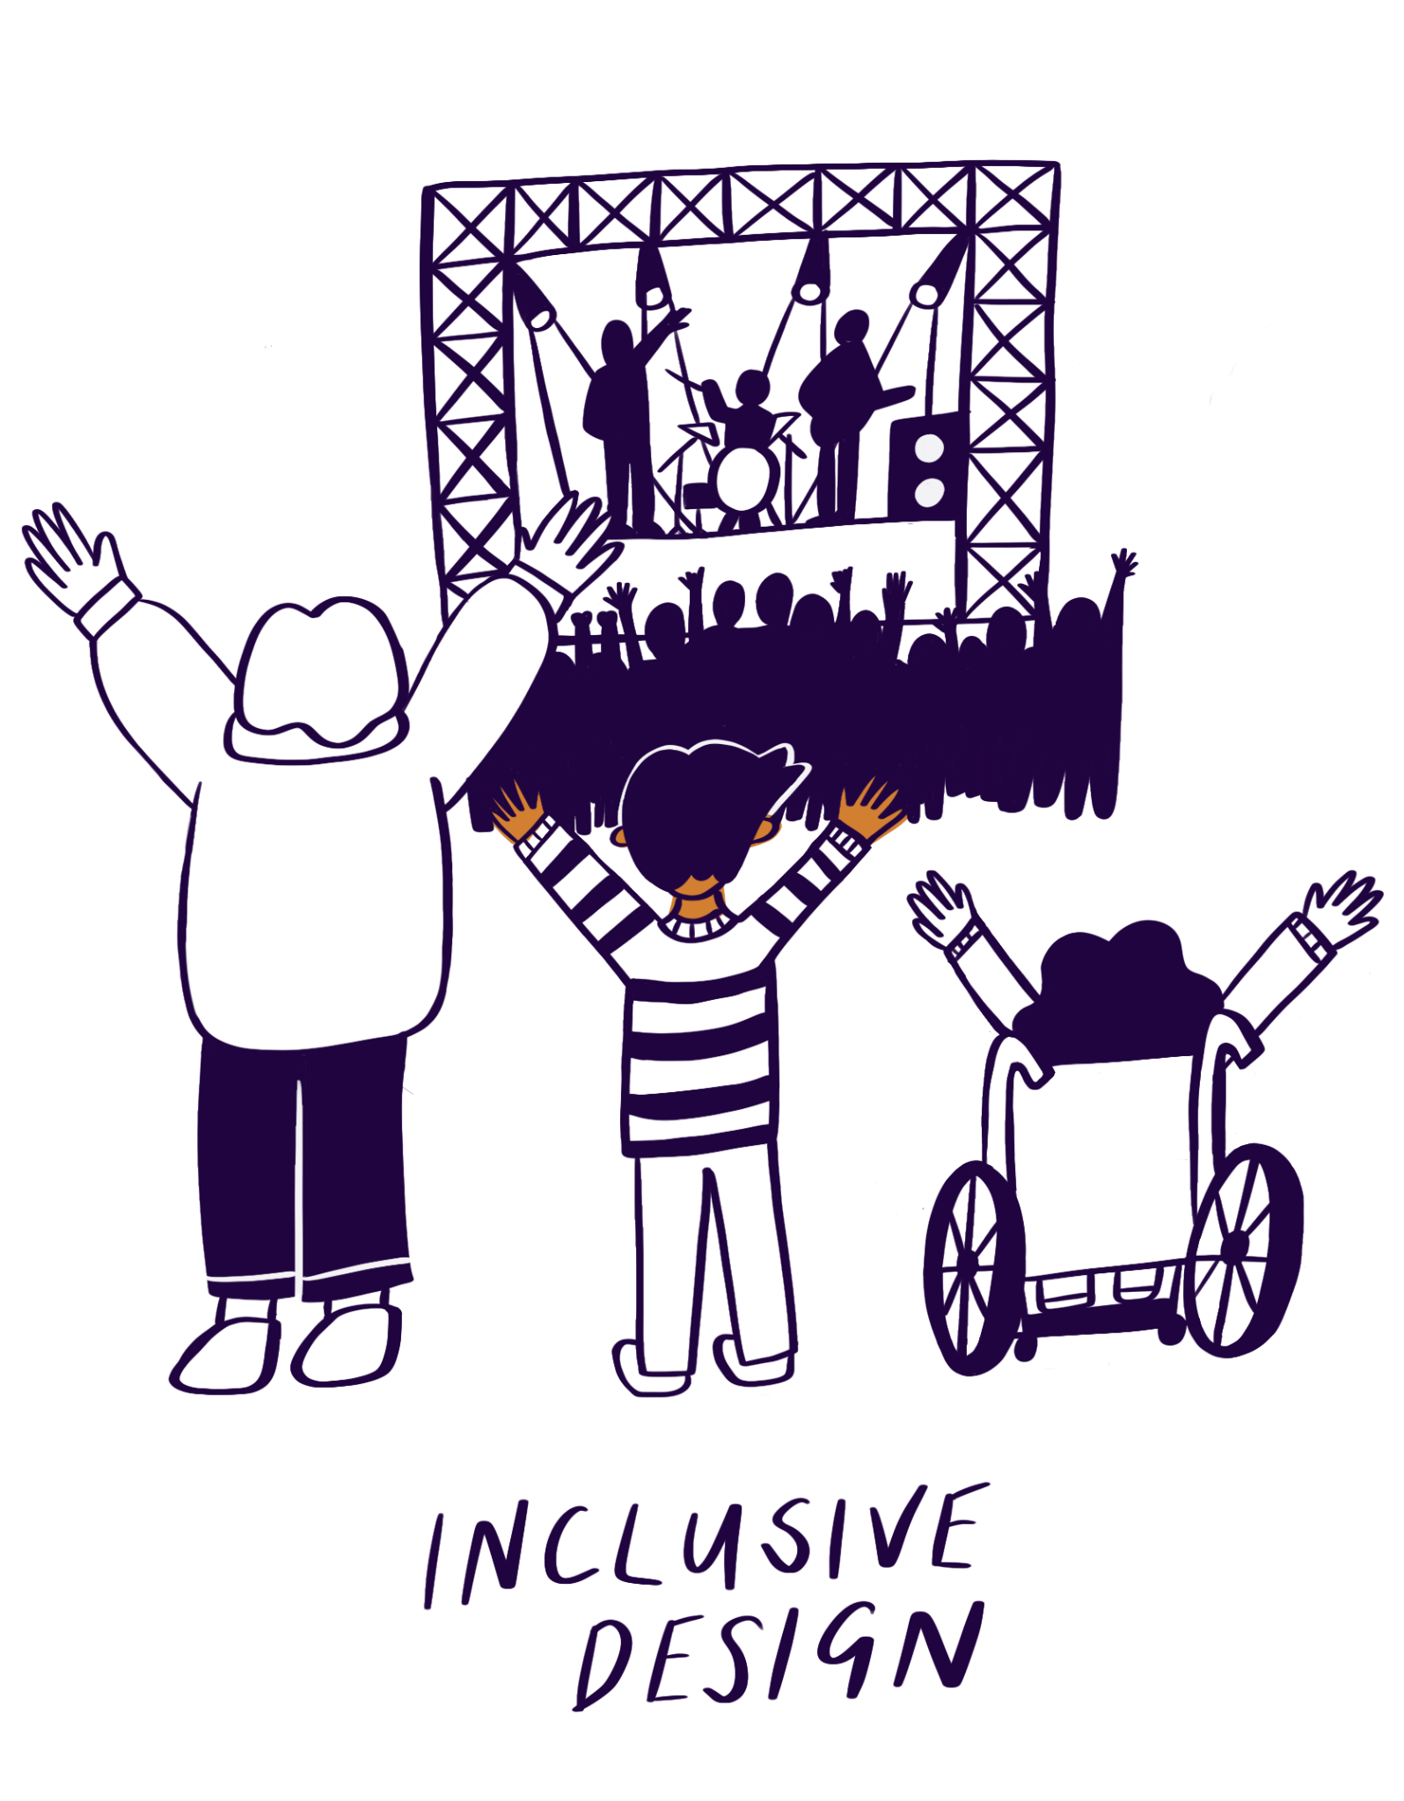
Equality or Equity

Slide 16
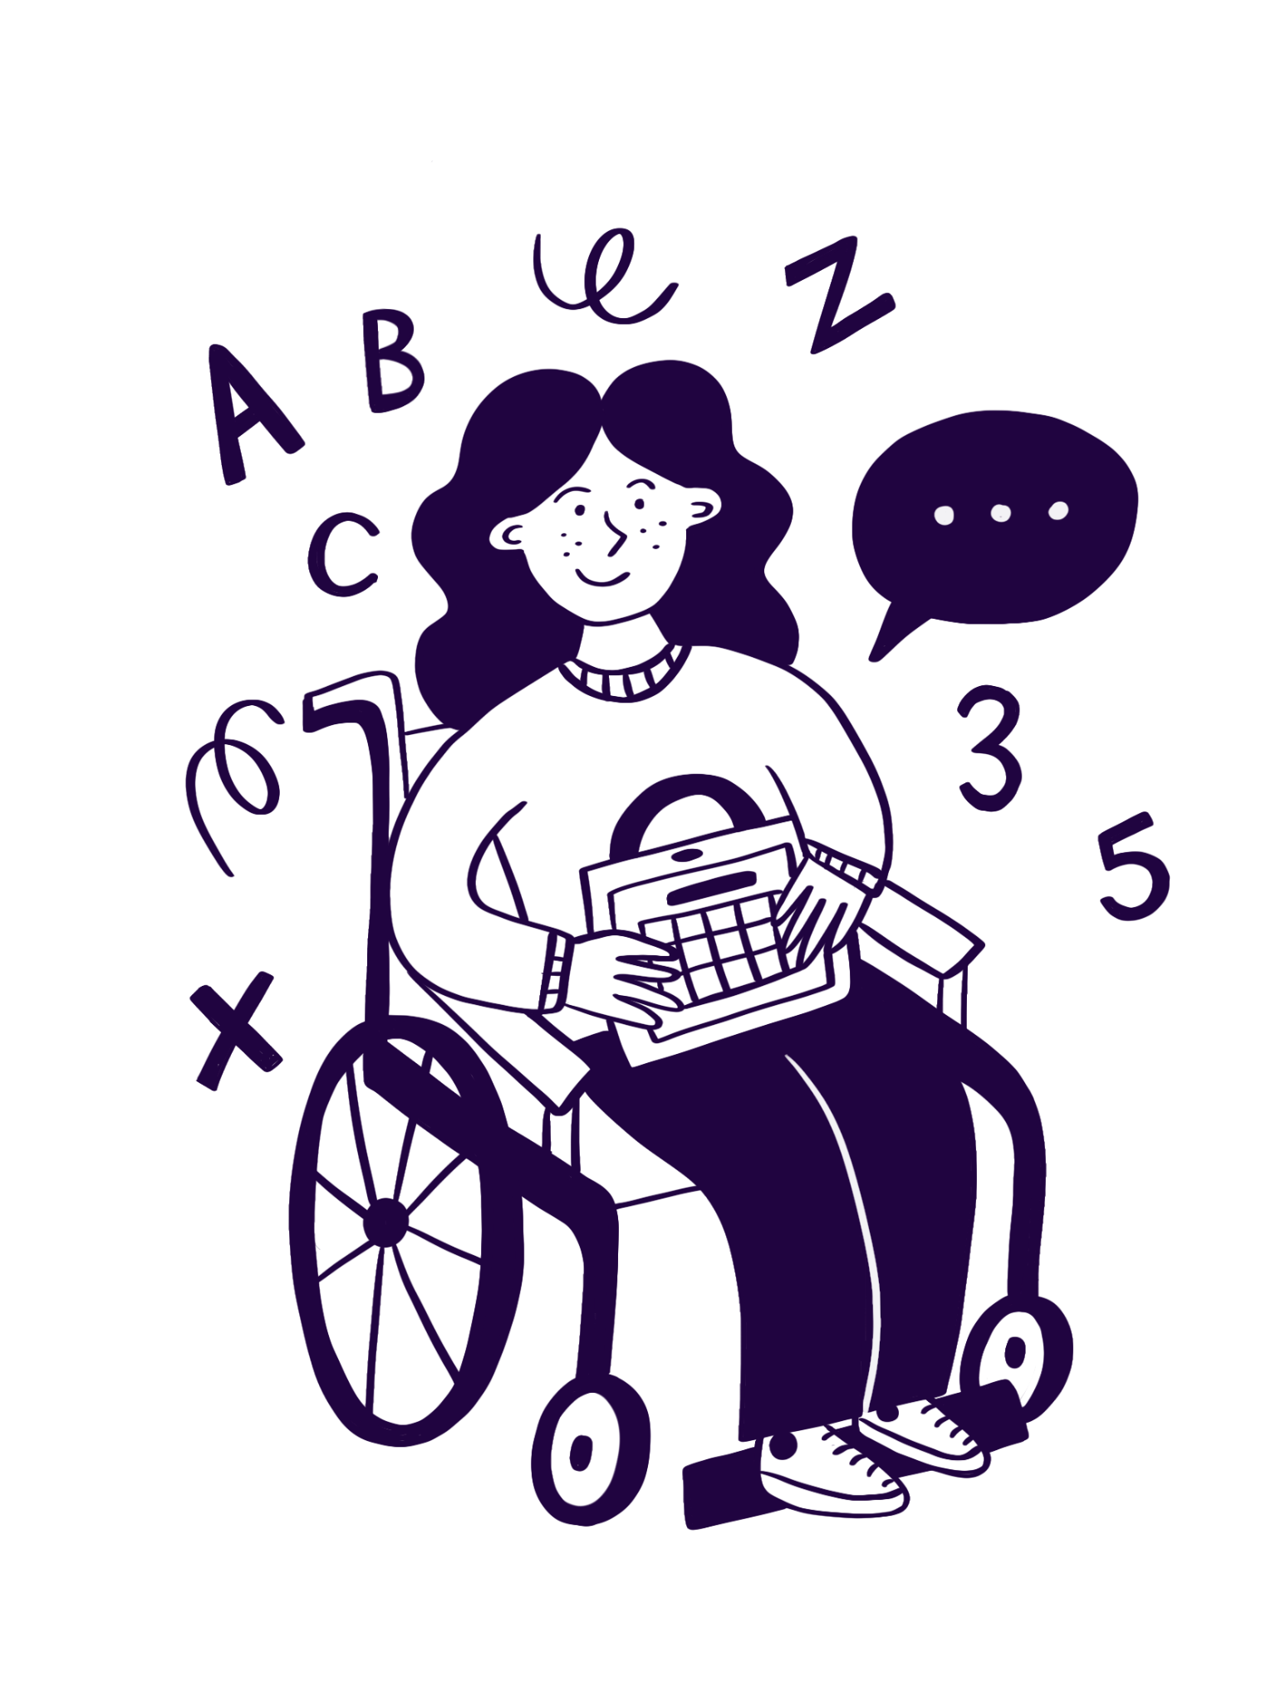
Access to Work
Access to Work is a government-funded scheme that helps remove practical barriers at work for disabled people.
Support can include things like:
Assistive technology or adapted equipment
Job coaches or support workers
Travel costs if public transport isn’t accessible
Mental health or job retention support

Slide 17
Practical Tips

Slide 18

Working with Organisations (1)
Embed adjustments into everyday processes, not just individual cases.
Highlight that a lot of adjustments are no to low cost
Treat inclusion as part of strategy, not compliance.
Build relationships with HR, Health & Safety, and leadership.

Slide 19
Working with Organisations (2)
Push for barrier-based policies and review outdated procedures.
Share success stories to normalise good practice.
Keep accessibility on meeting agendas and in decision-making
Challenge cultures that treat adjustments as “exceptions.”

Slide 20
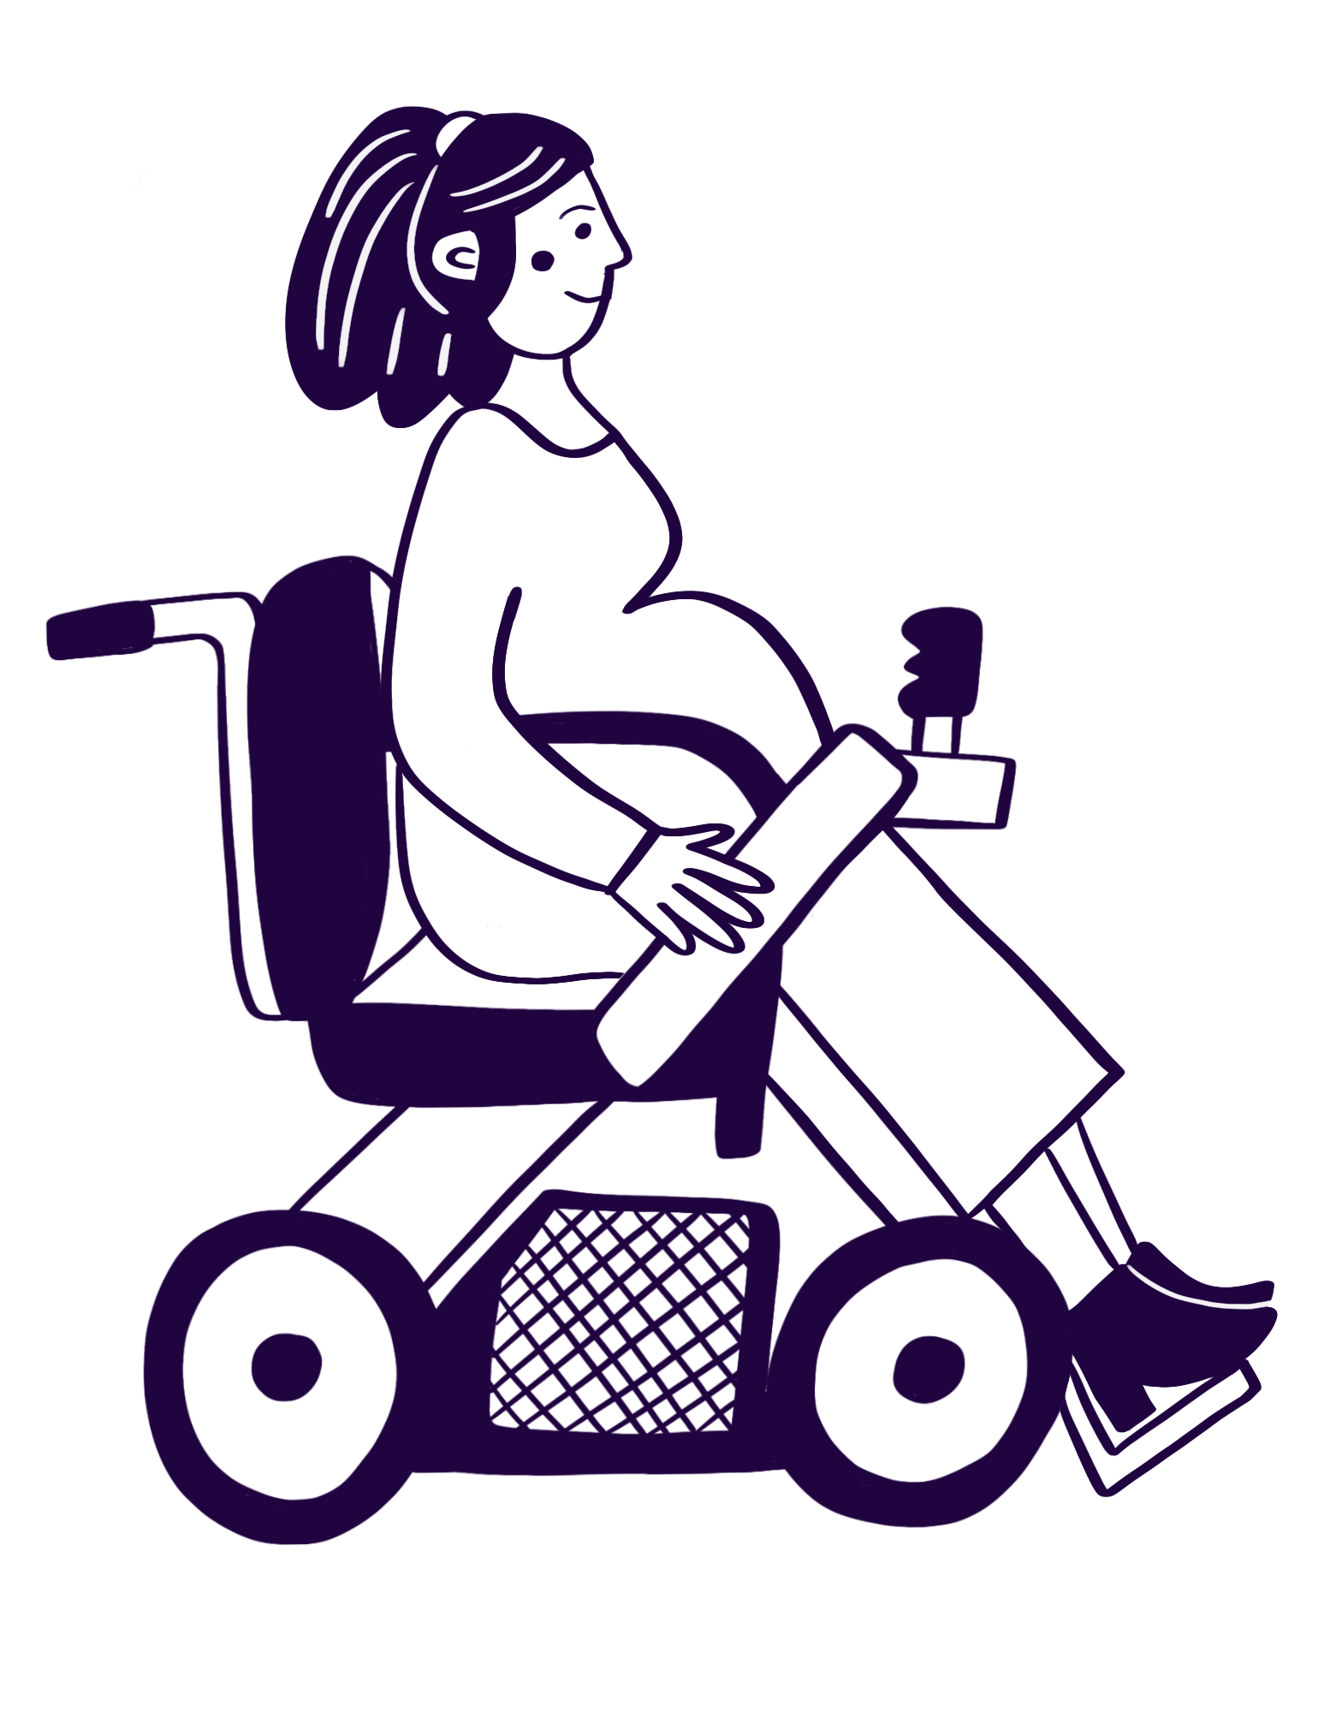
Working with Individuals
Start by asking about barriers, not medical details.
Listen first build trust and psychological safety.
Focus on what helps them do their best work.
Document requests and follow up on progress.
Encourage self-advocacy support, don’t speak over.
Know the tools: Access to Work, adjustment passports, HR routes.
Check in review adjustments regularly, not once.

Slide 21

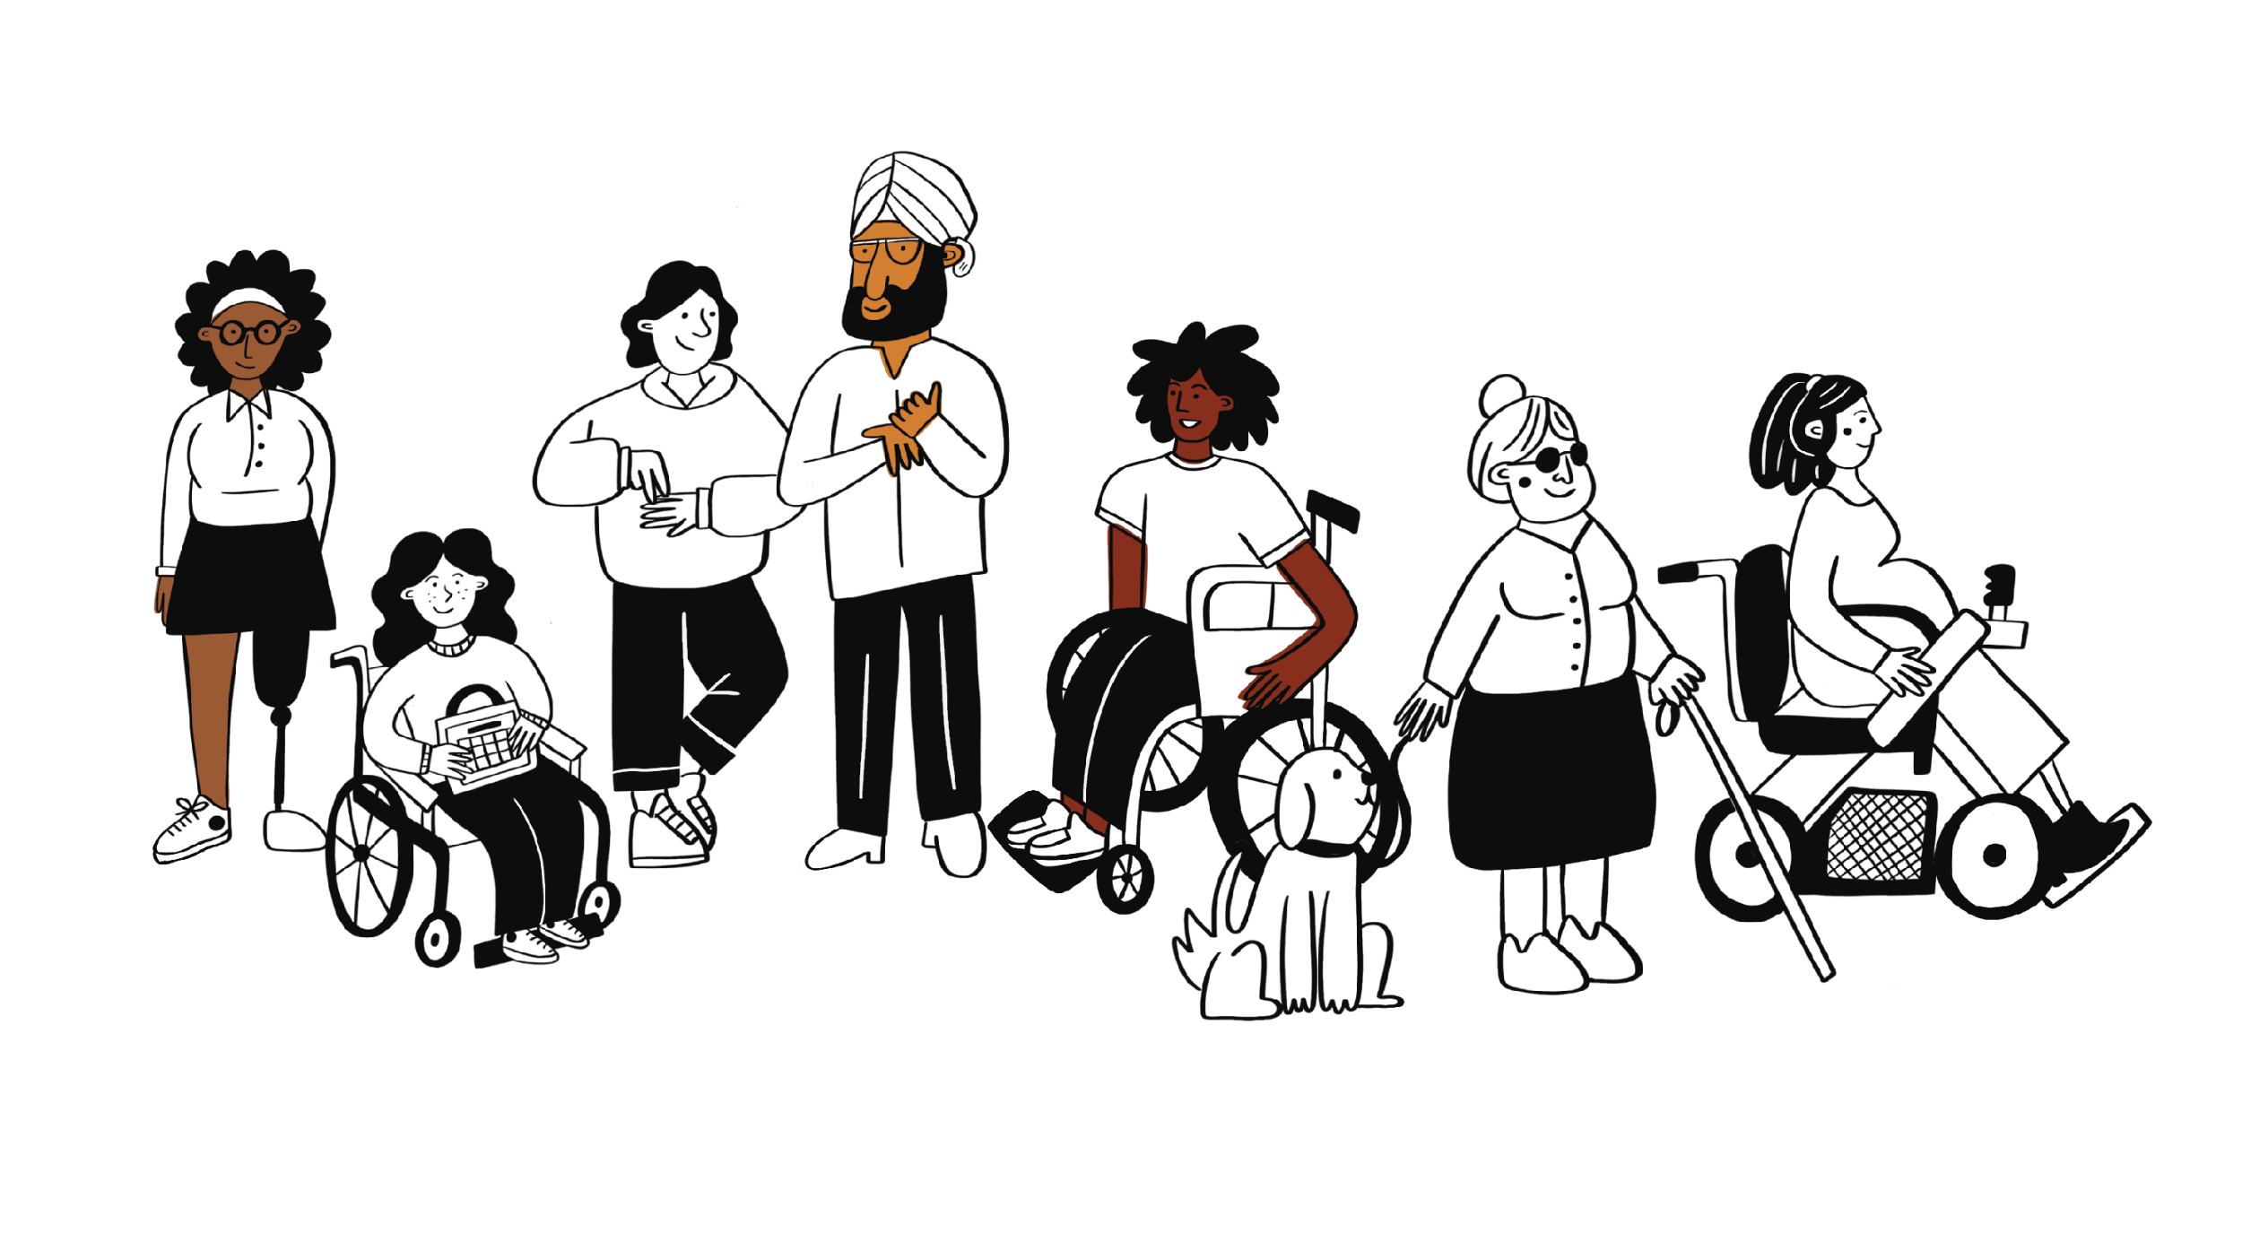
Not Sure?
Just Ask

Slide 22
What insight or reminder from today will stay with you?

Slide 23
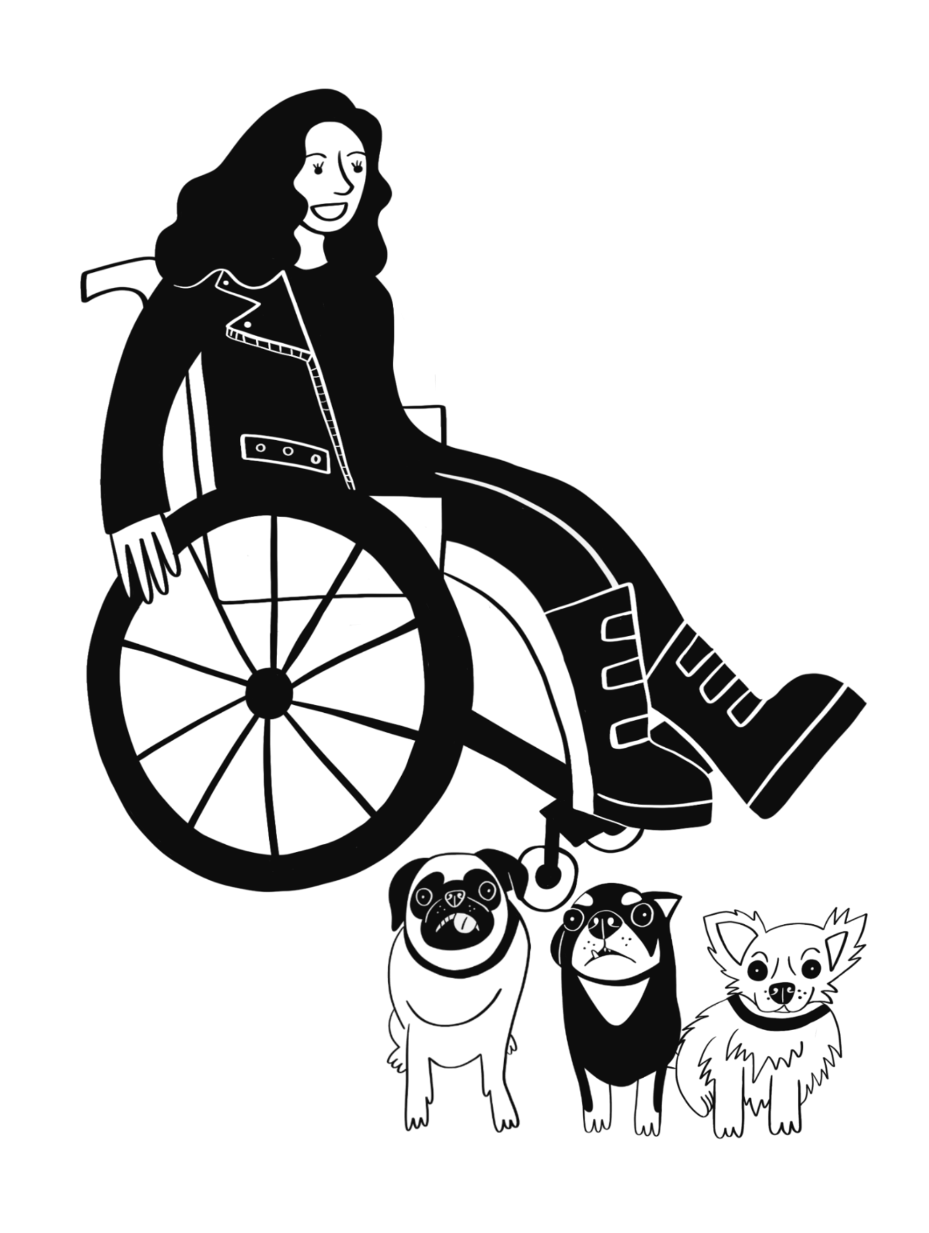
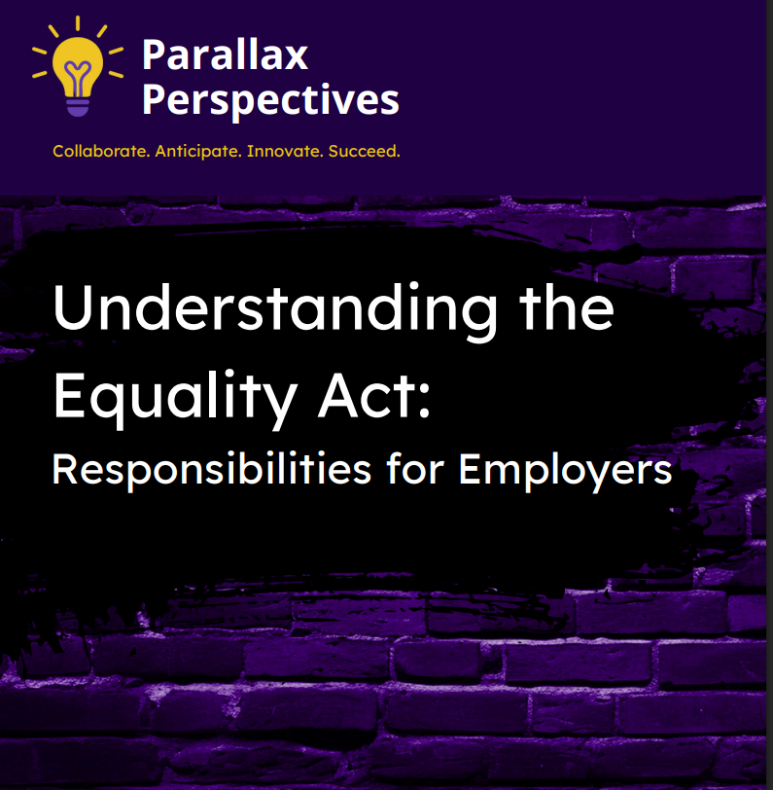
Collect Your Free Resource

Slide 24






Let’s connect
www.shinewithparallax.com
rox@shinewithparallax.com
shinewithparallax
shinewithparallax
Shine-with-Parallax-Parallax-Perspectives-Limited

