Slide 1
50 years of the Health & Safety at Work Act… Now what?

Slide 2
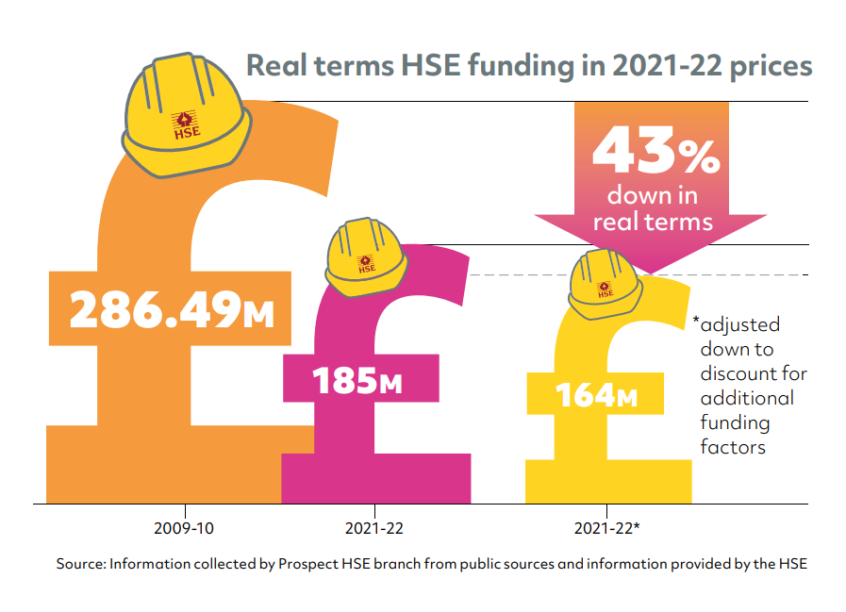

Slide 3
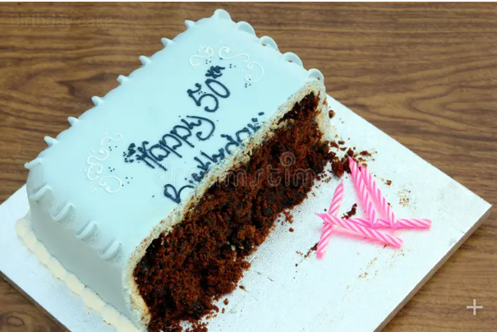

Slide 5
Unions make work safe
Union workplaces are statistically more likely to have…
Correct PPE
Risk assessment
Consultation
Fewer injuries

Slide 7
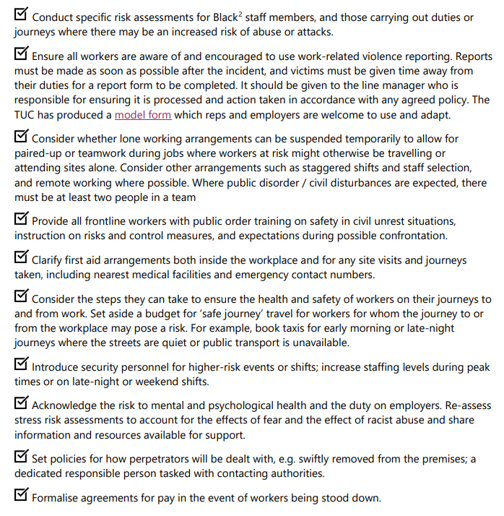
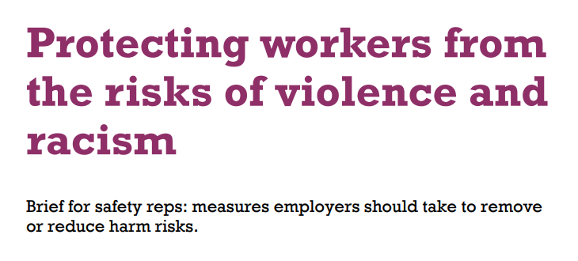

Slide 8
Covid and Long Covid

Slide 9
Building safety crisis

Slide 10
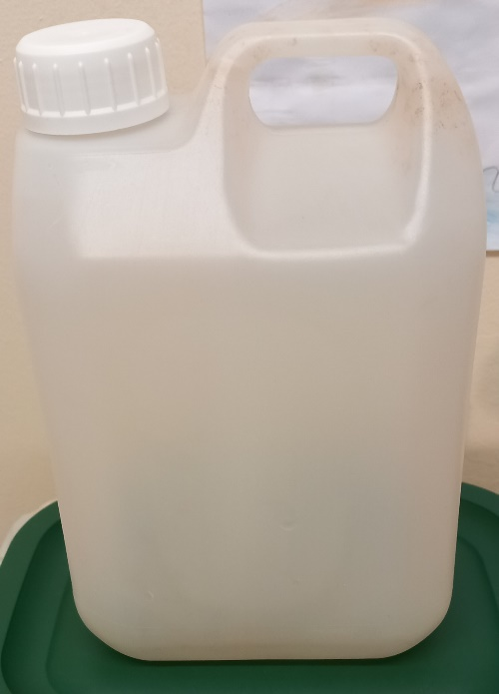
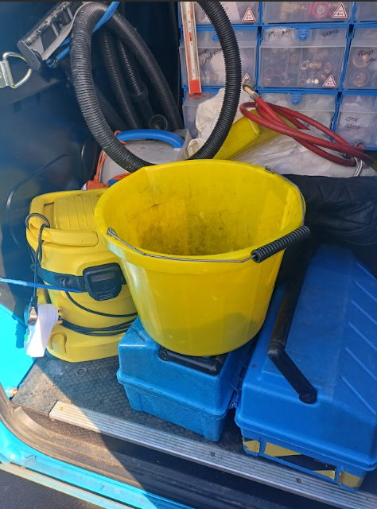
Toilets, toilets, toilets

Slide 11
We are aging out!

Slide 12
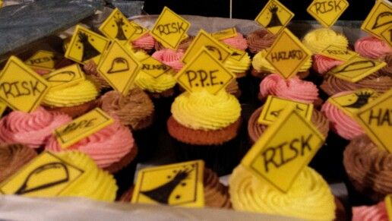
The next 50 years of safety at work

Slide 13
Keep in touch
Whatsapp alerts for health & safety activists
Latest guidance for reps
Upcoming webinars and in-person events
Campaign news and tools
Research and publications
TUC Education courses

