Slide 1
HASAWA – 50 years of protecting workers. Where does it go from here?
Philip Liptrot
Thompsons Solicitors
Safety Reps Connect Cymru
26th November 2024
Notes:
Introduction. Who you are. What you are going to say.
Context is everything.
To consider the future of the Act we must put it into context of what went before it, some of its achievements and how it could be improved (some overlap with David and Dan?)
Want to give 2 examples of the devastating effects of what happens when employers don’t adhere to H&S regulations
1

Slide 2
Purpose of the Act
“An Act to make further provision for
securing the health, safety and welfare of persons at work
for protecting others against risks to health or safety in connection with the activities of persons at work
for controlling the keeping and use and preventing the unlawful acquisition, possession and use of dangerous substances
and for controlling certain emissions into the atmosphere
to make further provision with respect to the employment medical advisory service; to amend the law relating to building regulations, and the Building (Scotland) Act 1959; and for connected purposes.”
Health and Safety at Work Act 1974
Notes:
As a starting point let’s remind ourselves of what the Act says [NEXT SLIDE]
2

Slide 3
In other words…
The primary piece of legislation covering occupational health and safety setting out the
general duties for:
Employers to employees
Employers and self-employed to persons other than employees
Employees to employees
Notes:
It is the primary overarching piece of legislation for occupational health and safety in the UK setting out the duties of, in particular, employers
3

Slide 4
Context is everything
Factories Acts 1800s to 1961
1900s – 4400+ fatal injuries
2023 – 135 fatal injuries (*)
Since 1974 a reduction of 85% of work-related deaths/70% reduction of injuries, days lost (*)
Notes:
Let’s put it into context whilst considering its impact.
Before the Act, very limited protection for workers. The Factories Act in its various iterations from 1833 to the 1960s. 1833 Act sounded like a remarkably progressive piece of legislation setting out a maximum working week of 48 hours until you realise that that was for children between the ages of 9 and 13. By 1961 it did set out some standards albeit mainly for factories as the name suggests.
4500 work related deaths in the 1900s – mainly accident-related as the extent of asbestos related deaths not acknowledged or recorded until later in that century
Cf 135 in 2023 – massive asterisk to emphasise that this is not really representative of the number of work-related deaths as Hazards regularly points out AND in many ways we’re not comparing apples with apples when we look at stats the number of work relate has fallen since the introduction of the HASAW Act in 1974
4

Slide 5
Groundbreaking
Duties imposed on employers
HSE
Inspections and notices
Offences and consequences
Notes:
So, in my view, it was a ground breaking piece of legislation (in its day) covering 8 million workers:
Imposed duties on employers to ensure workers’ safety as far as was reasonably practicable
Sowed seeds for risk assessments
Gave rights to appoint trade union health and safety reps and laid the foundations for Safety Representatives and Safety Committees Regulations 1977
Provided legal framework for consultation and co-operation to improve health and safety at work.
Legislated for formation of a regulatory health and safety body soon to be known as the HSE
Powers of inspection and to issue notices of improvement/prohibition
Ability of HSE to prosecute employers with consequential fines and custodial sentences where appropriate.
In my view, it had a profound impact on workplace safety
Background info
[If an inspector is of the opinion that a person—
(a)is contravening one or more of the relevant statutory provisions; or
(b)has contravened one or more of those provisions in circumstances that make it likely that the contravention will continue or be repeated, he may serve on him a notice (in this Part referred to as “an improvement notice”) stating that he is of that opinion, specifying the provision or provisions as to which he is of that opinion, giving particulars of the reasons why he is of that opinion, and requiring that person to remedy the contravention or, as the case may be, the matters occasioning it within such period (ending not earlier than the period within which an appeal against the notice can be brought under section 24) as may be specified in the notice.
Section 33 (1) “It is an offence for a person—
to fail to discharge a duty to which he is subject by virtue of sections 2 to 7...”
Section 40 “…it shall be for the accused to prove (as the case may be) that it was not practicable or not reasonably practicable to do more than was in fact done to satisfy the duty or requirement”
Magistrates court: 12 months imprisonment/£20,000 fine
Crown court: 2 years/unlimited fine]
5

Slide 6
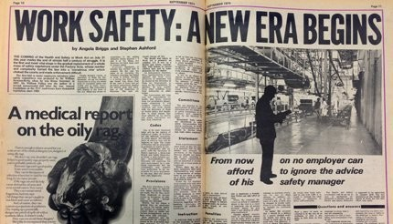
Notes:
It was quite rightly heralded as the start of a new era for health and safety at work and workers rights

Slide 7
Limitations and consequences
Tripartite approach
General duties
HSE resources
Timing
Notes:
Tripartite approach of employer, worker and State supposedly working in partnership. We know that is rarely the case - the worker (unless they are in a trade union) holding the fewest aces in that 3 hander.
Duties are general. Nothing specific. Unlike later regulations like 6 pack/COSHH or to some extent the 1961 Factories Act. The intention was well meaning to simplify existing regulations in 1974 but as we know working environments are far more complex and the generality of duties potentially makes easier for employers to fudge their responsibilities and escape actions/prosecution by HSE.
But in order for the HSE to do this and fulfil its roles in preventing injuries it needs resources.
The recent Prospect Union publication “HSE Under Pressure: A Perfect Storm” sets out the budget cuts since 2010 which have led to significant diminution of its role.
In summary:
43% reduction in funding
35% reduction in staffing
41% reduction in inspectors since 2003 (when the primary aim of the Act is accident prevention!)
And what shouldn’t be forgotten is that it only had 5 years to bed in before Thatcher started to dismantle the State, attack the unions (resulting in TU membership halving since the Act) and created an environment in which health and safety regulation was no longer a priority – wading in with further changes to the laws and austerity when they got back in in 2010.
The limitations of the Act coupled with the sustained attacks on Health and Safety often fuelled by persistent lobbying by fat cat insurance companies have devastating consequences and we must never forget the victims and their families.
Just 3 examples …..
7

Slide 8
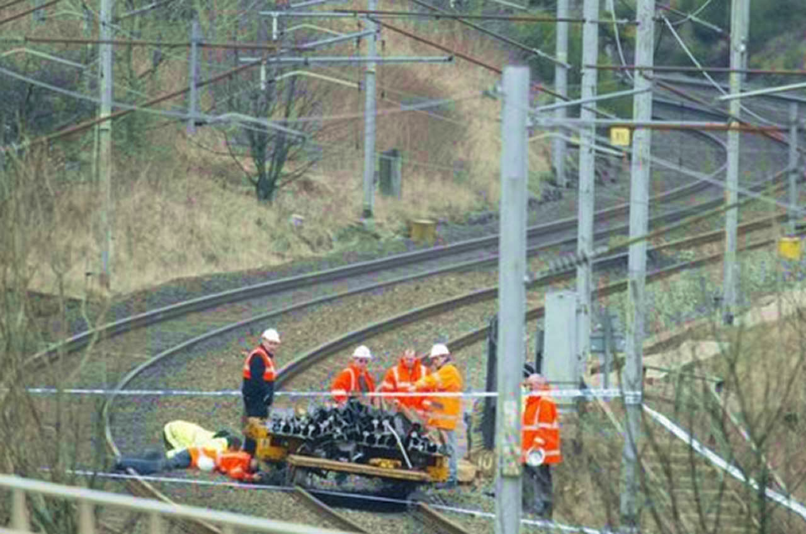
Tebay tragedy
Notes:
Tebay tragedy. Four railway workers were killed, and several others were injured when a runaway trailer loaded with steel rails rolled down a slope and struck them
Poor Equipment Maintenance: The trailer and its braking system were not properly maintained or checked before use.
Inadequate Safety Protocols: There was a lack of robust safety protocols to prevent such incidents, such as fail-safes or warning systems to alert workers of runaway vehicles.
Failure to Secure Equipment: The equipment was not adequately secured, leading to its uncontrolled movement.
Communication Breakdown: There was insufficient communication between workers and supervisors, contributing to the lack of awareness and preparedness for such an event.
Background info only
Tebay Tragedy: Summary Notes
Incident Overview
Date and Location: The Tebay rail accident occurred on February 15, 2004, near Tebay, Cumbria, England.
Fatalities and Injuries: Four railway workers were killed, and several others were injured when a runaway trailer loaded with steel rails rolled down a slope and struck them.
Causes and Contributing Factors
Runaway Trailer: The primary cause of the incident was a trailer that became uncoupled from a maintenance train. It was loaded with steel rails and rolled downhill uncontrolled for about three miles before hitting the workers.
Brake Failure: Investigations revealed that the trailer's brakes were not engaged, and there was no secondary safety mechanism to prevent it from rolling away.
Lack of Proper Safety Measures: The incident highlighted severe lapses in safety protocols, including inadequate risk assessments and failure to follow basic safety procedures during railway maintenance work.
Health and Safety Failures
Poor Equipment Maintenance: The trailer and its braking system were not properly maintained or checked before use.
Inadequate Safety Protocols: There was a lack of robust safety protocols to prevent such incidents, such as fail-safes or warning systems to alert workers of runaway vehicles.
Failure to Secure Equipment: The equipment was not adequately secured, leading to its uncontrolled movement.
Communication Breakdown: There was insufficient communication between workers and supervisors, contributing to the lack of awareness and preparedness for such an event.
Legal and Regulatory Impact
Prosecutions and Sentences: The incident led to the prosecution of the individuals responsible for maintaining the trailer and ensuring the safety of the workers.
Mark Connolly, the owner of the trailer, was found guilty of manslaughter and sentenced to nine years in prison.
Railtrack (now Network Rail) and other contractors involved faced significant fines and legal scrutiny.
Regulatory Changes: The tragedy spurred changes in railway safety regulations, including stricter maintenance requirements for equipment and improved safety protocols for trackside workers.
Awareness and Training: Increased focus on safety training for railway workers, emphasizing the importance of equipment checks and adherence to safety procedures.
Impact on Railway Industry
Improved Safety Standards: The accident led to a reevaluation and improvement of safety standards across the railway industry.
Increased Accountability: The prosecutions highlighted the need for accountability among contractors and subcontractors responsible for railway maintenance.
Ongoing Safety Campaigns: The incident has been used as a case study in safety campaigns to prevent similar occurrences in the future.
Conclusion
The Tebay tragedy underscored the critical importance of rigorous safety protocols and regular maintenance checks in preventing workplace accidents. The incident led to significant legal and regulatory changes aimed at enhancing the safety and well-being of railway workers.
For further details, you can refer to the following resources:
BBC News Report on Tebay Tragedy
The Guardian's Coverage of the Incident
Rail Accident Investigation Branch Report

Slide 9
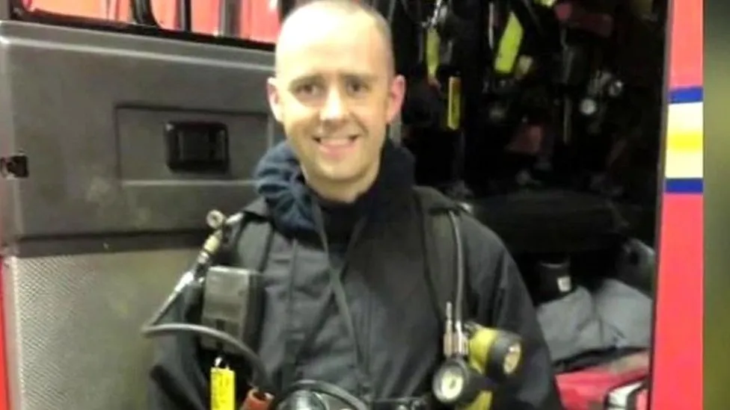
Notes:
Closer to home, literally and metaphorically, as I represented FBU and family of Firefighter Stephen Hunt who died aged 38 whilst attending a fire in Manchester in 2013. Left 2 teenage children and a devasted mum, step dad and siblings.
As the Coroner found, Stephen’s death was entirely avoidable and not only were there numerous health and safety failings (and resource issues in the fire service after 3 years of austerity) with grim echoes of the Glasgow furniture tragedy from 1968 (James Watt Street).
Background info only
Stephen Hunt Firefighter Tragedy: Summary
Incident Overview:
Date and Location: July 13, 2013, at Paul’s Hair World, Northern Quarter, Manchester.
Victim: Stephen Hunt, a 38-year-old firefighter, was tragically killed while tackling the blaze.
Cause and Contributing Factors:
Arson: The fire was started deliberately by two 15-year-old girls who had been smoking at the rear of the building. They were later arrested, and although one was charged with arson, the charges were dropped before trial​ (Manchester Evening News)​​ (Manchester Evening News)​.
Failure in Safety Protocols: The inquest revealed a series of management and communication failures:
Miscommunication: There were significant communication breakdowns during the shift handovers.
Inadequate Fire Risk Assessment: The fire risk assessment was found to be inadequate.
Poor Briefing: Misinterpretation of instructions and inadequate briefings contributed to the confusion.
Internal Layout and Blockages: The building’s internal layout and blocked emergency exits exacerbated the situation.
Equipment and Monitoring Failures: Stephen Hunt's use of breathing apparatus exceeded the safe duration, and there was a failure to monitor his status properly​ (GMFRS)​​ (Manchester Evening News)​.
Inquest Findings:
The jury concluded that Stephen Hunt was unlawfully killed due to the deliberate actions of the two girls and highlighted multiple operational failures by the Greater Manchester Fire and Rescue Service (GMFRS)​ (Manchester Evening News)​​ (GMFRS)​.
Impact and Aftermath:
Family's Response: Stephen's family expressed deep sorrow and frustration over the preventable nature of his death and the initial compensation offer, which was later increased following intervention by the Greater Manchester Mayor​ (Manchester Evening News)​.
GMFRS Response: The GMFRS acknowledged their failures and committed to improving safety protocols to prevent similar tragedies in the future​ (Manchester Evening News)​.
Legal and Financial Repercussions: GMFRS admitted liability and agreed to pay £80,000 in damages to Stephen Hunt's family, with additional legal costs covered following a court judgment​ (Manchester Evening News)​.
The Stephen Hunt case serves as a critical reminder of the importance of stringent safety protocols and effective communication in emergency response scenarios. The lessons learned from this tragedy aim to enhance safety measures and prevent future incidents.
For more detailed information, you can refer to the sources:
Manchester Evening News
Greater Manchester Fire and Rescue Service Report

Slide 10
Notes:
Horrendous life changing consequences of a recycling plant’s negligence
50+ year old man accepted a job at a local recycling plant in the NW so as not to lose the benefits he was receiving
No training, no safe system of work, no guards on a cable stripping machine consisting of 2 teethed rollers clogged up with dirt and tarmac which he was told to clean by starting the rollers and chipping away at it with a long handled screwdriver and a hammer
Glove got caught in the rollers pulling his hand in, only stopping because there was a dead man’s stop button at head height which his forehead came into contact with, preventing his whole arm being dragged in
6 operations including stitching his middle finger on as best they could as can be seen in the photograph
Employer cover up in a non-unionised small firm (thankfully he was a union member and cld take advantage of their legal services) meant that there was no HSE prosecution
Denied liability and ended up with a 4 day trial – successful at the end despite a Daily Mail reading judge awarding 35% contributory negligence (requiring a successful appeal)

Slide 11
The Next 50 Years
Restore (and increase) HSE resources
More specific duties/details – incorporate various regs eg 6 pack
Accountability of directors/senior managers
Extend the current duties of care of employers to all workers
Notes:
Looking to the future and how can we fix this broken model, what might the HSWA look like in 2074
Priority is to restore and increase HSE resources and powers, particularly in respect of inspections
With an increased involvement of unions and health and safety reps, using your experience and expertise so that that role is more prominent than the broken tripartite model allows, (with of course the commensurate facility time. An effective regulatory body with teeth must underpin any new look Act.
General duties of employers should be more specific and comprehensive so employers are clear what they need to do to manage Health & Safety, better access to health & safety skills and expertise). And any reforms should include repealing s69 in particular of the ludicrous Enterprise Act which removed the ability to rely on statutory health & safety breaches to establish negligence if someone is injured at work
And we need to change the Tory donor, insurance company led narrative of compensation culture, “Health & Safety gone mad” and red tape nonsense espoused by the likes of Tories such as Chris “50 shades of” Grayling and made worse by Brexit fuelled bonfires of health & safety regulations.
It must clearly set out the responsibility for ensuring compliance and legal duties lies firmly with the directors/senior managers and make them accountable.
As I have said the Act is of its time and the nature of work has drastically changed to 50 years ago with fragmentation of the workplace, the gig economy and zero hours contracts. Employers duties must extend to all workers not just employees
Encouraging references in the New Deal/green paper but we obviously need to see what is actually implemented in the next 12 months and beyond. The related green paper released recently skirted over some of these issues and therefore perhaps unsurprisingly, but still disappointingly , no reference to H&S (harassment?) in the Employment Bill.
Enforce safe and healthy workplaces
Establish a single enforcement body
Strengthen the law
We would wholeheartedly support these aspirations but that is all they are without proper funding and meat on the bone.
11

Slide 12
Thank You
philipliptrot@thompsons.law
Notes:
12

Slide 13
ANY QUESTIONS?

