Slide 1
Health and Safety Campaign Updates
Janet@gmhazards.org.uk

Slide 2
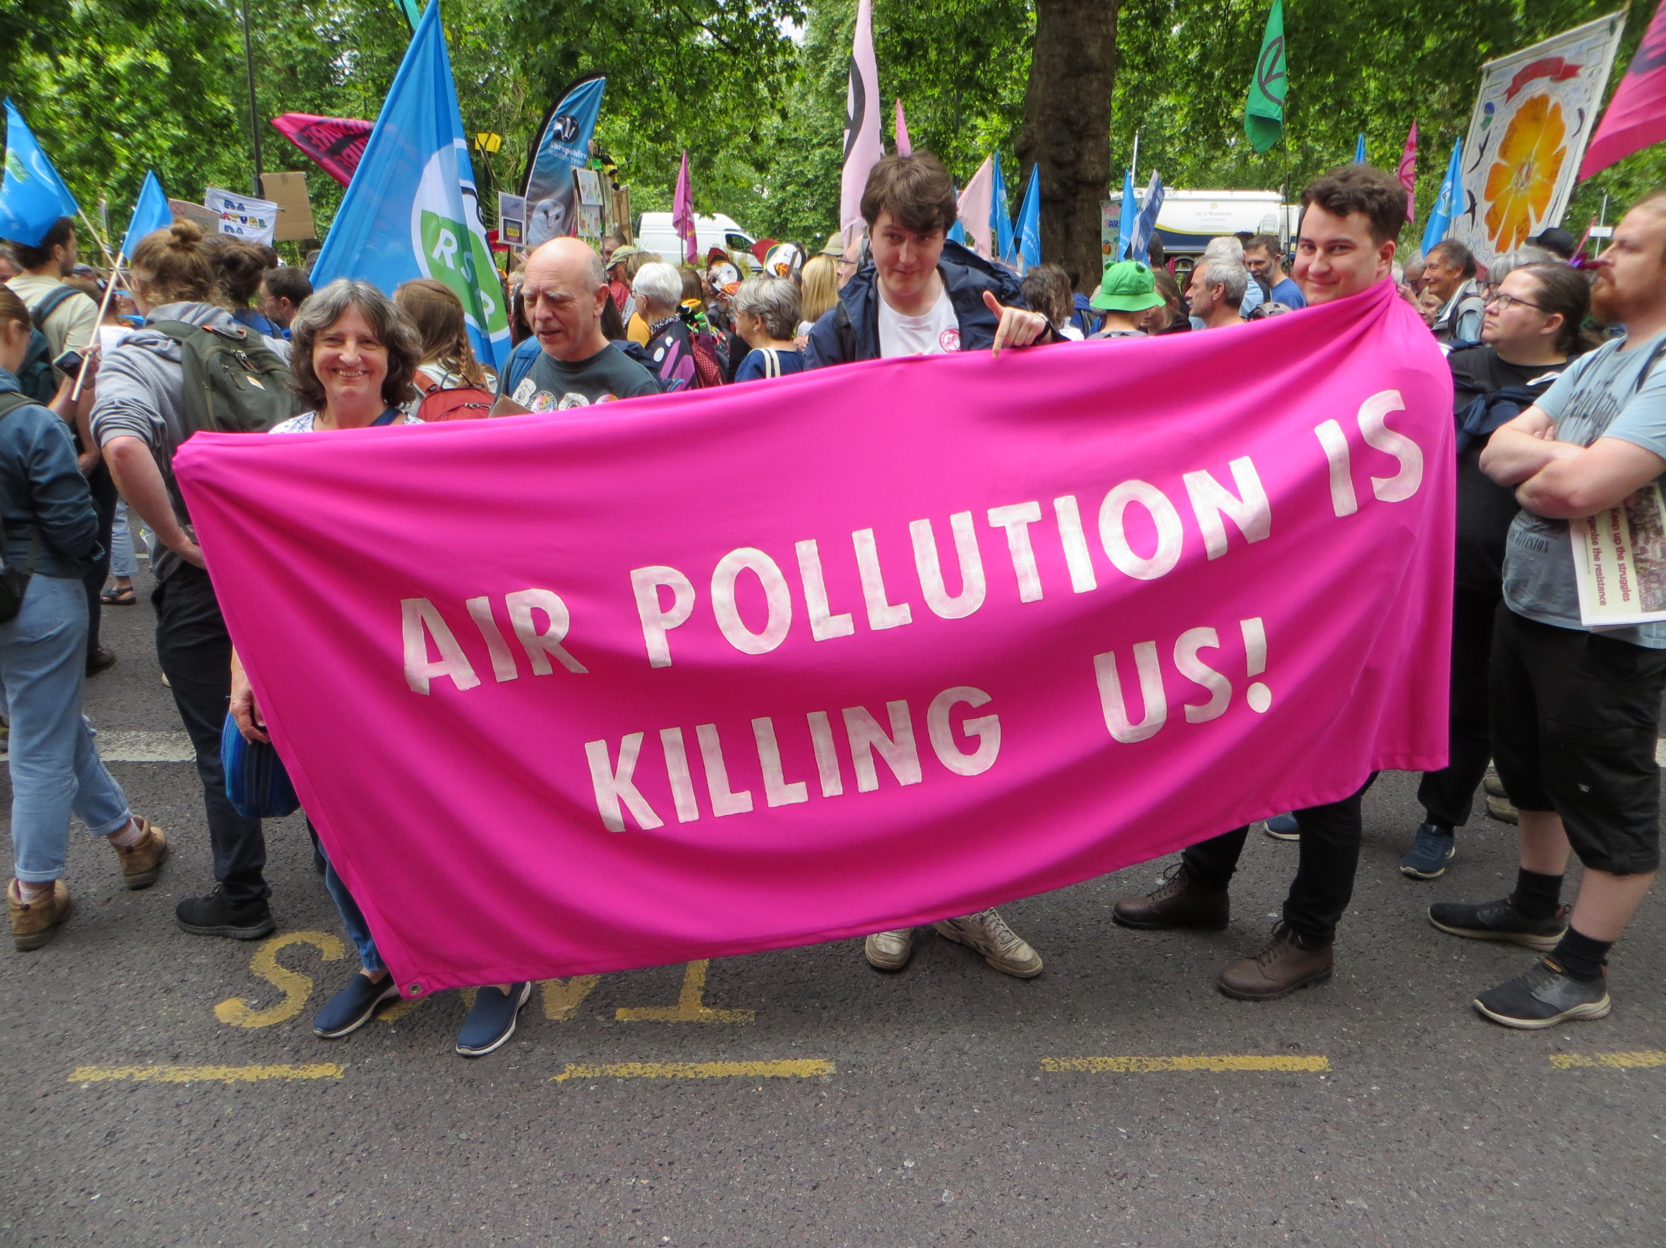
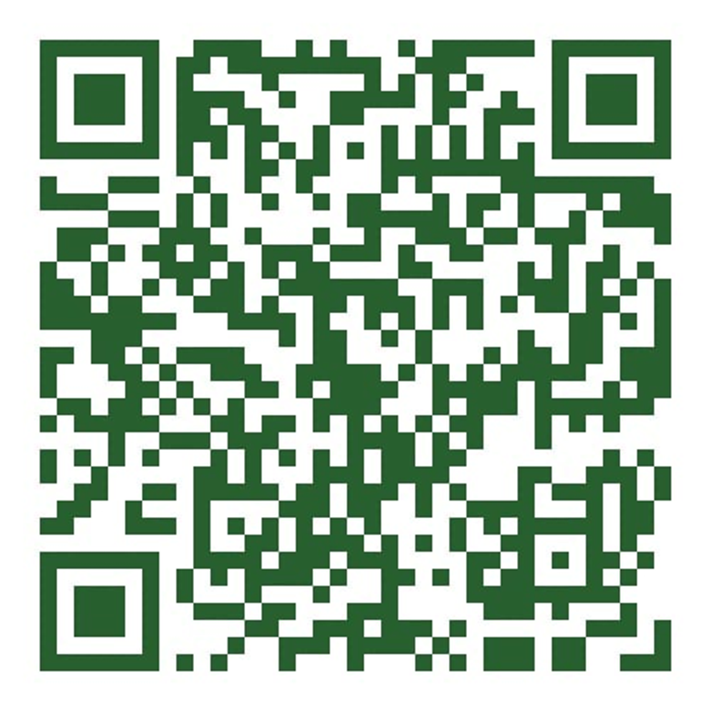
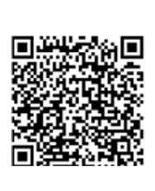
Campaign Priorities
Mental Health Crisis / Work related Stress / PSP / WR Suicide
Covid Infections/Long covid/ Reasonable adjustments / infection control https://petition.parliament.uk/petitions/700304#:~:text=Petition%20Introduce%20new%20air%20quality,ill%20staff%20to%20stay%20home
https://gmhazards.org.uk/wp-content/uploads/2024/07/Long-Covid-Charter-online-version-5-1.pdf
Women's health and safety / Menopause / PPE / SH
OHS and Casual contracts/ Gig economy/ Pseudo self employed/ Pay and conditions/ Hours at work / young workers – Training Safe App
Air pollution/ chemical and hazardous substances exposure
Trade Union Clean Air Network (TUCAN): greenerjobsalliance.co.uk/air-pollution
https://www.gmhctur.org/links-to-pages/
Accident book
An enforcement crisis / Decent jobs and Decent lives –a manifesto for a health and safety system fit for all workers https://www.hazardscampaign.org.uk/wp-content/uploads/2024/07/Final-Manifesto.pdf
Tucan / Greener Jobs Alliance
Petition – in Healthcare

Slide 3
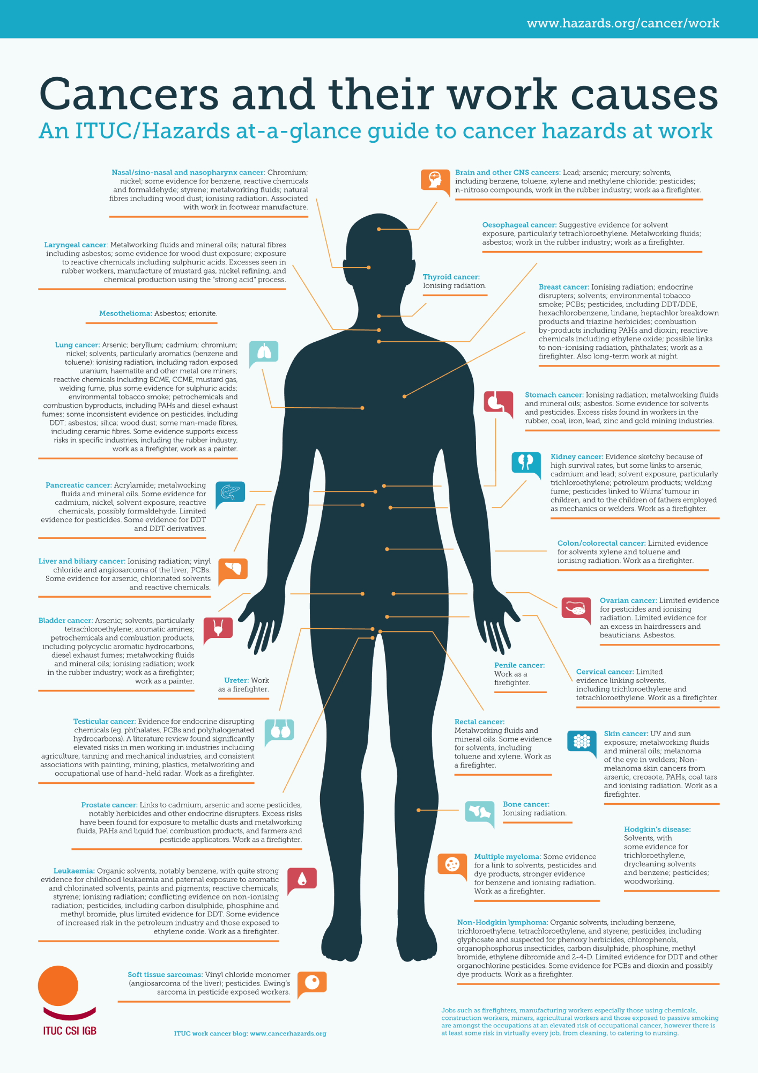
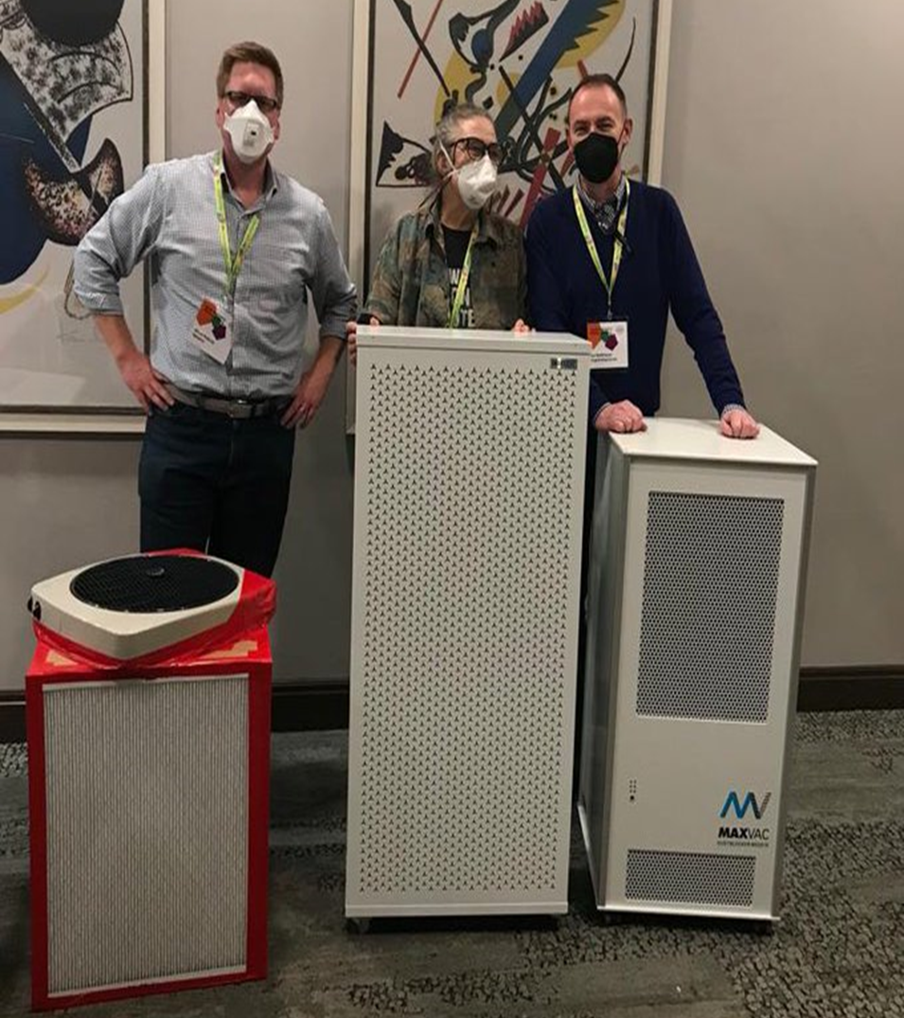
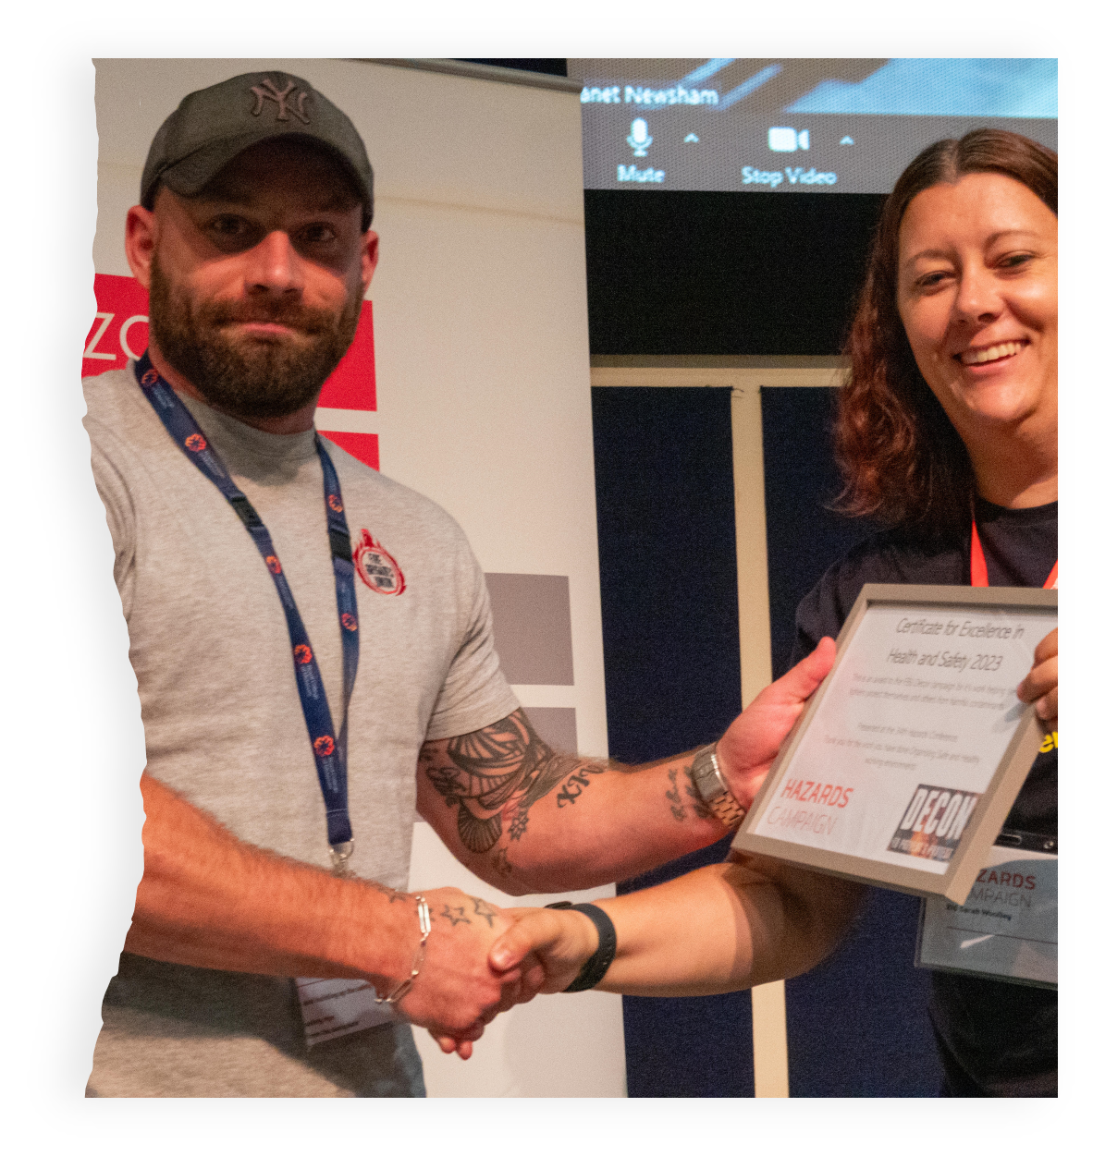
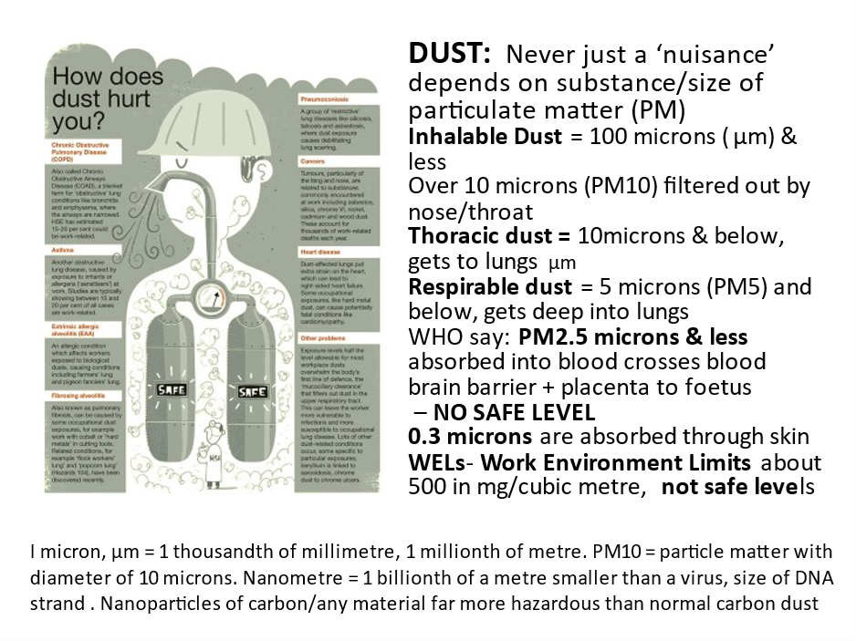
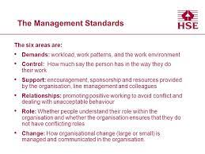
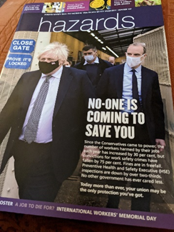
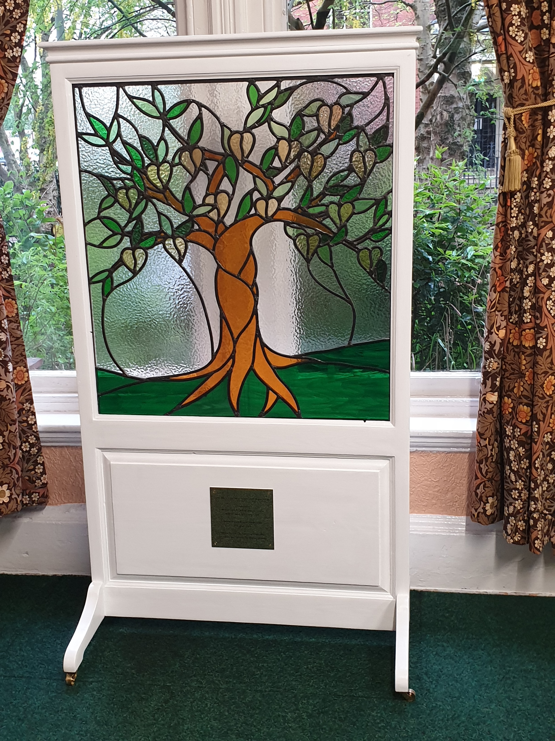
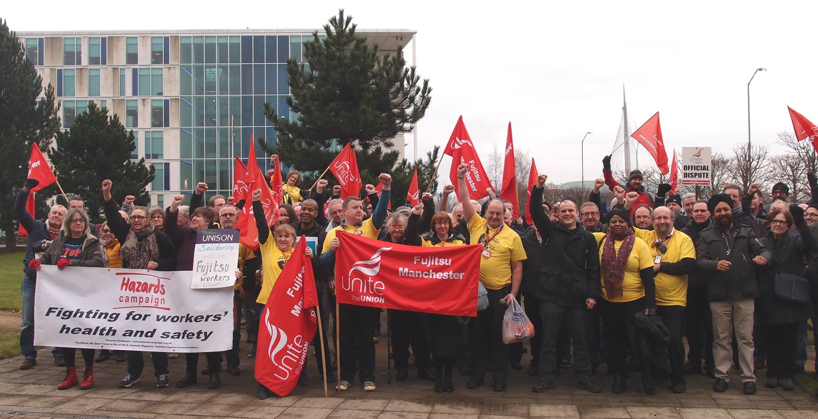
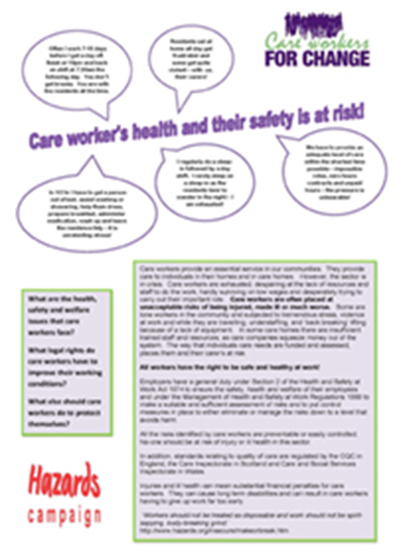
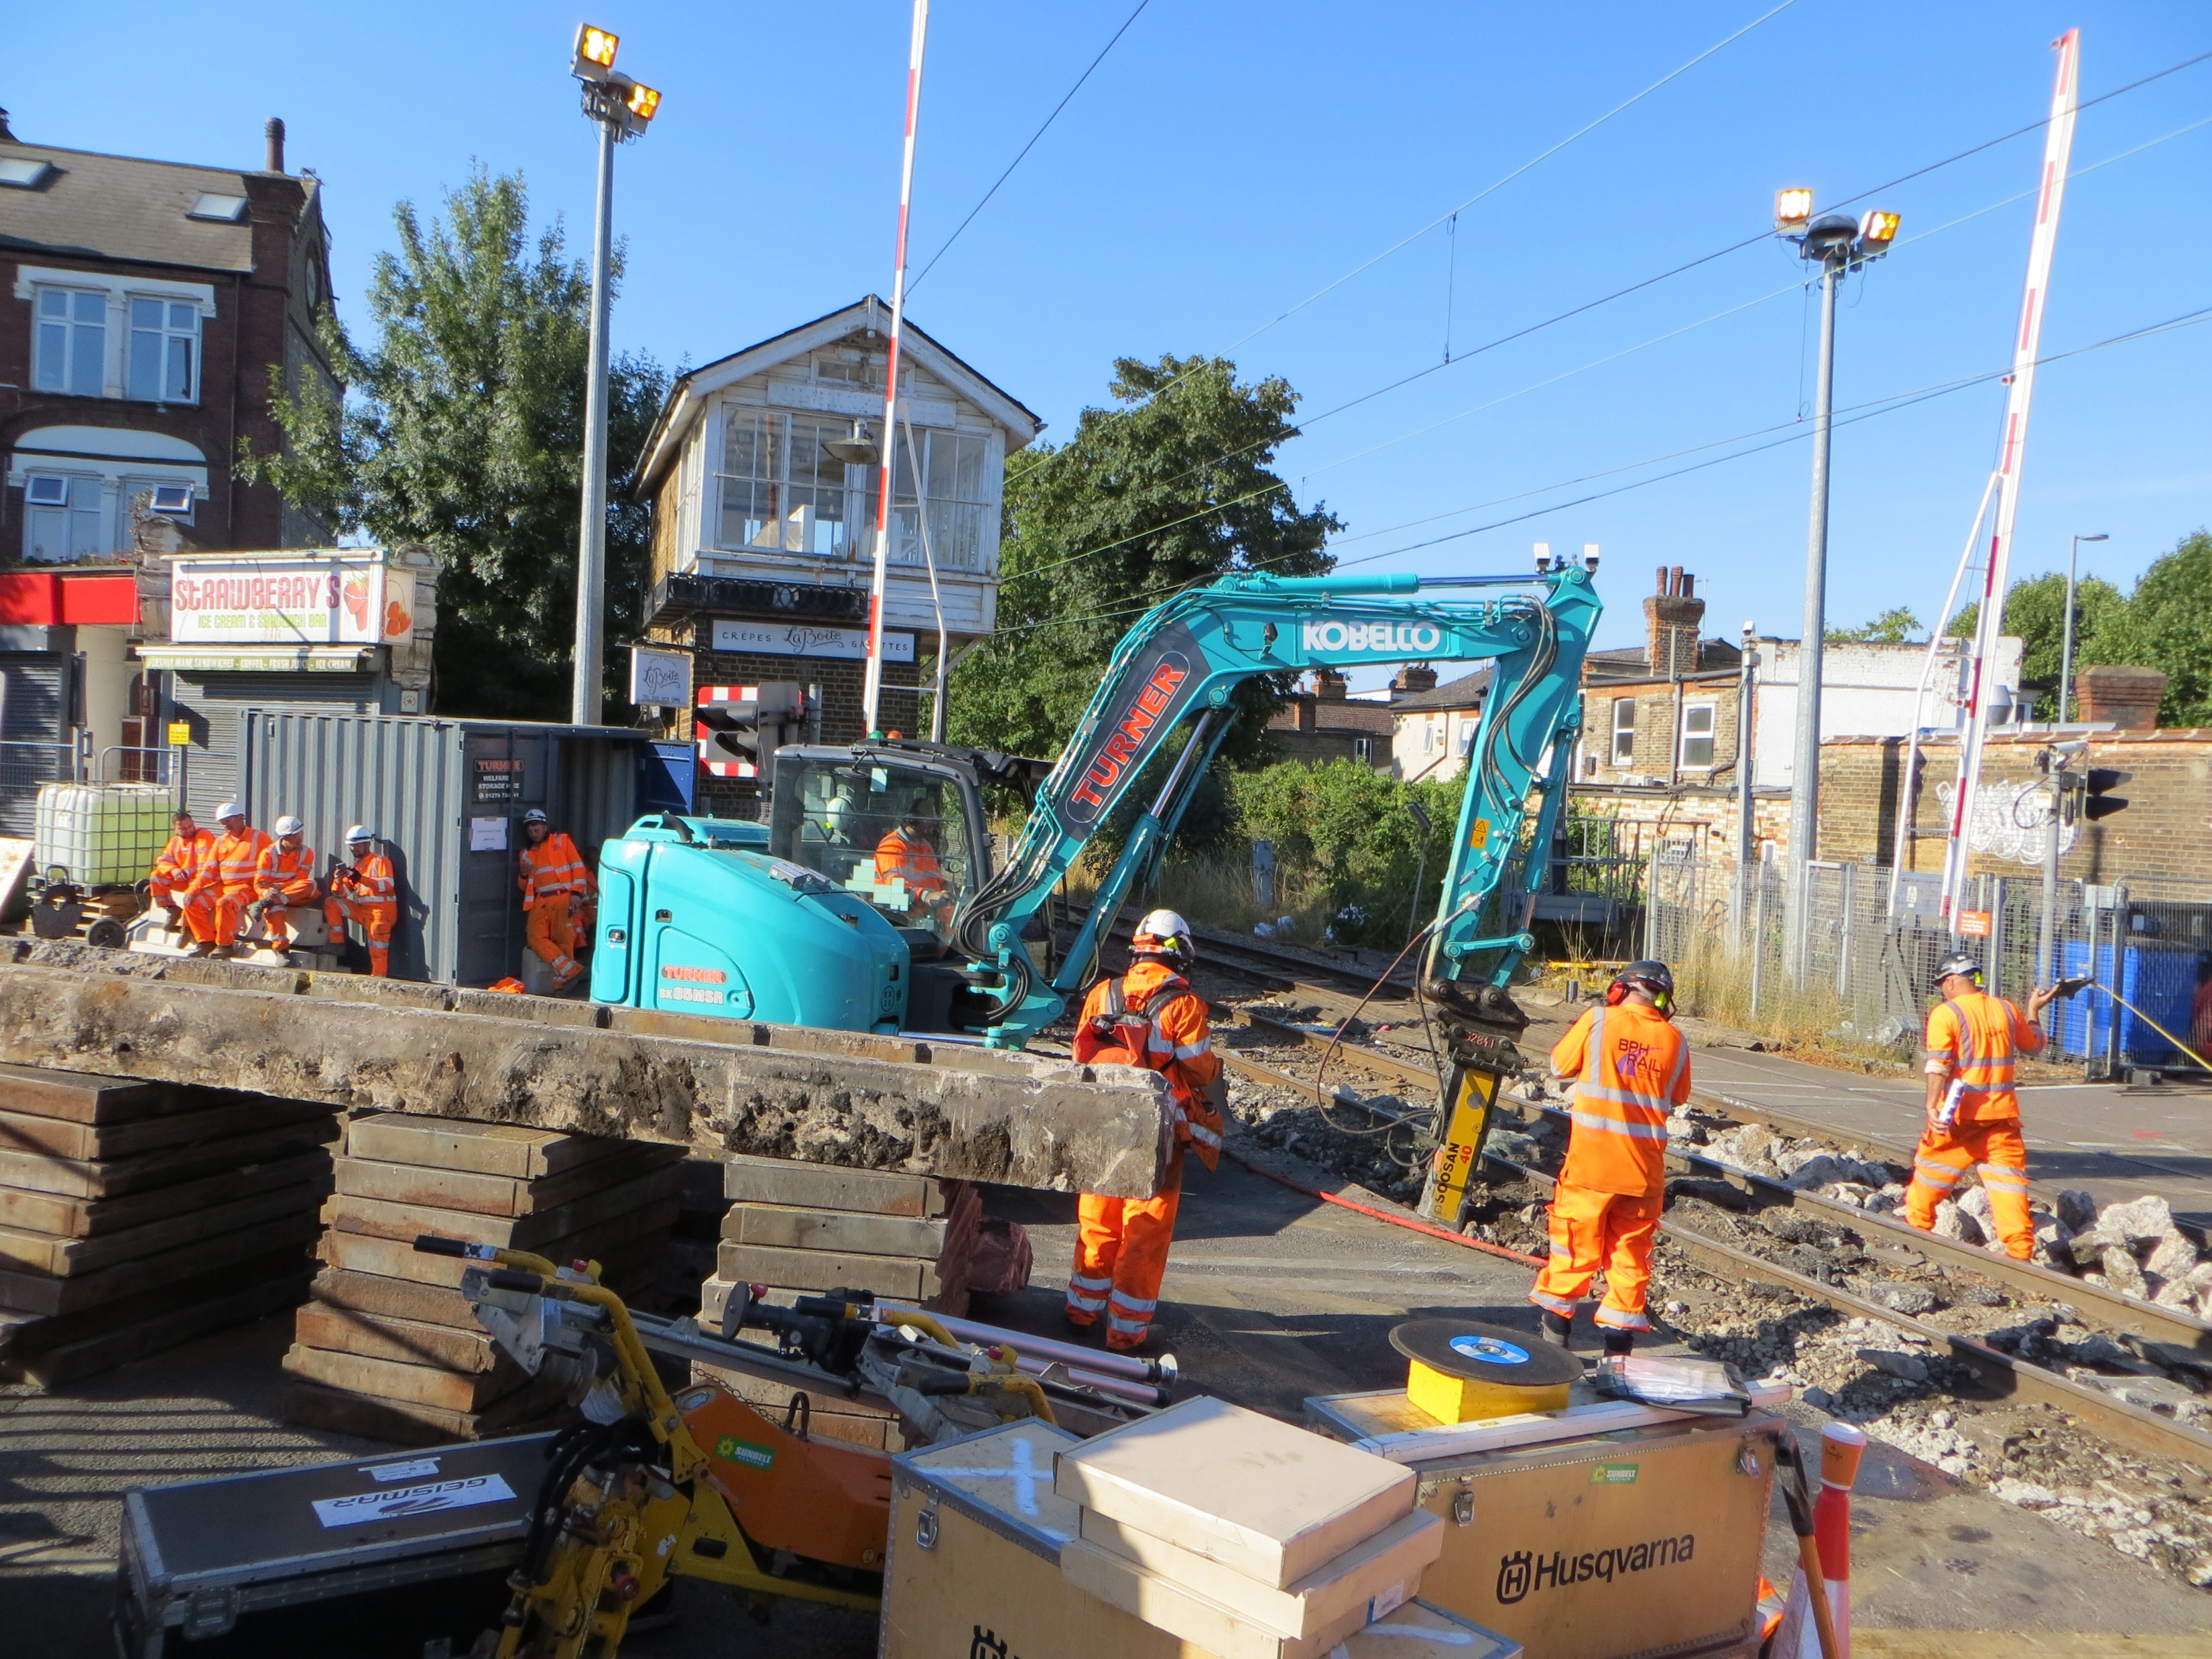
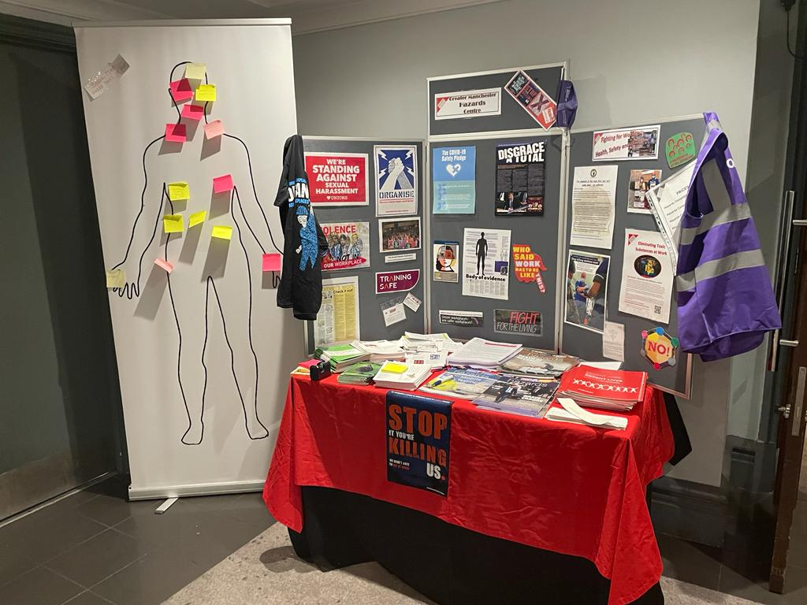
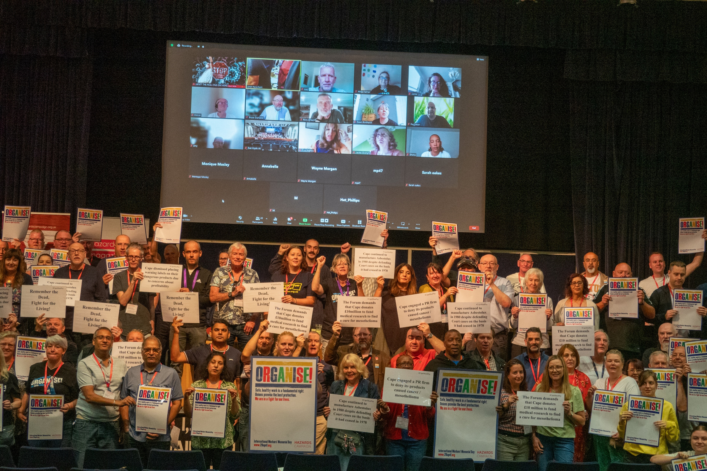
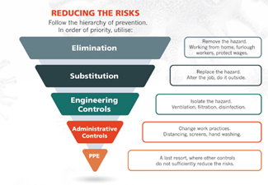
How can we secure safe workplaces?

Slide 4
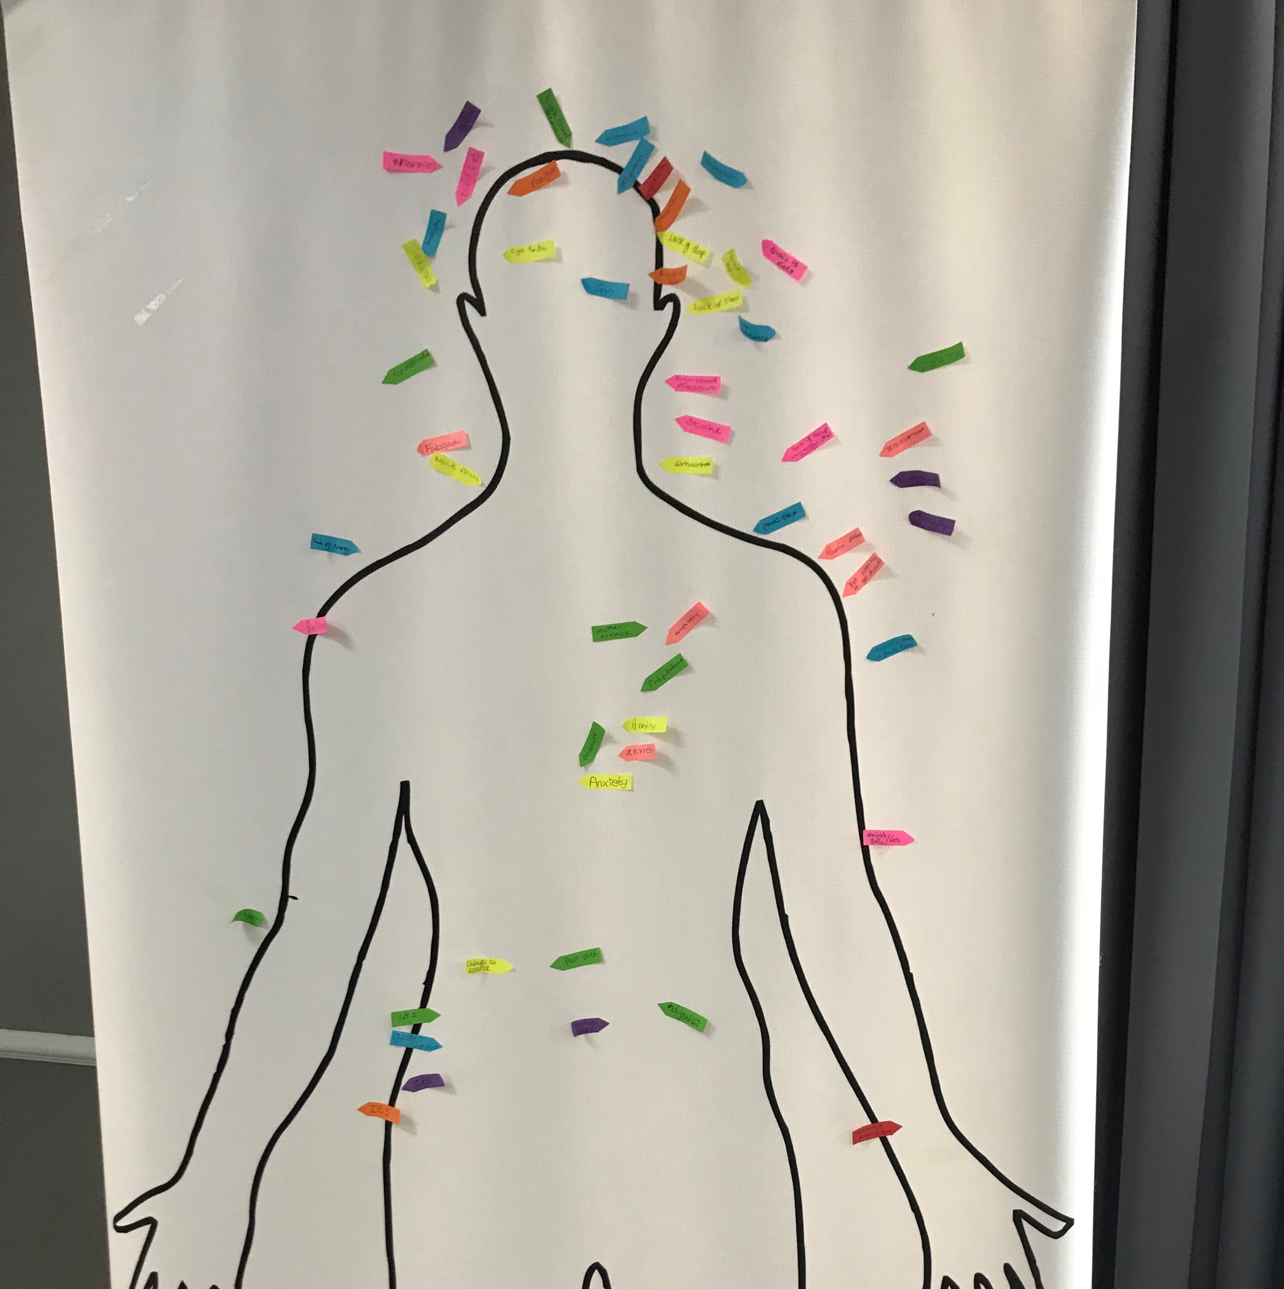
What are the practical approaches for identifying and mitigating workplace hazards to prevent injuries and illnesses?
Working with members and occupational health services to identify problems
Workplace inspections:
General
Specific including:
Fire inspection
Work related stress inspection
Bullying / sexual harassment inspection
Welfare inspection
Air pollution or Ventilation audit
document inspection
DIY research
Reviewing data
Surveys
Mapping
Body
Hazard
Support Roving Reps
Workplace Investigations – potential hazards; dangerous occurrences; the causes of accidents/incidents; and complaints by employees/ concerns raised; case work

Slide 5
What else?
Support the Hazards Magazine: https://www.hazards.org/subscribe/
2025 Hazards Conference – 5-7th September
2025 IWMD - 28th April

Slide 6
What resources?
GMHC website https://gmhazards.org.uk/
Hazards Campaign http://www.hazardscampaign.org.uk/
Hazards Magazine http://www.hazards.org/index.htm
HSE https://www.hse.gov.uk/
https://www.hazards.org/diyresearch/
TWITTER: @hazardscampaign @hazardsmagazine @hazardseditor@centregreater @Jnewsham @centregreater
FACEBOOK: We didn’t vote to die at work - Hazards Campaign
Greater Manchester Hazards Centre: https://gmhazards.org.uk/
TrainingSafe App
Bluesky

Slide 7
Any questions/comments

