Slide 1
Health and Safety Reps Why are you needed?
David Coulthard
Regional Personal Injury Manager
Thompsons Solicitors

Slide 2
Overview
Today, we will cover:
An introduction to Thompsons Solicitors
Summary of Legal Rights of Safety Representatives
How you can assist your members as a H&S Rep and top tips!
The HSE and why your role is vital
What's involved in pursuing a Personal Injury claim

Slide 3
Who are Thompsons?
We are the UK’s largest trade union law firm
We support Unite legal services, working with your internal team
We only act for injured or vulnerable people
We never act for insurance companies or employers
We represent members from all major trade unions

Slide 4
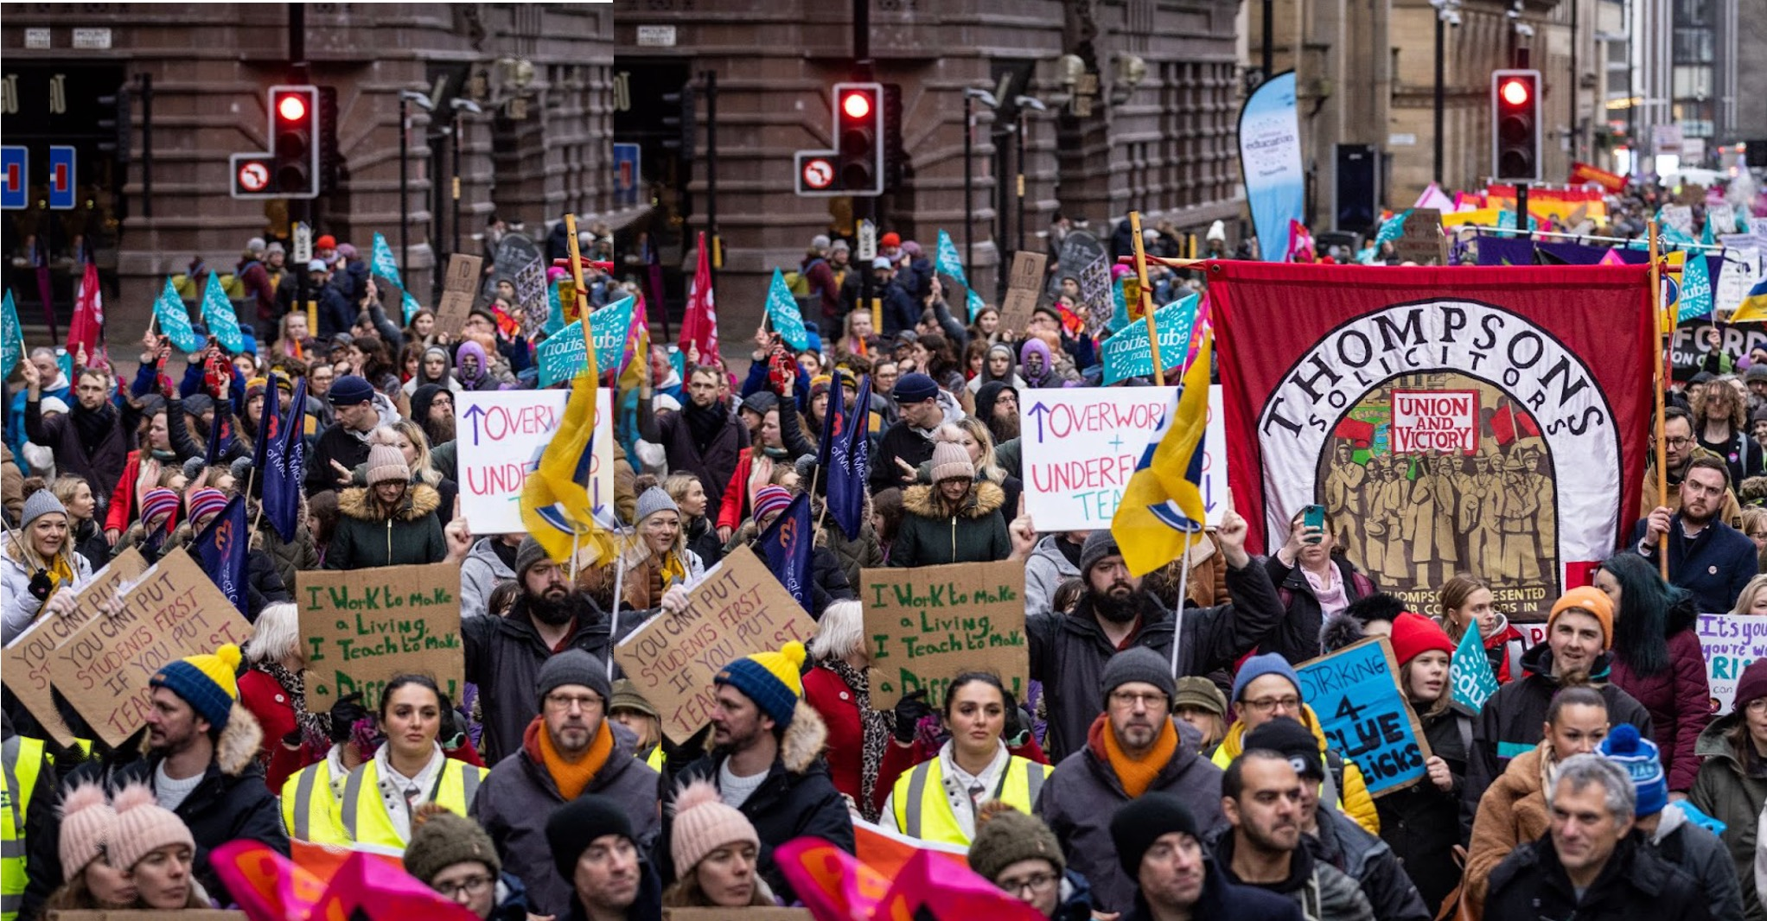
We were established in 1921 to act for working people and for trade unions and their members
We have offices across England and Wales, with a Belfast office servicing Northern Irish members and five offices under our sister company, Thompsons Scotland
We are the most experienced personal injury practice in the UK
We manage very high-profile cases on behalf of unions, such as Unite’s Blacklisting claims

Slide 5
Summary of Legal Rights of Safety Representatives Safety Representatives & Safety Committee Regulations 1977
To investigate
Potential hazards and all dangerous occurrences and accidents and (Reg 4)
Members’ complaints (Reg 4)
To inspect the workplace
At a minimum, every three months (Reg 5)
After accidents, dangerous occurrences and diseases which are notifiable to the HSE (Reg 6)
To talk to and consult
With the members and any employee concerned, in private (Reg 5/3)
With the (HSE) Inspector or Environment Health Officer (Reg 4)
With the employer on matters affecting health, safety and welfare at work (Reg 4)
With the employer before decisions being made which affect health and safety (e.g. plans and changes in the enterprise) (Code of Practice, paragraph 6)

Slide 6
Summary of Legal Rights of Safety Representatives Committee Regulations 1977 Continued
To get information
From the employer (and suppliers/third parties) on accidents, risks, technical information, consultants reports, monitoring/tests (Reg 7 & Code of Practice, para 6)
To get “reasonable” facilities and assistance from the employer
For carrying out independent investigations and inspections (Reg 5)
Facilities for writing reports, filing, sorting, copying and displaying information.
Facilities for talking privately to members and any employee (Reg 5)
For having enough paid time off to do the job of safety rep properly (Reg 4/2 (a)) For having paid time off to go on union approved training courses provided separately by the union and by the employer (Reg 4/2 (b))

Slide 7
What action should I take in the workplace?
All Health and Safety Representatives should ensure that they are aware of the accidents which are happening in the workplace.
If you have not previously looked at the Accident Book, then you should look at this as soon as possible.
You need to be aware of all accidents that have occurred.
For the future, you need to continue to be aware of accidents in the workplace.
Make sure that it is the procedure of your employer to inform you about all accidents and to send you a copy of all accident/incident report forms. This can be achieved in a number of ways but examples would include the following:
You are one of the points of contact in the event of an accident
The Accident Report form has a box where the injured person agrees for a copy of the form to be sent to you
You are, or are notified by, the first aider who would be called in the event of an accident

Slide 8
Other action to take includes:
Make sure that your employer has carried out risk assessments
Report all complaints about working conditions and relating to any health and safety issue in the workplace to the employer
Make sure all accidents are reported (even where member does not wish to make a claim) to the employer
Report all near misses to the employer
Attend Health and Safety Meetings and obtain and keep copies of all minutes of those meetings
In the event of an accident conduct an early and thorough investigation into the cause. This can be as part of your employer’s investigation or independently of it.
If you have health and safety concerns that have caused, or have the potential to cause, significant harm, that have not been resolved after consulting with the employer you can contact the Health and Safety Executive and their contact details are on the HSE Website
Make yourself known/introduce yourself to all members and potential new members in your workplace and tell them about your role and how you can help them.

Slide 9
The Role of the HSE
The Health and Safety Executive (HSE) is Britain’s national regulator for workplace health and safety.
They are dedicated to protecting people and places, and helping everyone lead safer and healthier lives.
Their role goes beyond worker protection to include public assurance.
They work to ensure people feel safe where they live, where they work and, in their environment.

Slide 10
The HSE has brought many successful prosecutions over the last 12 months
I have included some of the prosecutions of companies based in Wales.

Slide 11
Livestock auctioneers fined after man, 75, killed by cow 20th June 2024
A company has been fined £75,000 after a man was killed by a cow that had escaped from a livestock market in Wales. The cow knocked down and trampled the man.
A HSE investigation found J.J. Morris Limited, which has operated Whitland Livestock Market for over 30 years, failed to implement basic, physical control measures to prevent cattle from escaping.
HSE inspector Rhys Hughes said: “This tragic incident was foreseeable and preventable”.

Slide 12
Openreach fined following death of engineer 5th June 2024
Openreach Limited has been fined £1.34 million after an engineer died after he slipped and fell into the River Aber in Abergwyngregyn and was swept away, whilst trying to repair a telephone line.
The investigation found that there was no safe system of work in place for work on or near water, nor had Mr Owen – and others working by the river – received training, information or instruction on safe working on or near water.
HSE inspector Christina Roberts said: “Mr Owen should not have been put in the unsafe working situation”.

Slide 13
Recycling firm fined after dad killed by shovel loader 28th February 2024
A recycling company in Wales has been fined £300,000 after a man was killed after being run over from behind by a Volvo shovel loader at Atlantic Recycling Limited’s Atlantic Ecopark site in Cardiff.
HSE inspector Rhys Hughes said Atlantic Recycling failed to ensure pedestrians and vehicles were separated at its site.
The HSE investigation also found that although a risk assessment had been produced prior to the work commencing, it was not suitable nor sufficient and did not include work taking place in the wood yard.

Slide 14
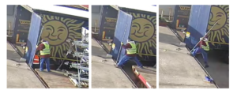
Haulage company fined after worker dies from injuries 22nd September 2023
Williams Haulage Limited, based in Wales, fined £100,000 after a worker fell from a loading bay and died.
The man had one foot on the loading bay and the other on the back of another lorry. However, he fell when the adjacent lorry was driven away.
A HSE investigation into this incident found Williams Haulage had carried out a risk assessment that identified the risk from falls and introduced control measures, but these had not been used in practice.

Slide 15
Company fined as joiner falls and breaks nine ribs 18th December 2023
Aspire Park and Leisure Homes Ltd, based in Porthmadog, fined £60,000 after a joiner fell from height and suffered a kidney laceration and head trauma.
A HSE investigation found staff at Aspire Park and Leisure Homes had not received information, instruction or training in the use of the mobile working platforms.
HSE inspector Matthew Pendle said: “This incident could so easily have been avoided had the company simply ensured the control measures and safe working practices were followed”.

Slide 16
Newport City Council fined £2million after death of much loved family man 14th December 2023
A man was barrowing tarmac from the back of the local authority’s tipper lorry when he was struck by a farm vehicle passing the road works.
An investigation by the HSE found that the council did not take all reasonably practicable steps to organise a safe working environment by ensuring there was a suitable and sufficient safety zone between the road works area and the running lane (the live part of the carriageway), as well as securing the perimeter of the road works site against road workers entering the running lane.

Slide 17
Should the worst happen! The Law
This section is intended to provide you with some guidance about the types of claims that could be brought by members when health and safety is breached by the employer.
What types of claim could employees bring?
Employees can bring either a claim for an accident at work or, alternatively, could bring a claim for an industrial disease which was caused by their work.
A disease claim
A claim where an employee has gradually begun to suffer from symptoms such as a repetitive strain injury or an asbestos related condition.
CICA Claim
If your member is assaulted at work then they may be able to claim compensation from the Criminal Injuries Compensation Authority (CICA). This is a Government funded scheme.
An accident claim
The date on which the member had an accident at work is clear and injury resulted.

Slide 18
Time limits
Seek professional legal advice as soon as possible to ensure you the best chance of winning your case
There are very few exceptions to these time limits. In cases overseas time limits can be shorter, such as in Spain where it is one year, so we recommend members seek legal assistance ASAP.
Type of claim | Time limit
Personal injuries | Three years from the date of your accident or injury developing
Industrial disease | Three years from the date of diagnosis OR three years from the date on which you became aware your illness was caused by someone else
Clinical negligence | Three years from the date of your injury OR three years from the date on which you could reasonably have become aware your injuries were caused by medical negligence
CICA | Two years from the date of the crime/injury

Slide 19
What we need to prove to succeed in a claim
Duty of Care
It is accepted that an employer owes its employees a duty of care.
Breach of Duty
It would need to be proved that the employer breached the duty of care of their employee.
There are two sources of law that we can use to show that an employer has breached a duty:
Common law
Statutory law

Slide 20
What we need to prove to succeed in a claim
A link between the breach of duty and the injury
If we are able to prove that the employer has breached their common law duty then we must show that this caused the injury. The position is more complex in relation to breach of statutory duties where it is no longer automatically the position that a case will be successful where a breach is proven to have caused the injury.
In accident cases, this is more straightforward, i.e. a missing guard causes a severed finger
In disease cases this is more difficult and the link generally will need to be dealt with by a medical expert.
Foreseeability
To succeed in a claim we also need to prove that the employer could have foreseen that the injury could have been caused by action or lack of action. To show this, we look at:
Reports of previous accidents / near misses & risk assessments
Reports of complaints

Slide 21
What to do in the event of an Accident
Carry out an early and thorough investigation into the cause of the accident and where possible assist the member in completing the accident/incident report form.
Ensure that key witnesses (names and addresses) are recorded and kept.. Witnesses can be eye witnesses and also witnesses to previous similar accidents and safe working practices.
Ensure that the accident is recorded correctly in accident reports. Provide as much information as possible as to what happened. The cause of the accident should be recorded. It is perfectly proper for an opinion to be given as to who or what was to blame for the accident.
Locate/retain relevant documents. Examples of relevant documents will be accident report form, risk assessments, RIDDOR form, health and safety minutes, safe system of work documents.

Slide 22
What to do in the event of an Accident
Take photographs if necessary to provide evidence of the cause of the accident, location, relevant equipment etc. The employer should not refuse permission for you to do this as this is an important part of the investigation.
The Health and Safety Rep should ensure that the member is immediately referred for free legal advice about making a claim for compensation
The Health and Safety Rep should keep all documentation regarding the member’s accident as it is likely that this will be requested by the member’s legal advisor at a later stage. The Health and Safety Rep is encouraged to contact the member’s legal advisor or Thompsons at the outset.
It should be remembered that some accidents occur outside the member’s usual place of employment. These accidents should be treated in exactly the same way. A member may suffer an accident whilst not at work. Such accidents should still be referred for free legal advice using the above procedure

Slide 23
What happens when a claim is made
Portal or non-portal process?
If Defendant admits liability what next?
If Defendant denies liability what next?
How do you value a claim?
What is Fundamental Dishonesty

Slide 24
Any questions?

