Slide 1
Toxics Chemicals Reduction: Glyphosate
Dan Shears
National HS&E Director
TUC Cymru Safety Reps Connect
Tuesday 26th November 2024

Slide 2
What is glyphosate?
Glyphosate is the key ingredient in a powerful herbicide (weedkiller) most commonly known as Roundup, but also known as Accord, Rodeo, Touchdown and Rosate.
Developed by the manufacturer Monsanto in the early 1970s, it has been on the market since 1973 and is the most commonly used weedkiller in the world.
Glyphosate can be found in many industrial and domestic weedkilling products.
In March 2015, The World Health Organisation’s International Agency on Research into Carcinogens (IARC) announced that glyphosate probably caused a cancer called Non-Hodgkin’s lymphoma (NHL).
This was based on a study of agricultural workers in Sweden, Canada and the USA who were exposed to the chemical, although it was backed up by tests on animals.

Slide 3
What are the health hazards?
Outside of NHL, the major health risk identified was until recently concern over stomach bacteria, damaging the gut microbiome.
There are potential links to coeliac disease and IBS
If swallowed it may cause corrosion of the throat and can lead to kidney or liver failure.
Recent research has identified glyphosate as a possible cause of thyroid disease
It has also been identified as a potential endocrine disruptor.
It can also cause discomfort if it is breathed in.
Exposure to the eyes can result in conjunctivitis.

Slide 4
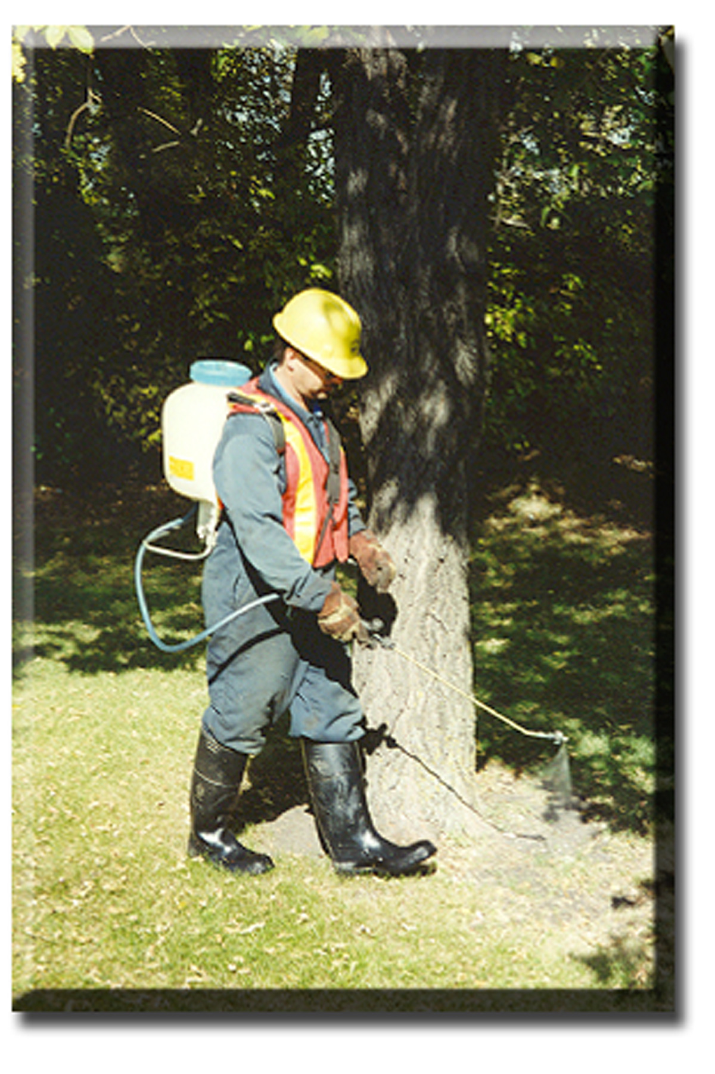
Why are GMB involved?
GMB members work in many outdoor industries, and we represent Park workers, groundskeepers, and arboricultural workers
A motion to our 2016 Congress commanded us to campaign on eliminating exposures to work-related carcinogens
The IARC report gave us the evidence needed to challenge glyphosate use

Slide 5
What did GMB do?
We developed new guidance for members on glyphosate
We used our network of MPs, and crucially local councillors, to raise awareness of the issue at Local Authority level
This campaigning saw both challenges and grievances in the workplace, and motions tabled for debate by Councils.

Slide 6
What are the alternatives?
Hot foam systems / hot water systems
Hand weeding is an option particularly for smaller areas such as playgrounds and on paths running through parks.
Acetic acid dilutions have been used very effectively to control weeds on hard surfaces in a variety of situations.
Manual approaches are available in the form of differing types of mulching.
Flame treatment has been used successfully to eliminate weeds.
Steel brushing can be used for large scale areas such as pavements and roads.
High pressure hot water treatments can be particularly effective
Adapted from an original list from the Pesticides Action Network UK

Slide 7
What was the impact?
Glastonbury, Somerset
Erewash, Derbyshire
Wadebridge, North Cornwall
Hammersmith and Fulham, London
Lewes District, East Sussex
Cowes, Isle of Wight
Frensham, Surrey
Peterlee, Durham
Shaftesbury, Dorest
Trafford, Manchester
Cambridge, Cambridgeshire –
Midlothian, Scotland
Highland, Scotland
Lyme Regis, Dorset
Greater London Authority
Frome, Somerset
Chichester, West Sussex
Colchester, Essex
Vale of Glamorgan, Wales
Derry, Londonderry
Folkestone & Hythe, Kent
Shetland, Scotland
Petersfield, Hampshire
Lambeth, London
Faversham, Kent
Hexham, Northumberland
Hadleigh, Suffolk
Balerno, Edinburgh
Wirral, Liverpool
Waverley, Surrey
Warminster, Wiltshire
Manningtree, Tendring, Essex
Bilbrook, South Staffordshire
Reading, Berkshire
Bath and North East Somerset
Renfrewshire, Scotland
Guildford, Surrey
Chelmsford, Essex
East Devon, Devon
Marlow, Buckinghamshire
Chipping Norton, Oxfordshire
Worthing, West Sussex
Newcastle, Tyne and Wear
Portsmouth, Hampshire
Westminster, London
West Suffolk, Suffolk
Berwick-upon-Tweed, Northumberland
Devon County
Flintshire, Wales
Newton Abbot, Devon
Notes:
Flintshire County, Wales – November 2023 – Have committed to end their use of glyphosate and have invested in a Foamstream machine to manage unwanted plant growth.
Glyphosate-based Weedkillers: 22 Oct 2024: Senedd debates – TheyWorkForYou – Joyce Morgan, Labour
15% of all herbicide used in Wales is Glyphosate

Slide 8
For more information:
GMB Guide: https://www.gmb.org.uk/assets/media/downloads/1894/hs-glyphosate.pdf
TUC Report: https://www.tuc.org.uk/research-analysis/reports/glyphosate
Hazards Magazine on Chemical Regulation and Glyphosate: https://www.hazards.org/chemicals/sheepish.htm
Pesticide Action Network UK: https://www.pan-uk.org/
US Right To Know: https://usrtk.org/pesticides/glyphosate-health-concerns/
Detox Project: https://detoxproject.org/

