Slide 1
Fit for the next 50 Years: Necessary changes on Health and Safety at Work
Dan Shears
National HS&E Director
Safety Reps Connect Cymru
Tuesday 26th November 2024

Slide 4
Mental Health
Mental Health at Work Act, going beyond voluntary Stress Management Standards.
Mandatory legal framework on employers to proactively manage mental health work.
Parity of esteem with physical health.

Slide 5
Mental Health
Bring the reporting, investigation and prosecution of cases of work-related suicide into the scope of workplace health and safety law.
Proactive requirement to manage suicide risk – risk assessment; occupational health support

Slide 6
Mental Health and Discrimination
It’s increasingly clear that racism, sexism, homophobia, disability discrimination and ultimately forms of inequality are health and safety issues. They damage our members mental health. That impacts on our members physical health.
The scope of the Health and Safety Work Act needs to be enlarged to include discriminatory behaviours from managers, from employers and from third parties.
The positive legal duty must be enforced to ensure that all employees consider these issues and reduce the risks from these hazards as part of their safety management system.

Slide 7
Violence
New regulations on the management of work-related violence.
This issue caught between two stools. It’s a police issue when there’s a serious incident, but when the violence is verbal or harassment, it’s too trivial to warrant health and safety action. Because violence is not explicitly covered in legislation, the response in 99% of instances is either to involve the Police, or more likely to do nothing.
Violence at work is never part of the job; there are always actions that can improve the situation and reduce risk.

Slide 8
Gender Equality
Menopause is an equality issue, but it is also a health and safety issue. It is not good enough for it to be kept on the back burner because male health and safety managers are uncomfortable, with discussing the topic and developing policies and procedures.
It is completely wrong for female workers to be provided with personal protective equipment designed for male workers. separate well-designed, well-fitting, fit for purpose protective equipment for female workers is not the norm. It is not standard. It cannot be left to the market.
There is a clear role for legislation here in terms of equality, in terms of health and safety, and simply in terms of doing the right thing.

Slide 9
Gig Economy and Precarious Employment
Law that is able to fully tackle the gig economy; that can compensate for the erosion of employment rights and that can see through the sham that is bogus self-employment.
There is an urgent need to end the practice of ‘sweating’ temporary workers for 11 weeks, by introducing day one employment rights to equal treatment.
Banning Zero Hours Contracts, and providing employment rights for workers with flexible contracts.
Enforcing PPE requirements for temporary workers
Regulating on hazard and risk to workers, not employment status

Slide 10
Automation and AI
New regulations are needed to ensure checks and balances on automation and AI are in place.
Automation may eliminate some hazards (manual handling), but introduce new ones (heavily increased pace of work).
Current regulation on deals directly with the inherent hazards (PUWER), not the consequential ones.
AI is potentially a greater risk. We already know of some employers using AI to produce policieis, procedures and risk assessments; and predicitive technology had advanced to the point where it can identify likely incidents before they occur in workplaces such as warehouses.
But these technologies are not proven, and not infallible – and complacency may create enormous risks

Slide 11
Clarifying that SFAIRP does not allow for regression
Guidance or regulation is required to ensure that Employers cannot skimp on the provision of health and safety at work when the economy takes a downturn.
Too many employers have spent the past 14 years hiding behind “reasonable practicability” as a justification to reduce their health and safety provisions to cut costs.
Fear of enforcement action and prosecution has historically been a powerful driver to not let standards slip, but the reduced likelihood of being inspected (once in every 75-250 years!!!) means the deterrent effect no longer exists.

Slide 12
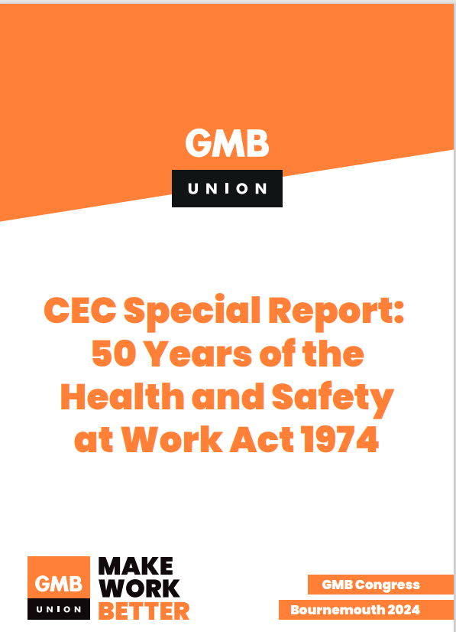
For more details…
https://www.gmb.org.uk/assets/media/downloads/2970/cec-special-report-50-years-of-the-hs-act-1974.pdf

