Slide 1
Barriers to Women Becoming Health and Safety Reps
Linda Butler

Slide 2
Session Objectives
Understand challenges women face in becoming safety reps
Identify workplace, cultural, and systemic barriers
Finding practical solutions to increase inclusivity

Slide 3
Why might women hesitate to become safety reps?
Pair: Share your thoughts with a partner
Share: Share key points with the group

Slide 4
Group Discussion: Barriers think about
Workplace challenges (e.g., culture, stereotypes)
Cultural or societal expectations
Perception of safety roles as male-dominated
Confidence gap and lack of role models
Time constraints and access to training

Slide 5
TUC-Women and the Union Safety Rep role Findings from focus groups, July - October 2022
Women felt they did not know much about the role of the safety rep and its powers:
Where women were in a workplace which already had a safety rep in post, they have been told there was no need for any additional reps.
Many women felt 'at capacity', and simply had too much else going on to consider taking on additional union duties. There was a perception that it involves a heavy workload burden, and a lack of knowledge of the right to carry out duties in work time.
The perception of being 'pigeonholed' as the union Equalities or Women’s Officer (even when in post as a safety rep!) because of their gender:
Some women felt they were, or would be, listened to less compared to men in similar roles; both by management and members.
There were negative associations with being vocal and adversarial with management, which came with fear of victimisation.
Women also raised difficulty accessing training: the dates, times, and locations of safety rep training made it hard to juggle caring responsibilities
Some women felt the safety rep role was the most 'boring' position in the union, or that it was daunting and involves a lot of legalistic knowledge
A lack of women role models to look up to and learn from meant some women just couldn't see themselves doing it. This was particularly true of younger women:
https://www.tuc.org.uk/research-analysis/reports/women-and-union-safety-rep-role

Slide 6
Solutions?
Promote success stories of female safety reps
Offer mentorship programs
Provide flexible training options
Challenge stereotypes in union messaging
Create inclusive workplace cultures

Slide 7
TUC Courses
Courses for Health and Safety Union Reps in Wales

Slide 8
Spring term 2025 - courses for reps
Course name | Pattern | Start date | End date | Venue | Provider
Health and Safety Reps Stage 1 | 10 Fridays | 17/01/ 25 | 28/03/25 | ALW Cardiff | Adult Learning Wales
Health and Safety Reps Stage 1 | 10 Fridays | 17/01/25 | 28/03/25 | ALW Wrexham | Adult Learning Wales
Union Reps Stage 2 | 10 Fridays | 24/01/25 | 04/03/25 | Online | Adult Learning Wales
Health and Safety Reps Stage 2 | 10 Tuesdays | 14/01/25 | 25/03/25 | Online | Coleg Gwent
Introduction to environmental awareness (for reps) | 1 Tuesday (half day) | 14/01/25 | 14/01/25 | Online | Adult Learning Wales
Greening the workplace – green rep skills | 3 Mondays | 27/01/25 | 10/02/25 | Online | Coleg Gwent
Negotiating for a Just Transition | 3 Thursdays | 20/03/25 | 03/04/25 | Online | ALW
Menopause in the Workplace | 3 Mondays | 10/03/25 | 24/03/25 | Online | Adult Learning Wales
Autism Awareness/ Neurodiversity in the Workplace | 2 Tuesdays | 04/03/25 | 11/03/25 | Online | Adult Learning Wales
Mental Health – from resilience to resistance | 2 Mondays | 31/03/25 | 07/04/25 | Online | Coleg Gwent

Slide 9
Summer term 2025 - courses for reps
Course name | Pattern | Start date | End date | Venue | Provider
Health and Safety Reps Stage 1 | 10 Tuesdays | 06/05/25 | 15/07/25 | Newport, Nash Road Campus | Coleg Gwent
Health and Safety Reps Stage 2 | 10 Fridays | 09/05/25 | 18/07/25 | Online | Adult Learning Wales
Introduction to environmental awareness (for reps) | 1 Wednesday (half day) | 7/05/25 | 7/05/25 | Online | Adult Learning Wales
Greening our workplaces - Green Representatives Skills | 3 Mondays | 02/06/25 | 16/06/25 | Online | Adult Learning Wales
Negotiating for a Just Transition | 3 Tuesdays | 10/06/25 | 24/06/25 | Online | Coleg Gwent
Tackling and preventing sexual harassment | 3 Thursdays | 08/05/25 | 22/05/25 | Online | Coleg Gwent

Slide 10
Toolkits
The Wales TUC has produced a number of toolkits that can be used in the workplace to assist with various areas of equality, workplace learning and environmental issues. Browse and download the full range of of toolkits here.
https://www.tuc.org.uk/wales/wales-tuc-toolkits-and-resources
Interactive guides
We have short bite-sized pieces of learning and longer courses. Each piece of learning is self-contained and contains a mixture of text, video and quizzes. They last between 20 and 45 minutes and can be returned to as many times as you like. Access our interactive guides
https://www.tuc.org.uk/Interactiveguides

Slide 11
Webinars
Our webinars on specific workplace issues are a valuable training tool for reps and members. Sign-up to our upcoming events or watch our past webinars.
https://www.tuc.org.uk/webinars
Networks
We have a number of active networks where you can receive regular updates on important workplace issues. They also provide ongoing opportunities to network and share experiences with other reps beyond the classroom.
Find out more about our Health and Safety Reps Network, Greener Workplaces Network and Union Learning Reps Network.
https://www.tuc.org.uk/events/tuc-cymru-health-and-safety-reps-network
https://www.tuc.org.uk/wales-tuc-cymru-greener-workplaces-network

Slide 12
TUC Stream
Short bite-sized pieces of learning and longer courses. Each piece of learning is self-contained and contains a mixture of text, video and quizzes. They last between 20 and 45 minutes and can be returned to as many times as you like.
https://tuc.curatr3.com/register

Slide 13
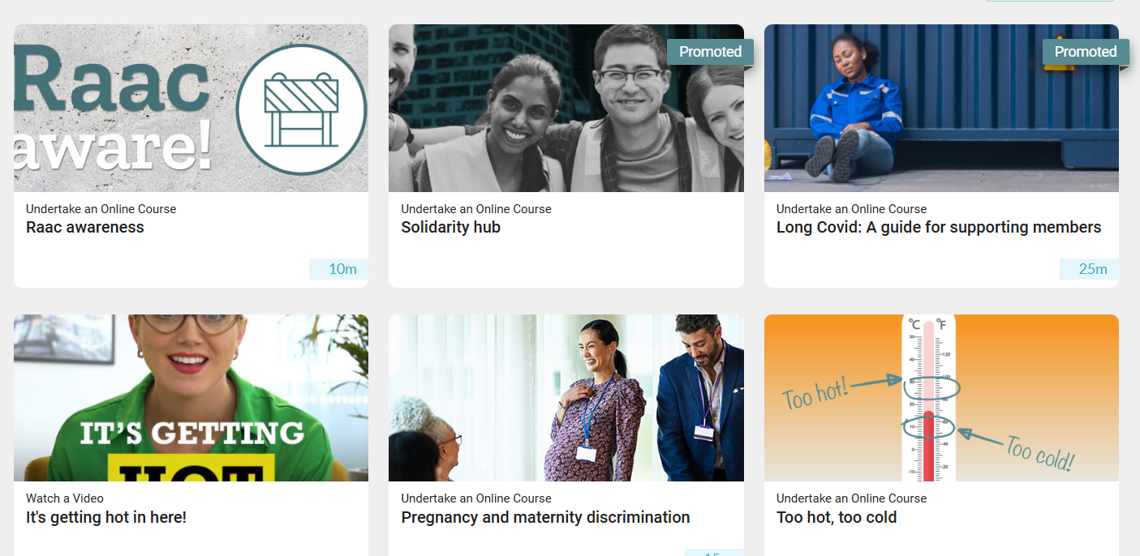

Slide 14
Thank you for listening
Any Questions

