Slide 1
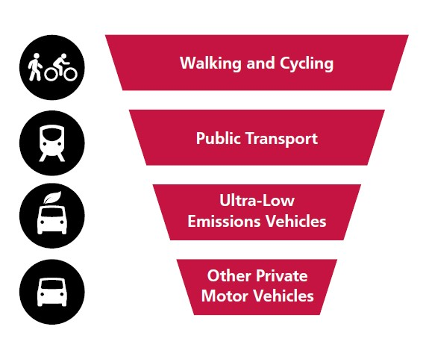
Why travel to work is an important issue for trade unionists

Slide 2
76% of journeys to work in Wales are made by car –and very few of those are EVs

Slide 3
The way we travel is a problem
It’s a problem for our environment:
It’s a problem for our health
It’s a problem for equality of opportunity
It’s a problem for our economy

Slide 4
The Environment
Transport accounts for 15% of Wales’ climate changing carbon emissions.
Over 50% of the emissions come from cars.
Air pollution from transport also contributes to nature loss and impacts negatively on ecosystems.
Car parking and roads take up large areas of urban space.

Slide 5
Health
Wales has the lowest physical activity levels in Britain.
This results in obesity and a whole range of illnesses that are estimated to cost the Welsh NHS £35 million each year.
Air quality
According to Public Health Wales, each year around 1,000 to 1,400 avoidable deaths in Wales are due to exposure to air pollution, both in the form of NO2 and particulate matter.
Road Casualties
In 2022 there were 4,447 road casualties in Wales

Slide 6
Equalities
Should you have to have a car to get a job?
Affordability
19% of Welsh households don’t have access to a car.
Young people face massive insurance costs.
Accessibility
Many disabled people cannot drive.

Slide 7
The Economy
Congestion is currently estimated to cost Wales £2bn per annum
Ill health resulting from physical inactivity is a major cost to the economy

Slide 8
So how do we bring about change?
Just because something is a problem doesn’t mean people – even trade unionists – will want to stop doing it!

Slide 9
Changing travel habits
Ask the members
It’s all about choice
Raise awareness of the alternatives
Emphasise the positives
Make it easier to be sustainable
If you don’t do it the employer might

