Slide 1
Diwrnod Rhwydwaith Cynrychiolwyr Dysgu
Undeb TUC Cymru 2023
Dydd Gwener 3 Tachwedd 2023
Wales TUC Union Learning Rep Network Day 2023
Friday 3 November 2023

Slide 2
Croeso
Welcome
Julie Cook, National Officer, Wales TUC

Slide 3
Wales TUC Code of conduct
Côd Ymddygiad
Mae’r TUC yn ymrwymedig i drefnu gweithgareddau
lle y gall pawb gyfrannu ynddyn nhw mewn amgylchedd
cynhwysol, parchus a diogel. Nid oes gan y TUC unrhyw
oddefgarwch tuag at unrhyw fath o aflonyddu, gan
gynnwys aflonyddu rhywiol. Ni fydd unrhyw ymddygiadau
neu sylwadau ymosodol, sarhaus, bygythiol, amharchus
neu annerbyniol yn cael eu goddef. Mae hyn yn cefnogi’r
ymrwymiad a osodwyd yn rheolau’r TUC i hyrwyddo
cydraddoldeb i bawb a chael gwared â phob ffurf o
aflonyddu, gan gynnwys aflonyddu rhywiol, rhagfarn a
gwahaniaethu annheg. Mae’r polisi hwn yn berthnasol i
bob agwedd o gyfathrebu mewn digwyddiad neu mewn
cysylltiad â digwyddiad, gan gynnwys postiadau ar y
cyfryngau cymdeithasol. Os oes gennych chi unrhyw
bryderon ynglŷn ag ymddygiad yr ydych chi’n dymuno eu
trafod, cysylltwch â ni drwy e-bost os gwelwch yn dda:
wtuc@tuc.org.uk
The TUC is committed to organising activities at which everyone can participate in an inclusive, respectful and safe environment. The TUC has zero tolerance for any type of harassment, including sexual harassment. Aggressive, offensive, intimidatory, disrespectful or unacceptable behaviour or comments will not be tolerated. This supports the commitment set out in the TUC’s rules to promote equality for all and to eliminate all forms of harassment, including sexual harassment, prejudice and unfair discrimination. This policy applies to all aspects of communication at or in connection with an event, including postings on social media. If you have any concerns about behaviour that you want to raise then please contact us by email wtuc@tuc.org.uk

Slide 4
Becky Sixsmith-Hughes
Project Officer

Slide 5
Diversifying the reps base
This workshop is an interactive session on diversifying our trade union reps, designed to give all reps and branch officials the confidence and knowledge to promote Black members development and address how we drive equality and diversity within trade unions. We will look at the barriers for Black workers to becoming more active in the movement and explore how we can increase recruitment of Black reps.

Slide 6
Introduction

Slide 8
What do we mean by Black
‘Black’ – with a capital B– is used to indicate people with a shared history. ‘Black’ is used in a broad political and inclusive sense to describe people in the UK who have suffered from colonialism and enslavement in the past and continue to experience racism and diminished opportunities in today’s society”.

Slide 9
Reps Survey 2019
Reps most likely to be men 57%; White 93% and middle-aged (49)
21% were the only rep at their place of work
Common for reps to have more than one role. 48% have one role, 31% hold 2 roles and 15% hold 3 roles. Average number of roles = 1.8.
Men somewhat more likely to hold senior positions 24% than women 19% & to be H&S reps 47%
Black reps most likely to be Equalities rep 20% & ULRs 25%
Most reps had been reps for more than 5 years
They’re ageing: ave. age was 45

Slide 10
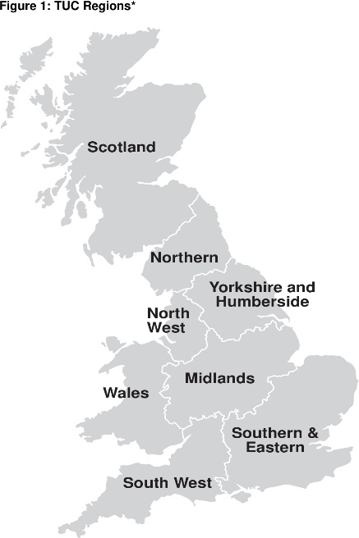
Diversifying the movement
National 2%
Black Activist Development Programmes
Open for applicants: Northwest,
Open in November: Midlands & LESE
TUC Black Network
34 unions engaged.
Roles: Reps 34%, Officers 26%, Equality 19%, H&S 15% ULR 6%
Training Black Tutors
Health and safety taster sessions
2%
7%
9%
17%
2%
55%
5%

Slide 11
Task 1
In your groups discuss and feedback:
The barriers for Black workers to becoming more active in the trade union movement?

Slide 12
Task 2
In your groups discuss and feedback:
What are the benefits of including and promoting the development of
Black reps in the branches?

Slide 13
Task 3
In your groups discuss and feedback:
What can we do to increase recruitment of Black ULR’s?

Slide 14
Rsixsmith-hughes@tuc.org.uk

Slide 16
Egwyl
Break

Slide 17
Taith y Rhaglen Datblygu Ymgyrchwyr Du
Black Activists’ Development Programme Journey
Amarjite Singh
Swyddog Trefnu a Datblygu
Organising and Development Officer

Slide 19
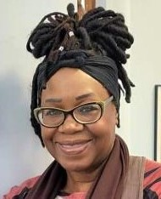
Humie Webbe – Cydlynydd
Humie Webbe – Co-ordinator
Notes:
Aelod o Unite
Unite member

Slide 20
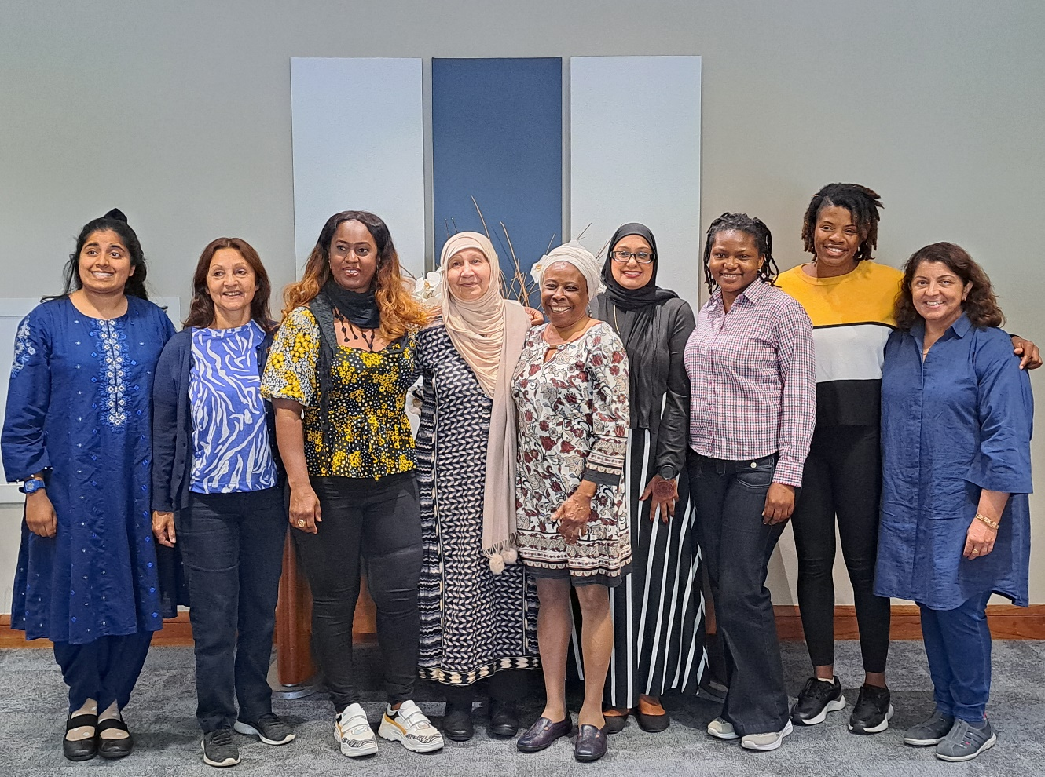
Notes:
9 cyfranogwr
9 participant

Slide 21
Notes:
Modiwlau i ddilyn Modules to follow

Slide 22
Modiwlau
Modules
Cyflwyniad
Strwythurau undebau
ACAS (y Gwasanaeth Cynghori, Cymodi a Chyflafareddu)
Creu ymgyrch
Datblygu a mentora
Cyngor Menywod yr Ynysoedd
Introduction
Union structures
ACAS (advisory Conciliation and Arbitration Services)
Building a campaign
Development and mentoring
Women’s Council of the Isles

Slide 23
Y Daith
Journey
Mynd i ddigwyddiadau fel:
Gwobrau EMWWA (Cyrhaeddiad Menywod Ethnig Leiafrifol Cymru)
Digwyddiad Mis Hanes Pobl Ddu
Trefnu eich digwyddiad Mis Hanes Pobl Ddu eich hun
Cyngor Menywod yr Ynysoedd
Attend events such as:
EMWWA Awards (Ethnic Minority Welsh Women Achievement)
Black History Month Event
Organising own Black History Month Events
Women’s Council of the Isles

Slide 25
Notes:
Modiwlau i ddilyn Modules to follow

Slide 26
Notes:
Modiwlau i ddilyn Modules to follow

Slide 27
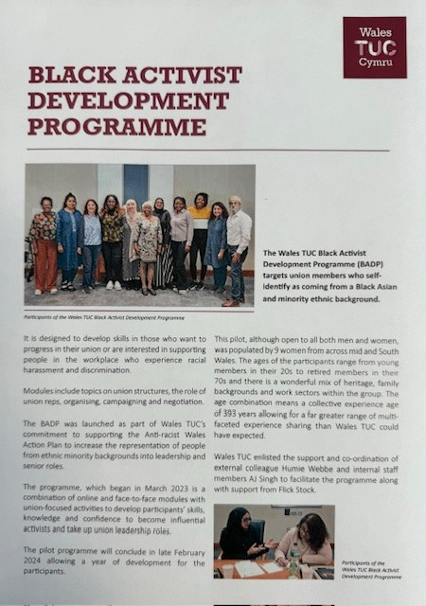
Notes:
Modiwlau i ddilyn Modules to follow

Slide 28
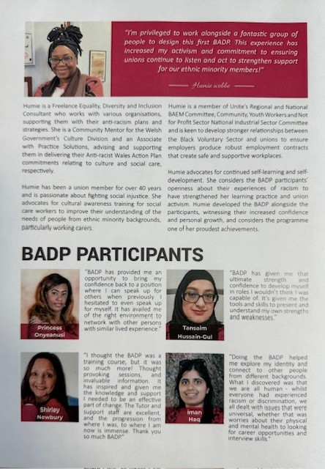
Notes:
Modiwlau i ddilyn Modules to follow

Slide 29
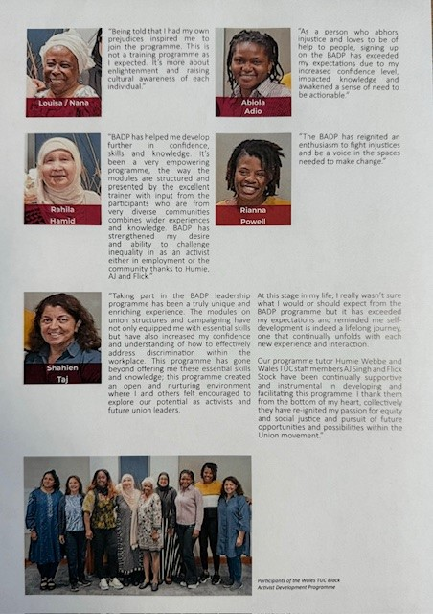
Notes:
Modiwlau i ddilyn Modules to follow

Slide 30
Rhwystrau rhag dysgu
Barriers to learning
Ydych chi’n dysgu ar hyn o bryd?
Os nad ydych chi, pam?
Sut gallwch chi oresgyn eich rhwystrau eich hun?
Are you currently learning?
If no, why?
How can you overcome your own barriers?

Slide 31
Modiwlau sydd ar y gweill:
Modules still to come:
Datblygu CV a Chamu Ymlaen yn eich Gyrfa
Hyfforddiant ar y cyfryngau
Trafodaeth wleidyddol - Dylanwadu a Chynrychioli
Negodi a Hyrwyddo
CV building & Career Progression
Media training
Political discussion – Influencing and Representation
Negotiation & Promotion

Slide 32
Llwybr
Pathway
Diwydiannol
Gwleidyddol
Trydydd Sector
Industrial
Political
Third Sector

Slide 33
Manylion cyswllt Contact details
gwefan/website: www.tuc.org.uk/wales
e-bost/e-mail: wtuc@tuc.org.uk
ffôn/phone: 029 2034 7010
WalesTUCCymru
WalesTUCCymru
WalesTUC
WalesTUC

Slide 35
TUC Cymru - Dysgu fel adnodd recriwtio
Wales TUC – Learning as a recruitment tool
Linsey Imms

Slide 36
Introduction
Cyflwyniad
A proud history
Need to adapt
Declining membership
Political attack
Hanes balch
Yr angen i addasu
Gostyngiad yn nifer yr aelodau
Ymosodiad gwleidyddol

Slide 37
The importance of union uearning in recruitment
Pwysigrwydd dysgu undebau wrth recriwtio
Skills Development:
Confidence, qualifications, employability
Potential members are more likely to join us if they see that we are invested in their professional growth.
.
Datblygu Sgiliau:
Hyder, cymwysterau, cyflogadwyedd
Mae darpar aelodau’n fwy tebygol o ymuno â ni os byddan nhw’n gweld ein bod wedi buddsoddi yn eu twf proffesiynol.

Slide 38
The importance of union learning in recruitment
Pwysigrwydd dysgu undebau wrth recriwtio
Retention and Loyalty:
Investment in learning = loyalty and engagement
Existing loyalty and engagement attract new members
Cadw Staff a Ffyddlondeb:
Buddsoddi mewn dysgu = teyrngarwch ac ymgysylltiad
Mae ffyddlondeb ac ymgysylltiad sydd eisoes yn bodoli yn denu aelodau newydd

Slide 39
The importance of union learning in recruitment
Pwysigrwydd dysgu undebau wrth recriwtio
A lighter side:
What’s in the news? A cost-of-living crisis and strikes
Union learning offers a different angle
Ochr ysgafnach:
Beth sydd yn y newyddion? Argyfwng costau byw a streiciau
Mae dysgu undebau yn cynnig ongl wahanol

Slide 40
The importance of union learning in recruitment
Pwysigrwydd dysgu undebau wrth recriwtio
Competitive Advantage:
A highly skilled and educated workforce is a powerful tool.
Jobs for Life vs Skills for Life
Mantais Gystadleuol:
Mae gweithlu medrus ac addysgedig iawn yn arf pwerus.
Swyddi am Oes vs Sgiliau am Oes

Slide 41
The importance of union learning in recruitment
Pwysigrwydd dysgu undebau wrth recriwtio
Community and Solidarity:
Union learning fosters a sense of community and solidarity among members. When potential recruits witness the supportive environment we provide, they are more likely to join our ranks.
Cymuned ac Undod:
Mae dysgu undebau yn meithrin ymdeimlad o gymuned ac undod ymysg aelodau. Pan fydd darpar recriwtiaid yn gweld yr amgylchedd cefnogol rydyn ni’n ei ddarparu, maen nhw’n fwy tebygol o ymuno â’n rhengoedd.

Slide 42
Trafodaeth:
Oes gennych chi berthynas â threfnwyr eich undeb?
Oes gennych chi enghreifftiau o ddysgu sydd wedi arwain at recriwtio/cadw staff?
Ydych chi’n cael eich gwahodd i/cymryd rhan yng nghyfarfodydd/pwyllgorau rhanbarthol ehangach eich undeb?
Pa broblemau ydych chi’n eu hwynebu wrth drefnu? – dim mynediad at y bobl iawn, dysgu’n cael ei ystyried fel rhywbeth ‘arall’ ac ati

Slide 43
Discussion:
Do you have a relationship with your union organisers?
Have you got examples of learning leading to recruitment/retention?
Are you invited to/engaged in your union’s wider regional meetings/committees?
What issues do you face around organising? – not having access to the right people, learning seen as ‘other’ etc

Slide 44
Cinio
Lunch

Slide 45
Young Activist Development Programme 2023 Rhaglen Datblygu Ymgyrchwyr Ifanc 2023
Developing future leaders in our movement
Datblygu arweinwyr y dyfodol yn ein mudiad
Chloe Rees, Organising & Development Officer

Slide 46
Learning outcomes
Deilliannau dysgu
Aims and Objectives of the Young Activist Development Programme
Current work – Norwegian Summer Patrol Mode trial
Call to action
In conversation with a young ULR
Nodau ac Amcanion y Rhaglen Datblygu Ymgyrchwyr Ifanc
Gwaith presennol – Treial Modd Patrôl Haf Norwy
Galwad i weithredu
Sgwrs gyda Chynrychiolydd Dysgu’r Undebau Ifanc

Slide 47
Young Activist Development Programme
Rhaglen Datblygu Ymgyrchwyr Ifanc
Network of Young Workers/Reps across Wales
Training and Development
Mentoring and work experience
Campaigns
Social Partnership work
Rhwydwaith o Weithwyr/Cynrychiolwyr Ifanc ar hyd a lled Cymru
Hyfforddiant a Datblygiad
Mentora a phrofiad gwaith
Ymgyrchoedd
Gwaith Partneriaeth Gymdeithasol

Slide 48
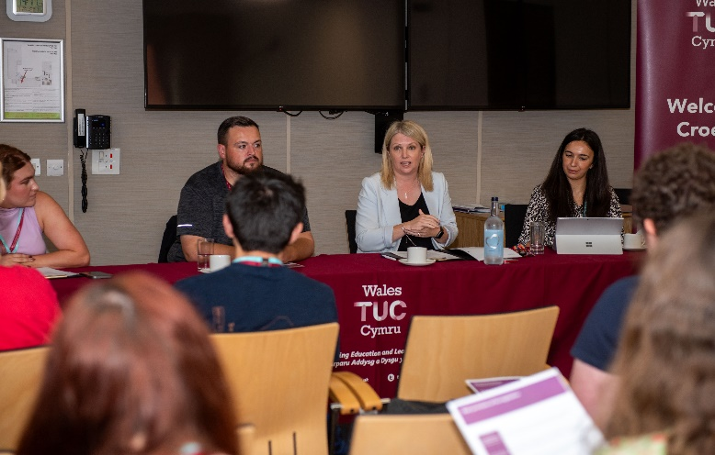
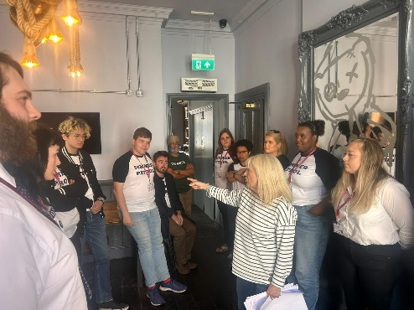
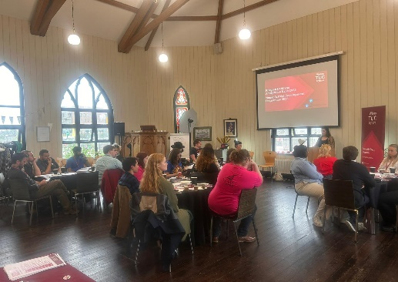
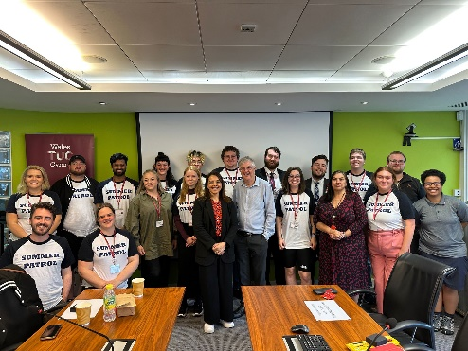

Slide 49
Partnership with Taith
Partneriaeth â Taith
Wales TUC Cymru visit Norway - Taith

Slide 50
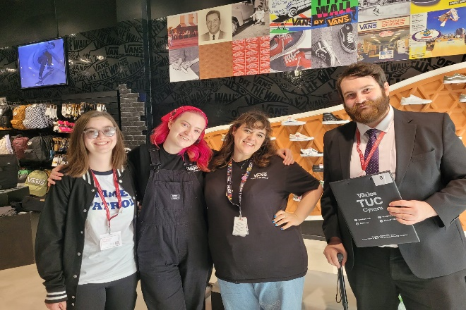
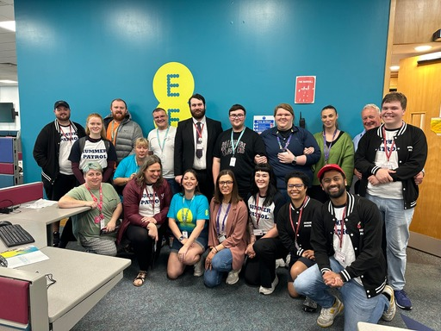
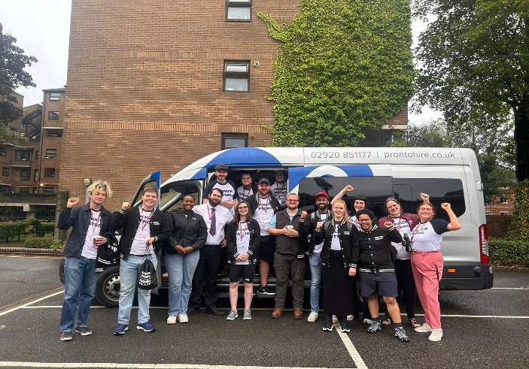

Slide 51
In Conversation with Liz Holyoak, Union Learning Rep
Sgwrs gyda Liz Holyoak, Cynrychiolydd Dysgu'r Undebau

Slide 53
Partneriaeth Gymdeithasol fel cyfrwng trefnu
Social Partnership as an organising tool
Ceri Williams
Wales TUC Cymru

Slide 54
Trosolwg
Overview
Cefndir ac egwyddorion
Beth mae'r Ddeddf yn bwriadu ei gyflawni
Deddf Llesiant Cenedlaethau'r Dyfodol (Cymru) 2015 (trosolwg lefel uchel)
Background and principles
What the Act sets out to achieve
Well-being of future Generations (Wales) Act 2015 (high level overview)

Slide 55
Cefndir Deddf SPPP
SPPP Act Background
Cyflawni un o ymrwymiadau’r Rhaglen Lywodraethu i roi sail statudol i bartneriaeth gymdeithasol yng Nghymru.
Fframwaith i wella lles pobl yng Nghymru.
Gwella gwasanaethau cyhoeddus drwy waith partneriaeth gymdeithasol, hyrwyddo gwaith teg a chaffael cyhoeddus cymdeithasol gyfrifol.
Fulfils a Programme for Government commitment to place social partnership on a statutory footing in Wales.
A framework to enhance the well-being of people in Wales.
Improving public services through social partnership working, promoting fair work and socially responsible public procurement.

Slide 56
Egwyddorion / Principles
Partneriaeth Gymdeithasol
Social Partnership
Caffael Cymdeithasol Gyfrifol
Socially Responsible Procurement
Gwaith Teg
Fair Work
Datblygu Cynaliadwy
Sustainable Development

Slide 57
Beth fydd y ddeddf yn cyflawni?
What will the Act deliver?
Creu Cyngor Partneriaeth Gymdeithasol (CPG), dan gadeiryddiaeth Prif Weinidog Cymru.
Rhoi dyletswydd statudol ar Weinidogion Cymru i ymgynghori â'r Cyngor hwn wrth wneud penderfyniadau ynghylch cyflawni eu hamcanion llesiant o dan Ddeddf Llesiant Cenedlaethau'r Dyfodol (Cymru) 2015
Create a new Social Partnership Council (SPC), chaired by the First Minister.
Place a statutory duty on Welsh Ministers to consult the SPC when making decisions about the delivery of their well-being objectives under the Well-being of Future Generations (Wales) Act 2015.

Slide 58
Rhoi dyletswydd partneriaeth gymdeithasol ar gyrff cyhoeddus penodol i ddod i gonsensws neu gyfaddawd gyda'u hundebau llafur wrth osod a chyflawni eu hamcanion llesiant o dan Ddeddf Llesiant Cenedlaethau'r Dyfodol (Cymru) 2015.
Diwygio adran 4 o Ddeddf Llesiant Cenedlaethau’r Dyfodol (Cymru) 2015 Drwy roi ‘gwaith teg’ yn lle ‘gwaith addas’ yn y nod presennol ‘Cymru lewyrchus’.
Place a social partnership duty on certain public bodies to reach consensus or compromise with their trade unions when setting and delivering their well-being objectives under the Well-being of Future Generations (Wales) Act 2015.
Amendment of section 4 of the Wellbeing of Future Generations (Wales) Act 2015 By substituting ‘fair work’ for ‘decent work’ within the existing “A prosperous Wales” goal.

Slide 59
Rhoi dyletswydd statudol ar gyrff cyhoeddus penodol i ystyried caffael cymdeithasol gyfrifol ac i gyflawni dyletswyddau rheoli contractau i sicrhau bod canlyniadau sy’n gyfrifol yn gymdeithasol yn nod i anelu ato drwy ddefnyddio cymalau contract sy’n llifo drwy gadwyni cyflenwi cyfan ar gyfer prosiectau adeiladu mawr.
Place a statutory duty on certain public bodies to consider socially responsible procurement and carry out contract management duties to ensure that socially responsible outcomes are pursued by using contract clauses which flow through whole supply chains for large construction projects.

Slide 60
Social Partnership
in Action
Gweithredu
Partneriaeth
Gymdeithasol

Slide 61
Cymru lewyrchus
Cymdeithas arloesol, gynhyrchiol, carbon isel sy’n cydnabod y terfynau sydd ar yr amgylchedd byd-eang ac sydd, o ganlyniad, yn defnyddio adnoddau mewn modd effeithlon a chymesur (gan gynnwys gweithredu ar newid yn yr hinsawdd); ac sy’n datblygu poblogaeth fedrus ac addysgedig mewn economi sy’n cynhyrchu cyfoeth ac yn cynnig cyfleoedd cyflogaeth, gan ganiatáu i bobl fanteisio ar y cyfoeth a gynhyrchir drwy gael gafael ar waith teg.
Cymru gydnerth
Cenedl sy’n cynnal ac yn gwella amgylchedd naturiol bioamrywiol gydag ecosystemau iach gweithredol sy’n cynnal cydnerthedd cymdeithasol, economaidd ac ecolegol ynghyd â’r gallu i addasu i newid (er enghraifft newid yn yr hinsawdd)
Cymru iachach
Cymdeithas lle mae llesiant corfforol a meddyliol pobl cystal â phosibl a lle deellir dewisiadau ac ymddygiadau sydd o fudd i iechyd yn y dyfodol.
Cymru sy’n fwy cyfartal
Cymdeithas sy’n galluogi pobl i gyflawni eu potensial ni waeth beth fo’u cefndir neu eu hamgylchiadau (gan gynnwys eu cefndir a’u hamgylchiadau cymdeithasol-economaidd).
Cymru sy’n gyfrifol ar
lefel fyd-eang
Cenedl sydd, wrth iddi wneud unrhyw beth i wella llesiant economaidd, cymdeithasol, amgylcheddol a diwylliannol Cymru, yn ystyried a allai gwneud peth o’r fath gyfrannu’n gadarnhaol at lesiant byd-eang
Cymru â diwylliant bywiog lle
mae’r Gymraeg yn ffynnu
Cymdeithas sy’n hyrwyddo ac yn gwarchod diwylliant, treftadaeth a’r Gymraeg ac sy’n annog pobl i gyfranogi yn y celfyddydau, a chwaraeon a gweithgareddau hamdden.
Cymru o gymunedau cydlynus
Cymunedau atyniadol, hyfyw a diogel sydd â chysylltiadau da.

Slide 62
A prosperous Wales
An innovative, productive and low carbon society which recognises the limits of the global environment and therefore uses resources efficiently and proportionately (including acting on climate change); and which develops a skilled and well-educated population in an economy which generates wealth and provides employment opportunities, allowing people to take advantage of the wealth generated through securing fair work.
A resilient Wales
A nation which maintains and enhances a biodiverse natural environment with healthy functioning ecosystems that support social, economic and ecological resilience and the capacity to adapt to change (for example, climate change).
A healthier Wales
A society in which people’s physical and mental well-being is maximised and in which choices and behaviours that benefit future health are understood.
A more equal Wales
A society that enables people to fulfil their potential no matter what their background or circumstances (including their socio-economic background and circumstances).
A globally responsible
Wales
A nation which, when doing anything to improve the economic, social, environmental and cultural well-being of Wales, takes account of whether doing such a thing may make a positive contribution to global well-being.
A Wales of vibrant culture and thriving Welsh language
A society that promotes and protects culture, heritage and the Welsh language, and which encourages people to participate in the arts, and sports and recreation.
A Wales of cohesive communities
Attractive, viable, safe and well-connected communities.

Slide 63
Dyletswydd lles
Well-being duty
Each public body must carry out sustainable development.
What does this mean for existing bodies? (48)
When setting goals after the 1 April 2024, public bodies must consult with trade unions or worker representatives.
Mae'n rhaid i bob corff cyhoeddus ymgymryd â gwaith datblygu cynaliadwy.
Beth mae hyn yn ei olygu i gyrff sy’n bodoli eisoes? (48)
Wrth bennu nodau ar ôl 1 Ebrill 2024, rhaid i gyrff cyhoeddus ymgynghori ag undebau llafur neu gynrychiolwyr gweithwyr.
Beth mae hyn yn ei olygu i gyrff newydd? (8)
Byddant yn pennu eu hamcanion lles cyntaf ar yr un pryd ag y byddant yn cychwyn y ddyletswydd partneriaeth gymdeithasol.
What does this mean for new bodies? (8)
They will be setting their first well-being objectives at the same time as commencing the social partnership duty.

Slide 64
Cyrff sydd eisoes yn bodoli sy’n ddarostyngedig i’r Ddyletswydd
Existing bodies subject to the Duty
Awdurdodau Lleol
Y 4 Cyd-bwyllgor Corfforedig
Byrddau Iechyd Lleol
Ymddiriedolaeth GIG Iechyd Cyhoeddus Cymru
Ymddiriedolaeth GIG Felindre
Awdurdodau’r Parciau Cenedlaethol
Awdurdodau Tân ac Achub
Cyfoeth Naturiol Cymru
Y Comisiwn Addysg Drydyddol ac Ymchwil
Cyngor Celfyddydau Cymru
Cyngor Chwaraeon Cymru (Chwaraeon Cymru)
Llyfrgell Genedlaethol Cymru
Amgueddfa Genedlaethol Cymru (Amgueddfa Cymru)
Gweinidogion Cymru
Local authorities
The 4 Corporate Joint Committees
Local Health Boards
Public Health Wales
Velindre NHS Trust
National Park Authorities
Fire and Rescue Authorities
Natural Resources Wales
the Commission for Tertiary Education and Research
the Arts Council of Wales
the Sports Council for Wales (Sport Wales)
the National Library of Wales
the National Museum of Wales (National Museum Wales)
the Welsh Ministers

Slide 65
Yr wyth corff newydd sy’n ddarostyngedig i’r Ddyletswydd
The 8 new bodies subject to the Duty
Cymwysterau Cymru
Gofal Cymdeithasol Cymru
Addysg a Gwella Iechyd Cymru
Awdurdod Cyllid Cymru
Trafnidiaeth Cymru
Y Ganolfan Gwasanaethau Cyhoeddus Digidol
Iechyd a Gofal Digidol Cymru
Ymddiriedolaeth GIG Gwasanaethau Ambiwlans Cymru
Qualifications Wales
Social Care Wales
Health Education and Improvement Wales
Welsh Revenue Authority
Transport for Wales
Centre for Digital Public Services
Digital Health and Care Wales
Welsh Ambulance Services NHS Trust

Slide 66
Y Ddyletswydd Partneriaeth Gymdeithasol
The Social Partnership Duty

Slide 67
Y Ddyletswydd Partneriaeth Gymdeithasol
The Social Partnership Duty
O 1 Ebrill 2024, bydd yn ofynnol i rai cyrff cyhoeddus geisio dod i gonsensws neu gyfaddawd â'u hundebau llafur cydnabyddedig, neu, os nad oes undeb llafur cydnabyddedig, gynrychiolwyr eraill eu staff, wrth bennu eu hamcanion o ran llesiant a chyflawni'r amcanion hynny o dan adran 3(2) o Ddeddf Llesiant Cenedlaethau'r Dyfodol (Cymru) 2015.
From 1 April 2024, certain public bodies will be required to seek consensus or compromise with their recognised trade unions, or where there is no recognised trade union other representatives of their staff, when setting their well-being objectives and delivering on those objectives under section 3(2) of the Well-being of Future Generations (Wales) Act 2015.

Slide 68
Crynodeb o’r Ddyletswydd
Summary of the Duty
Pwy fydd angen cydymffurfio â’r Ddyletswydd?
Pob Corff cyhoeddus Perthnasol
Gweinidogion Cymru
Who needs to comply with the Duty?
All in-scope Public Bodies
Welsh Ministers

Slide 69
Unrhyw gwestiynau? Any questions?

Slide 70
Egwyl
Break

Slide 71
Intro Slide Title 1
Wales TUC ULR Network & Open University
Learn with your union
Sam Forde
Partnerships Manager
3.11.23

Slide 72
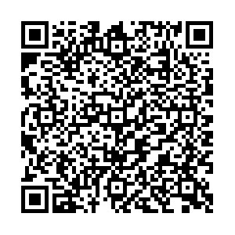
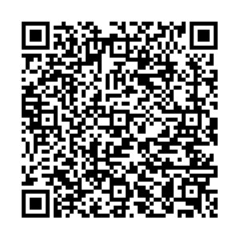
** NEW WEBSITE ***
Wales TUC in partnership with The Open University in Wales
English registration form
Welsh registration form
Notes:
We support Welsh workers to start or continue their learning journey by accessing our brand-new partnership website

Slide 73
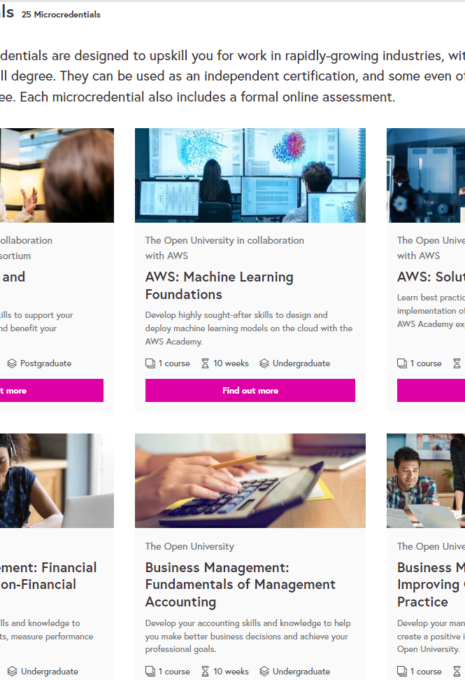
FREE Micro
credentials
Project Management
Organisational Practice
CISCO – CCNA networks/DevOps
Marketing
CISCO: Python Programming
Climate Change/Sustainability
Digital Photography
People Management and Leadership
Business Management
Financial Accounting
Amazon Web Services: Machine Learning
Amazon Web Services: Certified Solutions Architect Associate
Notes:
Microcredentials | The Open University
Who's eligible and how to apply
You can apply for a place on a microcredential by downloading our application form. You can only apply for a funded place through this page. There are a limited number of places available. You are eligible to apply if you meet all of the following criteria:
are domiciled in Wales
are eligible to pay the Wales fee for OU study (this means you’re a UK national, Irish citizen or have settled status in the UK, you’re living in Wales on 1 September 2023 and have been living in the UK and Islands for 3 years before starting your course. Further information can be found on our fee rules page)
are 18+ years of age
are not in further or higher education when your funded course starts.
have a personal income of £30,000 or under, or are in receipt of qualifying benefits.
As we have a limited number of places, priority will be given to students who:
are carers
are care leavers or are care experienced
have a disability
are from a Black, Asian or minority ethnic background
are refugees or asylum seekers
identify as LGBTQ+.
What are microcredentials?
Delivered on our partner platform, FutureLearn, microcredentials allow you to gain specialist knowledge and skills to help advance your career. Created by world-class OU academics, microcredentials offer a perfect balance of academic excellence and workplace relevance. In just 10–12 weeks you can gain:
cutting-edge knowledge in a specialised subject
practical skills that you can immediately apply to your work, or boost your CV
undergraduate credit you could use in the future towards further study.
With microcredentials, your study is entirely online using a combination of learning materials including videos, quizzes and activities to develop your specialist professional knowledge.
What you can study
If you meet the entry criteria, you can apply for a fully-funded (free) place on one of the microcredential courses below. Our microcredentials run for 10–12 weeks and require around 10–13 hours of study a week. A level 4 course is equivalent to studying at the first year of university. Level 5 is equivalent to studying at the second year; Level 6 is equivalent to studying at the third/final year of university. Some microcredentials may require previous knowledge or experience. Please check the Requirements section on the FutureLearn course page for more information.

Slide 74
OpenLearn Champions
Volunteer Advocacy programme
Signpost your members
OpenLearn with your Union
We work with advocates within Welsh unions and businesses to become OpenLearn Champions to promote informal to formal learning pathways.
We created the brand 'OpenLearn with your Union’ with Wales TUC and co-designed a collection page on OpenLearn to support this key strategic partnership.

Slide 75
Become an OpenLearn Champion
Notes:
https://www.youtube.com/watch?v=nOuTrKi4LIk

Slide 76
Any Questions?
Thank you
Diolch yn fawr
wales-partnerships@open.ac.uk

Slide 77
ULR Network Workshop
Gweithdy Rhwydwaith ULR
Angharad Halpin
Wales TUC Cymru

Slide 78
Swydd: Gweithio gyda'n gilydd Task: Working Together

Slide 79
* Gofynnwyd i chi drefnu digwyddiad trwy'r dydd ar gyfer eich cyd-ULRS yn eich Undeb. * You have been asked to organise an all day event for your fellow ULRS within your Union.
1) Bydd y digwyddiad hwn yn para 6 awr
This event will last 6 hours
2) Cyflwyniadau, Hyfforddiant, Gweithdai, Dathlu, Astudiaethau Achos
Presentations, Training, Workshops, Celebration, Case Studies

Slide 80
Mewn grwpiau cymysg..
In Mixed Groups..
Cyfuno pob syniad o amgylch pob agwedd ar eich rôl
Fel grŵp, dewiswch chwe phrif faes i'w cynnwys yn ystod y dydd
Cofnodwch a disgrifiwch eich agenda, gan gynnwys cynnwys, amseriadau, seibiannau a chinio.
Pool all ideas around all aspects of your role
As a group, choose six main areas to cover during the day
Record and describe your agenda, including content, timings, breaks and lunch.

Slide 81
Gweithdy ULR - Adborth
ULR Workshop - Feedback

Slide 82
YMARFER GWERTHUSO
EVALUATION EXERCISE

Slide 83
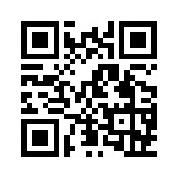
INTERACTIVE JAMBOARD

Slide 84
Diolch i bawb yn TUC Cymru
Thank you from all at Wales TUC
ULR Queries & Contact: ahalpin@tuc.org.uk

