Slide 1
Peer to peer texting
Lois McCallum
Digital Campaigner - TUC

Slide 2
This session
What is peer-to-peer texting?
How are unions using it?
How might you use it?
What we’ve learnt / best practice
Extra tools and tactics

Slide 3
Who are you?
Name and where you live?
What union have you come from?
What are you hoping to get out of this session?

Slide 4
Caveats
Process trumps tools - There is no one tool, app or platform that will always work - solid processes will make the tools effective
Everything I’ll talk about today complements traditional organising, it doesn’t replace it
GDPR makes things harder, not impossible
Sometimes you don’t need digital

Slide 5
Peer-to-peer texting
The best way to organise any collective action is through one-to-one, informal conversations.
These platforms allow you to do that by text messaging: quickly, at scale, and in a way that respects everyone's privacy.

Slide 6
Peer-to-peer texting
Allows organisers, reps and volunteers to quickly and effectively deliver calls to action via text messages.
It’s different to blast text messaging!
Has anyone used peer-to-peer text messaging?

Slide 7

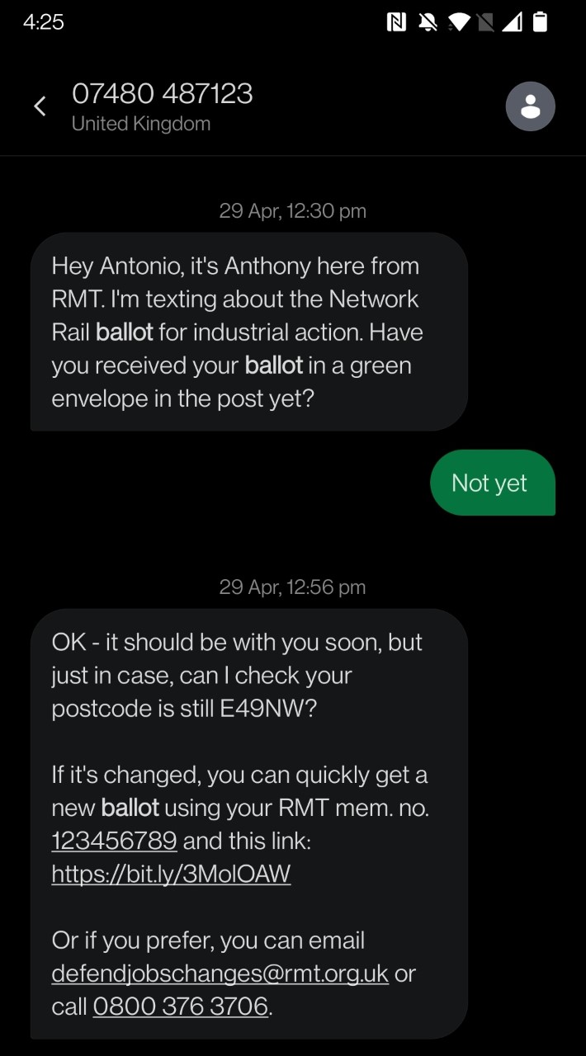
ThruText - What is it?
A peer-to-peer texting platform that allows activists to have hundreds of conversations per hour
Complements face-to-face organising
Helps reach members at a critical point in the balloting process

Slide 8
How unions have been using it
The TUC have trained 300 activists and staff from UCU, RMT, CWU, NUJ, AEP and FBU to send messages
They average 1,100 text conversations each
98% open rate
50-60% response rate from members
Able to contact hundreds of thousands of members in a few days - RMT sent 40,000 texts in a weekend

Slide 9
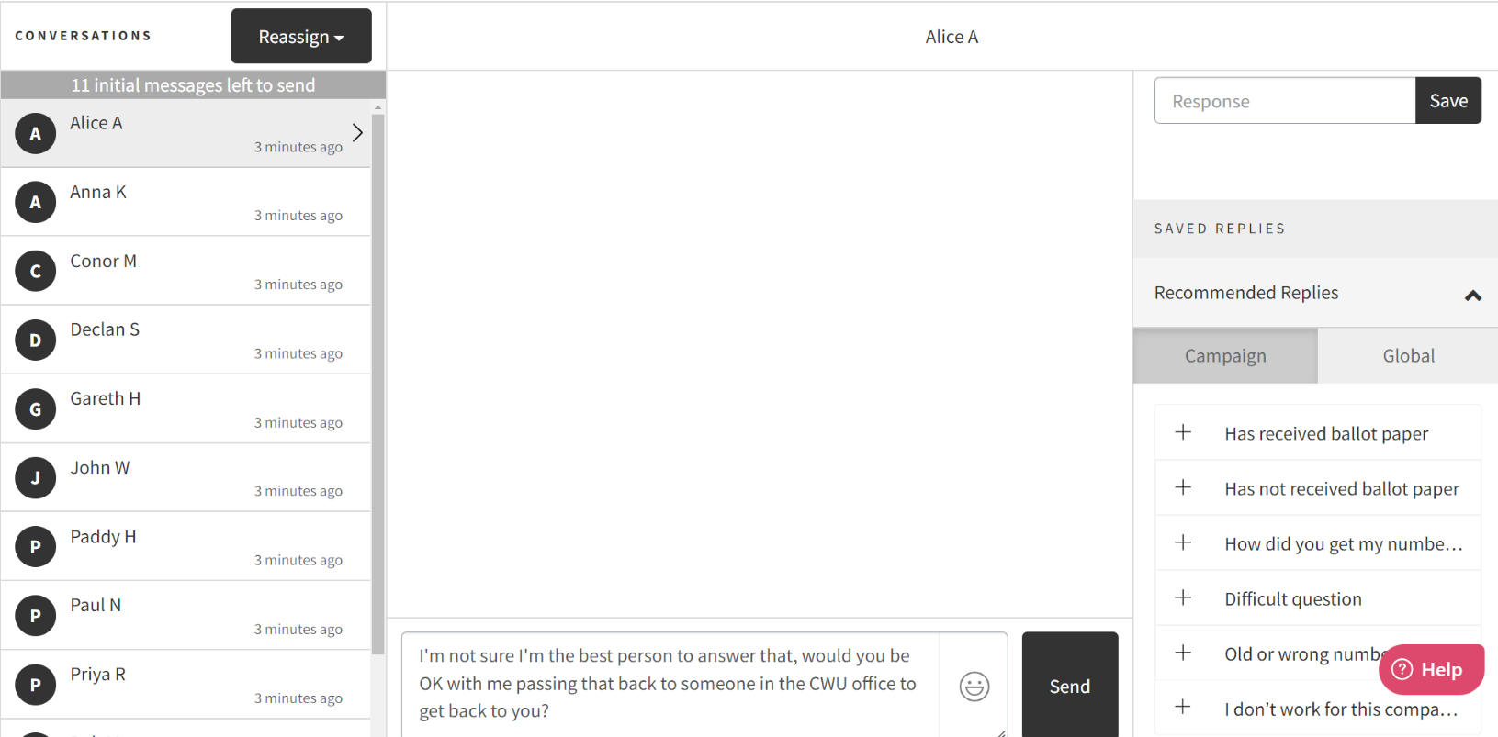

Slide 10
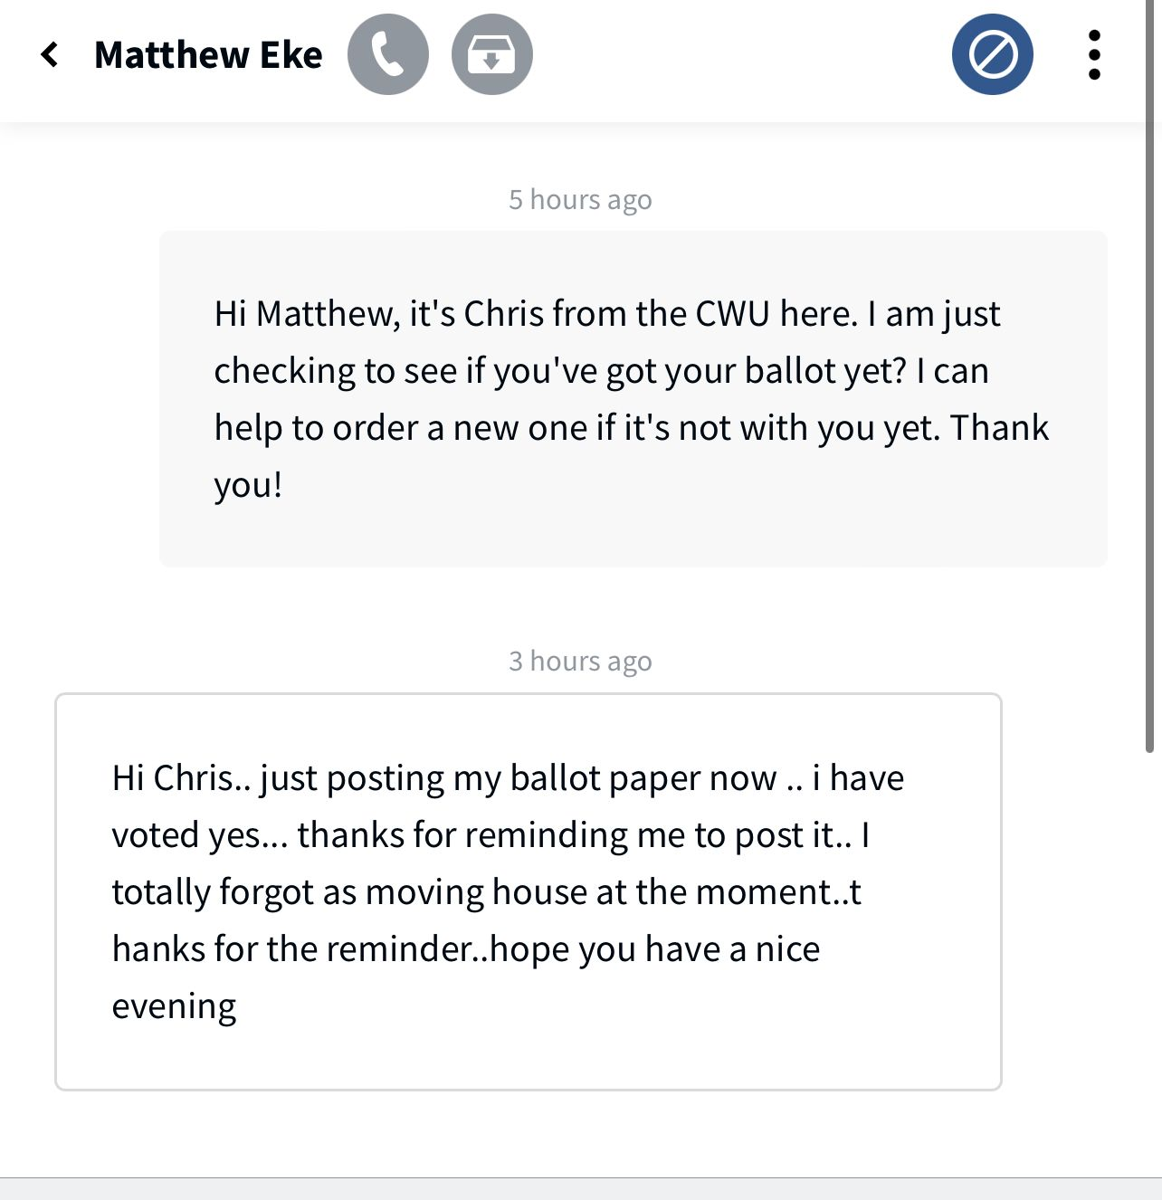
Timely reminders

Slide 11
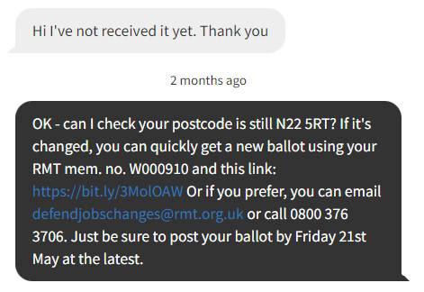
Checking addresses and getting replacements ballots sent

Slide 12
Peer-to-peer texting: what we’ve learnt
Text like you would a friend or family member
Start with a short, informal message that includes a question
Those most invested in the campaign are the best at this
Activists enjoy the experience
Develop answers to the FAQs as a group
It scales really well
There will be other uses: like recruiting new reps, contacting resigned members, welcoming new members

Slide 13
How might you use it?
How do you currently contact your members?
How might you use it in your branch?
Has your union used it nationally?
Have you received a text from your union? What was your experience?

Slide 14
Your experiences of digital
Are you using digital to communicate in your branch?
Is it helping? Or hindering?
Are there any tools you are using that you like or don’t like?
Are there any digital activities you did during the pandemic you will keep doing?

Slide 15










You can do it well for cheap
The best digital campaigns are not coming for the organisations with the most money.

Slide 16
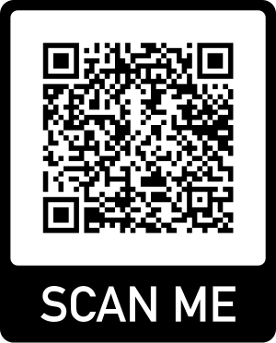
Lois McCallum - lmccallum@tuc.org.uk

Slide 17
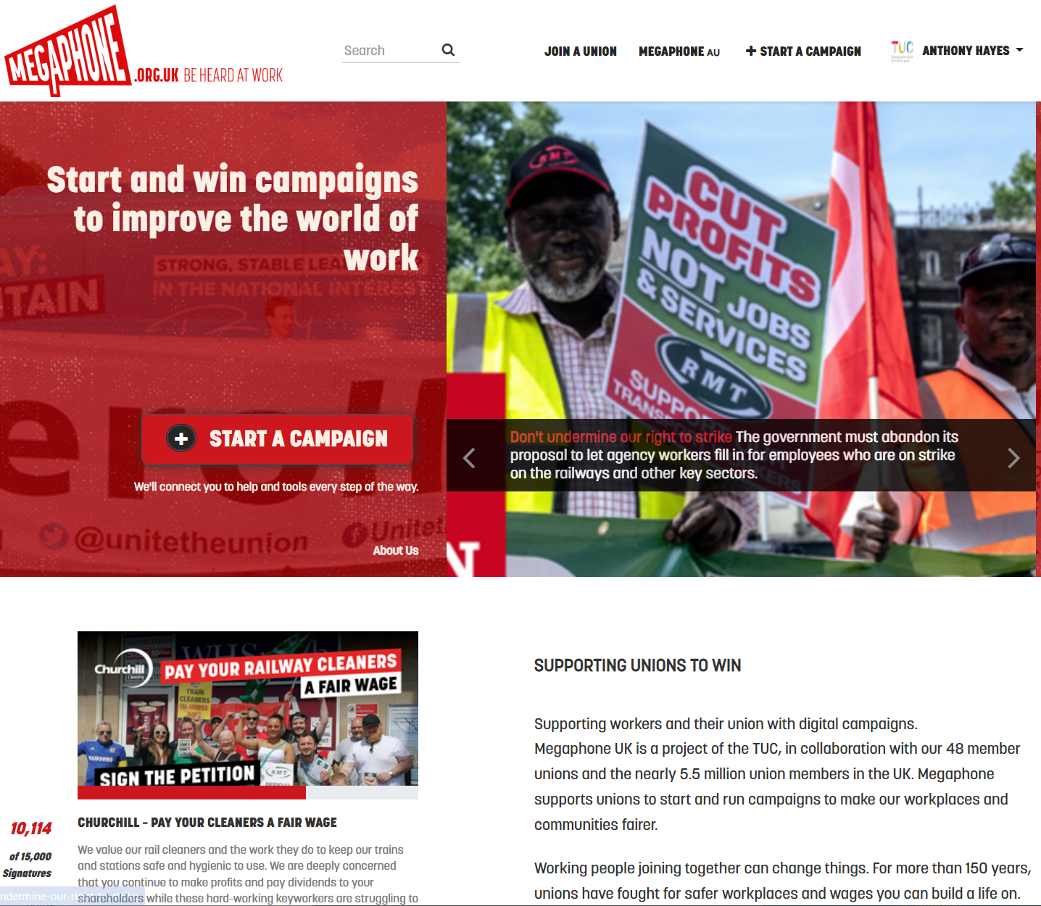

Slide 18
How organisers are using online petitions to support their work
Find new leaders and potential members
Put pressure on management during disputes
Put pressure on other decision makers to take action
Building confidence amongst members that they can win
Get media attention

Slide 19

