Slide 1
Winners and losers of the current pay crisis
Alex Collinson, TUC Policy Officer
Notes:
Hi everyone.
Thanks for having me. I’m Alex Collinson, policy officer for research and analysis at the TUC.

Slide 2
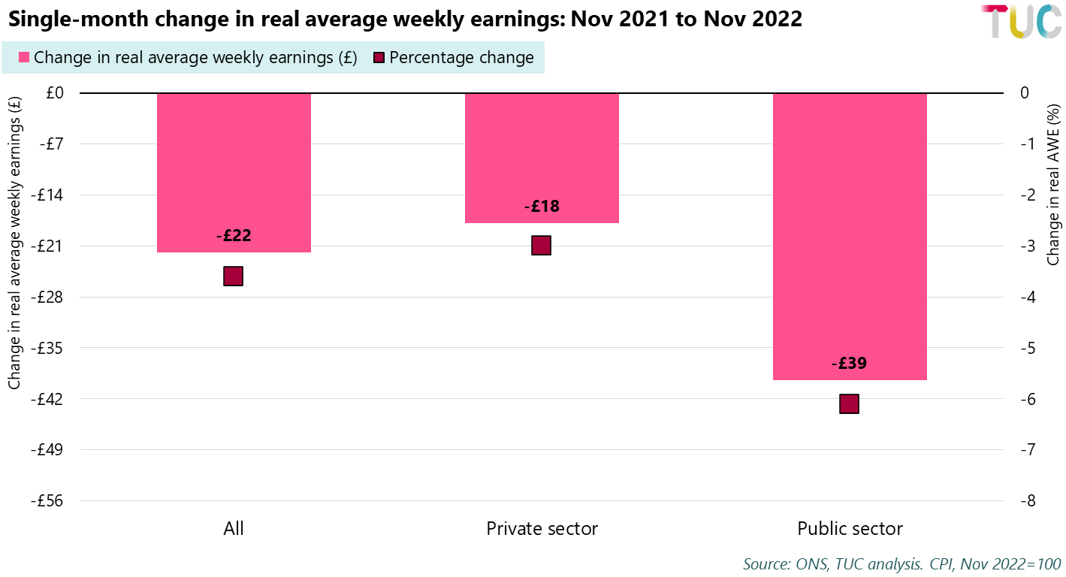
What do we mean by the current pay crisis
Notes:
I want to start by just clarifying what we mean by the current pay crisis. A lot of the headlines at the moment are about year-on-year growth. And for good reason, it’s terrible. Real weekly pay has fallen by £22 in the space of just a year. This is particularly hitting public sector workers, where nominal wage growth is weak. Real weekly wages have fallen by almost £40 per week over the past year.

Slide 3
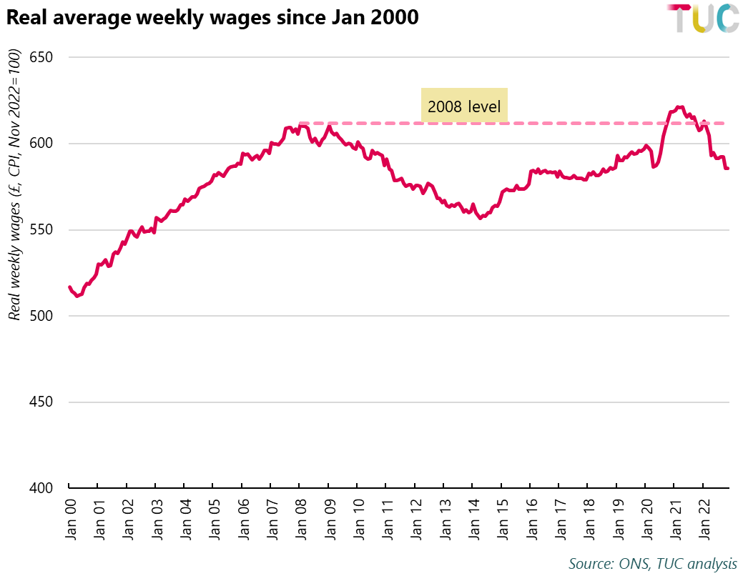
What do we mean by the current pay crisis
Notes:
But what’s happened to pay over the past year needs to be put into the context of what’s been happening to pay since 2008.
The recent falls in real pay are just the latest in a pay squeeze that’s soon to be in its fifteenth year. This chart shows real weekly pay since 2000. Before the financial crisis, real wages typically grew at about 2% per year. This trend ended in 2008, and the latest data shows real wages are still £26 per week lower than they were in 2008. We did have this recovery back above 2008 levels during the pandemic, but that was due to so many low-paid workers lost their job during the pandemic that it skewed the stats upwards.
So who are the winners and losers of this ongoing pay squeeze?

Slide 4
Losers
Notes:
I’m going to start with the losers, because that’s a bit easier and more obvious.

Slide 5
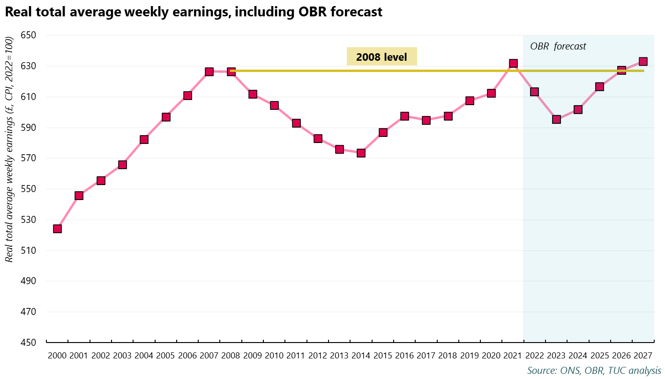
The average worker
Notes:
Most obviously, the average worker is really losing out in the current pay crisis. As mentioned, real pay is currently plummeting. And this follows a pay squeeze that began back in 2008, and, based on OBR forecasts, is set to last until 2027.
The extent of this pay squeeze is incomparable to anything we have reliable data for. If we look through the Bank of England’s millennium of data, it’s the worst pay squeeze since Napoleonic times.

Slide 6
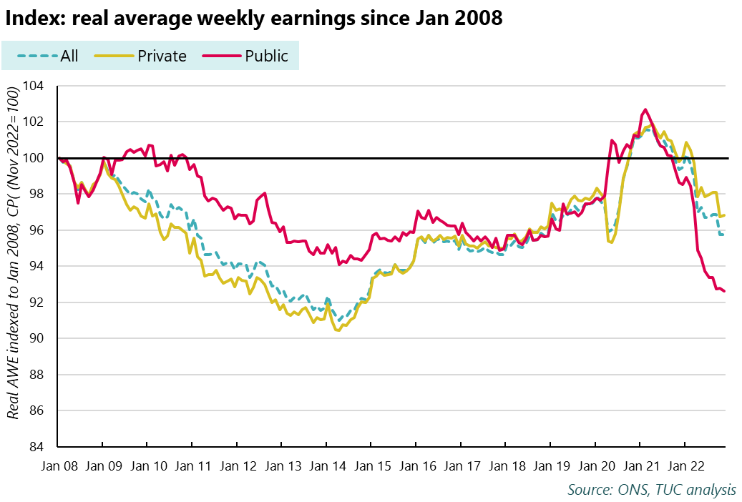
Public sector workers
Notes:
The current pay squeeze is particularly hitting public sector workers, where years of pay restraint have eroded real average pay.
The chart on screen now shows

Slide 7
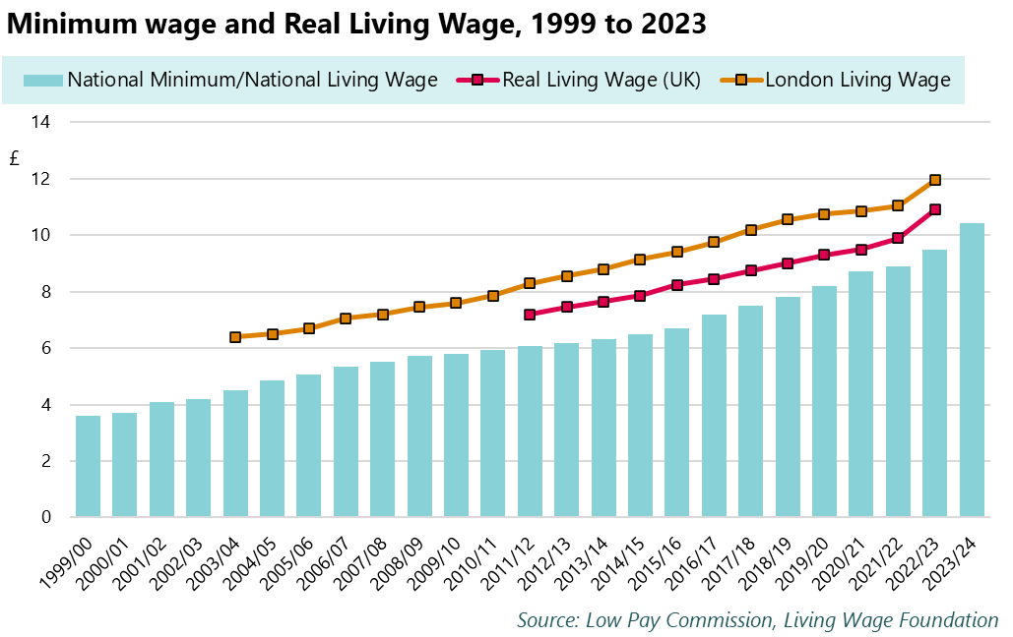
Low-paid workers
Notes:
It’s no surprise that those already on low pay will struggle the most when prices begin to rise. This is especially the case when our minimum wage does not guarantee workers enough to live on. The government’s National Living Wage, while increasing by over £4 per hour during the government’s time in power, remains below the Real Living Wage established by the Living Wage Foundation, and far below the TUC’s ask of £15 per hour. The government hyped up its most recent minimum wage rise as large and generous, but the reality is that the minimum wage remains too low to live on.
The double whammy of this is that the recent rise in inflation comes straight after a pandemic that disproportionally hit low-paid workers. Low-paid industries faced higher job losses,and low-paid furloughed workers were the most likely not to have their pay topped up while on furlough. Low-paid workers were significantly less likely to get decent sick pay, were more likely to have their finances hit during the pandemic and less likely than higher earners to have saved during the pandemic.

Slide 8
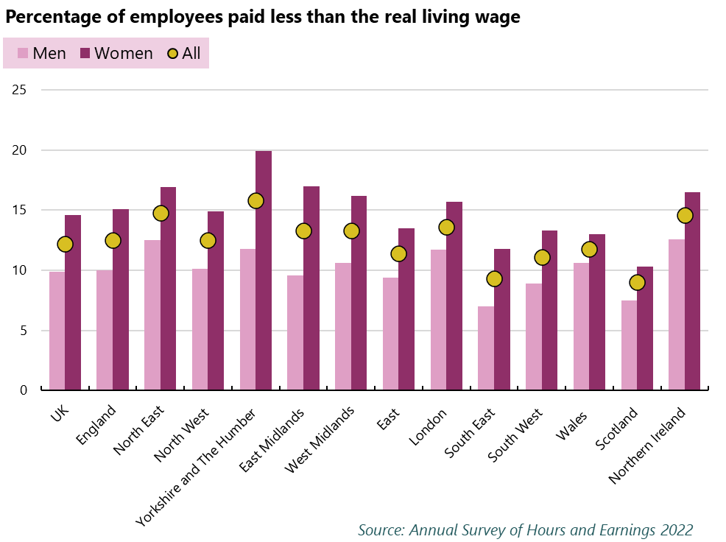
Low-paid workers
Notes:
We know that around 12% of workers We don’t have further breakdowns by ethnicity and disability here as they’re not provided in the annual survey of hours and earnings.

Slide 9
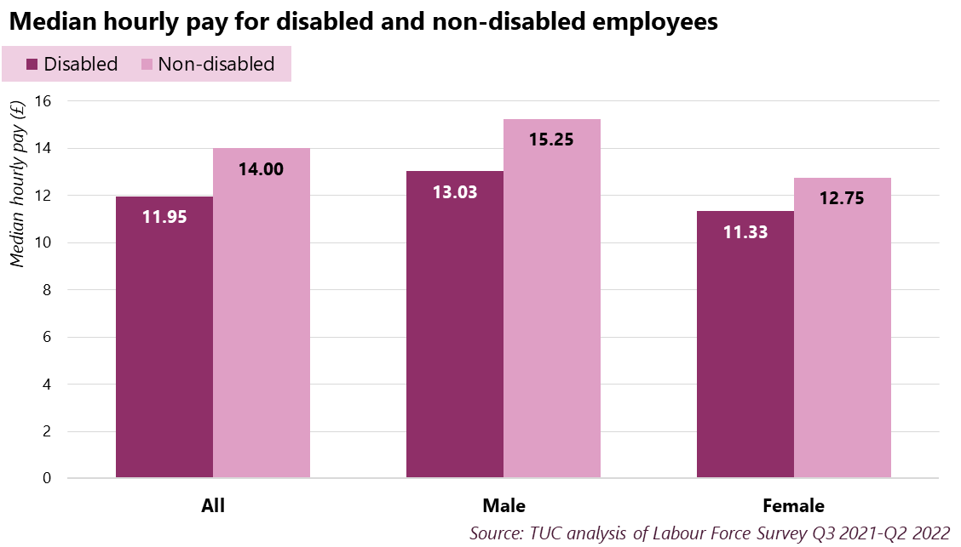
Low-paid workers
Notes:
It’s worth noting here who’s more likely to be low-paid. We know that significant gender pay gaps, disability pay gaps and ethnicity pay gaps exist. Disabled women, for example, are, on average, paid £3.93 per hour less than non-disabled men. Worryingly, we don’t even really know the full extent of these pay gaps for disabled workers and BME workers, as the Annual Survey of Hours & Earnings, which is the most comprehensive data on pay in the UK, doesn’t include a breakdown by ethnicity and disability status.

Slide 10
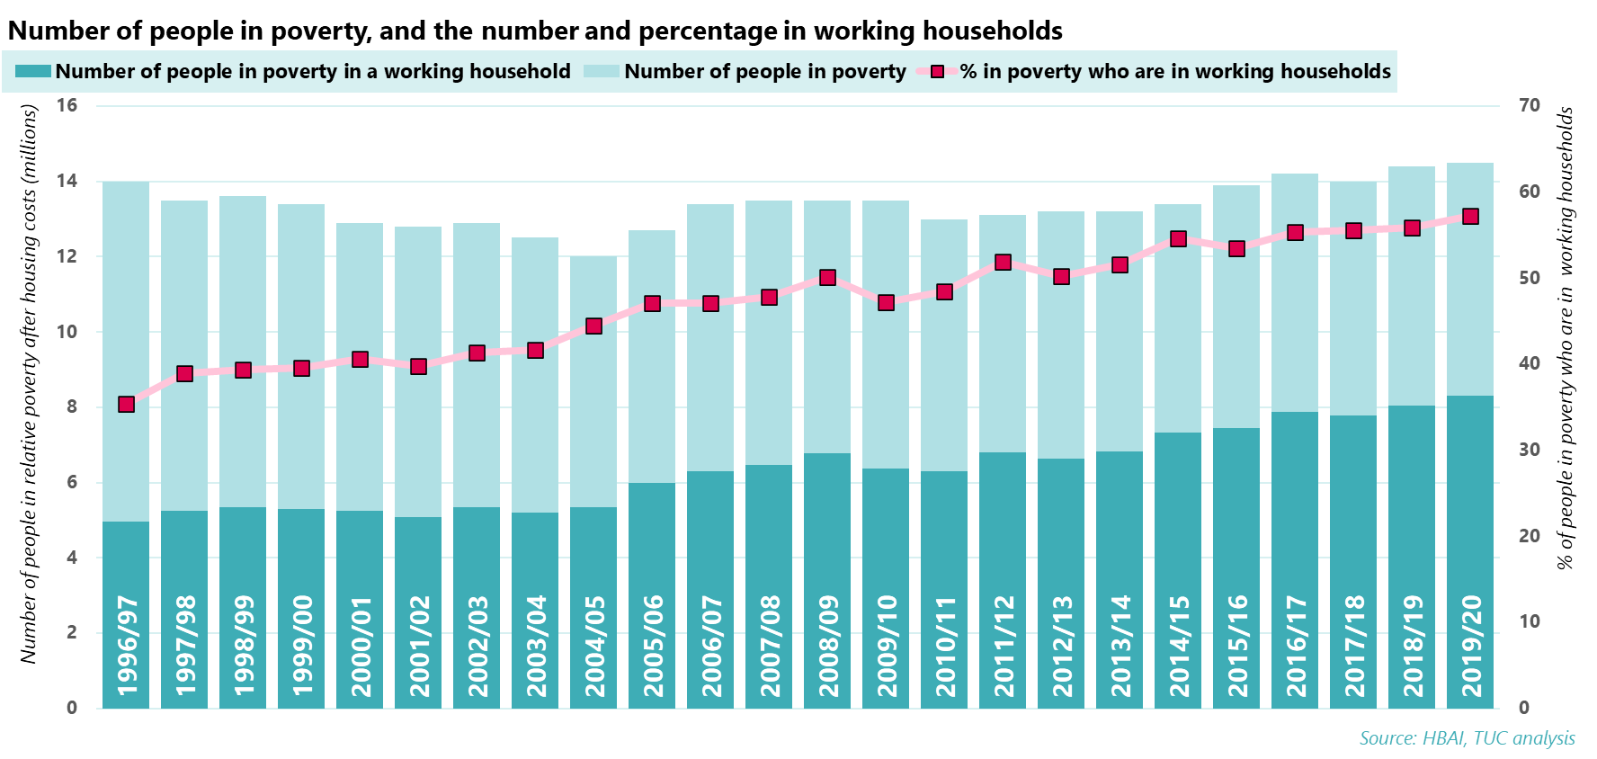
Anyone already struggling
Notes:
Given a minimum wage This point about . In-work poverty was at a record high.
The reality is that the current pay crisis comes when many people’s finances have already been torn apart
From Stepchange: Around 55% of clients were in some form of employment in December 2022.
And debt was worsening already due to the pandemic.
A range of research, including polling from the TUC and analysis from the IPPR, has shown that BME people, renters, those on low incomes, and young people are more likely to be struggling to be
Some will
https://www.tuc.org.uk/blogs/coronavirus-has-exposed-flaws-our-social-safety-net-heres-how-fix-it
https://www.tuc.org.uk/blogs/immense-hardship-makes-consumer-led-recovery-biggest-risk-all
https://www.ippr.org/research/publications/helping-households-in-debt
https://economy2030.resolutionfoundation.org/comment/wishful-thinking-will-not-close-britains-inequality-gaps/
https://www.resolutionfoundation.org/press-releases/wealth-gaps-between-different-ethnic-groups-in-britain-are-large-and-likely-to-persist/

Slide 11
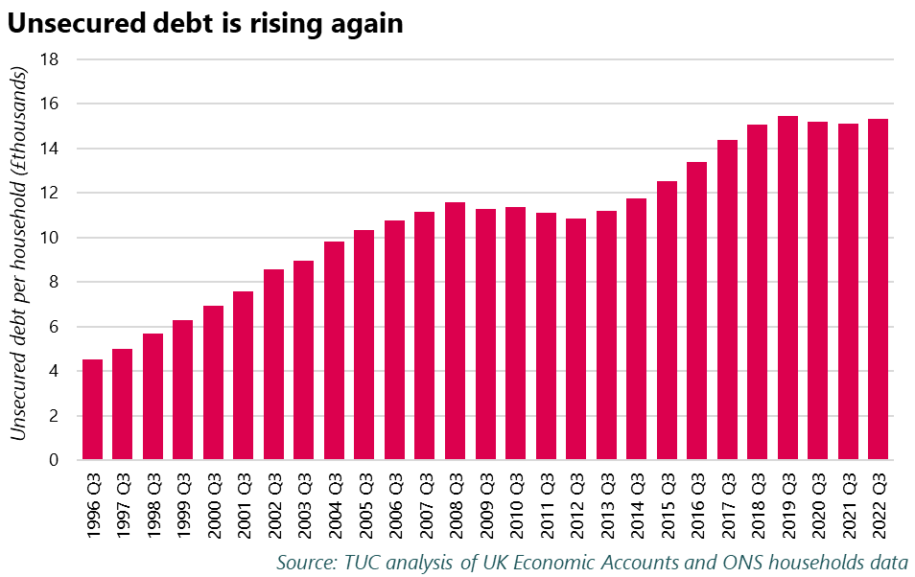
More struggles
Notes:
These struggles are getting worse. There’s warning signs everywhere. Food bank use is up, demand for debt advice is up, individual insolvencies are rising. Research from the Joseph Rowntree Foundation has shown that 7.2 million low-income households (62% of low-income households) are going without essentials. This means that they have reported going hungry, or cutting down the size of meals or skipping meals in the last 30 days, or going without basics like showers or adequate clothing since June. 4.7 million households (41%) are in arrears with at least one household bill. Over 3 million households (28%) have not been able to keep their home warm since June because they couldn’t afford to.
ResFo: In November 2022, 11 per cent of respondents said that their debts had increased moderately or substantially in the past three months, rising to 20 per cent amongst workers in low-income families. … Families are taking actions to cope with higher costs today which will worsen their future financial resilience. In November 2022, 27 per cent of adults report using their savings for daily living expenses in the previous four weeks up, from one-in-five (20 per cent) in June. In the four weeks preceding the survey, 12 per cent of workers in the lowest income quintile report selling or pawning possessions they would have preferred to keep, 7 per cent have cancelled or not renewed their insurance, and 7 per cent say they have stopped or reduced pension contributions to save money. https://www.resolutionfoundation.org/publications/the-living-standards-outlook-2023/#:~:text=Absolute%20poverty%20is%20set%20to,but%20will%20then%20trend%20upwards.
A lot of headline debt stats saw a slight easing during the pandemic. Some of this was due to some households, particularly better off households, being able to save some money and pay off some debts due to the restrictions in place.
In this one, put how debt has worsened since the financial crisis
https://www.trusselltrust.org/news-and-blog/latest-stats/mid-year-stats/

Slide 12
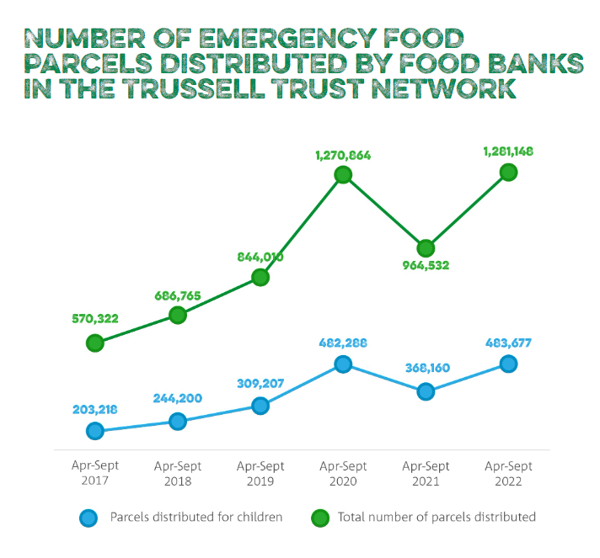
People without a safety net
“Shocking levels of economic and racial inequality in Britain are revealed in The Colour of Money ... Black and minority ethnic (BME) people generally have much lower levels of savings or assets than White British people.”
- Runnymede Trust
Notes:
. Some people will have wealth or savings to fall back on, but this isn’t true of everyone. And there’s massive wealth inequalities. The Runnymede Trust and the Resolution Foundation have both highlighted racial inequalities when it comes to savings and wealth, with Black and minority ethnic (BME) people generally having much lower levels of savings or assets than White British people. https://www.runnymedetrust.org/publications/the-colour-of-money
For those without wealth or savings to fall back on, they need to look elsewhere. This could mean food banks, or cutting back on essentials, missing essential bills, or borrowing to get by, or selling possessions. Government schemes to help provide a safety net have been lacklustre, mostly in the form of the Household Support Fund, a temporary underfunded scheme that gets regularly extended but never made permanent.
Resolution Foundation: People are also falling behind on bills: 10 per cent of people – and a quarter of workers in poorer households – have missed at least one payment of a priority bill over the past three months.

Slide 13
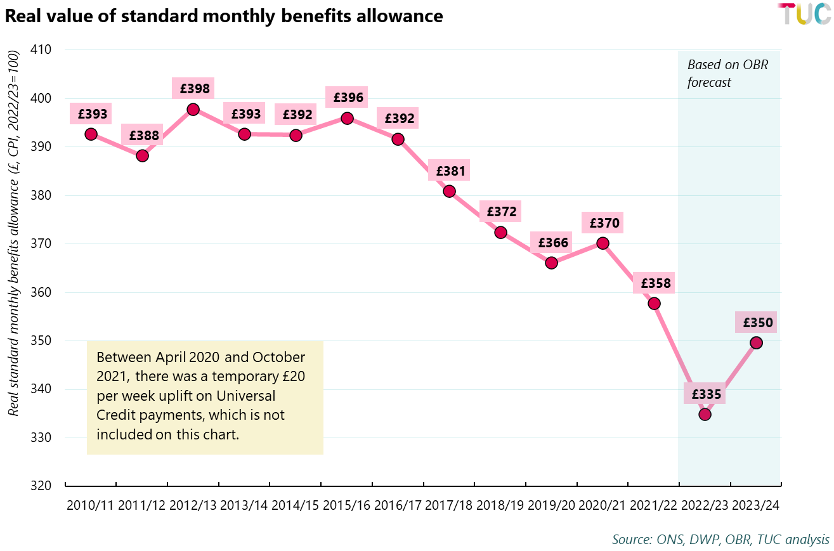
Benefits recipients

Slide 14
Winners?

Slide 15
Shareholders and CEOs
Shareholder dividends have grown faster than wages, and the gap between the two is getting wider. Before the financial crisis, the average annual growth of dividends to shareholders was double the rate of annual average wage growth. Since the financial crisis, the gap has widened with dividends growing at more than three times the rate of wages.
High Pay Centre and TUC research finds that median FTSE 100 CEO pay increased 39% in 2021
Period | CPI inflation | Dividends | Wages | Wages/dividends growth ratio
1987-2008 | 2.8% | 10.4% | 5.2% | 2.0/1
2008-2019 | 2.2% | 6.3% | 1.9% | 3.2/1
Notes:
Research published in August by the High Pay Centre and the TUC found that the pay of the CEOs of Britain’s biggest companies surged by 39% in the aftermath of the Covid-19 pandemic.
Median pay for a FTSE 100 CEO increased from £2.46m in 2020 to £3.41m in 2021. CEO pay has also surpassed the £3.25m median recorded in 2019.
The research shows that the median FTSE 100 CEO is now paid 109 times the median UK full-time worker, up from 79 times in 2020 and 107 times in 2019
Those getting big city bonuses are also doing pretty well, especially as the government lifted the cap on bankers’ bonuses in September, allowing bankers to give themselves unlimited bonuses.
It’s an absolutely great time to be a bad employer. If you want to use insecure contracts, dodgy employment practices, and refuse to pay staff a real living wage, now’s the time.

Slide 16
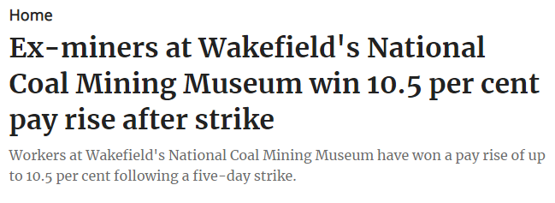
Unions
Notes:
But there’s also good news. Unions are, in a literal sense, winning during this pay crisis. Unions across the country are winning double figure pay rises, organising in new workplaces, and fighting bad employment practices such as outsourcing.
This is particularly impressive given the raft of anti-trade union laws that have been introduced in the UK, most recently the 2016 trade union act, and the threat of more to come.

Slide 17
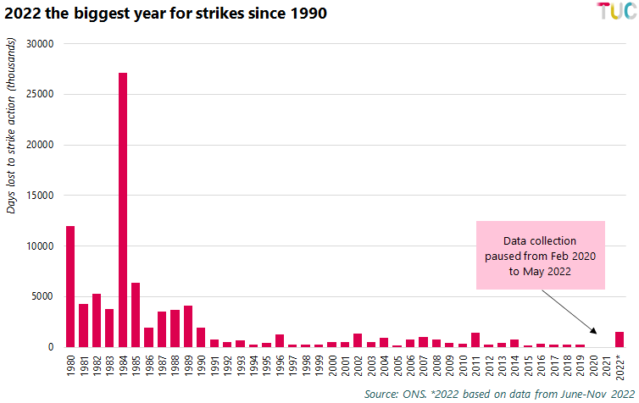
Unions
Notes:
Even with only six months of data available, 2022 was the biggest year for strike action since 1990. This is before we include December 2022, which saw postal workers, rail workers, bus drivers, nurses, higher education workers, and paramedics strike.
This is particularly impressive given the raft of anti-trade union laws that have been introduced in the UK, most recently the 2016 trade union act, and the threat of more to come.

