Slide 1
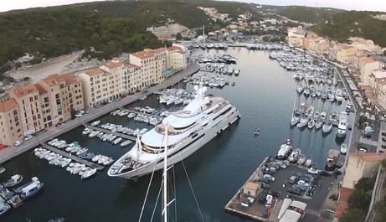
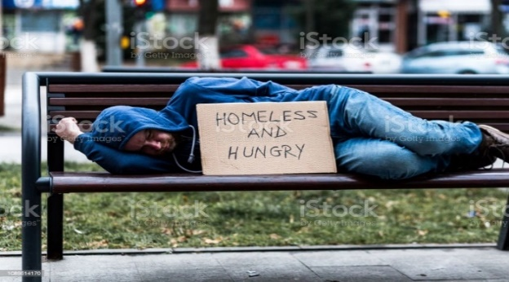
TUC Conference, 2023
Britain’s wealth mountain and
social reconstruction
Stewart Lansley
www.stewartlansley.co.uk

Slide 2
Asset rich wealth as share of economy, UK
7.5 x
3 x

Slide 3
Public v private assets, UK, 1970 – 2018
Source: The Richer, The Poorer, How Britain Enriched the Few and Failed the Poor

Slide 4
Wealth concentration, UK 1940-2020
Bottom 50%
1940
1990
2020

Slide 5
Sources of wealth inequality
Privatisation
‘Passive accumulation` via asset inflation:
John Stuart Mill called ‘growing rich while asleep`
Corporate extraction –
- profit rises siphoned off via dividends/ executive pay
- anti-competitive devices
- private equity

Slide 6
Nineteenth century capitalism: Warnings re ‘extraction’
‘production of economic goods’ v ‘appropriation
of goods produced by others’
Vilfredo Pareto, 1896
‘market sabotage’
Thorsten Veblen, 1905

Slide 7
Impact of wealth accumulation ‘crowding out’
Unearned, yet v lightly taxed
Principal driver of inequality
Return x ‘luxury capitalism’ - econ activity skewed by over-rich class, resources deflected from essential needs
‘Private affluence, public squalor’

Slide 8
Impact: government made poorer
(assets less debts, % of UK economy, 1970-2020)

Slide 9
Impact: on environmental crisis global carbon emissions, 2019
48%
17%
12%

Slide 10
The policy response
Tax rate – 1.5%
Politics pro-wealth tax
Option 1: higher taxes: one-off solidarity tax/ higher existing wealth taxes
Option 2: common ownership

Slide 11
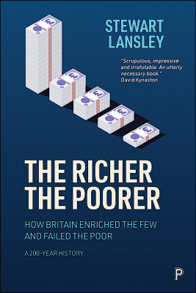
Source:

