Slide 1
Randeep Ramesh
Chief Leader Writer, the Guardian

Slide 2
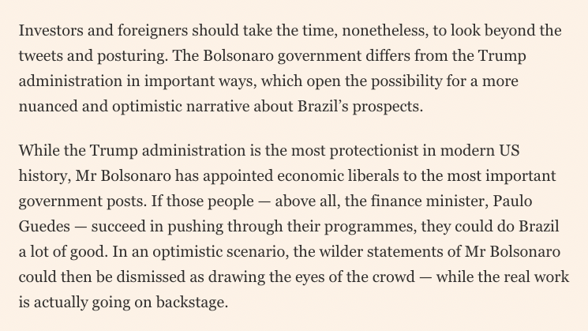
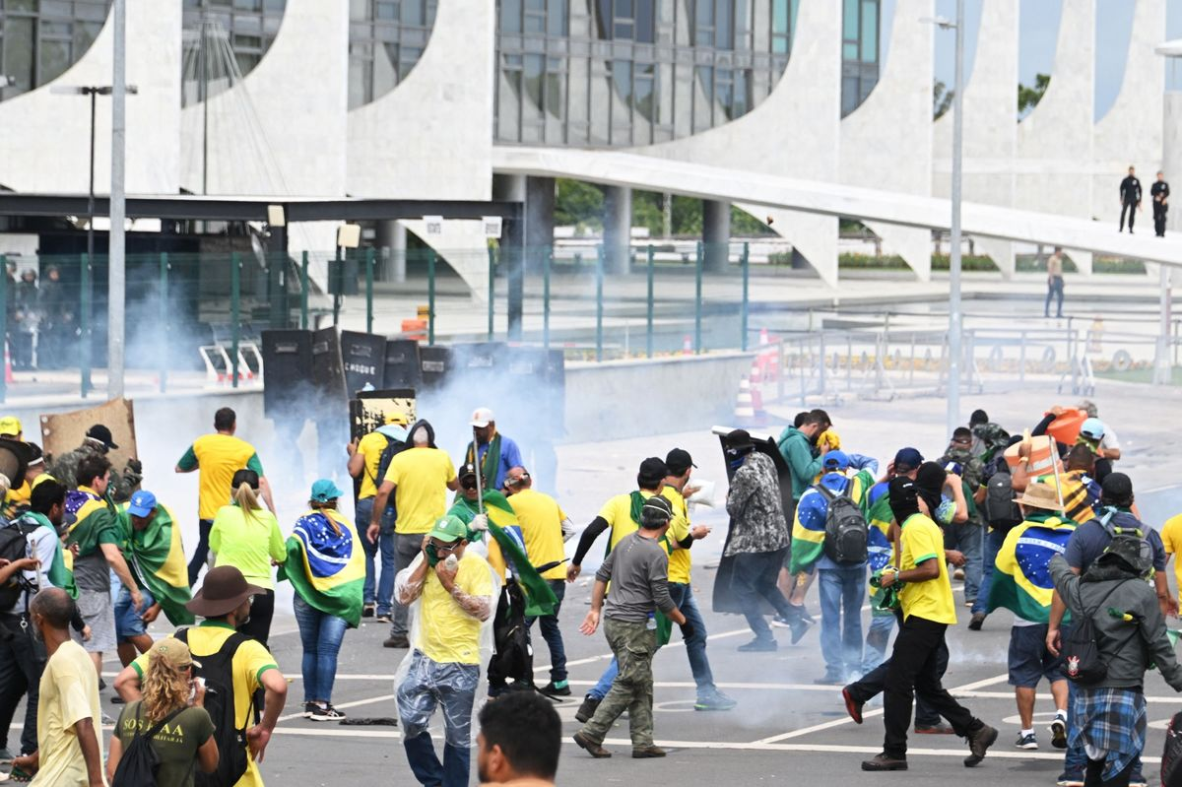
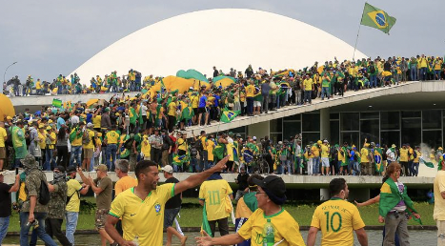
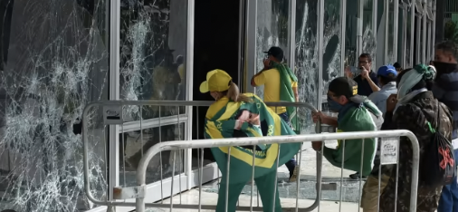
How it started
How it’s going
Source: https://www.ft.com/content/33e2640c-5ba6-11e9-939a-341f5ada9d40
The promise and perils of Bolsonaro’s Brazil, FT view, April 22 2019
Jan 2023

Slide 3
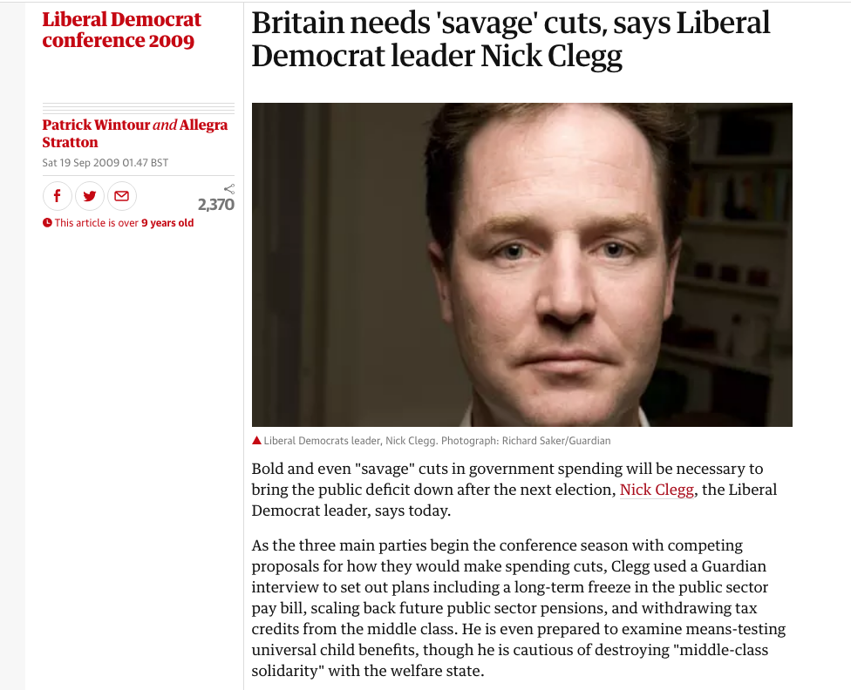
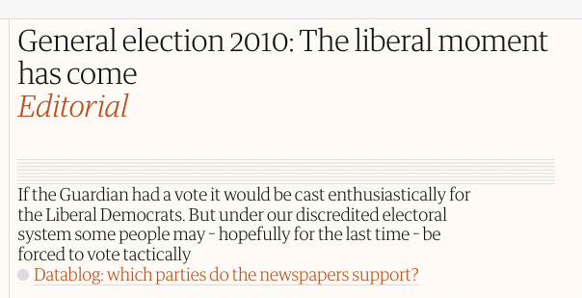
We’ve all been there

Slide 4
A turning point in history?
France in 1789. Russia in 1917. The Europe of the 1930s. The pandemic of 2020. They are all junctures where the river of history changes direction - Margaret MacMillan, historian writing in the Economist, May 2020
https://www.economist.com/by-invitation/2020/05/09/margaret-macmillan-on-covid-19-as-a-turning-point-in-history

Slide 5
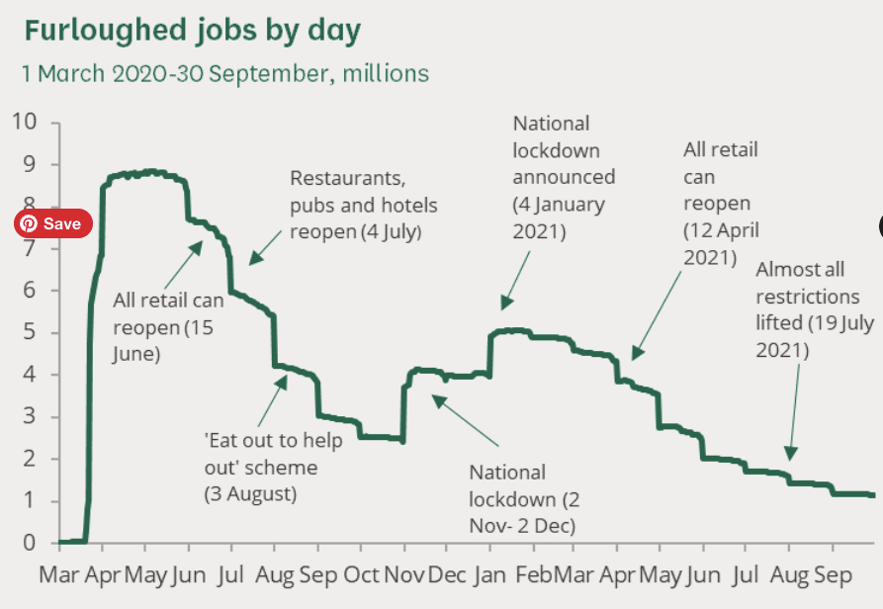
It certainly seemed that way..
UK Government spending increased from 39.5% of GDP in 2019/20 to 53.0% in 2020/21
The budget deficit reached a peacetime record of 15% of GDP
“Governments can run large fiscal deficits. Central banks can make these fundable at close to zero rates”.

Slide 6
A new Jerusalem?
April 3 2020

Slide 7
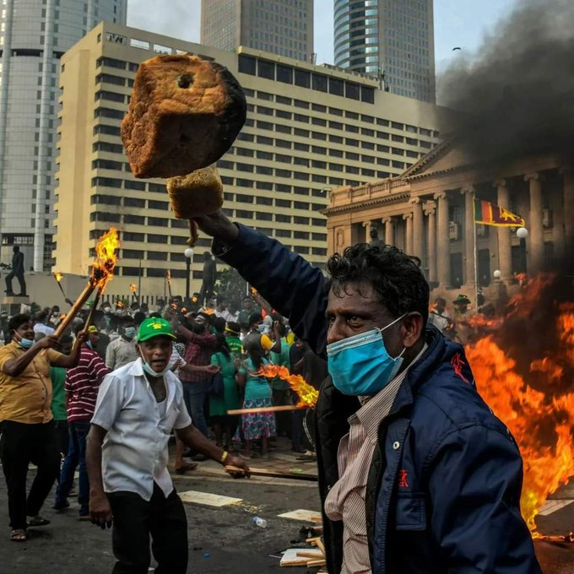
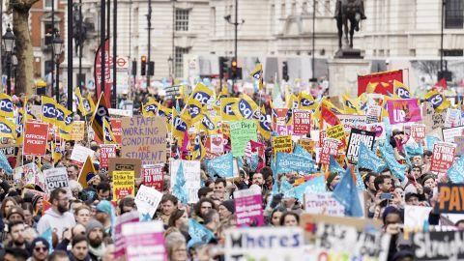
Two years later… “Polycrisis”
Sri Lanka May 2022 riots
Covid (mask), Food (bread), Fuel (fire) and Dollar debt (banks)
Britain 2023
Family food bills up by £800 a year
Meters: 3.2m people cut off from gas and electricity
Inequality fell to lowest level in a decade during Covid. Now back up to 2018

Slide 8
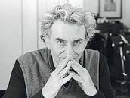
Ideology is the problem
Hyman Minsky: “The game of policy making is rigged. The Prince is constrained by the theory of his intellectuals”
Minsky argued politicians – the Princes in his Hamlet allusion – who believed themselves above influence were, in fact, limited by the beliefs used to determine the options that are presented to them.

Slide 9
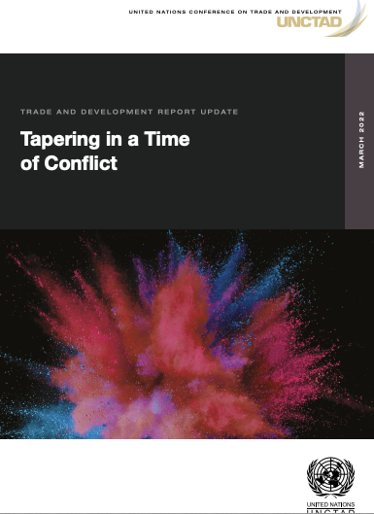
Inflation has multiple causes. The response is orthodoxy.
Inflation from war - food, fuel
Inflation from Covid supply constraints and climate emergency
Answer: Austerity and Interest Rate hikes
Heading into recession purely as a policy choice
In richer nations dampen domestic economic activity, lowers demand
Big developed central banks - led by Federal Reserve - hike interest rates, suck capital back from developing countries to the Global North, causing currency depreciation and dollar debt crisis

Slide 10
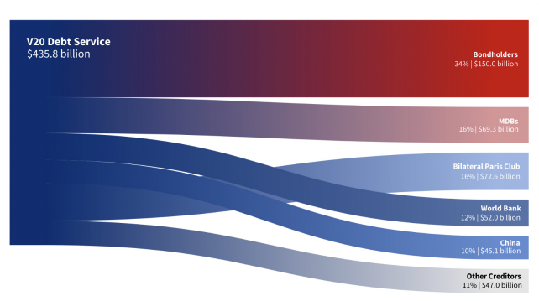
Don’t put Central Banks in charge of the crisis
Central banks cannot bring inflation down at a socially acceptable cost.
UNCTAD in OCT: The Fed’s stance has already caused the currencies of about 90 developing countries to weaken against the dollar this year, making it harder for them to purchase goods priced in dollars, or pay back dollar-denominated debt.
In the Vulnerable Twenty (V20) Group of Finance Ministers – a bloc of 55 climate vulnerable
nations – total debt climbed from $464 billion in 2015 to $570 billion in 2018 and $686 billion in 2020.

Slide 11
Inflation is always and everywhere a matter of social conflict.
Half of the inflation in the US is driven by higher profit margins – compared with 10% historically.
In food, just four companies account for at least 70% of global grain trade, with an incentive to hold stocks back until prices peak. Financial investors are also cashing in. Seven out of 10 buyers of wheat futures contracts are now speculators. In 2018, they accounted for just 23% of purchasers.
The record profit of $6.7bn made by the commodity trader Cargill last year makes the case for windfall taxes.
Shell announces record annual profits of £32.2bn after energy price surge… 35 employees in 2021 made $500-plus million in tax-free profits in the Bahamas, via a little-known oil trading outfit.
Interest rate hikes drive up business costs → corporations with market power pass the costs rises on and drive the inflationary surge.
In the developing world, Unctad says growing corporate muscle has seen a fall in labour costs, while firms’ profitability has increased. When higher profit margins are a source of higher prices, raising interest rates is inefficient and unfair because the tightening needs to be larger to affect inflation, damaging growth and employment.

Slide 12
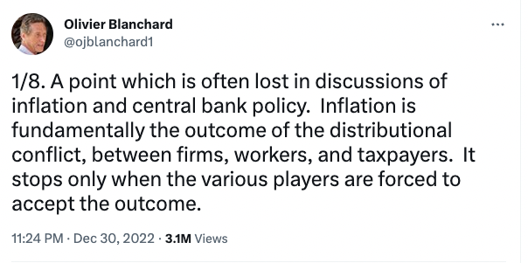
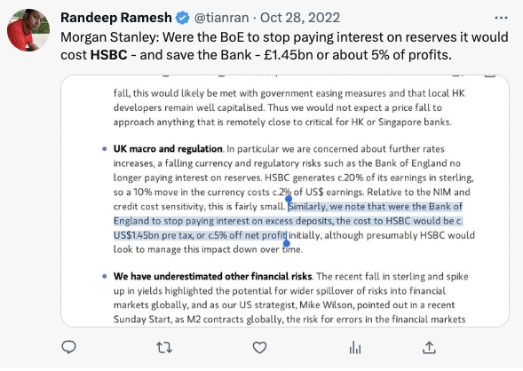
Monetary policy is not apolitical, but it is undemocratic.
Rate hikes:
Deflationary shift of disposable income from poorer households that spend to richer ones that do not
Cool asset (ie house) prices.
Pay banks more to hold risk-free financial assets
Upward pressure on the currency
Regain control of interest rates by tightening and then offering gilts to private investors rather than purchasing them itself
Central Bank acting for the financial interests that it is meant to oversee…

Slide 13
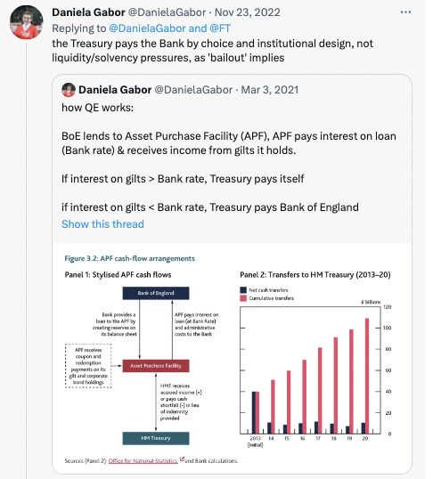
Austerity by design
Central Banks don’t go bust
But system is designed so Treasury pays BoE ‘losses’ on QE programme
“it seems very likely that, over its lifetime,
BoE QE will realise a total loss in the order
of £10bns, if not £100bns.” - Tim Young, former BoE market operations

Slide 14
“It’s an oligarch’s world, we only live here” - James Galbraith
Labour has no power to set prices. [shouldn’t it get some? Trade U? Price controls, worker ownership?]
Inflation today is not a struggle between capital and labour but one between capitalists rooted in finance, technology, energy, aerospace, defence, pharma, insurance, housing.
Workers survive because a strong currency, cheap basics (food fuel), and “the Schumpeterian gains from radical improvements in (mostly imported) consumer goods.”
Can wages really fall much further?
A power struggle between oligarchs?
“Real estate, construction, tech and energy at the moment are losers; banks as always are among the winners. No surprise in this: the Federal Reserve works for the banks. The interest rate it sets is not natural in any sense: it is a weapon in the struggle. “Fighting inflation” is just a smokescreen for the real fight.”

Slide 15
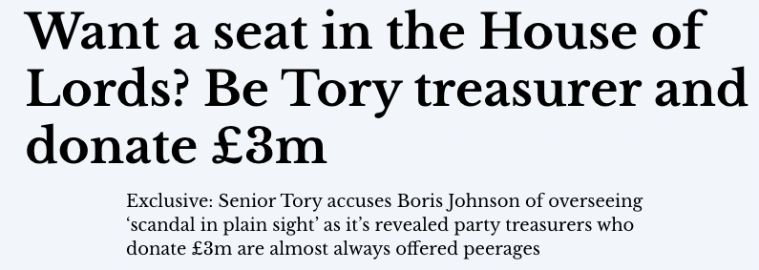
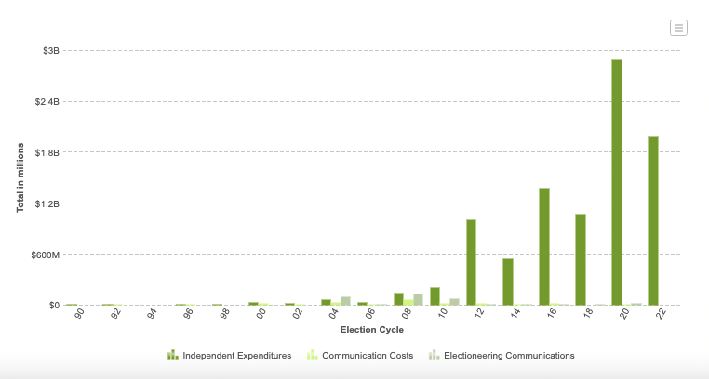
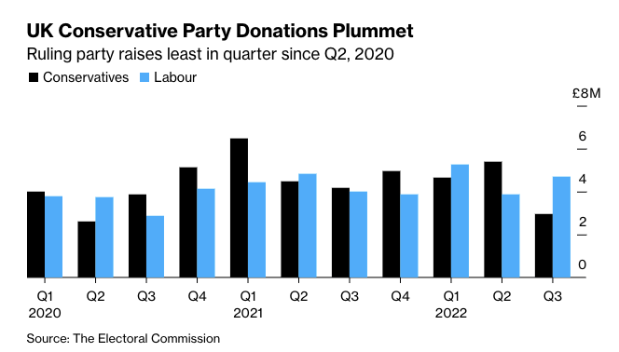
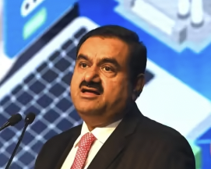
Money power
2010 Citizens United: Firms can spend as much as they want to help their favoured candidates. US is “extraordinarily corrupt”

Slide 16
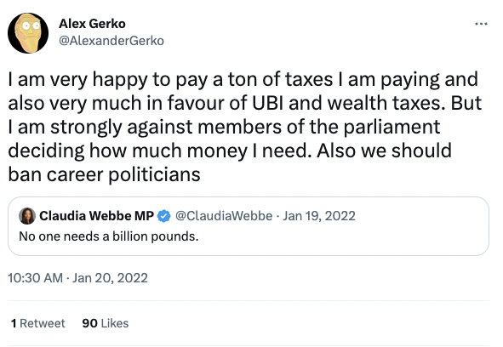
Democracy v Capitalism
Can one separate wealth from power?

Slide 17
A society not a market
From capital’s perspective: inflation is always bad, because its wealth is being debased.
From workers’ view: inflation means you have to find other ways to live.
In the past workers went into political struggles… where are they going now?
Will pro-labour movements arrive or the politics of “sound money” prevail?
In democracy every vote is equal. But in capitalism every dollar is equal. More dollars, more power. Plutocracy not Democracy
Democracy seems embedded in capitalism. Shouldn’t it be the other way around?

