Slide 1
From the doom loop to a (global) economy for work not wealth
Geoff Tily, TUC

Slide 2
Outline
Observations
real GDP doom loop
versus wealth boom loop
Diagnosis / theory
Conclusions

Slide 4
1a. The doom loop in real GDP

Slide 5
1a. The doom loop in real GDP

Slide 6
1a. The doom loop in real GDP

Slide 7
1a. The doom loop in real GDP

Slide 8
1a. The doom loop in real GDP

Slide 9
1a. The doom loop in real GDP

Slide 10
1a. The doom loop in real GDP

Slide 11
1a. The doom loop in real GDP

Slide 12
h/t Paul Mason

Slide 13
1b. Doom loop in GDP v boom loop in wealth

Slide 14
1b. Doom loop in GDP v boom loop in wealth

Slide 15
1b. Outturn: annual percentage growth
 | Pre 1979 | Post 1979
Economy | 3.1% | 1.8%
Wealth | 1.8% | 3.9%

Slide 16
2. Diagnosis
1979 finance liberalised; labour repressed
Failed productivity / supply narrative.
Instead the relation between distribution/power and economy operates through demand

Slide 17
Instead the relation between distribution/power and the economy operates through demand
…conflict mainly between bankers and owners of financial wealth on one side and ordinary households on the other – between the very rich and everyone else.
The underlying problem was an economic and political system that “placed large surplus savings in the hands of a plutocracy”. Income concentration gave the rich “an excess of consuming power that they cannot use” at the expense if everyone else.

Slide 18
Diagnosis
1979 finance liberalised; labour repressed
Failed productivity / supply narrative.
Instead the relation between distribution/power and economy operates through demand
Conventional wisdoms inverted:
Supply excessive not demand (in relative terms)
The real danger is balance sheet inflation not price inflation
Conclusions
Domestic: strengthen purchasing power (and remove from wealth)
International: rebalance economic relations between nations

Slide 19
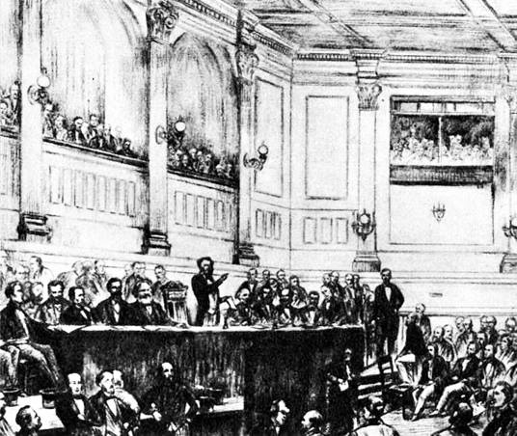
The inaugural meeting of the International St Martin’s Lane 28 September 1864

Slide 20
Rebalancing power through rebalancing the economic relations between nations
If nations can learn to provide themselves with full employment by their domestic policy … there need be no important economic forces calculated to set the interest of one country against that of its neighbours …
J. M. Keynes, The General Theory of Employment, Interest and Money, 1936
It is recognised at last that the expansion of international trade depends on the maintenance of Full Employment – and not the other way round … i.e. a solid foundation on which we could build a positive international full employment policy. This, in my view, transcends in importance all else.
Hugh Gaitskell, The Daily Herald, 1945 (cited in Williams, 1979, p. 217)

Slide 21
Ernest Bevin, writing when Minister of Labour sometime between Oct. and Dec. 1940
In short, international policy should be based not on the increase and safeguarding of the total trade and income of individual countries, but on the provision by international cooperation of the needs of human individuals … Britishers, Poles, Chileans, etc. being looked at together as human beings whose well-being is interdependent.

