Slide 1
TUC Conference: Economics for workers not wealth 2 February 2023 Panel: The international landscape for a workers' economy
Andrew Fischer
Institute of Social Studies, Erasmus University Rotterdam

Slide 2
‘as of 15 March 2021, 85% of the 107 COVID-19 loans negotiated between the IMF and 85 governments indicate plans to undertake austerity once the health crisis abates.’

Slide 3
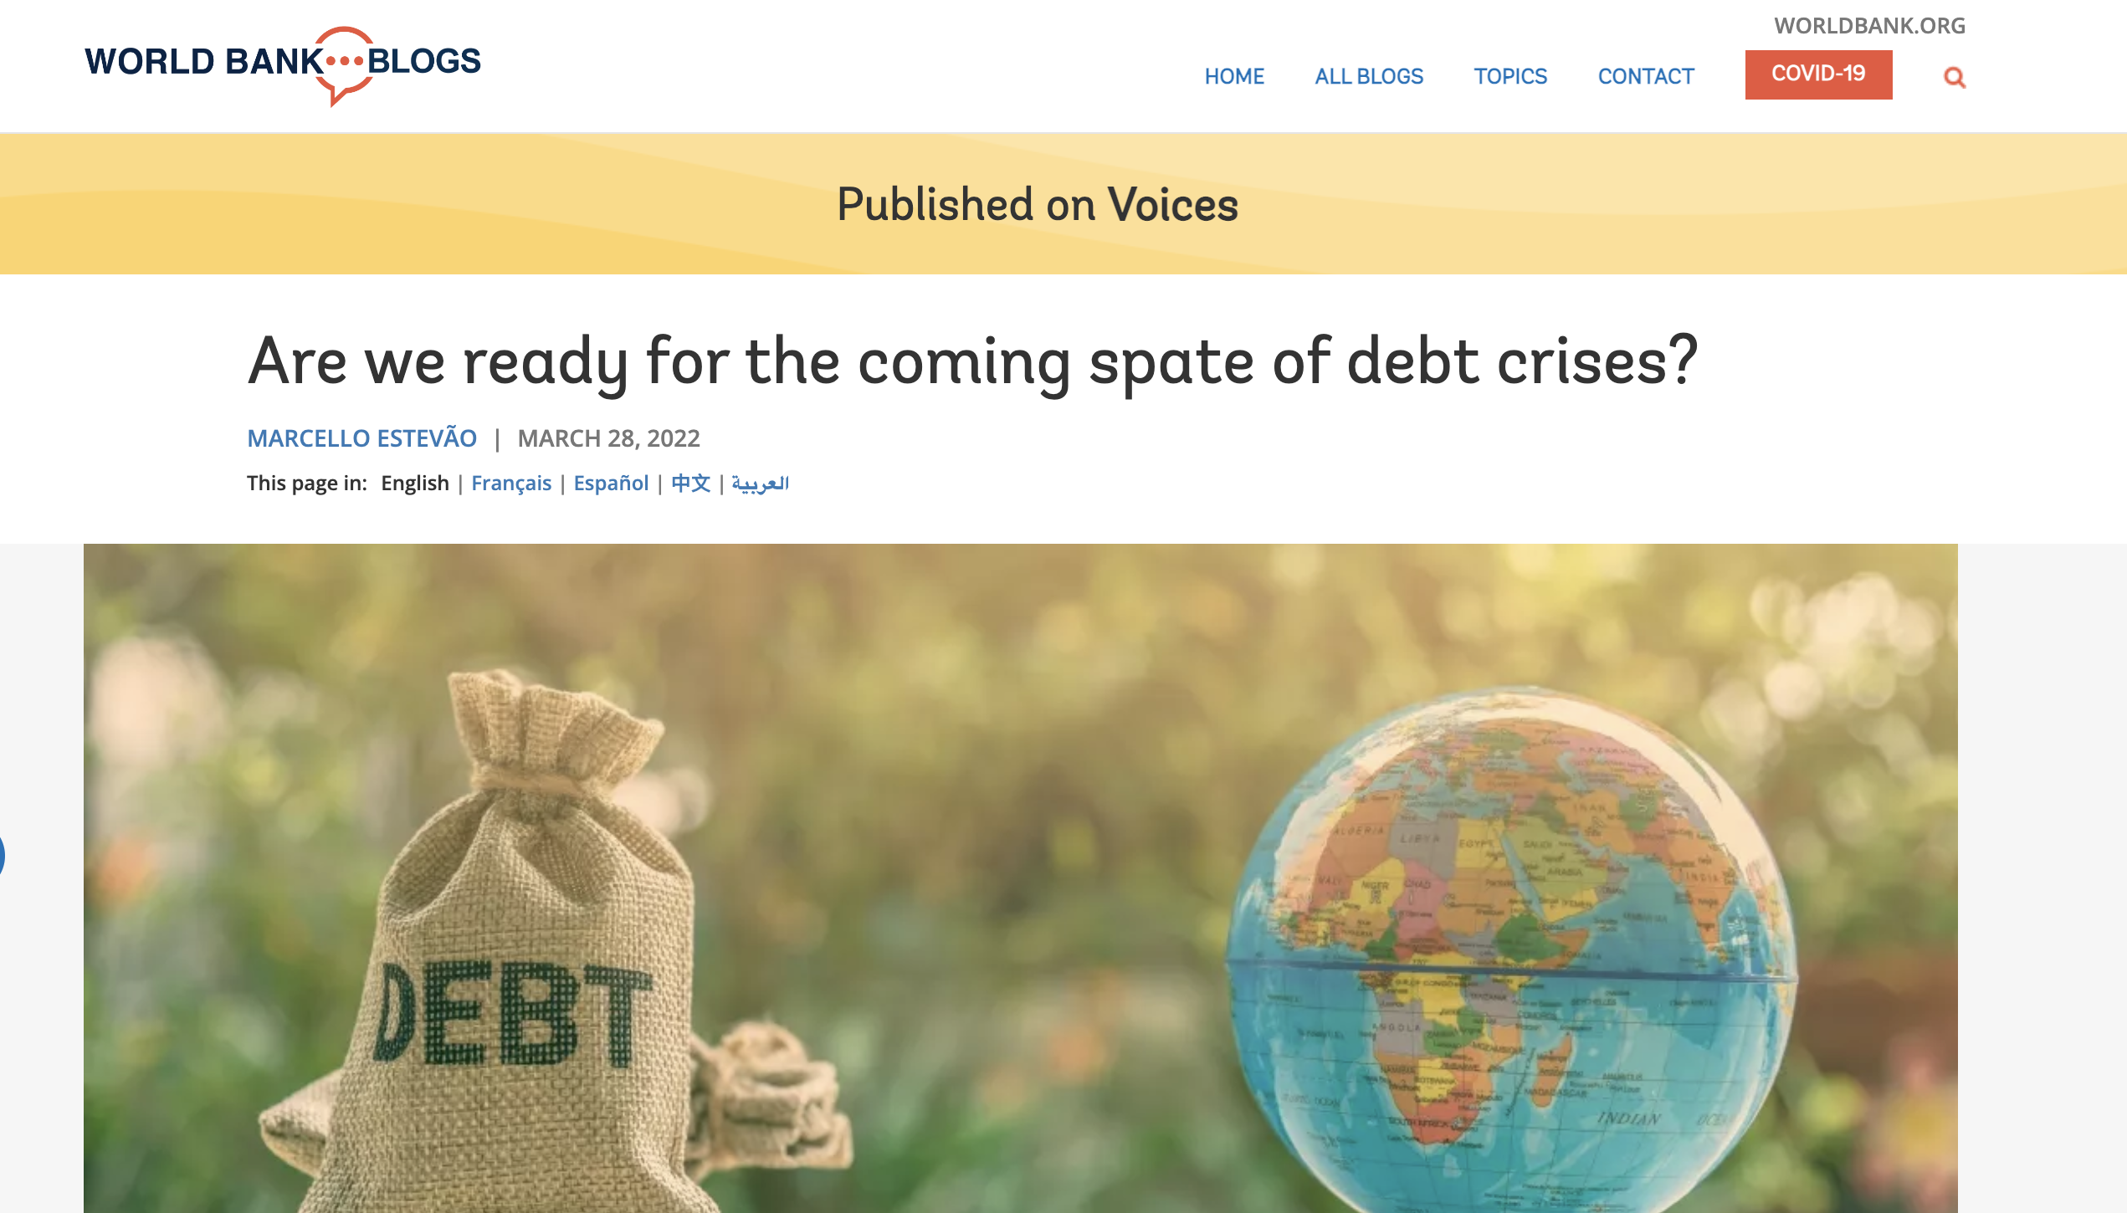
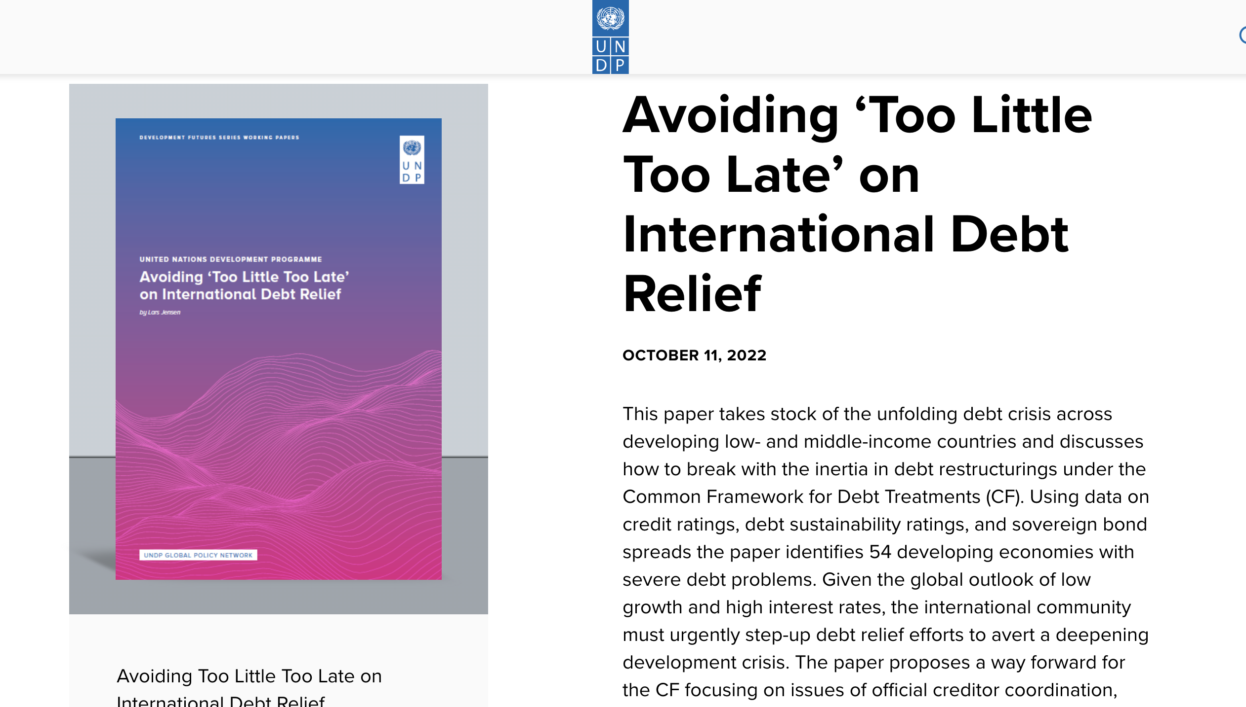
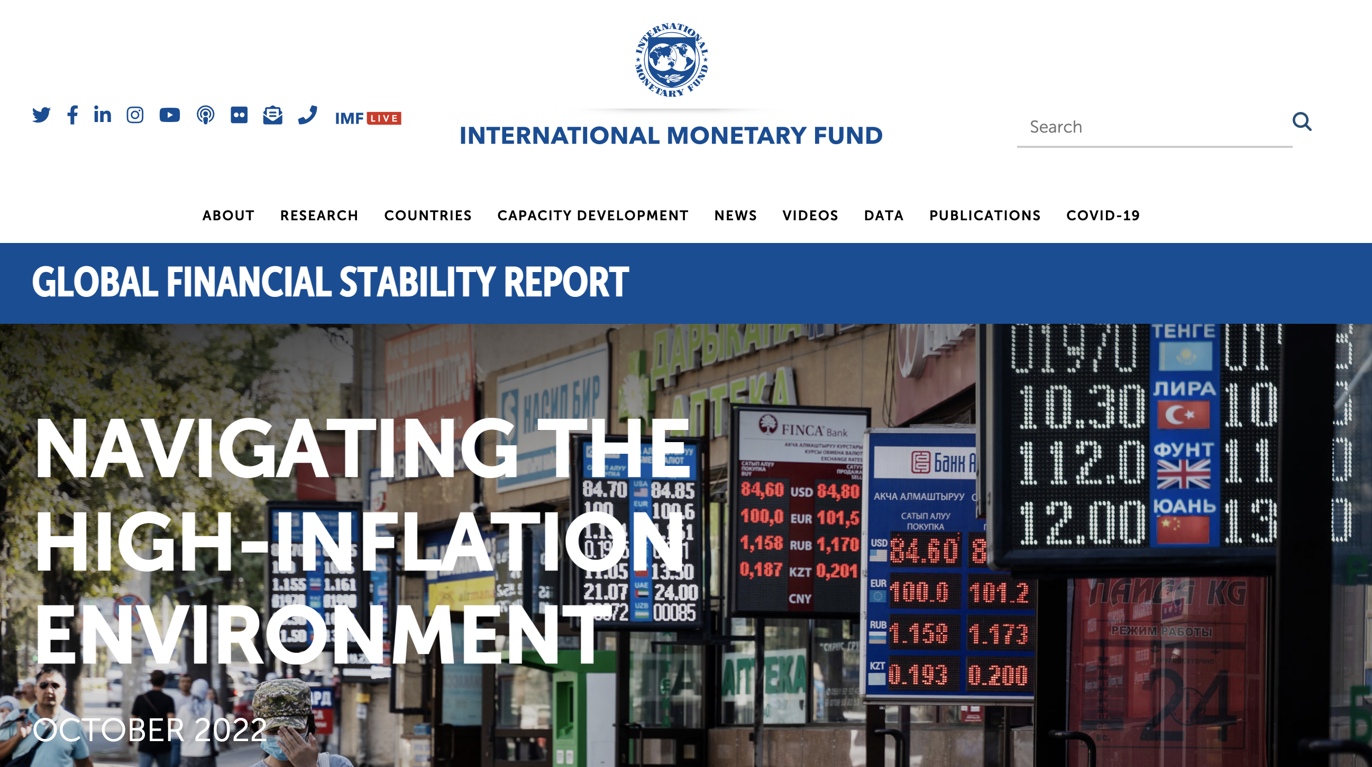

Slide 4
Zambia, general government fiscal balances, 2000-2026 (projected after 2020 as per IMF WEO (thanks to David Munevar from Eurodad)

Slide 5
What does halving primary expenditures do?
Social programmes and services usually frozen or retrenched, often discretely such as through lack of indexing in context of rising inflation
‘Reforms’ in subsidies or public pensions (i.e., reduced or cut)
Salaries often reduced (again, often discretely, such as through delays in payment, non-indexing, etc.)
Anything related to infrastructure or industrial strategy usually freezes, including R&D, given its high forex demands
Public investment typically gets hit first and hardest (infrastructure, etc) because quickest way to ‘rebalance’ (fiscal and balance of payments) without immediately or obviously touching salaries

Slide 7
Foreign exchange constraints and the ‘balance of payments dominance’ (Ocampo 2013) of macroeconomics in the peripheries
Forex is a distinct constraint from savings or aggregate demand, and tends to dominate these other variables
Insufficient forex imposes austerity (quantity rather than price adjustment) on both investment and consumption
Cannot be overcome through ‘right’ prices or demand management
E.g., inflation: devaluation (which is used to balance the external accounts) worsens inflation in economies with strong import dependence
Early rationale for aid (grants or concessional debt) in early post-WWII period: to supplement forex, not overall savings
Also the idea behind Marshall Plan

Slide 8
Domestic Financing and Priorities (the MMT case?)
Governments are able and do fund their own priorities entirely from their own domestic fiscal resources
E.g., Zambia:

Slide 9
Zambian government expenditure in 2019 (from the ‘Green Book’)

Slide 10
Zambia, current account, 1978-2021 (millions current $US)

Slide 11
Zambia, goods trade, 1978-2021 (millions current $US)

Slide 12
Zambia, selected other investment + portfolio, millions $US (current), 1997-2021

Slide 13
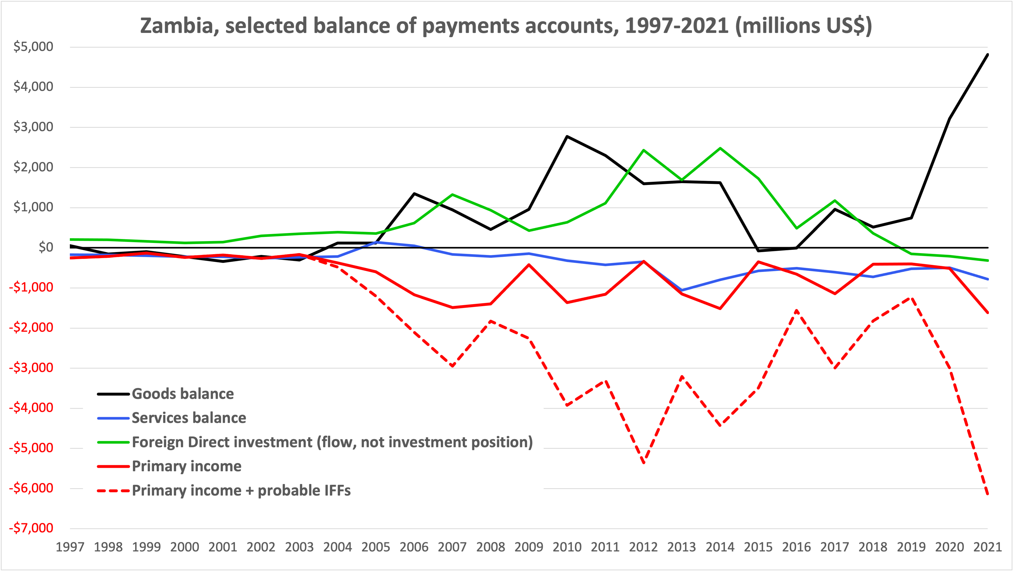
-29% of GDP

Slide 14
Internationalist Agenda for a Worker’s Economy
Imperative of (progressive) redistribution for development
As first step, reverse regressive redistribution from poor to rich (through illicit financial flows, or even licit flows)
Debt restructuring and/or cancellation without punitive conditionalities needed, BUT
Needs to be accompanied by international financial reform +
Important not to lose focus on underlying structural factors and the dominance of foreign ownership that drive outflows
Redistribution beyond tax & spend + space for development strategies, which need stable forms of external finance

