Slide 1
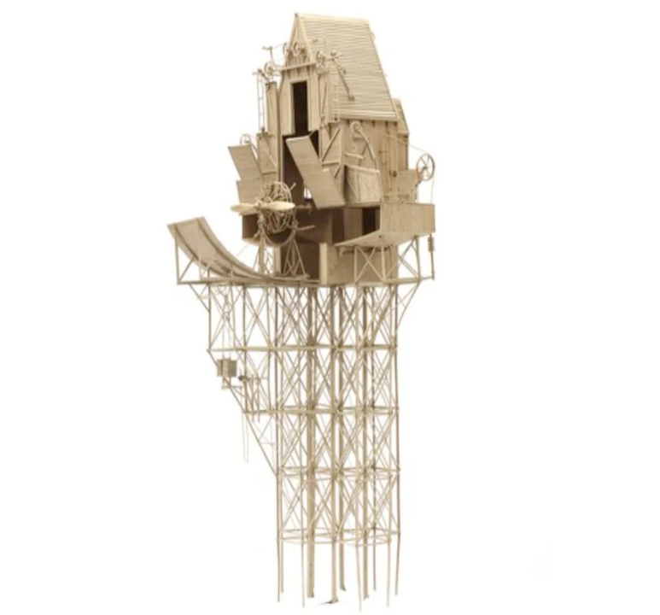
We Ignore at Our Peril the
Wealthy, Fragile Utopia
that is
Financial Globalisation
By Ann Pettifor
TUC: 02 February, 2023
Economics for Workers not Wealth
Policy Research in Macroeconomics
(PRIME)

Slide 4
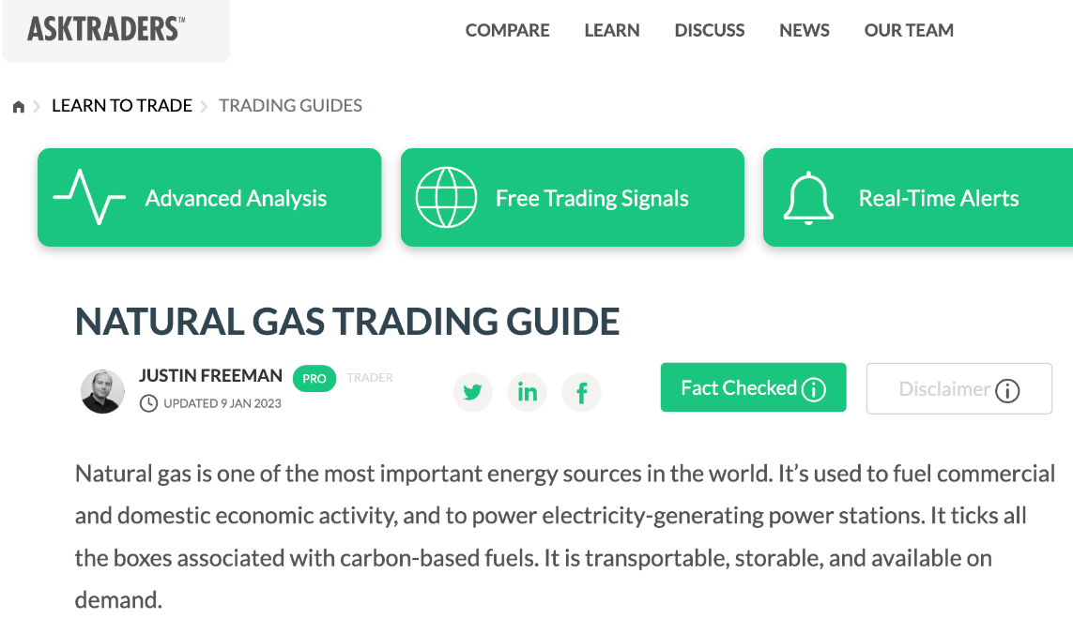

Slide 6
How to speculate on gas?

Slide 7
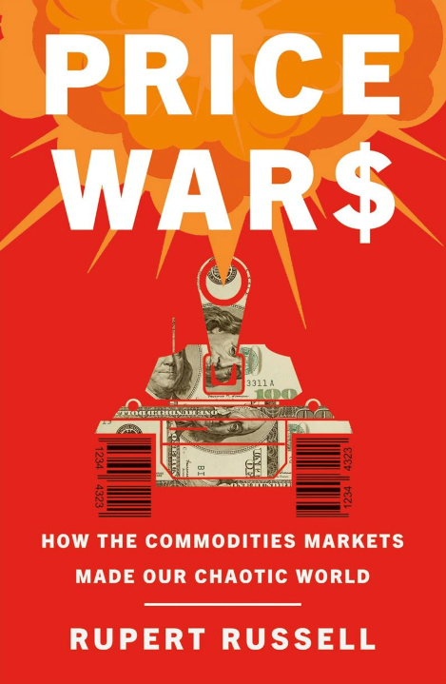
Playing Poker with the Economy & Ecosystem
Rupert Russell reminds readers in Price Wars that the power of speculative finance was hitched to real-world commodities markets when US legislation was adopted at the turn of the twenty-first century by the Clinton administration.

Slide 8
26 March 2008
Essential commodities like oil and wheat, that had been traded in traditional markets were financialised through deregulation embodied in the
Commodities Futures Modernisation Act of 2000.

Slide 9
Playing Poker with the Economy & Ecosystem
New ‘paper barrel’ instruments – futures’ options’ and OTC derivatives’ contracts (such as credit default swaps) - would not be regulated as "futures" under the Commodity Exchange Act of 1936 (CEA) or as "securities" under the federal securities laws…..

Slide 10
Playing Poker with the Economy & Ecosystem
…..The Commodity Futures Trading Commission's (CFTC) desire to have "functional regulation" of the market was also rejected.
Instead, the CFTC would continue to do "entity-based supervision of OTC derivatives dealers".

Slide 11
‘The hunger profiteers’ & cost-of-living crises
“After Russia’s invasion of Ukraine investment in commodity markets for grain (wheat etc.) significantly increased.
Direct purchase of futures and investments in agriculture indexes multiplied and reached levels equivalent to those of 2009/2011.
For instance during the first week of March 4,5 billion dollars was invested in food commodity-based Exchange Traded Funds (ETFs).
Lighthouse Reports, 2022. The Hunger Profiteers, al Hekman, L.et al. May 2022.

Slide 12
The hunger profiteers
During April two of the leading ETFs within agriculture attracted $1,2 billion net investment from investors – compared with only $197 million during the whole of 2021.
This caused prices to more than double in some countries in Africa and the Middle East.[ii]”
Lighthouse Reports, 2022. The Hunger Profiteers, al Hekman, L.et al. May 2022.

Slide 13
The ongoing cost-of-living crisis is not a matter of war ….
It is about deregulated global markets in energy and grain commodities and a malfunctioning global food system.
Nor is about supply and demand between traders and suppliers at the domestic level
It is about global food chains and the role of financial actors/speculators that make (effortless) capital gains from high, volatile prices and from hunger.

Slide 18
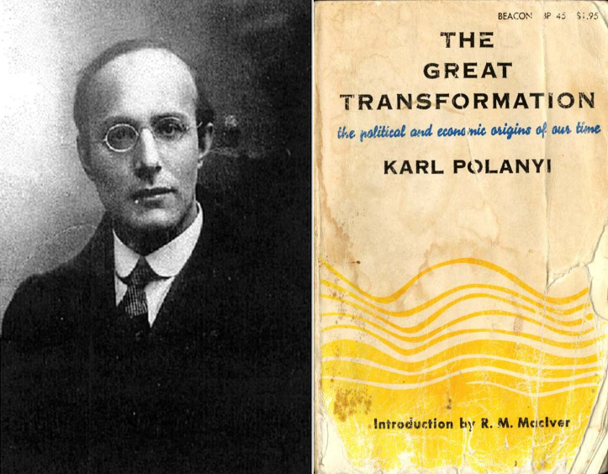
“A society containing within its orbit a separate, self-regulating and autonomous economic sphere is a utopia……
An unregulated world market inflicts losses, unemployment, inflation, debt, low wages and instability on society.

Slide 19
Polanyi argued that if democratic governments would not intervene in world markets to protect the interests of their citizens, then voters would turn to “strong men” (and women) for protection from those global markets.

Slide 20
“Society had a choice: integration of the economy and society through political power on a democratic basis.
Or, if democracy proved too weak, integration on an authoritarian basis – and at the price of the sacrifice of democracy.”

Slide 21
“For the sake of society the market mechanism must be restricted.
But this cannot be done without grave peril to economic life and therefore to society as a whole.”

Slide 22
Central bankers and western politicians are messing with, and trying to restrict the marvellously intricate and fragile workings of global financial markets - governed only by the ‘invisible hand’….

Slide 24
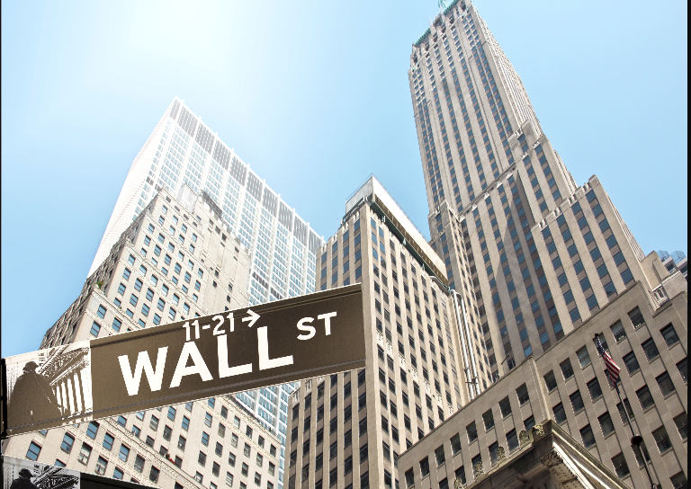
Central bankers acted to deliberately intervene in global markets by raising rates – to trigger recessions
– in the hope that a collapse in domestic economic activity would lower the inflation of prices fixed in global largely deregulated and speculative markets based on Wall St. and or, the Chicago Mercantile Exchange (CME).

Slide 25
Global Price stability?
“Central banks are in love with this idea that they control price stability”
- Zoltan Pozsar, global head of short-term interest rate strategy at Credit Suisse, said in a telephone interview.
“I find it shocking that entities as crucial to price stability as [commodities traders] ”are not more closely overseen by the Fed.”

Slide 26
The global system could be toppled by
Reckless commodity traders
Or by the rash decisions of, for example far-right politicians like Britain’s ‘Kami-Kwasi Kwarteng’ who casually chucked a grenade at financial markets in September, 2022 – and caused mayhem in pension markets.

Slide 27
Or.. by US acts of global economic aggression
Feb 2022: The United States retaliated to the invasion of Ukraine by freezing Russia’s central bank reserves.
Like all national reserves, Russia’s central bank reserves are a public good - the fruits of the work, economic activities and savings of the Russian people as a whole.

Slide 28
Or.. by US acts of global economic aggression
A week later, a meeting of G7 finance ministers went further: they agreed to intervene in the global market for oil, to impose a price cap on the market in Russian crude oil and petroleum products.

Slide 30
“For the sake of society the market mechanism must be restricted.
But this cannot be done without grave peril to economic life and therefore to society as a whole.”

Slide 32
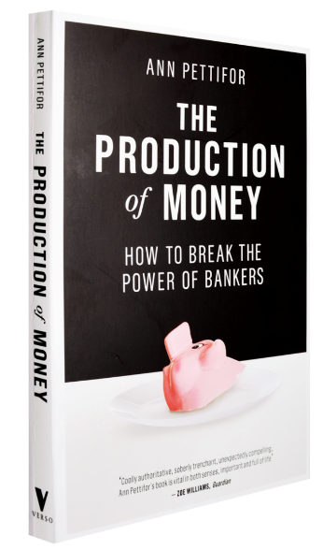
Ann Pettifor
Director
PRIME
Policy Research
in Macroeconomics
www.primeeconomics.org
Substack: System Change
twitter: @AnnPettifor

