Slide 1
Wales TUC Greener Workplace Network meeting
Graham Petersen
Greener Jobs Alliance
gjacoms@gmail.com
7/12/21

Slide 2
Aims of the session
Climate mitigation v adaptation
Policy framework – jobs and skills strategy
Range of adaptation risks
Case Study – Air quality
Union responses

Slide 3
Focus on:
Warmer and wetter winters.
• Drier and hotter summers
Continuing sea level rise
2nd National Adaptation Programme 2018-23. Risk assessments inadequate
Taskforce on Climate-related Financial Disclosure (TCFD)
‘A robust plan is needed for adaptation. The UK does not yet have a vision for successful adaptation to climate change, nor measurable targets to assess progress. Not one of the 34 priority areas assessed in this year’s progress report on adaptation is yet demonstrating strong progress in adapting to climate risk. Policies are being developed without sufficient recognition of the need to adapt to the changing climate. This undermines their goals, locks in climate risks, and stores up costs for the future.’ (Page 10) Progress-in-adapting-to-climate-change-2021-Report-to-Parliament.pdf (theccc.org.uk)

Slide 4
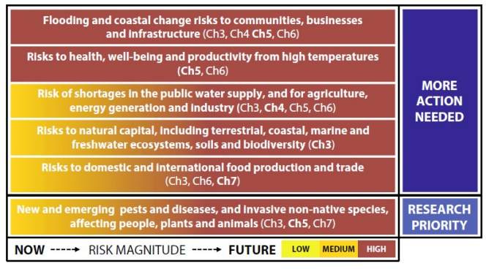
6 priority areas in the CCRA

Slide 5
Climate adaptation policy in Wales

Slide 6
Green Jobs Barometer
PwC Report gives Wales the lowest score – 31 out of 100.
Based on 5 categories – Green job creation / Wider benefits / Loss of sunset jobs / Carbon intensity / Green workplaces
Green Jobs Barometer - PwC UK
Green Jobs Barometer - PwC UK

Slide 7
Climate adaptation skills

Slide 8
Opportunities and threats
Over 60,000 jobs could be created in the green economy over the next 2 years with infrastructure investment.
However, the current skills pipeline is not prepared for this demand with our analysis suggesting low apprenticeship and training numbers in key sectors compared to potential job growth.
There is a mismatch between levels of existing employment and potential; the level of job creation is significant compared to existing numbers.
Funding to deal with this shortfall is insufficient to cope with demand and scale.
Targeted and sustained action is needed to ensure green growth industries provide entry for Black, Asian and minority ethnic people; women; disabled people and those furthest from the labour market
Skills – The Future Generations Commissioner for Wales

Slide 9
Range of work-related adaptation issues
Air quality
Flooding
Working in high temperatures
Travel to work
Supply chain
Skills
Stress and workload
Building fabric
Pandemics
Distributional impacts – low income and other disadvantaged groups
Any other?

Slide 10
Local Authority Skills Case Studies
UCU and community air pollution training event organised in Sept 2021
The unions in LB Wandsworth campaigned for the inclusion of jobs and skills in the climate action plan. Union seat on the Skills and Jobs committees.
Yorks + Humber Climate Commission. ‘The Commission will work with skills providers, businesses, trade unions and workers to develop and enhance access to climate and nature related training across the region’ Climate Action Plan | Yorkshire & Humberside Climate Commission (yorksandhumberclimate.org.uk)
Publications Online :: Publications (lrdpublications.org.uk)

Slide 11
Resources

Slide 12
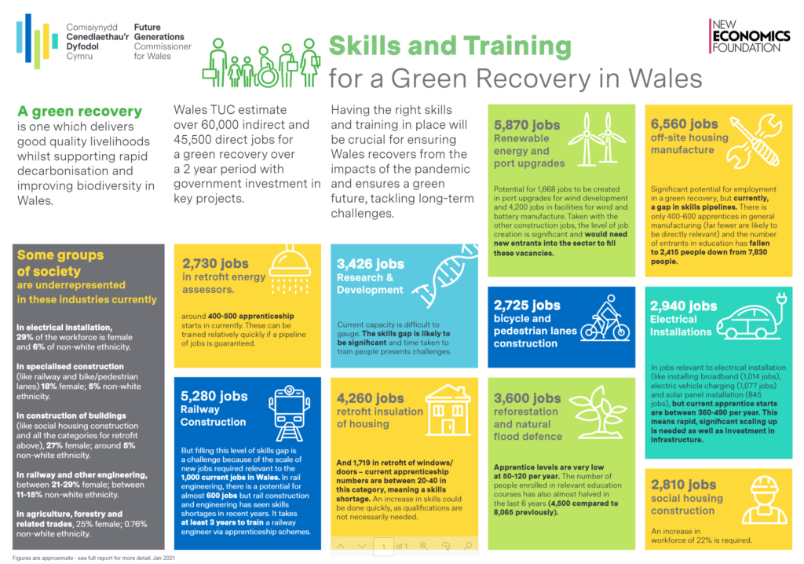

Slide 13
Action on climate adaptation
Discussion in the branch / joint committee
Arrange a meeting to discuss a climate adaptation risk assessment
Support Wales TUC Green Reps Network
Support Wales TUC courses – Greening the Workplace and Just Transition
Link to just transition strategies in the workplace and community Outline-Legal-Framework-Final.pdf (greenerjobsalliance.co.uk)

