Slide 1
Climate risks in the workplace
Protecting workers in a changing climate
Catherine Payne, Sniffer| Teams| 13 July 2021

Slide 2
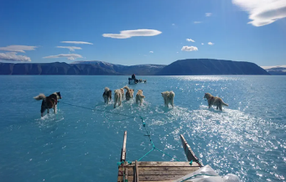
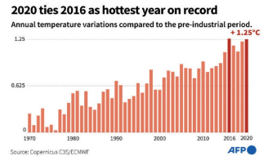
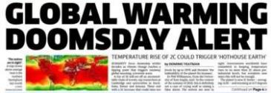
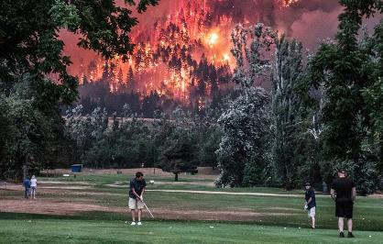
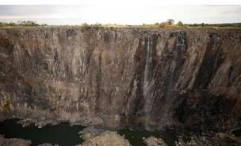
The impacts from +1.25°C warming. How much worse can it get?
“Nowhere is safe … who would have predicted a temperature of 48/49C in British Columbia?” Sir David King
Notes:
I know I’m preaching to the converted but sometimes we forget the bigger picture and I want to centre how dire our current predicament is to focus our minds!
What are we adapting to? The only certainty about the future climate that we have now is in hindsight. But it’s fair to say its not looking good. The impacts from 1.25C of warming are already really scary. And the more we learn the worse it looks. Change is being felt all over the world, every day and today’s changes are rewriting our scientific understanding. I’ve been talking about climate risks for 20 years and I always used to joke that it was the ONE area of science where scientists were more terrified than the Daily Mail – but the top middle headline is from the DM so I can’t say that anymore.
We must remember that climate projections are NOT predictions. Models have huge uncertainty:
Models rely on educated guesses about people yet to be born using technologies not yet invented (not all will be right)
Intricate interactions between earth systems and human activity too complex to model perfectly; plus big modelling gaps
Climate change isn’t linear - we’re destabilising climate patterns. Weirding not warming – harder to model AND adapt to
Today’s observations are rewriting scientific understanding - we must use the precautionary principle
Models significantly underestimate warming
Unrealistic assumptions about deployment of negative emissions technologies
The future is going to be messy and surprising

Slide 3
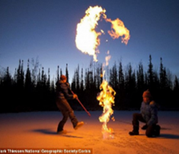
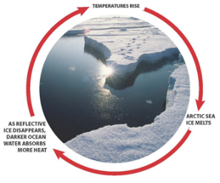
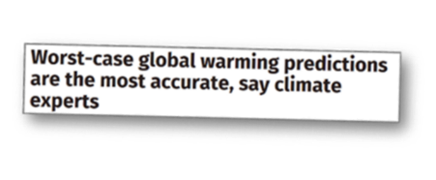
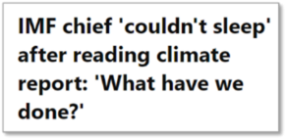
Hope for the best, plan for the worst
At the brink of climate breakdown – runaway warming
If vast natural carbon sinks become net emitters - could trigger a spiral of warming potentially unstoppable over human timescales
Limiting warming to 2°C will deliver 50+% likelihood of climate breakdown Would you put your kids on a plane with 50% odds of crashing?
If we limit warming to <1.5°C our odds of disaster could still be 33%
We must limit warming to <1.5°C and the faster the better
COP26 pledges will deliver 1.5°C between 2030 and 2050
COP26 pledges, even if kept will deliver warming of 2.7°C and a high risk of runaway warming
Notes:
Scientists aren’t renowned for panic yet here they are sounding the alarm – what’s changed? Well, we appear to be approaching (or potentially might have already crossed) important tipping points which keep the climate system stable, and there is a real risk that we have warmed the planet to the point that vast natural stores of GHG emissions (from carbon sinks in forests, soils, the ocean) are about to be released to the atmosphere – which would create an unstoppable warming spiral and a planet that basically, is incompatible with complex civilisation. This is the so-called hot house earth scenario or runaway warming. Atmospheric physics doesn’t care about current affairs, while we have taken our eyes off the environment to gape at Donald Trump, COVID19, BREXIT, - climate change is happening faster than models predicted. Our models have significantly underestimated the sensitivity of the climate and been too optimistic about our collective enthusiasm to cut emissions. We are witnessing changes to planetary systems that scientists did not predict would be observed until the 2080s, indeed changes that the climatology community hoped we would never see. When I first started working in this topic runaway warming was a very leftfield concept that there was no way humans could ever be dumb enough to let happen because we would totally cut emissions in time to avoid it. But today it is no longer the ‘worst case scenario’, positive feedbacks are now happening at scale and run-away climate change by mid-century is now the most likely case if we do not decarbonise FAST. Even if we manage to halt emissions reductions at 1.5C (something which will require us to throw everything and the kitchen sink at decarbonisation and carbon storage) – we still risk 33% odds of triggering unstoppable runaway warming within the lifetime of our children. Our best case scenario is akin to putting our children on a plane with a 1 in 3 chance of crashing. To echo the sentiments of the Head of the IMF “what have we done?”

Slide 4
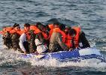
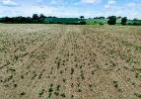
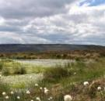
How to respond? Cut, cope, capture
Mitigation
Preventing the causes of climate change
Adaptation
Dealing with the consequences of climate change
Sequestration
Getting GHG out of the atmosphere
CUT
COPE
CAPTURE
Notes:
Knowing that our best case scenario today is akin to putting our children on a plane with a 1 in 3 chance of crashing. We don’t get to pick anymore. We must do all 3. Every project where we fail to cut emissions, adapt to climate risks and store carbon away from the atmosphere is a wasted chance to increase our odds of survival.
It really isn’t about choosing between whether we fancy choosing mitigation, adaptation OR sequestration action any more – we have to do all three akin to a war footing as if our lives and the lives of our children depend on it. Because they do.

Slide 5
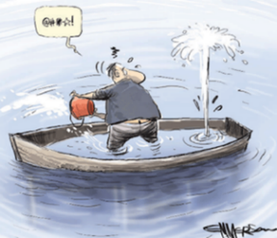
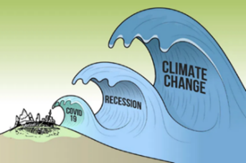
Why think about climate change adaptation today?
Not a problem for the future. Climate change is here, now and is only worsening
Compared to COVID we have a longer (but still narrow) window of time to prepare before the brunt of the climate crisis hits us
Transformational changes brought by the pandemic are an opportunity
To consciously PLAN our future considering climate change impacts and the need to achieve net zero - now
Proactive, precautionary, science-led action is vital
Systems underpinning modern life are already vulnerable (especially after austerity and the pandemic)
Impacts will be surprising
The billions being invested in the ‘Green Recovery’ are at risk from climate impacts if we overlook resilience
Notes:
It’s dangerous to think about the next black swan event in terms of the past, but there are lessons to learn from the last 20 months.
Proactive, precautionary, science-led action is vital
Responding reactively costs more, risks lives, causes unintended consequences, worsens inequalities,
Regulations insufficiently agile for emerging risks
Underlying vulnerabilities and risks of cascading failures
Systems underpinning modern life are already vulnerable (especially after austerity and the pandemic)
Systems are operating outwith conditions they were designed for – just because systems haven’t been overwhelmed in the past doesn’t mean they will be able to cope with the future
Impacts will be surprising:
Full range / breadth of impacts often not apparent until months later
Recovery may be protracted and uneven
Those already vulnerable likely to face worst impacts and have least ability to react
Easy to think that in a temperate, wealthy nation such as Scotland, with well developed infrastructure that we will be safe but humans suffer from a collective failure of imagination regarding new risks…

Slide 6
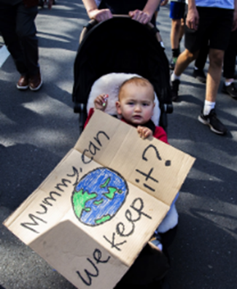
What was the response of TU in Scotland?
Moments of crisis offer us a chance to make big transformations
‘Normal’ wasn’t working for the majority so why go back?
COVID demonstrated that workplace protections were not sufficiently robust to protect workers against new fast paced threats
STUC and Unison Scotland decided to take advantage of this unique moment to:
Upskill TU reps to identify emerging climate risks and codesign adaptation solutions that protect Scotland’s workers
Ensure workers voices are heard
Ensure health, wellbeing, social justice and employment rights are at the heart of Scotland’s climate action
Handbook for TU reps available January 2022, training videos already available: https://www.adaptationscotland.org.uk/how-adapt/tools-and-resources/climate-risks-workplace-protecting-workers-changing-climate

Slide 7
Why should Trade Unionists care about adaptation?

Slide 8
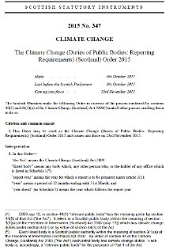
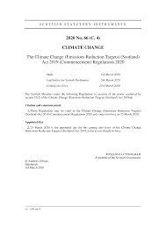
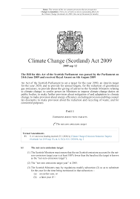
In Scotland many organisations are legally obligated to adapt
The Climate Change (Scotland) Act states:
“A public body must, in exercising its functions, act in the way best calculated to contribute to the delivery of:
emissions reduction targets (known as ‘mitigation’),
… any statutory climate change adaptation programme, and
in a way that it considers is most sustainable
Legal obligation to act under the Climate Change (Scotland) Act 2009, as amended 2015 and 2019
This is a statutory obligation - something all public bodies MUST do
Not an optional extra
Not something that would be ‘nice to have - if budgets allow’

Slide 9
Climate change is a health and safety issue
New pests and diseases such as:
reawakening of extinct pathogens, pandemics, mosquito borne infections
Rising temperatures:
heat-stress and fatigue leading to safety lapses, heatstroke, sunburn,
food poisoning and gastrointestinal infections, accidents, drowning,
electrical faults and electrocution, fire and wildfires,
negative impacts on productivity, chronic kidney failure linked to excessive sweating and dehydration during heavy outdoor work,
increasing ground-level ozone concentrations with adverse effects,
workers’ exposure to hazardous chemicals,
Air pollution already kills 7 million people a year:
asthma, dementia, respiratory infections, COVID-19
cardiovascular conditions (including COPD, lung cancer, strokes, heart disease),
Storms and flooding:
road accidents, trips and falls (ice), hypothermia, safety lapses,
more downtime (for example working from heights during high winds) could result in unsafe pressure on workers to rush delayed tasks

Slide 10
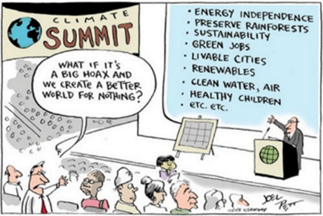
Adapting to climate change is social justice
Those who’ve done the least to cause climate change
Are the least able to address it,
AND face the worst impacts
Adaptation is not a question of jobs vs environment – we can protect BOTH
Adaptation will create decent, rewarding, permanent, local jobs
Move debate on from pointing the finger at climate ‘bad guys’
There is no job security in the hothouse earth scenario
IMPOSSIBLE to achieve ANY core TU goals (social justice, community revitalisation, health / wellbeing, poverty reduction) unless we adapt
Adaptation demonstrates international solidarity and intergenerational fairness
resource scarcity caused by climate change exacerbates conflict
Well-planned climate change adaptation brings a host of cobenefits

Slide 11
What do we know about climate risks today?

Slide 12
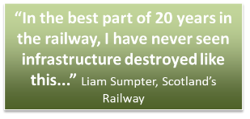
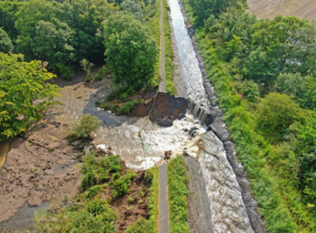
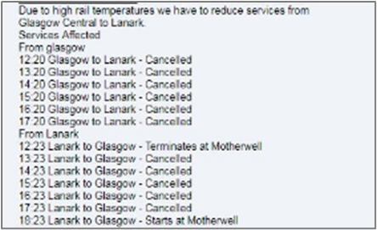
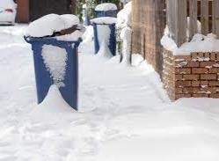
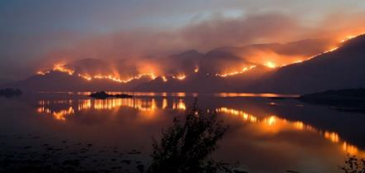
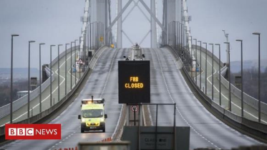
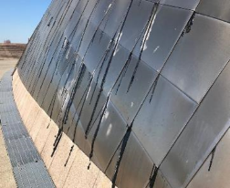
Climate change is already happening in Scotland
Record breaking extremes of all weather types
NOT just flooding
Impacts are starting to hurt
Cascading impacts can devastate communities for months, lives are being lost
Even brand new buildings or the latest infrastructure recently inspected can fail
“Climate change has arrived.”
Baroness Brown
Notes:
Contrary to popular belief – adapting to the unavoidable impacts of climate change is not just something for the Global South. Environment Agency chair Emma Howard Boyd was brief but to the point: “Adapt or die”.

Slide 13
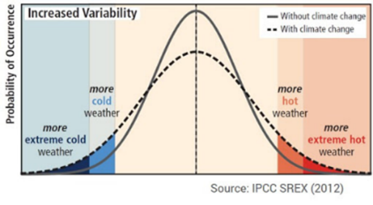
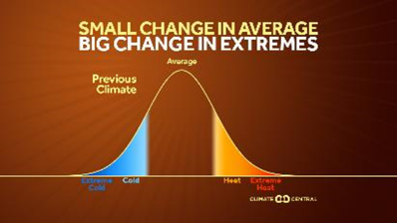
Climate projections are NOT predictions
There are many sources of uncertainty:
Models rely on educated guesses about people yet to be born using technologies not yet invented (not all will be right)
Intricate interactions between earth systems and human activity too complex to model perfectly; plus big modelling gaps
Climate change isn’t linear - we’re destabilising climate patterns. Weirding not warming – harder to model AND adapt to
Today’s observations are rewriting scientific understanding - we must use the precautionary principle
Models significantly underestimate warming
Unrealistic assumptions about deployment of negative emissions technologies
The future is going to be messy and surprising

Slide 14
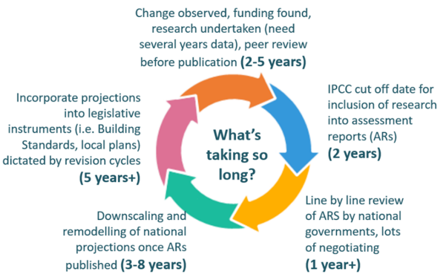
Meeting current legislation ≠ safety
According to UKCCRA3, UK:
“failing to keep pace with the worsening reality”
less well prepared now than 5 years ago
plans are inadequate to cope even with a 2°C temperature rise
has the resources to respond effectively, but it has not yet chosen to do so
Of the 61 climate change risks and opportunities identified for Scotland:
More action is needed now to address 33
Sustaining current action only deemed appropriate in 4 cases
Guidance and regulations lagging 13-20 years behind the science.
Notes:
Meeting current legislation and statutory instruments does not EQUAL safety. Regulations struggling to keep up with climate impacts. Seems very difficult to try to square the circle of slow review cycles with unexpected impacts that are rewriting scientific understanding. The CCC was scathing about UK policy on adaptation thus far – we have the resources to respond effectively but so far the UK has not yet chosen to do so

Slide 15
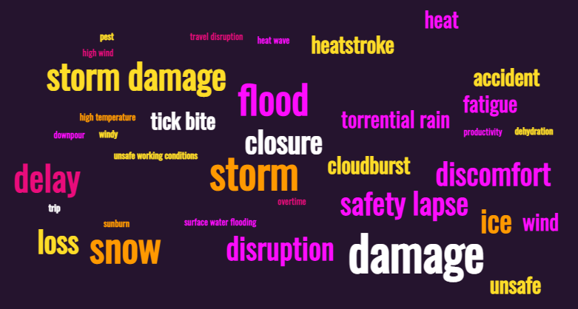
What workplace climate issues did TU reps tell us about?

Slide 16
How do TU reps feel that their workplace will cope?
After raising the matter for years we now have outdoor trousers, jackets and boots that are freezing … poorly fitted … and aren't suitable for the winter
Only 16.7% felt that their workplace was sufficiently resilient to weather-related risks
72% said climate impacts were happening more frequently and / or had more severe effects on their workplace and workers
Unpredictable weather patterns are impacting negatively on planned activities and events. It’s hard to plan
We have carers walking between clients in knee deep snow wearing only canvas shoes because they can’t afford winter boots, let alone a car
Railway is frequently disrupted by extreme weather events … causing delays, late running, enforced overtime, angry passengers, cancelled services, overcrowding…
The Beast from the East closed all of our buildings. We just couldn’t cope
Weather affecting trains is reported to staff so they can leave early
In the heatwave of 2018 a local substation failed in the heat – the fire alarms were triggered and we all had to go home

Slide 17
Climate risk and adaptation basics
If adaptation is about becoming more resilient where to start?

Slide 18
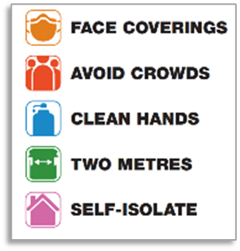
What is adaptation planning?
“A process of adjustment to the impacts of climate change, including actions taken to reduce the negative impacts of climate change, or to take advantage of emerging opportunities”.
Adaptation is not just about averting disaster - timely, well planned, adaptation could deliver a better world
Think about what other problems adaptation action could help to solve.
Needs outcome based thinking – what do we want to achieve?
Adaptation action takes many different forms:
Building design and retrofit
Place making and planning policy
Land management and landscaping
Soft adaptation – changes to policy, PPE, behaviour change
Adaptation planning must be undertaken at a range of scales:
Households, organisations, towns, regions and whole sectors
Notes:
Generally, in today’s interconnected world good resilience is relatively invisible until something fails. Most of us struggle to visualise what good resilience and adaptation action looks like.

Slide 19
How to identify potential climate risks in the workplace
Toolbox talks / gather observations
From frontline staff, contacts from upstream and downstream
Site walkabouts (similar to a fire safety audit) think about how buildings, sites and activities could be impacted by droughts, temperature extremes, storms, flooding, transport and supply chain disruption, loss of utilities and extreme winter conditions.
Is there a mis-match between critical activities and vulnerable site location (i.e. pharmacy or servers in a basement would be at risk of flooding) and
Are there other factors which might compound risks (i.e. buildings without openable windows)
Are there parts of the site having problems already?
Establish a working group i.e. to liaise with facilities management, business continuity, risk management and workplace health / wellbeing practitioners
Near miss reporting and instances of ‘we were lucky that time’
Identify pinch points
Where is there rationalisation or JIT delivery in essential systems, stock storage and supply chains
Build the evidence base for action keep a record of downtime, staff absences, damage and insurance claims, and other costs of climate events
Watch the news for impacts on similar organisations (for sectoral issues that might affect yours in the future) and impacts on properties nearby (for risks based on location)

Slide 20
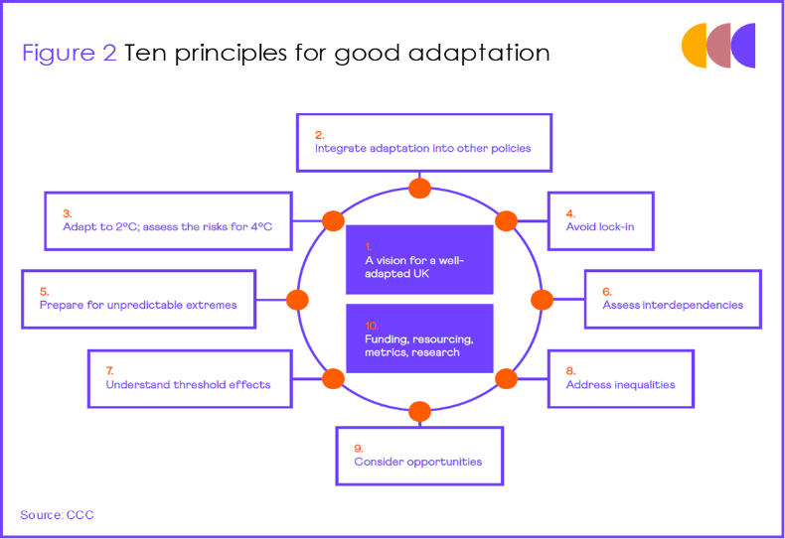
UKCCRA3 Ten principles of good adaptation

Slide 21
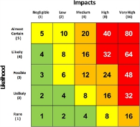
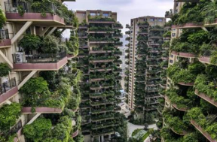
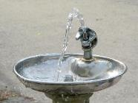
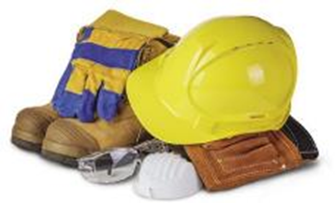
Basics of good adaptation
Common sense NOT rocket science
Not one size fits all – location specific, industry specific, individual specific
Difficult to retrofit
Go for win-wins
Flexible solutions that can cope with a range of different climate extremes
Choose solutions which help tackle other problems too
Avoid adaptation choices that increase GHG emissions
Systems should fail to safety not fail to risk
Redundancy / spare capacity in supply chains, infrastructure etc
Develop contingency plans (and supplies) BEFORE problems arise
Involve upstream / downstream bodies in emergency preparedness exercises
Learn from experience, solutions need to evolve:
Evaluate adaptation actions to see how they fared. What could be improved?
Be led by the science and use weather warnings
Precautionary principle - build in lots of ‘headroom’ - assume the reasonable worst case
Don’t assume that supporting infrastructure can’t fail just because it has coped before

Slide 22
What does good look like?
Examples of adaptation solutions for different workplace settings…

Slide 23
Resilience for workers who travel
Involve staff in regular business continuity exercises
Climate is changing fast, workplace protections need to be reviewed regularly
Use weather data to plan
PPE / uniform that reflects seasonal extremes
Longer rest breaks
Build more downtime into travel schedules
Alternative travel plans including options to safely extract workers
Provide emergency travel kit including communications equipment (phone or radio)
Business continuity plans for extremes
Climate risk assessment
Feedback mechanism for remote or travelling staff to report risks observed on the frontline
Threshold triggers for suspending travel
Prohibit solo working in extreme conditions
Update work statements to consider reasonable worst case

Slide 24
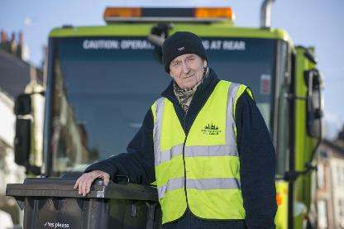
Resilience for outdoor workers
Locate welfare facilities in most resilient spot (heat, cold, flood, storm risks)
PPE that reflects seasonal extremes
Improved welfare facilities – cold water, shading, sunscreen, cool rooms, heating as needed
Look at work practices with a new eye and an open mind –impacts will be surprising
No blame site culture - empower workers to speak out about safety
Emergency comms for staff i.e. storm warnings to trigger site closure or halting activities
Capture weather data in accident & downtime reporting
Changes to shift patterns to avoid extremes
Longer rest breaks
Changes to work statements & emergency plans for extremes
Weather related contract terms
Build more downtime into construction schedules /

Slide 25
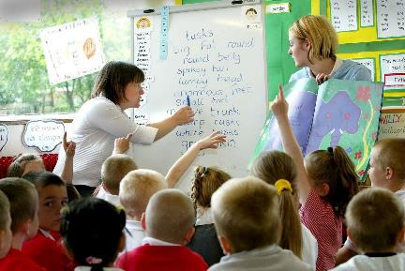
Resilience for indoor workers
Windows that open / other means of natural ventilation
Chilled storage for food
Emergency comms for staff i.e. storm warnings
Workers able to control workplace temperature
Hot & cold drinks
Site most critical activities in least vulnerable location
Sustainable resilience options that don’t increase GHG emissions
Record climate risk near misses & down time
Blinds to reduce glare
Passive solar design to plan out activities (i.e. north facing rooms for ‘hot’ activities)
Green shading to reduce overheating
Well maintained, heavy-weight, insulated buildings
PPE
Avoid JIT delivery
Home working options
Back up systems / spare capacity in supply chain
Maximum & minimum working temperatures for activities
Notes:
maximise win-wins, reflects local needs and gets buy-in, and allows multiple risks / resilience options to be considered together
On every project there are opportunities to deliver massive cobenefits for local people and the environment –

Slide 26
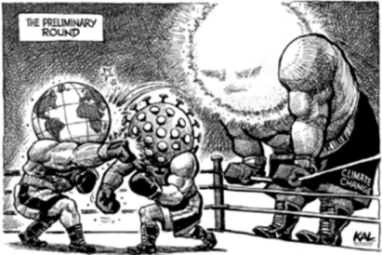
What can we learn from the pandemic?
Proactive, precautionary, science-led action is vital
Humans have collective failure of imagination regarding risks / unexpected consequences
Responding reactively costs more, risks lives, causes unintended consequences, worsens inequalities,
Regulations insufficiently agile for emerging risks
Distant events can have big impacts
Systems underpinning modern life are more vulnerable than we’d like to think
Especially after austerity
Systems are operating outwith conditions they were designed for
Infrastructure failures to be expected
Impacts will be surprising:
Full range / breadth of impacts often not apparent until months later
Recovery may be protracted and uneven
Low paid and front line workers most at risk
Notes:
maximise win-wins, reflects local needs and gets buy-in, and allows multiple risks / resilience options to be considered together
On every project there are opportunities to deliver massive cobenefits for local people and the environment –

Slide 27
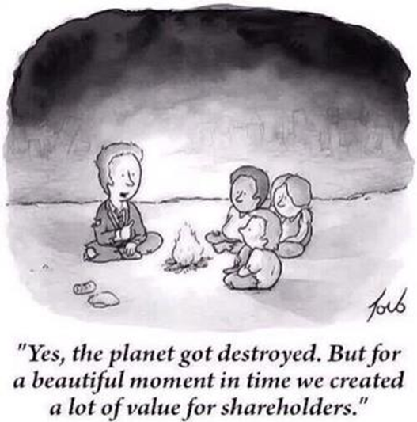
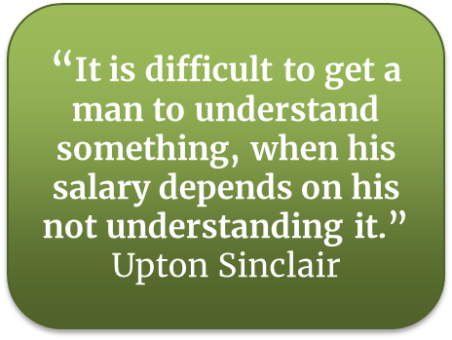
Take homes – we need to do things differently, starting today
Climate change is not a problem for the future, the window for action is now and it is fast closing
Climate change impacts will dwarf the deaths and damages from COVID19
BAU will compound the problem - not deliver solutions
Tinkering around the edges is not going to fix this
Climate change demands action from ALL of us (not just dedicated champions)
We must all adapt to climate risks, store carbon and cut emissions
We’ve lost the surety of a stable climate – but we can’t wait for certainty before we act
We need to think flexibly and assume the reasonable worst case
Ask challenging questions and go beyond the legal minimums
Climate change is the biggest social justice and health and safety issue
We need to stop polarising environment vs jobs and collaborate compassionately to help all workers flourish
there is no job security on the hot house earth scenario
Notes:
maximise win-wins, reflects local needs and gets buy-in, and allows multiple risks / resilience options to be considered together
On every project there are opportunities to deliver massive cobenefits for local people and the environment –

Slide 28
Further information
Adaptation Scotland Scotland’s national climate risk and adaptation programme
https://adaptationscotland.org.uk/how-adapt/tools-and-resources
Climate Just compendium of adaptation resources focusing on social justice impacts
https://www.climatejust.org.uk/resources
Scotland’s Climate Assembly Recommendations for Government report from the people’s panel
https://www.climateassembly.scot/full-report
UN 1.5C Special Report summarises the latest climate science and risks of runaway warming
https://www.ipcc.ch/sr15/download/
UKCCRA3 Independent Assessment of UK Climate Risk: Advice to Government
https://www.theccc.org.uk/wp-content/uploads/2021/07/Independent-Assessment-of-UK-Climate-Risk-Advice-to-Govt-for-CCRA3-CCC.pdf
UKCCRA3 Evidence Report for Scotland Summary, Climate Change Committee
https://www.ukclimaterisk.org/wp-content/uploads/2021/06/CCRA-Evidence-Report-Scotland-Summary-Final.pdf
EPSU Public Services and Adaptation to Climate Change https://www.epsu.org/sites/default/files/article/files/2_EPSU%20Public%20services%20and%20adaptation%20to%20climate%20change%20for%20reading.pdf
Scottish Climate Change Adaptation Programme (SCCAP) Scottish adaptation action being undertaken 2019-24 by the Scottish Government & partners https://www.gov.scot/publications/climate-ready-scotland-second-scottish-climate-change-adaptation-programme-2019-2024/
New UKCP18 climate projections for Scotland summary https://www.adaptationscotland.org.uk/news-events/stories/new-climate-projections-summary-scotland
Welsh TUC Greener Workplaces for a Just Transition https://www.tuc.org.uk/sites/default/files/2021-02/Greener%20Workplaces%20-%20English%20Version_0.pdf
Our handbook for identifying climate hazards in the workplace and developing socially just adaptation options will be released in January 2022 – we’ll keep you posted!

Slide 29
^{cat@sniffer.org.uk}

