Slide 1
Wales’ Climate
Adaptation Plan
Michelle Delafield, Welsh Government

Slide 2
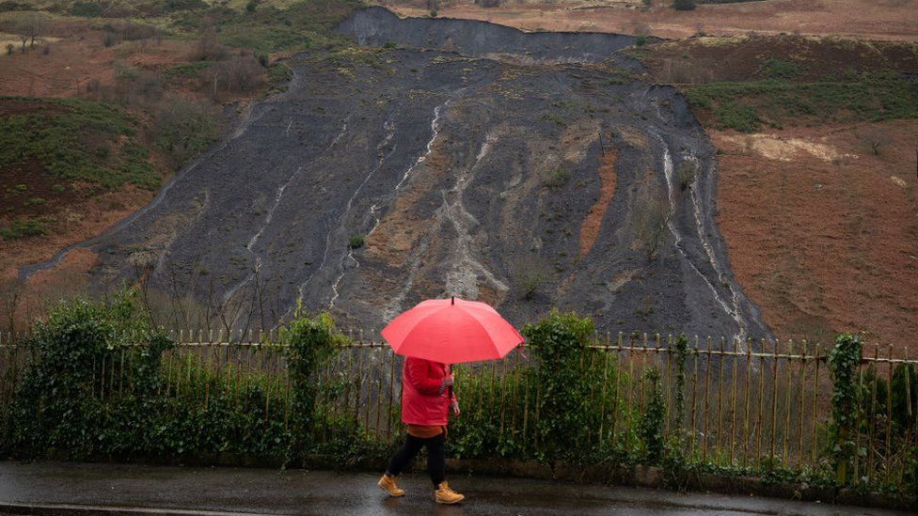
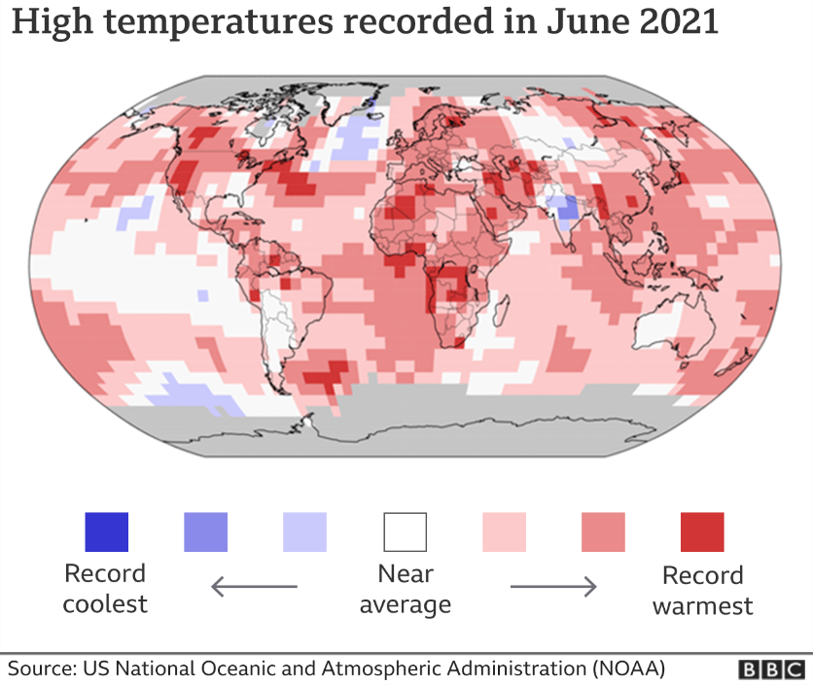
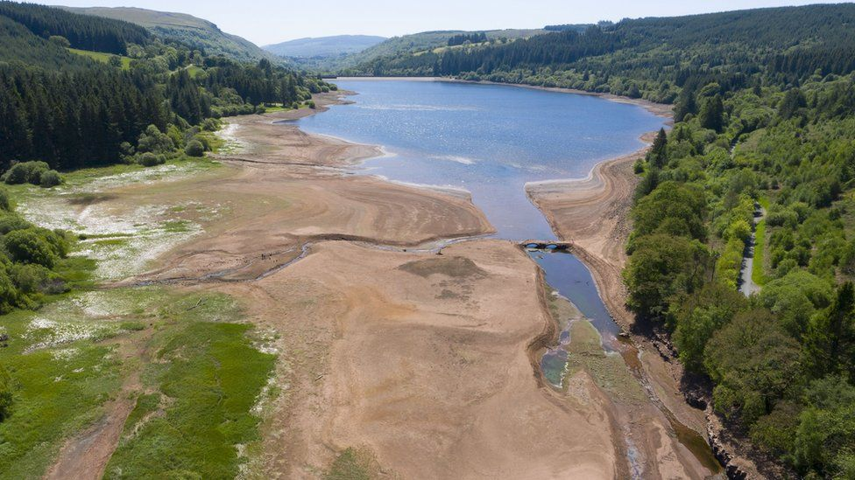
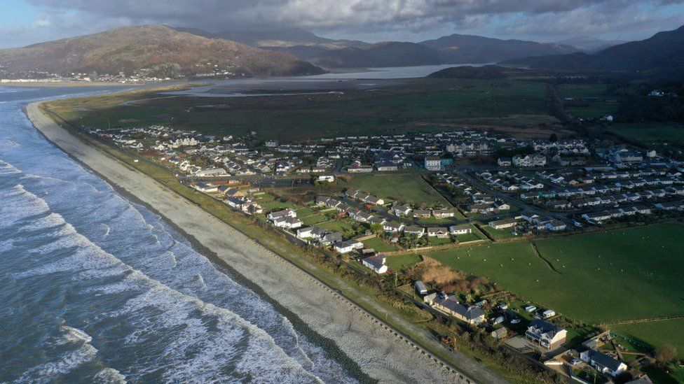
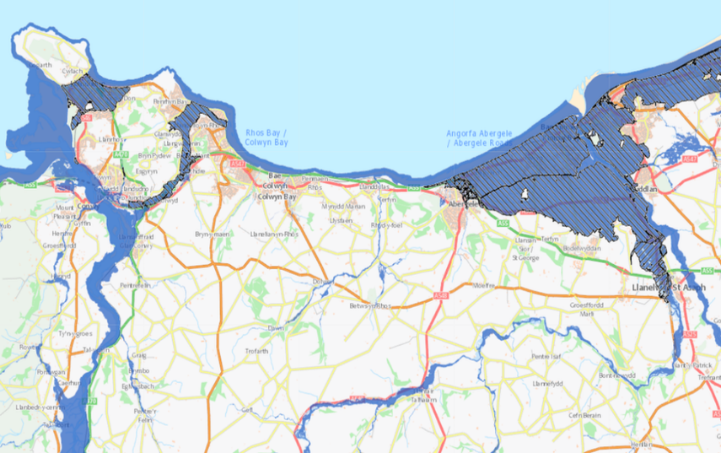
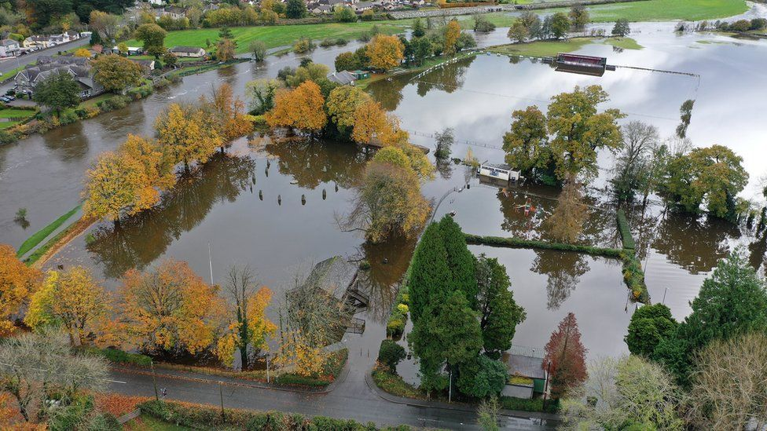
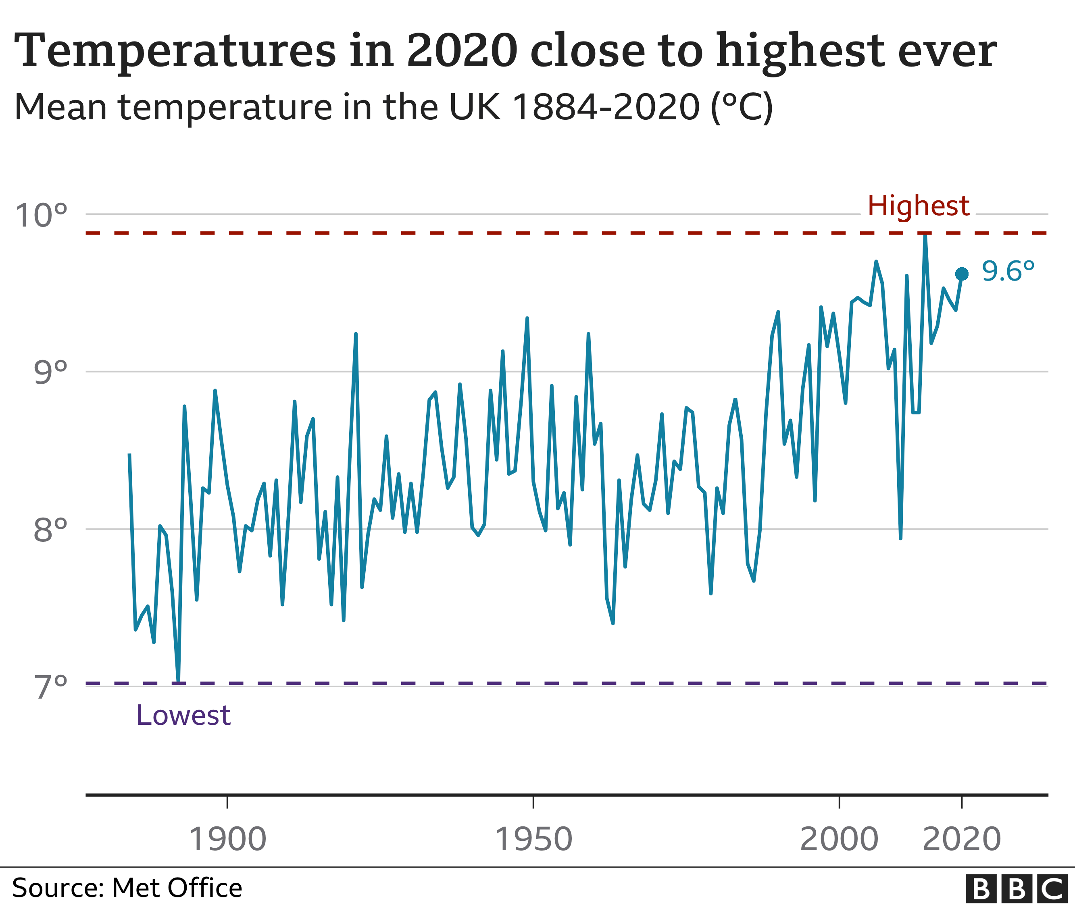

Slide 3
Policy framework
Climate Change Act 2008 (Part IV)
Environment (Wales) Act 2016 , WFG Act 2015, Paris Agreement 2016
Current 5 year plan – Prosperity for All: A Climate Conscious Wales
Reviewing WG policy vs 3rd Climate Risk Independent Assessment

Slide 4
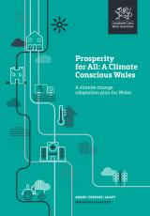
‘Prosperity for All:
A Climate Conscious Wales’
Strategic Actions
Adaptive Nature & the Rural Economy
Protecting our Coasts and Seas
Staying Healthy
Safe Homes and Places
Caring for the Historic Environment
Successful Businesses
Resilient Infrastructure and Transport
https://gov.wales/prosperity-all-climate-conscious-wales

Slide 5
‘Prosperity for All:
A Climate Conscious Wales’
Examples:
Policies
Natural Resources Policy
Sustainable Farming Scheme
River Basin Management Plans
National Flood and Coastal Erosion Management strategy
Water Resource Management Plans
National Development Framework
Building Regs update –ventilation
Research
Heat – risks to public health and wellbeing
Links with air quality and health
Vector-borne pathogens
Business risks – heat & infrastructure disruption (power, digital, transport etc)

Slide 6
Business risk perceptions
– heat and infrastructure disruption
Evidence report Sept 2020 - ‘Businesses’ perceptions of risk of reduced employee productivity due to higher working temperatures and infrastructure disruption in working environments’
https://gov.wales/business-perceptions-risks-due-heat-related-climate-change
Level of action - 32% climate risk assessments - 11% adaptation plans – 54% interested
Risk perception - 4% high risk from higher working temperatures – 5% infrastructure disruption.
Barriers & drivers - information & guidance – funding & resources
Welsh Government - follow-up – new policy measures & support to businesses

Slide 7
HSE advice
HSW Act / Management of Health & Safety Regs – risk mitigation – including risks from a changing climate
Workplace (Health, Safety and Welfare) Regs - workplace temperature
Guidance on thermal comfort / working outdoors – hse.gov.uk
Industry-led risk assessment
Risks can be location specific
Worker involvement to understand issues

Slide 8
CCC Climate Risk Advice
3rd Climate Risk Independent Assessment – June 2021
5-yearly statutory advice to Government
Informs UK Gov Climate Change Risk Assessment (CCRA) & National adaptation programmes
61 risks & opportunities across sectors - Risks have increased - Widening gap between level of risk and planning / action
Huge benefits in acting & acting later will cost more
8 Priority Areas for next 2 years - 10 ‘Principles for Good Adaptation’
Welsh Government – reviewing policies & strategic approach

Slide 9
Thank you!

