Slide 1
HEALTH AND SAFETY REPS
KEEPING MEMBERS SAFE
BEFORE, DURING AND
BEYOND THE PANDEMIC

Slide 2

Safety Reps and Covid
Research into Covid-19 workplace safety outcomes in the food and drinks sector
University of Greenwich for the TUC
‘One of the most important roles played by unions is in monitoring risk amongst members and non-members, ensuring compliance with regulations and overcoming resistance or what one respondent called ‘a culture of denial’
https://www.tuc.org.uk/research-analysis/reports/research-covid-19-workplace-safety-outcomes-food-and-drinks-sector

Slide 3
Findings on safety reps
Workers in workplaces with a union health and safety rep were more likely to feel that they were consulted over Covid related health and safety issues.
Where there were union health and safety reps, 66% of workers said that risk assessments had been carried out, compared with only 43% where there were no health and safety reps
Line managers endorsed this finding even more emphatically – 85% stating that risk assessments had been shared with workers in unionised settings compared with 46% in nonunion contexts
Workers in workplaces with union health and safety reps were significantly more likely to report sufficient PPE (73% versus 53% of those with no health and safety rep)

Slide 4
Why union safety reps work
Communication:
  Listening to members’ concerns
  Feedback to management on effectiveness of controls
Knowledge and experience of trained reps
Networking on good practice with reps in other employers
Backing of officials and union guidance

Slide 5
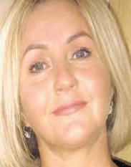
Reps making a difference
Tracy Honeyman, Tesco call centre rep
MSD: quick transition from office to home working at the start of the pandemic, lots of staff were sitting at makeshift workspaces and the risk became significant. Staff are now encouraged to take frequent short breaks when they’re working at their desks. This is having a massive impact on the physical and mental wellbeing of hundreds of our staff.
Ventilation: the company has replaced the air-conditioning systems in mailroom and gym with a new state of the art system that pulls in the maximum amount of fresh air

Slide 6
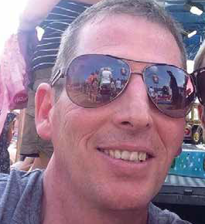
Reps making a difference
Richard Waters, Next distribution
We locked down on the Thursday and I got a phone call on the Tuesday asking me if I would be prepared to come back in and help management to reshape the warehouse to make social distancing possible.
Next wanted to have union input on the alterations they were planning to make. So a team of six of us set to work reorganising the warehouse from top to bottom. It was quite difficult to be honest, warehouses aren’t built for social distancing, they’re built for productivity. We had to move all the walkways and install a one-way system.

Slide 7
Safety Reps – What’s Next
Managing return to work
Making sure risk assessments are in place
Protecting vulnerable workers
Dealing with issues around workplace testing and isolation of potentially infected workers
Mental health and work-related stress

Slide 8
And the future?
Keeping health and safety at the centre of the organising agenda.
Tackling the big occupational health and safety issues – stress, MSDs, slips and trips, vehicle accidents, hazardous substances, air pollution, climate change.

