Slide 1
Workers challenging bad air at/from work
May, 2021
Janet Newsham – janet@gmhazards.org.uk / 07734 317158

Slide 3
Air quality, Covid-19 and RA
Workers are exposed to a toxic cocktail of chemicals in their homes, environment and in their workplaces
Those who live in the poorest areas, work in the lowest paid jobs are more exposed
Air pollution is an equality issue
30,000 deaths annually
?workers made ill every year
Ventilation – will better ventilation for Covid-19 make it better for workers working in polluted air?
TUCAN Guidance and the charter – How can we raise the debate?

Slide 6
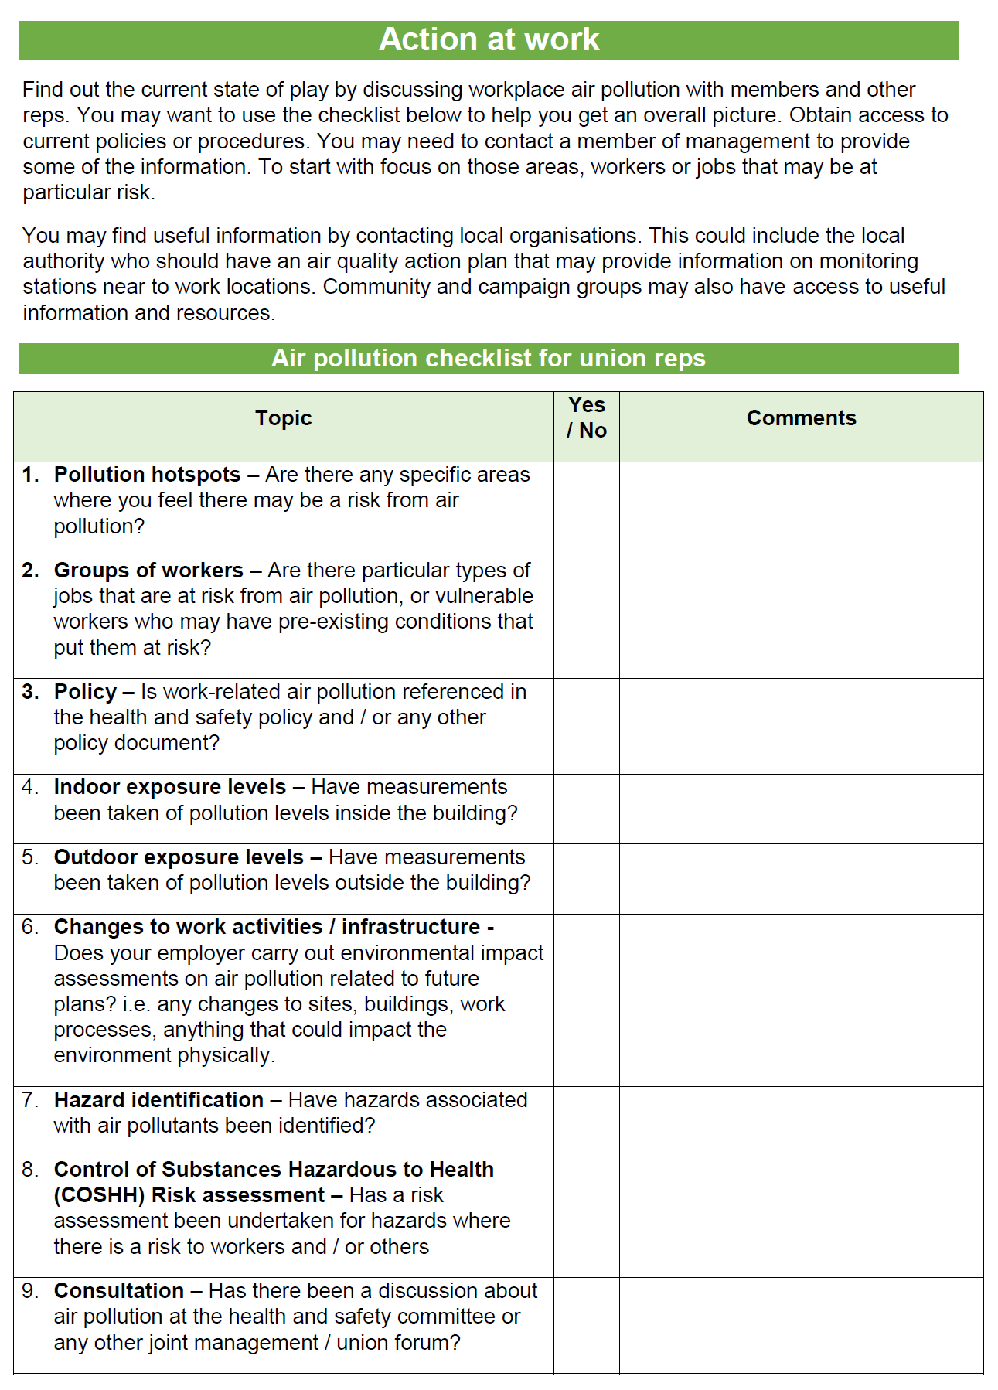
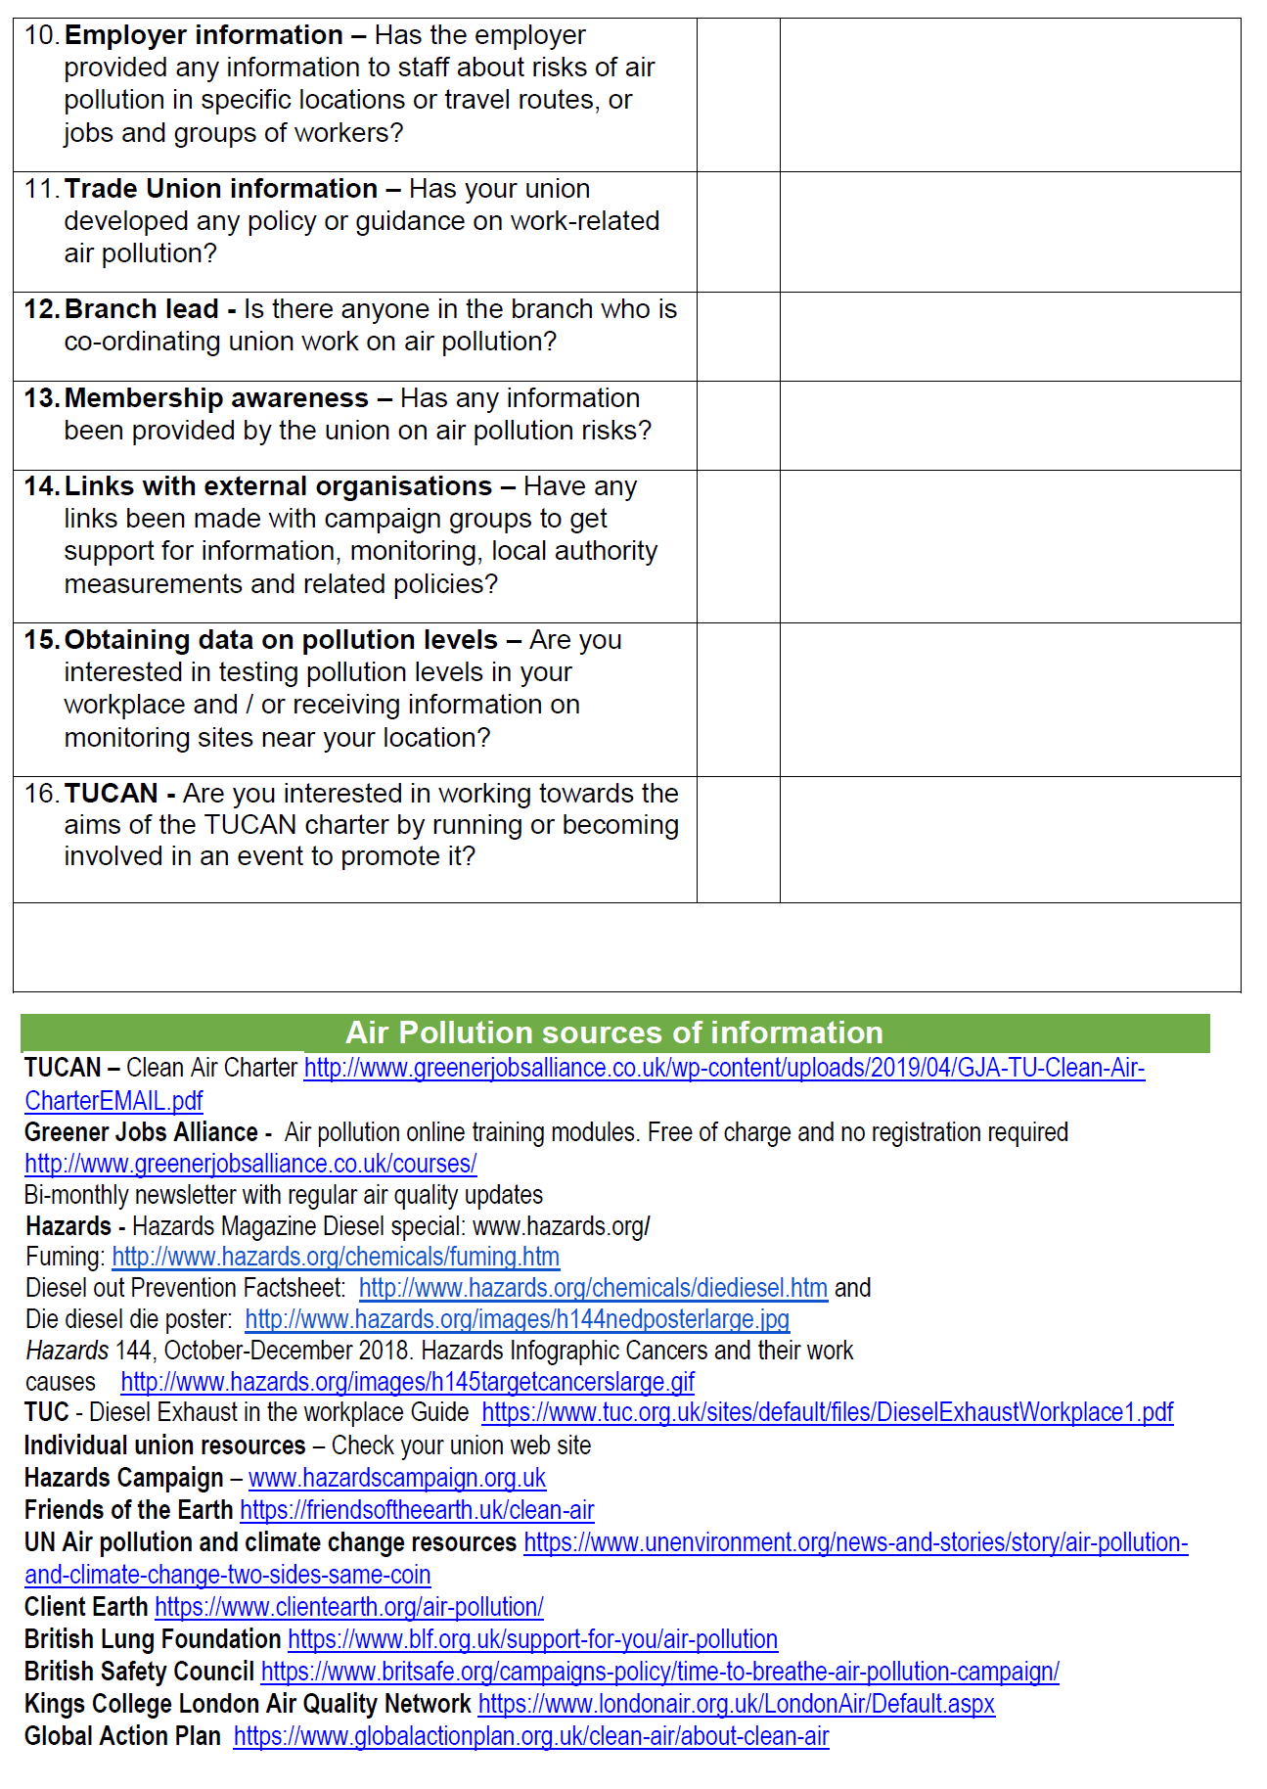
Contact us for support to use monitor for PM2.5 Working with Global Action Plan

Slide 7
