Slide 1
Nature/Natur - 2
TUC Cymru Wellbeing sessions

Slide 2
Nature/ Natur – 2
This session will look at:
The wonder of nature
Perspective
Zooming in and out
Micro-details and scanning the horizons

Slide 3
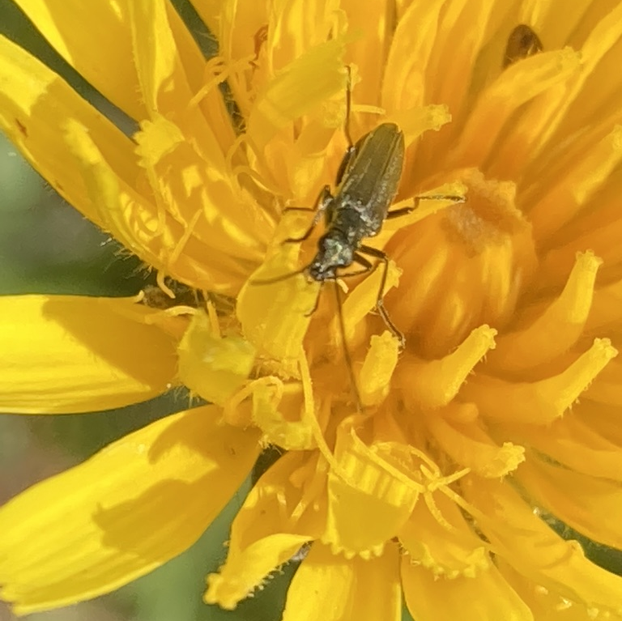
Nature/Natur – 2
What can you see in this picture?

Slide 4
Nature/Natur – 2

Slide 5
Nature/Natur – 2
Looking at a broader perspective; loooking distant is really different from a closer ‘micro’ inspection

Slide 6
Nature/ Natur – 2

Slide 7
Nature/ Natur – 2

Slide 8
Nature/Natur - 2
These web-sites will help with your thinking.
https://www.takingcharge.csh.umn.edu/how-does-nature-impact-our-wellbeing
https://www.bupa.co.uk/newsroom/ourviews/nature-wellbeing
https://www.nature.com/articles/s41598-019-44097-3
https://theguardian.com/environment/2020/may/30/nature-on-uk-doorstep

