Slide 1
Gweithwyr BME yng Nghymru
3 Gorffennaf 2020
BME workers in Wales
3 July 2020
Nisreen Mansour

Slide 2
  Ble mae gweithwyr BME yng Nghymru?
  Anghydraddoldeb, gwahaniaethu, gwaharddiad?
  Gweithwyr BME ac undebau llafur
  Where are BME workers in Wales?
  Inequality, discrimination, exclusion?
  BME workers and trade unions

Slide 3
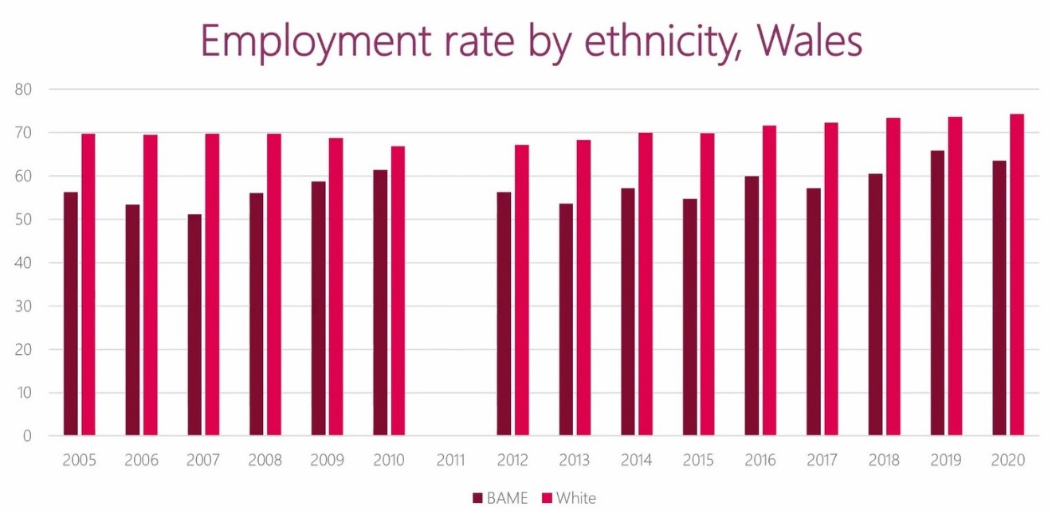
Cyfradd cyflogaeth yn ôl ethnigrwydd,
Cymru
Employment rate by ethnicity,
Wales

Slide 4
Cyflogaeth yn ôl galwedigaeth ac ethnigrwydd, DU
Employment by occupation and ethnicity, UK
 | All | Asian | Indian | Pakistani, Bangladeshi | Asian Other | Black | Mixed | White | White British | White Other | Other
Occupation | % | % | % | % | % | % | % | % | % | % | %
Managers, Directors and Senior Officials | 11 | 10 | 11 | 8 | 9 | 5 | 9 | 11 | 11 | 10 | 10
Professional | 21 | 27 | 33 | 18 | 29 | 21 | 23 | 20 | 20 | 21 | 21
Associate Professional and Technical | 15 | 12 | 14 | 10 | 11 | 12 | 19 | 15 | 15 | 13 | 12
Administrative and Secretarial | 10 | 9 | 9 | 8 | 9 | 9 | 9 | 10 | 11 | 8 | 7
Skilled Trades | 10 | 6 | 5 | 7 | 6 | 6 | 6 | 11 | 11 | 10 | 10
Caring, Leisure and Other Service | 9 | 8 | 7 | 8 | 9 | 18 | 9 | 9 | 9 | 7 | 9
Sales and Customer Service | 8 | 10 | 7 | 14 | 9 | 7 | 9 | 7 | 8 | 5 | 7
Process, Plant and Machine Operatives | 6 | 9 | 5 | 15 | 5 | 7 | 5 | 6 | 6 | 10 | 8
Elementary | 10 | 11 | 9 | 12 | 12 | 16 | 12 | 10 | 10 | 15 | 15

Slide 5
Cyflogaeth yn ôl diwydiant ac ethnigrwydd, DU
Employment by industry and ethnicity, UK
 | All | Asian | Indian | Pakistani, Bangladeshi | Asian Other | Black | Mixed | White | White British | White Other | Other
Industry | % | % | % | % | % | % | % | % | % | % | %
Agriculture, forestry and fishing | 1.1 | 0.1 | ? | ? | ? | ? | ? | 1.2 | 1.3 | 0.8 | 0.3
Banking and finance | 17.5 | 18.1 | 20.5 | 14.6 | 19 | 16.7 | 20.1 | 17.4 | 17.1 | 19.5 | 20.9
Construction | 7.2 | 3 | 3.8 | 2.5 | 2.3 | 4 | 4.1 | 7.7 | 7.7 | 7.6 | 5.1
Distribution, hotels and restaurants | 18.2 | 24.2 | 18.6 | 30.7 | 24.7 | 14.9 | 20.4 | 17.8 | 17.5 | 19.9 | 23.7
Energy and water | 1.7 | 0.7 | 0.8 | 0.6 | 0.7 | 0.9 | 0.7 | 1.9 | 2 | 1.3 | 1.1
Manufacturing | 9 | 6.1 | 8 | 4.6 | 4.7 | 4.6 | 7.5 | 9.5 | 9.2 | 11.4 | 6.9
Other services | 6 | 4.3 | 3.7 | 4 | 5.6 | 5.5 | 8.6 | 6 | 6.1 | 5.6 | 7.2
Public admin, education and health | 30.2 | 27.5 | 26.8 | 25.2 | 31.7 | 43.6 | 28.3 | 30.1 | 31 | 22.6 | 22.5
Transport and communication | 9.1 | 16.1 | 17.7 | 17.8 | 11.1 | 9.7 | 10.3 | 8.4 | 8.1 | 11.3 | 12.4

Slide 6
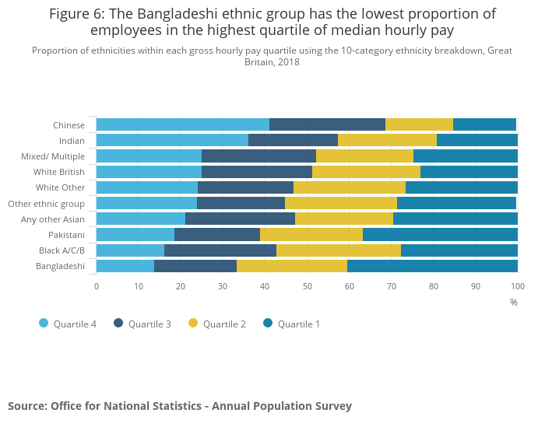
Ethnigrwydd a chyflog isel
Ethnicity and low pay

Slide 7
Croesdoriadaeth
Intersectionality

Slide 8
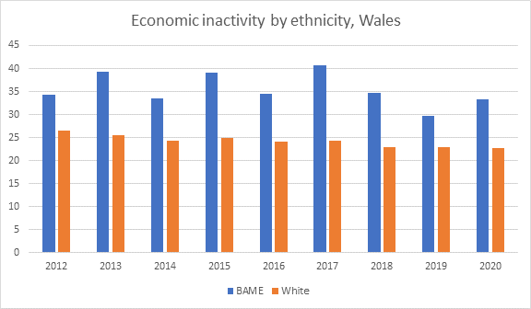
Mae'r cysylltiadau â thlodi yn gymhleth ...
The links with poverty are complex…
  Diweithdra ac anweithgarwch economaidd
  Gwaith ansicr
  Tlodi – darlun dryslyd, ond mae gwaith yn allweddol
  Unemployment and economic inactivity
  Insecure work
  Poverty – a confusing picture, but work is key

Slide 9
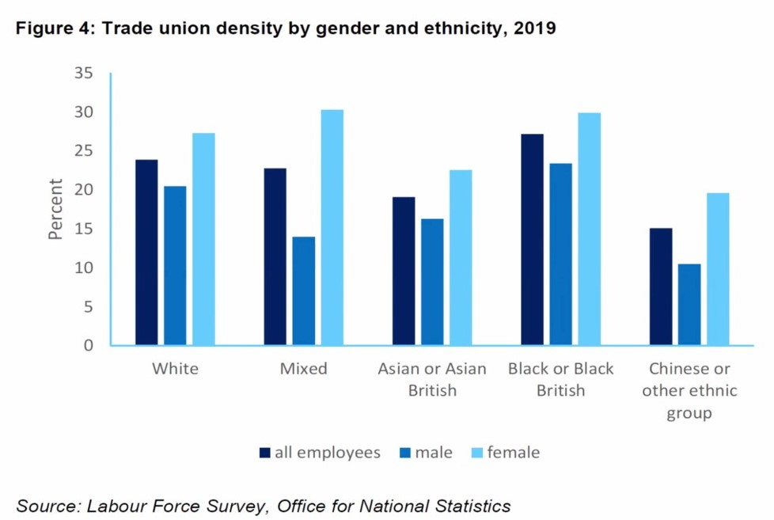
Ethnigrwydd ac aelodaeth o undeb llafur
Ethnicity and trade union membership

Slide 10
Rhywfaint o'n gwaith diweddar
Some of our recent work
  COVID-19 Canllaw ar gyfer gweithwyr BME
  Arolwg
  Partneriaeth gymdeithasol
  COVID-19 guide for BME workers
  Survey
  Social partnership

