Slide 1
How to have a good organising conversation.
Rohan Kon (BFAWU / Sheffield Needs A Pay Rise organiser)
Stuart McMillan (Yorkshire TUC workers’ patrol volunteer)

Slide 2
3 ways to participate
Ask questions and vote for your favourite – links below this presentation
Answer the polls – link below this presentation
Comment and chat – click on ‘Say something nice’ (bottom-right)

Slide 3
Session outline
Introduction: what is an organising conversation and why are they so important?
Structure of an organising conversation
Dos and Don’ts
Vision: Sheffield Needs A Pay Rise
Handling objections
Roleplay example
Q&A

Slide 4
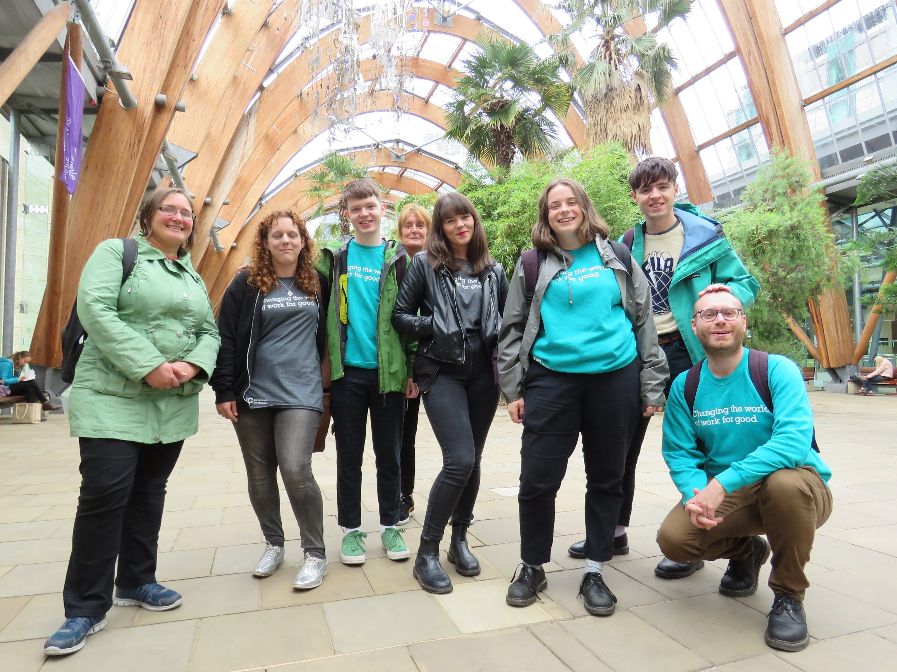


Sheffield Needs A Pay Rise

Slide 5
Dos and Don’ts
Do
Learn about the worker beforehand
Schedule a time (30-60 minutes)
Go with a specific aim or ask(s)
Have a clear plan and structure
  Anticipate possible concerns
Share your personal experiences and motivations
Ask difficult questions which might make you both a bit uncomfortable
Practice, practice, practice (& reflect!)
Don’t
Talk at the worker, rather than listen and ask open questions
Skip their stories to ‘get to the point’
Treat the union as a transactional solution or service provider
Introduce convenient “white lies” to avoid discomfort
End without clear next steps
Beat yourself up if it doesn’t go perfectly!

Slide 6
Structure of a good organising conversation
Introductions: Establishing trust, building a relationship
Issues and agitation: Raising workers’ expectations
  “If you could change any three things at work tomorrow, what would they be?”
  70/30 listening/talking, open questions
Vision: Education and urgency
  Building collective power as the only solution
  Examples from other campaigns
What you’re up against: Inoculating/vaccinating with the bosses’ poison
Call the question: framing the hard choice
  Plan to win
  Assignments / next steps

Slide 7
15 agitational questions for your back pocket
Can you live on what they pay you?
Do you work hard?
Who does all the work at your store?
Who makes all the money?
Do you think [company] can afford to pay you [X]?
What could you do with [X]?
Why don’t they pay you more?
Do you think the owner of [company] lives like you do?
Where would this company be without you and your co-workers?
When did you get your last raise?
How do you think you’re going to get your next raise?
Do you deserve to be treated like this?
How much money do you think this company makes off your back?
Have you ever done anything to try and change it?
What would happen if you and your co-workers decided to stopped working [X]?

Slide 8
Structure of a good organising conversation
Introductions: Establishing trust, building a relationship
Issues and agitation: Raising workers’ expectations
  “If you could change any three things at work tomorrow, what would they be?”
  70/30 listening/talking, open questions
Vision: Education and urgency
  Building collective power as the only solution
  Examples from other campaigns
What you’re up against: Inoculating/vaccinating with the bosses’ poison
Call the question: framing the hard choice
  Plan to win
  Assignments / next steps

Slide 9
Handling objections: AAR
Acknowledge
  Affirm their feelings
Answer
  Answer the question directly, concisely and honestly
Redirect
  Ask question(s) to guide the conversation back to organising.

Slide 10
Heartunions week
10 to 16 February 2020
A week of activity throughout England and Wales that highlights the good work that unions do every day to offer everyone a voice at work.
This year unions are fighting to end sexual harassment at work.
https://www.tuc.org.uk/heartunions

