Slide 1
Wales TUC Campaigns 2014
Living Wage Week 2014

Slide 2
Why we campaign
Our priorities on the agenda
Jobs, Growth & New Economy
Good Public Services & Welfare
Voice at work
Living Wage & Fair Pay
Stronger Unions

Slide 3
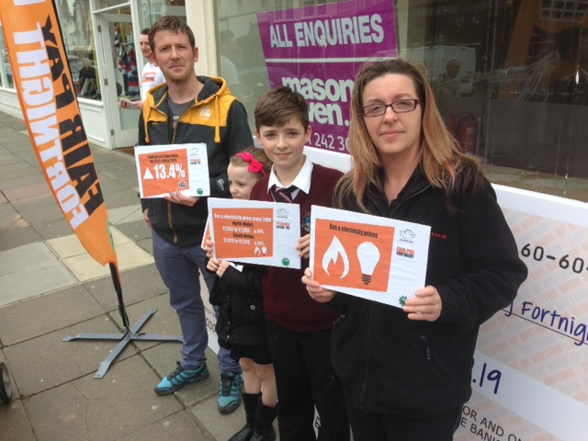
Fair Pay fortnight
Fair Pay Fortnight formed part of the “Britain Needs A Pay Rise” campaign. For two weeks the Wales TUC sought to highlight the squeeze in living standards for people in the UK. The cost of energy, food and housing is soaring but pay is not keeping up. On average real wages are £2,000 lower now than in 2010 and many people are trapped in low-paid and insecure jobs. During the two weeks we released new analysis of regional pay inequality and hosted a panel event in Cardiff Bay. Bryony Hamblin, 21, a supermarket worker from the Rhondda valleys, spoke at the event and gave powerful testimony to the plight of many young workers

Slide 4
#OurWelshNHS
Joint WTUC statement
NHS 66th Anniversary
Case studies
Sara’s story: (Walesonline)
A COURAGEOUS 24-yearold who dropped to just 5st in weight after suffering from a severe form of anorexia says she would have died if it had not been for the dedication of doctors and nurses.
She added: "I don't think I will ever be free of my anorexia but I have learnt to keep it under control. I know the NHS will be there if I relapse."

Slide 5
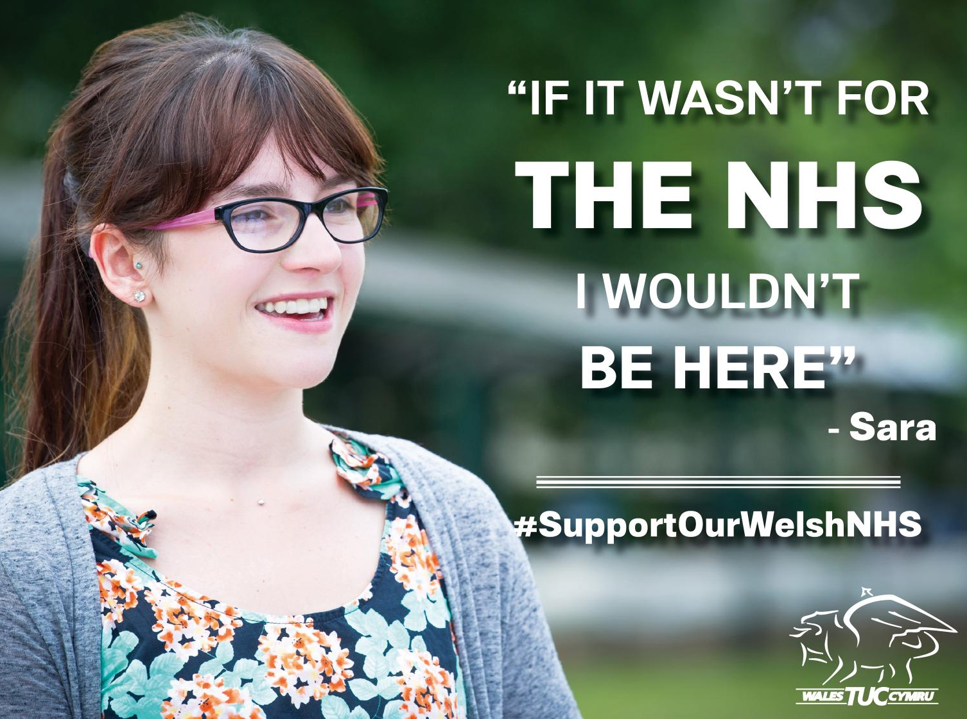

Slide 6
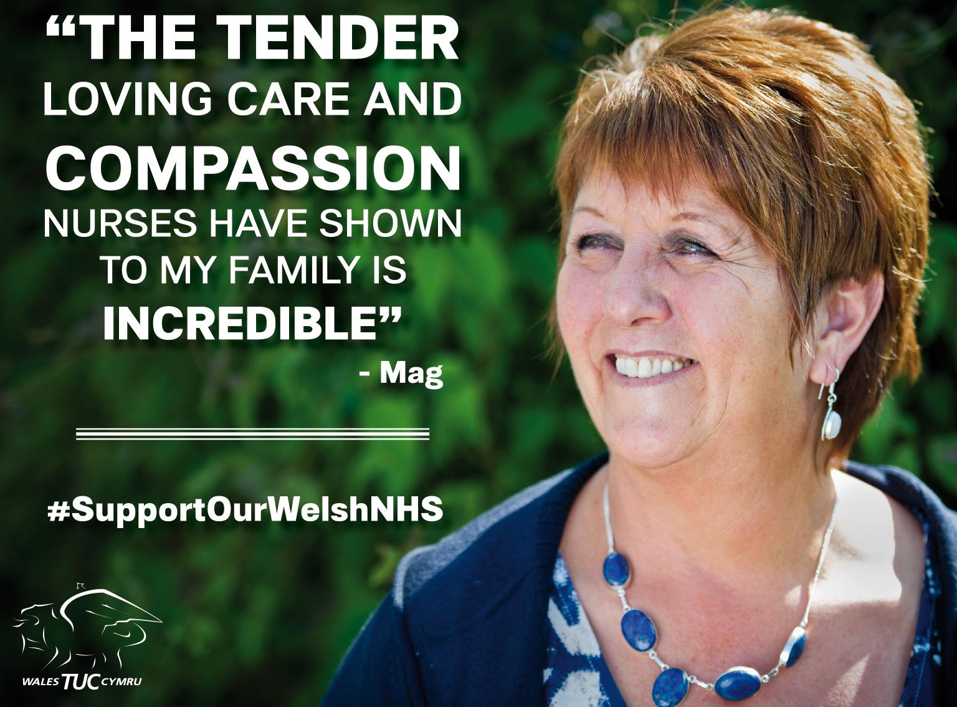

Slide 7
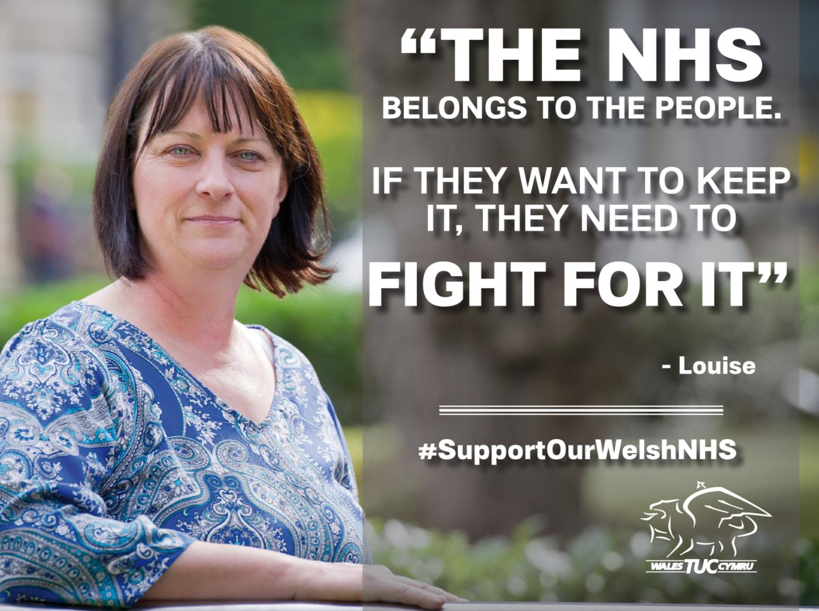

Slide 8
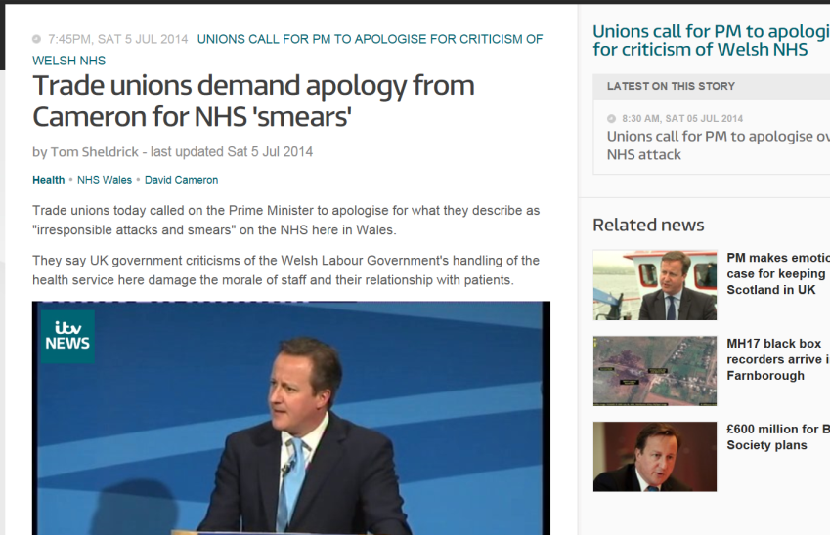
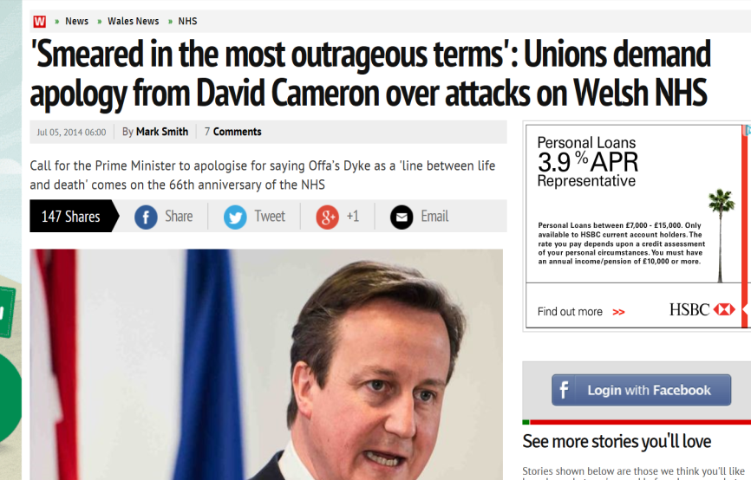
#OurWelshNHS
Mag: “It’s a dreadful statement to make. You’d feel worthless.”
Sara: “It’s not good for staff morale if you hear your own Prime Minister talking about your job like that.”
Louise: “Politicians need to sit back and remember who elects them and why they elect them.”

Slide 10
Britain Needs A Pay Rise March
80,000-90,000 Marched against austerity
Wales TUC Charter train carrying nearly 500 people from Cardiff along with coaches from all over Wales.
https://www.youtube.com/watch?v=3vvga8PTWCg&list=UUyhQv5v49YyLsRcGQQiJp1A

Slide 11
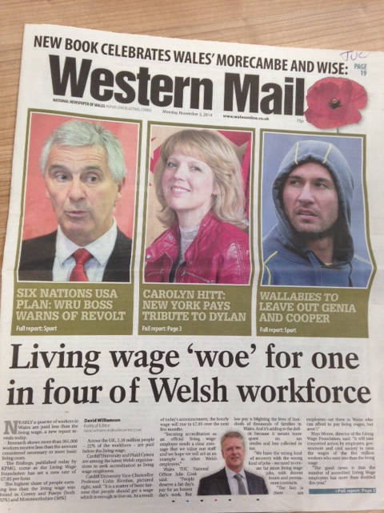
Living wage week
The Living Wage is the minimum earning required in order to cover the basics in life. Currently set at £7.85
Nearly a quarter of workers (24 per cent) in Wales are paid below the living wage. In Flintshire six in ten women working part-time earn less than the living wage.
Employers who pay the living wage have higher staff retention rates and report better productivity levels.
Paying the living wage makes good economic sense and will reduce many low-paid workers’ reliance upon in-work benefits to make ends meet.

Slide 12
Britain Needs a Pay Rise animation
http://www.youtube.com/watch?v=wxJjcSCnba0

Slide 13
Decent jobs week
Just 1 in 40 new jobs since recession are full time
71,000 workers in Wales are on part time hours but need full time work
1.4m on Zero Hours Contracts
1 improved rights for zero-hours workers
2 the same decent employment rights for all
3 equal pay for agency workers
4 better enforcement of workplace rights for low-paid, vulnerable workers
5 better access for all workers to union representation and collective bargaining.
December street stalls:
Colwyn Bay – 15th
Swansea – 17th
Cardiff – 18th

